Slide 1
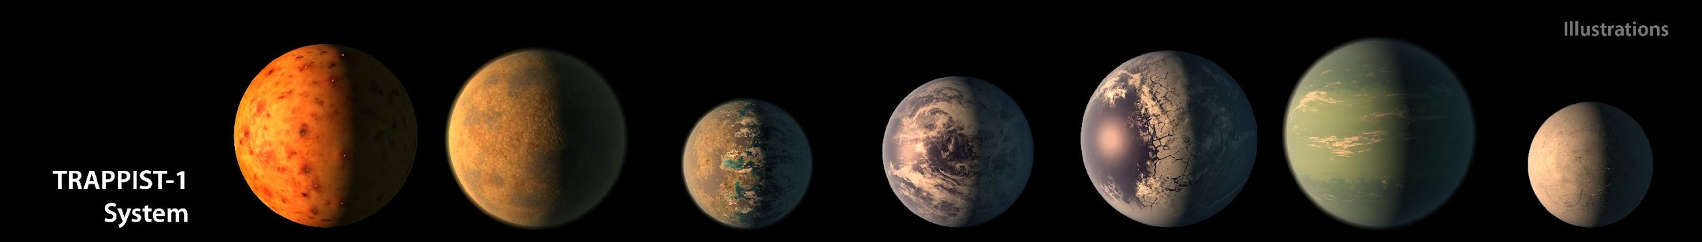

2017
illustrations
TRAPPIST-1 Exoplanets
 | b | c | d | e | f | g | h
Orbital Period days | 1.51 days | 2.42 days | 4.05 days | 6.10 days | 9.21 days | 12.35 days | ~20 days
Distance to Star Astronomical Units (AU) | 0.011 AU | 0.015 AU | 0.021 AU | 0.028 AU | 0.037 AU | 0.045 AU | ~0.06 AU
Planet Radius relative to Earth (R _{earth}) | 1.09 R _{earth} | 1.06 R _{earth} | 0.77 R _{earth} | 0.92 R _{earth} | 1.04 R _{earth} | 1.13 R _{earth} | 0.76 R _{earth}
Planet Mass Relative to Earth (M _{earth}) | 0.85 M _{earth} | 1.38 M _{earth} | 0.41 M _{earth} | 0.62 M _{earth} | 0.68 M _{earth} | 1.34 M _{earth} | -
Planet Density Relative to Earth (ρ _{earth}) | 0.66 ρ _{earth} | 1.16 ρ _{earth} | 0.90 ρ _{earth} | 0.80 ρ _{earth} | 0.60 ρ _{earth} | 0.93 ρ _{earth} | -

Slide 2
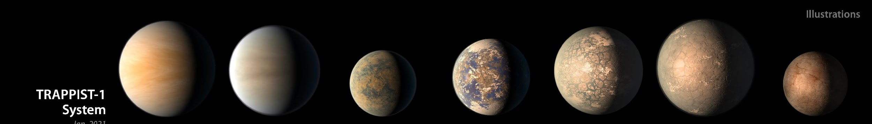
2021
illustrations
TRAPPIST-1 Exoplanets
 | b | c | d | e | f | g | h
Orbital Period days | 1.51 days | 2.42 days | 4.05 days | 6.10 days | 9.21 days | 12.35 days | 18.77 days
Distance to Star Astronomical Units (AU) | 0.0115 AU | 0.0158 AU | 0.0223 AU | 0.0293 AU | 0.0385 AU | 0.0469 AU | 0.0619 AU
Planet Radius relative to Earth (R _{earth}) | 1.12 R _{earth} | 1.10 R _{earth} | 0.79 R _{earth} | 0.92 R _{earth} | 1.05 R _{earth} | 1.13 R _{earth} | 0.76 R _{earth}
Planet Mass Relative to Earth (M _{earth}) | 1.37 M _{earth} | 1.31 M _{earth} | 0.39 M _{earth} | 0.69 M _{earth} | 1.04 M _{earth} | 1.32 M _{earth} | 0.33 M _{earth}
Planet Density Relative to Earth (ρ _{earth}) | 0.99 ρ _{earth} | 0.99 ρ _{earth} | 0.79 ρ _{earth} | 0.89 ρ _{earth} | 0.91 ρ _{earth} | 0.92 ρ _{earth} | 0.75 ρ _{earth}

Slide 3
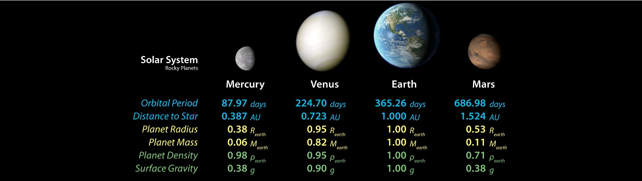
illustrations
Rocky Planets of our Solar System
Our
’s
 | Mercury | Venus | Earth | Mars
Orbital Period days | 87.97 days | 224.70 days | 365.26 days | 686.98 days
Distance to Star Astronomical Units (AU) | 0.387 AU | 0.723 AU | 1.000 AU | 1.524 AU
Planet Radius relative to Earth (R _{earth}) | 0.38 R _{earth} | 0.95 R _{earth} | 1.00 R _{earth} | 0.53 R _{earth}
Planet Mass Relative to Earth (M _{earth}) | 0.06 M _{earth} | 0.82 M _{earth} | 1.00 M _{earth} | 0.11 M _{earth}
Planet Density Relative to Earth (ρ _{earth}) | 0.98 ρ _{earth} | 0.95 ρ _{earth} | 1.00 ρ _{earth} | 0.71 ρ _{earth}

Slide 4
Key terms:
Orbital Period (days) – The time it takes for the planet to complete one orbit around its star, measured in Earth days.
Distance to Star (AU) – The average distance from the planet to its star, measured in Astronomical Units (AU), where 1 AU is the average distance between Earth and the Sun.
Planet Radius (R_{earth}) – The planet's radius relative to Earth's radius. For example, 1.12 R_{earth} means the planet is 1.12 times the size of Earth.
Planet Mass (M_{earth}) – The planet's mass relative to Earth's mass. For example, 1.02 M_{earth} means the planet has 1.02 times Earth's mass. Mass is a measure of how much “stuff” is in an object.
Planet Density (ρ_{earth}) – The planet's density relative to Earth's density. For example, a density of 0.99 ρ_{earth} means the planet is 99% as dense as Earth. Density is how compact a material, like a rock or water, is (the relationship between its mass and volume).

Slide 5
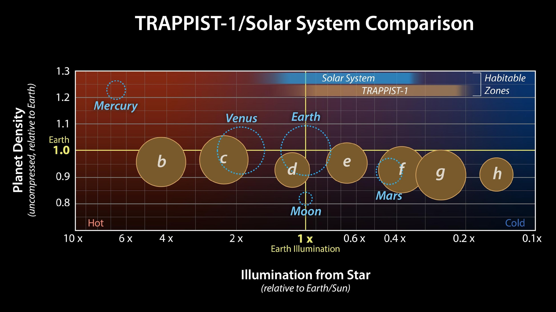
Description:
This graph compares properties of the seven TRAPPIST-1 exoplanets (as they were understood based on 2021 data) with Earth and our solar system's rocky planets. Note: The TRAPPIST-1 exoplanets are not anywhere near our solar system but are shown beside Earth, Venus, and Mars for the purpose of comparison in this graph. The size of each circle represents the relative size of each planet.
Vertical axis: The vertical axis shows uncompressed “Planet Density,” a key to understanding what a planet is made of (composition). The TRAPPIST-1 planets share similar densities, implying they are similar compositions, unlike the varied densities of the rocky planets in our solar system (e.g., Mercury’s high iron content makes it very dense).
Horizontal axis: The horizontal axis shows the amount of illumination each planet receives from its host star. Though the TRAPPIST-1 star is cooler and less massive than our Sun, its planets orbit very closely, so they receive a similar amount of light and heat compared to Earth’s inner planets.
Habitable zones: The habitable zones —shown along the top of the graph — indicate where liquid water could exist. Around TRAPPIST-1, this zone (shown in light brown) lies farther from the star than the habitable zone does in our solar system (shown in blue) because TRAPPIST-1 emits more infrared light, allowing for Earth-like temperatures at lower illumination levels.

