Slide 1
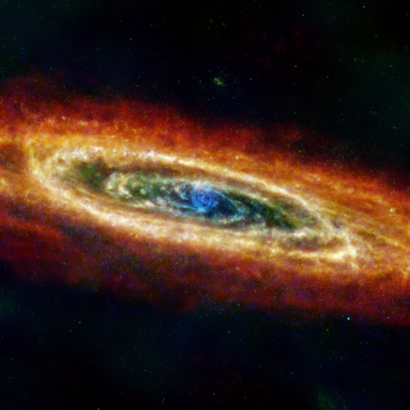




Andromeda Galaxy
Ben Williams
University of Washington
Michelle Collins
University of Surrey
Ivanna Escala
Space Telescope Science Institute
Seppo Laine
Caltech/IPAC
ESA/NASA/JPL-Caltech/GBT/WSRT/IRAM/C. Clark (STScI)

Slide 2
Outline of this Science Briefing
Ben Williams
  University of Washington
  Introduction to Andromeda and Its Stars
Michelle Collins
  University of Surrey
  Stellar Streams and Unusual Satellite Galaxies in Our Large Spiral Galaxy Neighbour, the Andromeda Galaxy
Ivanna Escala
  Space Telescope Science Institute
  Elemental Abundances and Stellar Kinematics in the Andromeda Galaxy
Q&A
Seppo Laine
  Caltech/IPAC
  Science and Education Resources

Slide 3
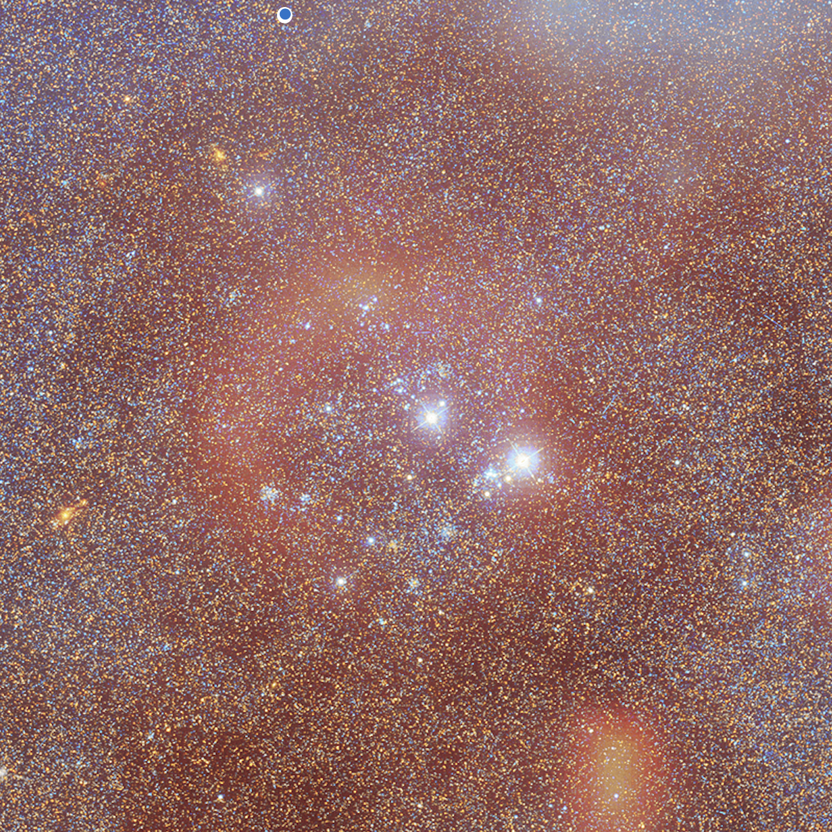

Introduction to Andromeda and Its Stars
Like the Milky Way, only different!
Ben Williams
University of Washington
A small region within Andromeda resolved into individual stars by HST with extended gas emission from ground-based imaging providing more context
M31 Hubble Photomosaic (NASA, ESA, Benjamin Williams (UWashington), Zhuo Chen (UWashington), L. Cliff Johnson (Northwestern); Gas emission imaging (Xavier Strottner, Marcel Drechsler, Yann Sainty (https://yann-sainty.com))

Slide 4
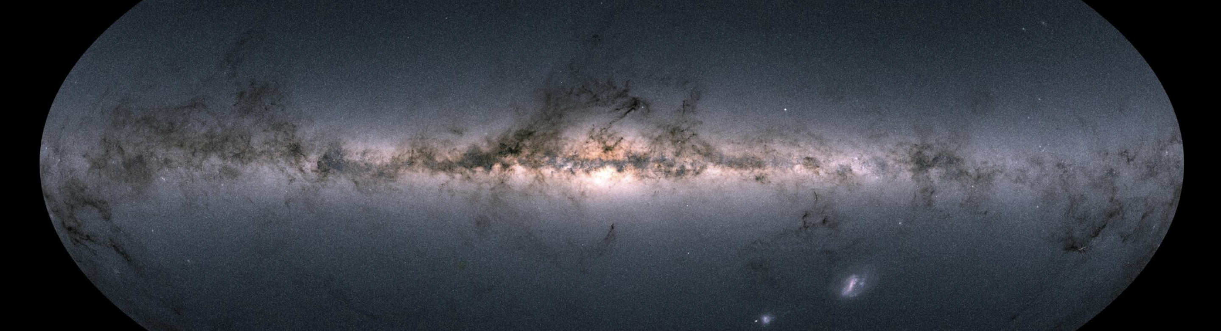
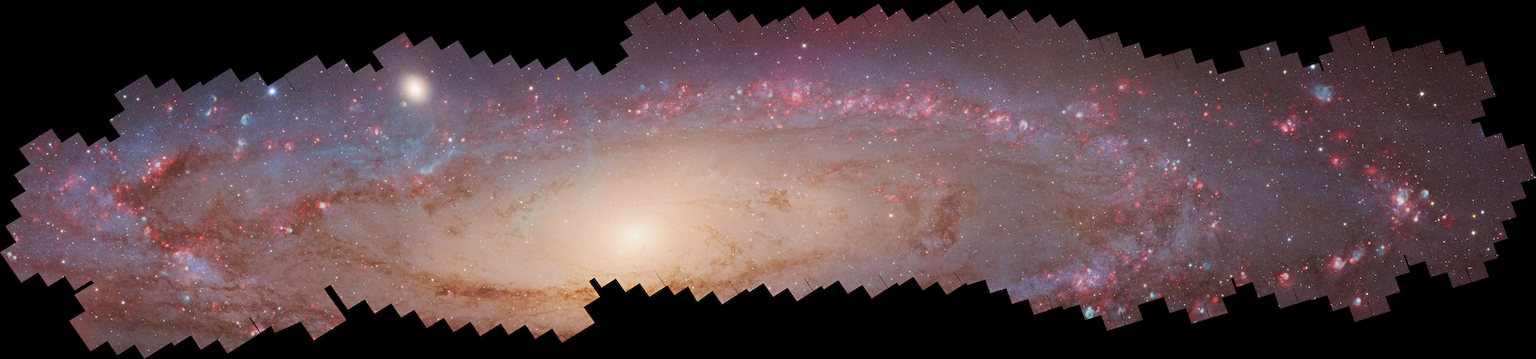
The Milky Way and Andromeda
Milky Way star map (ESA/Gaia, https://www.esa.int/Science_Exploration/Space_Science/Gaia/Gaia_creates_richest_star_map_of_our_Galaxy_and_beyond)
M31 Hubble Photomosaic (NASA, ESA, Benjamin Williams (UWashington), Zhuo Chen (UWashington), L. Cliff Johnson (Northwestern); Gas emission imaging (Xavier Strottner, Marcel Drechsler, Yann Sainty (https://yann-sainty.com))

Slide 5
Andromeda Has A More Prominent Bulge
Milky Way star map (ESA/Gaia, https://www.esa.int/Science_Exploration/Space_Science/Gaia/Gaia_creates_richest_star_map_of_our_Galaxy_and_beyond)
M31 Hubble Photomosaic (NASA, ESA, Benjamin Williams (UWashington), Zhuo Chen (UWashington), L. Cliff Johnson (Northwestern); Gas emission imaging (Xavier Strottner, Marcel Drechsler, Yann Sainty (https://yann-sainty.com))

Slide 6
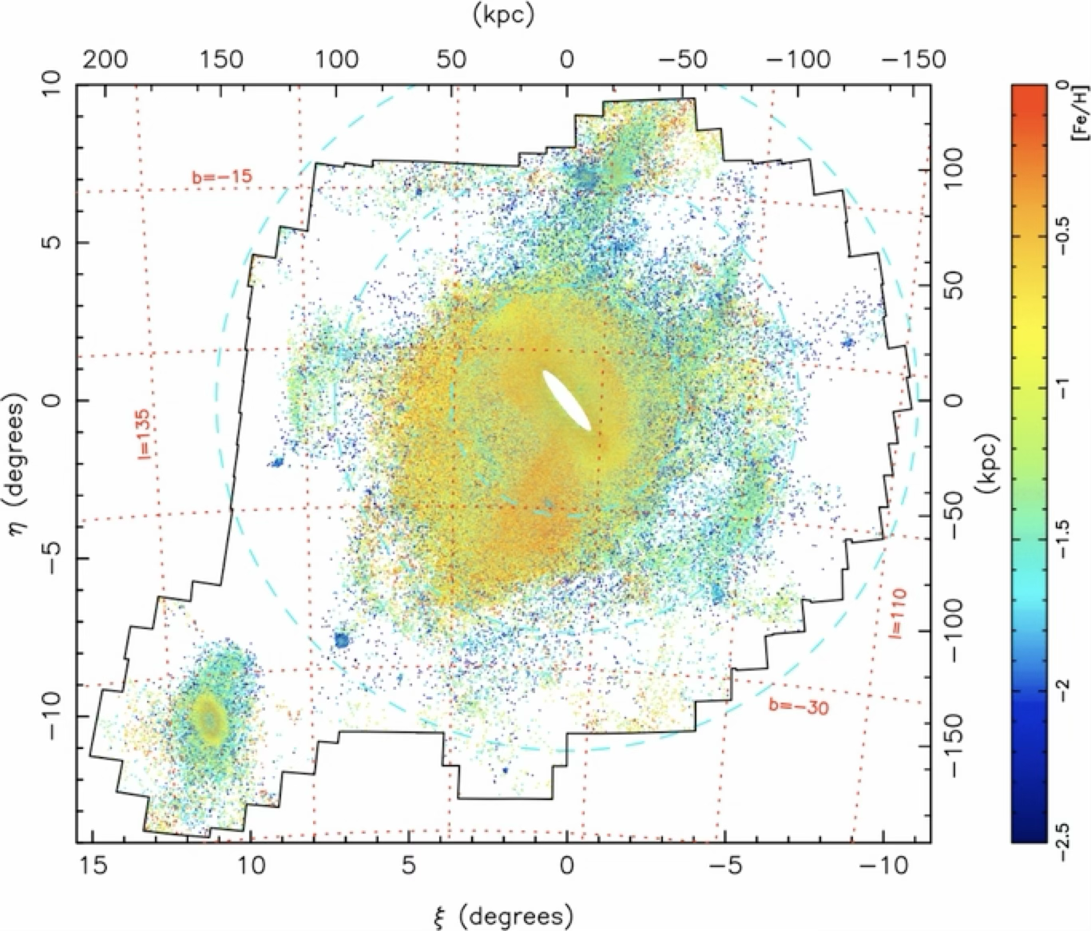
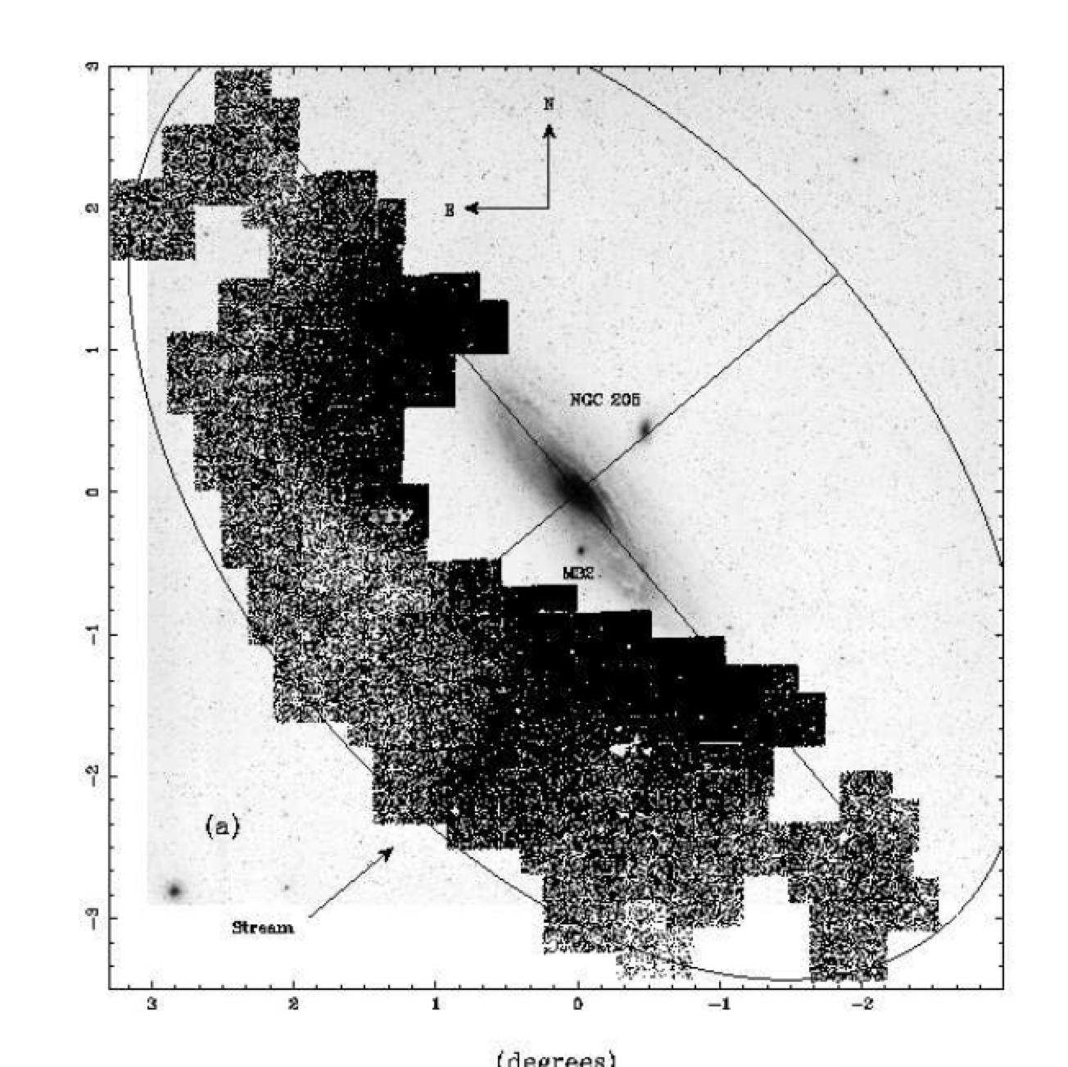
Andromeda Has More Prominent Halo Structures (more from Dr. Collins and Dr. Escala)
Ibata et al. 2001
Ibata et al. 2014

Slide 7
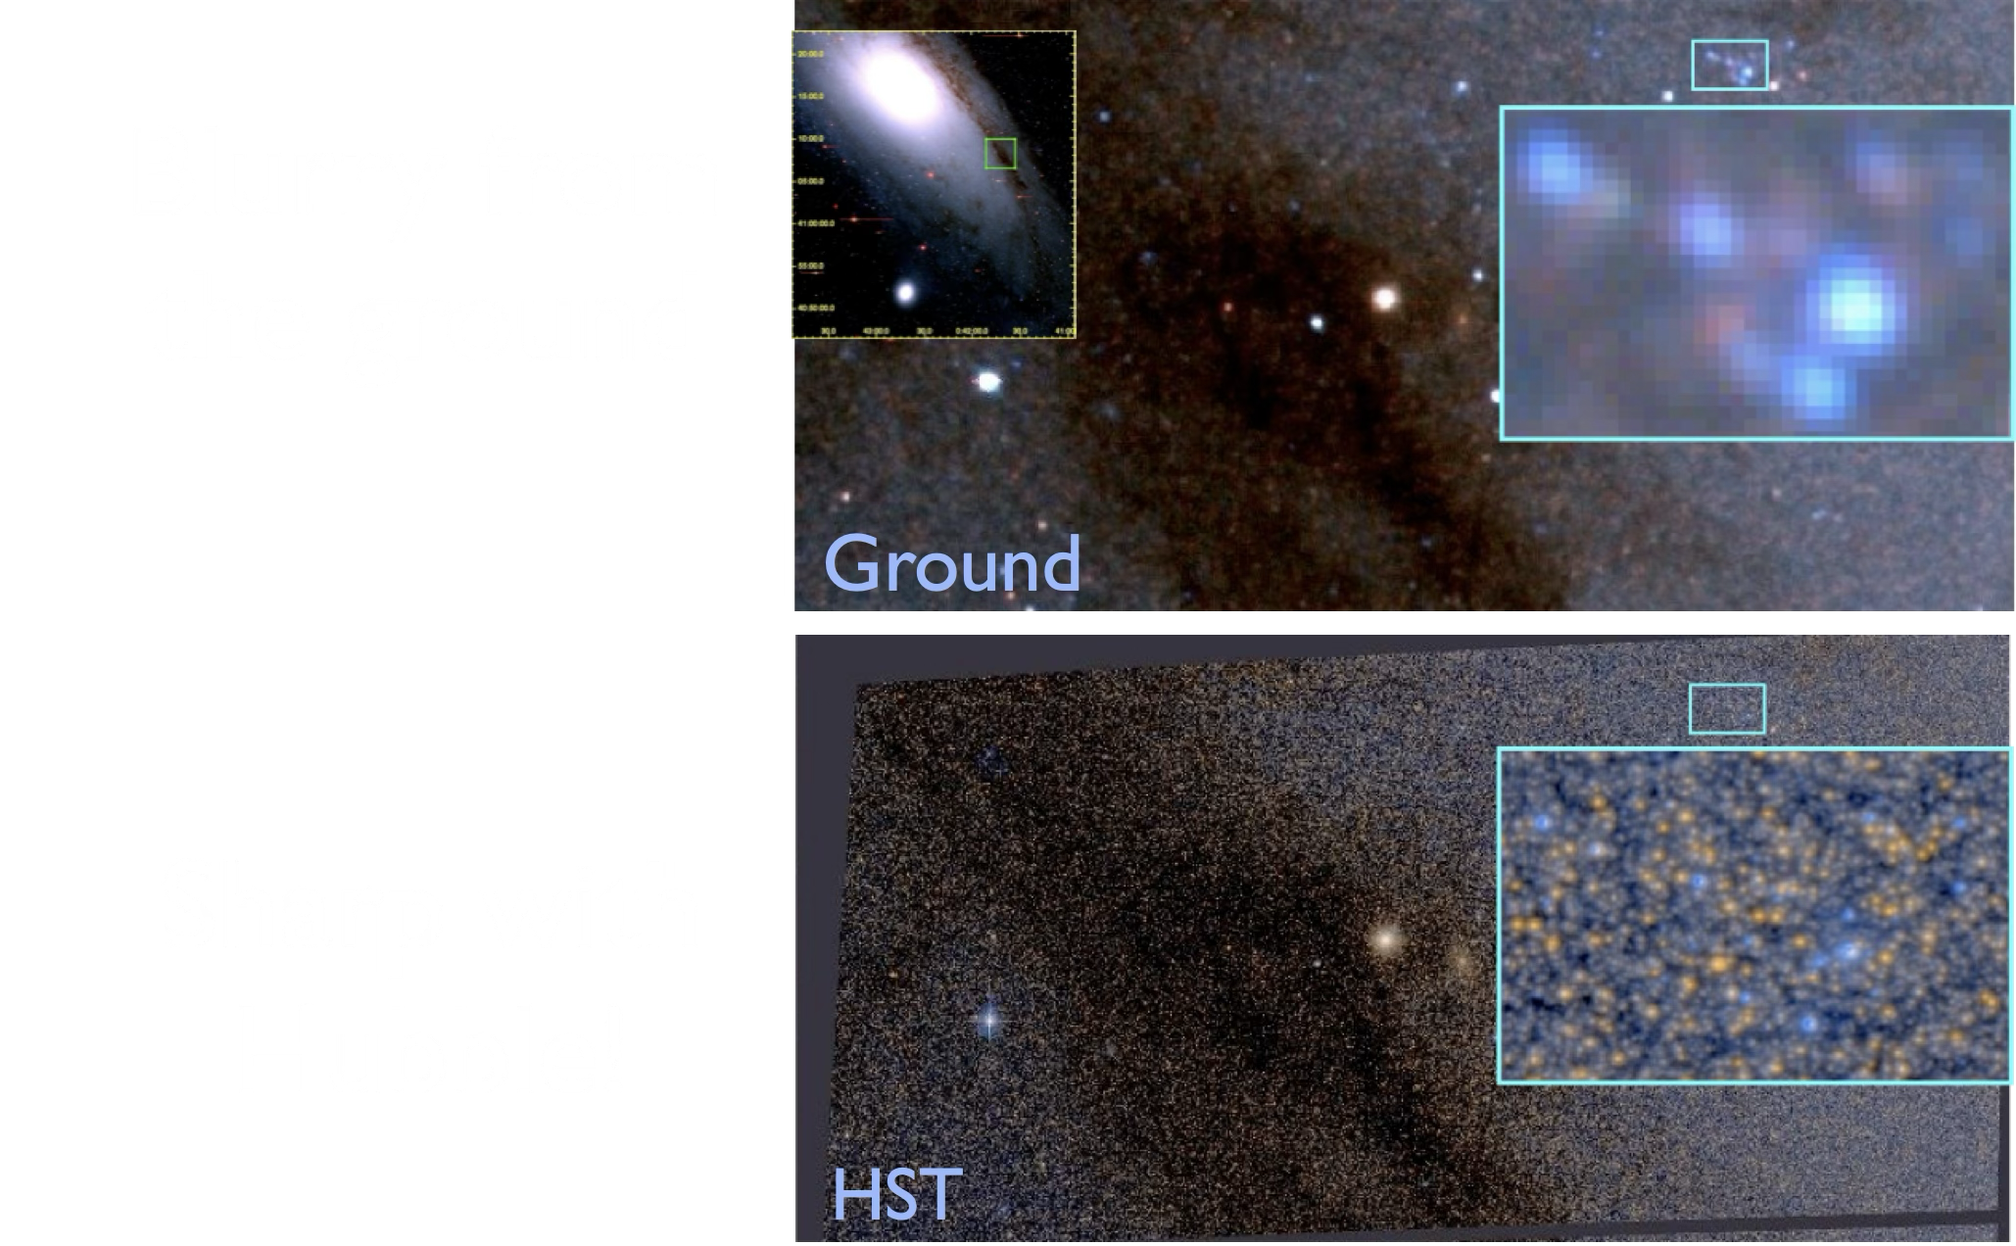
M31 Disk Stars

Slide 8
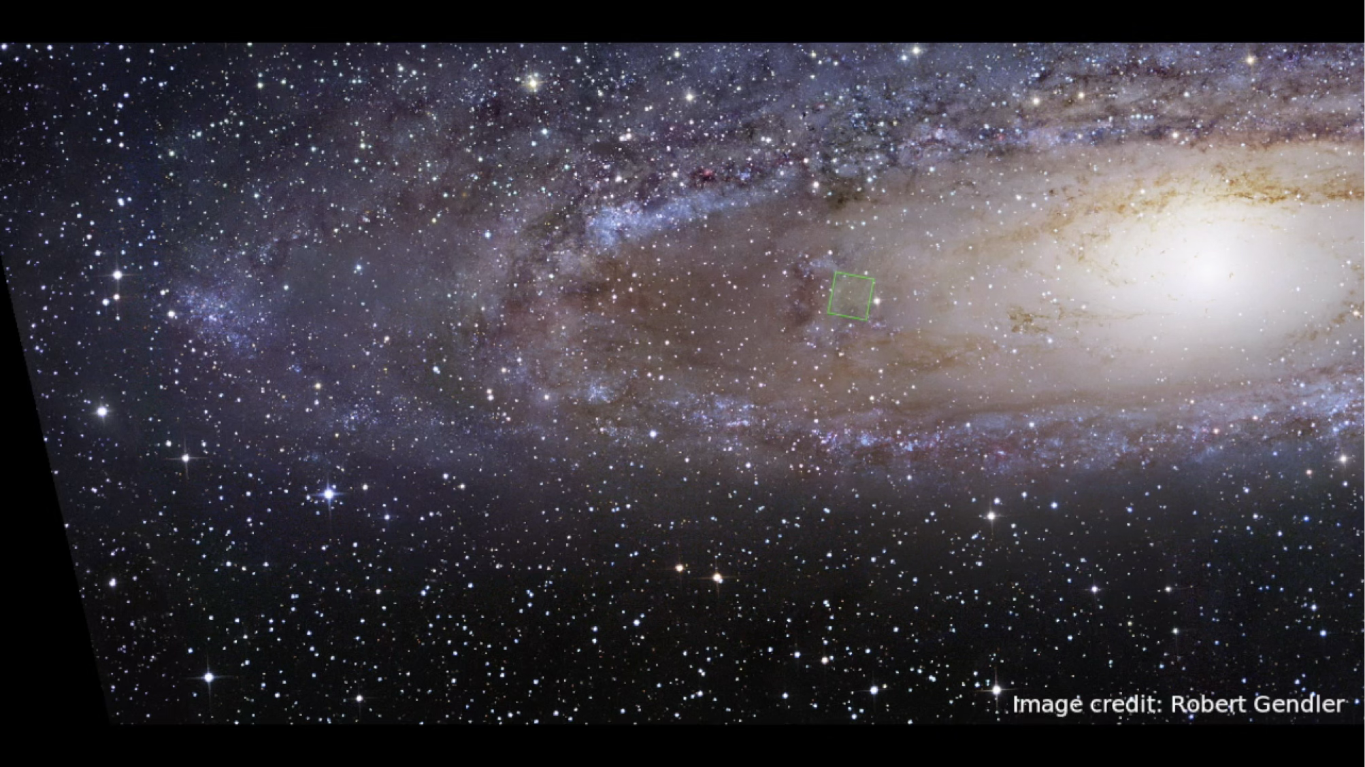
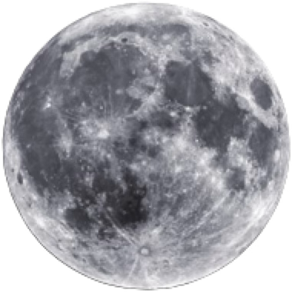
Surveying Andromeda with Hubble

Slide 9
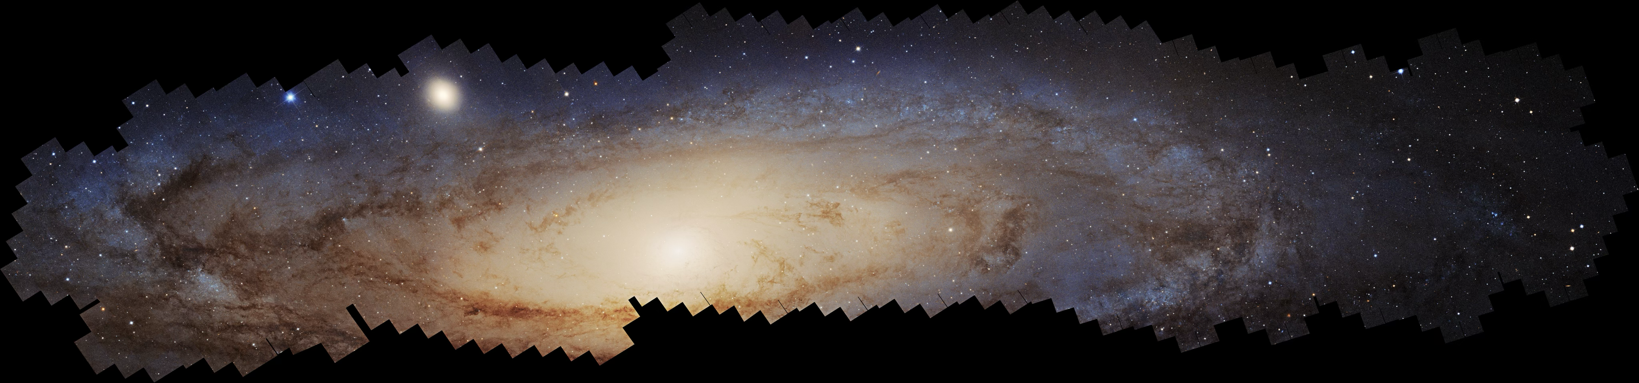
Largest photomosaic ever assembled from HST observations
10,000 light years
Panchromatic Hubble Andromeda Southern Treasury (PHAST) Panchromatic Hubble Andromeda Treasury (PHAT) Distance to Andromeda: 2.5 million light years
NASA, ESA, Benjamin F. Williams (UWashington), Zhuo Chen (UWashington), L. Clifton Johnson (Northwestern)
Over 5000 HST exposures covering over 600 HST pointings
170k x 40k pixels

Slide 10
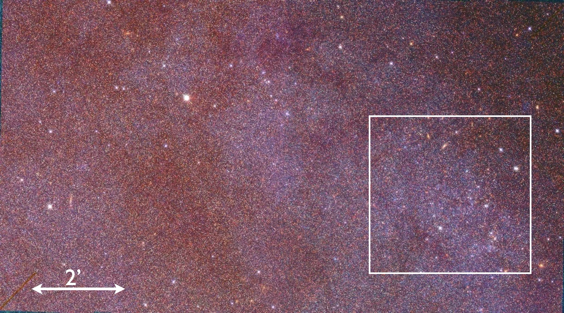
Resolving Andromeda into Stars
1’ = 730 light years

Slide 11
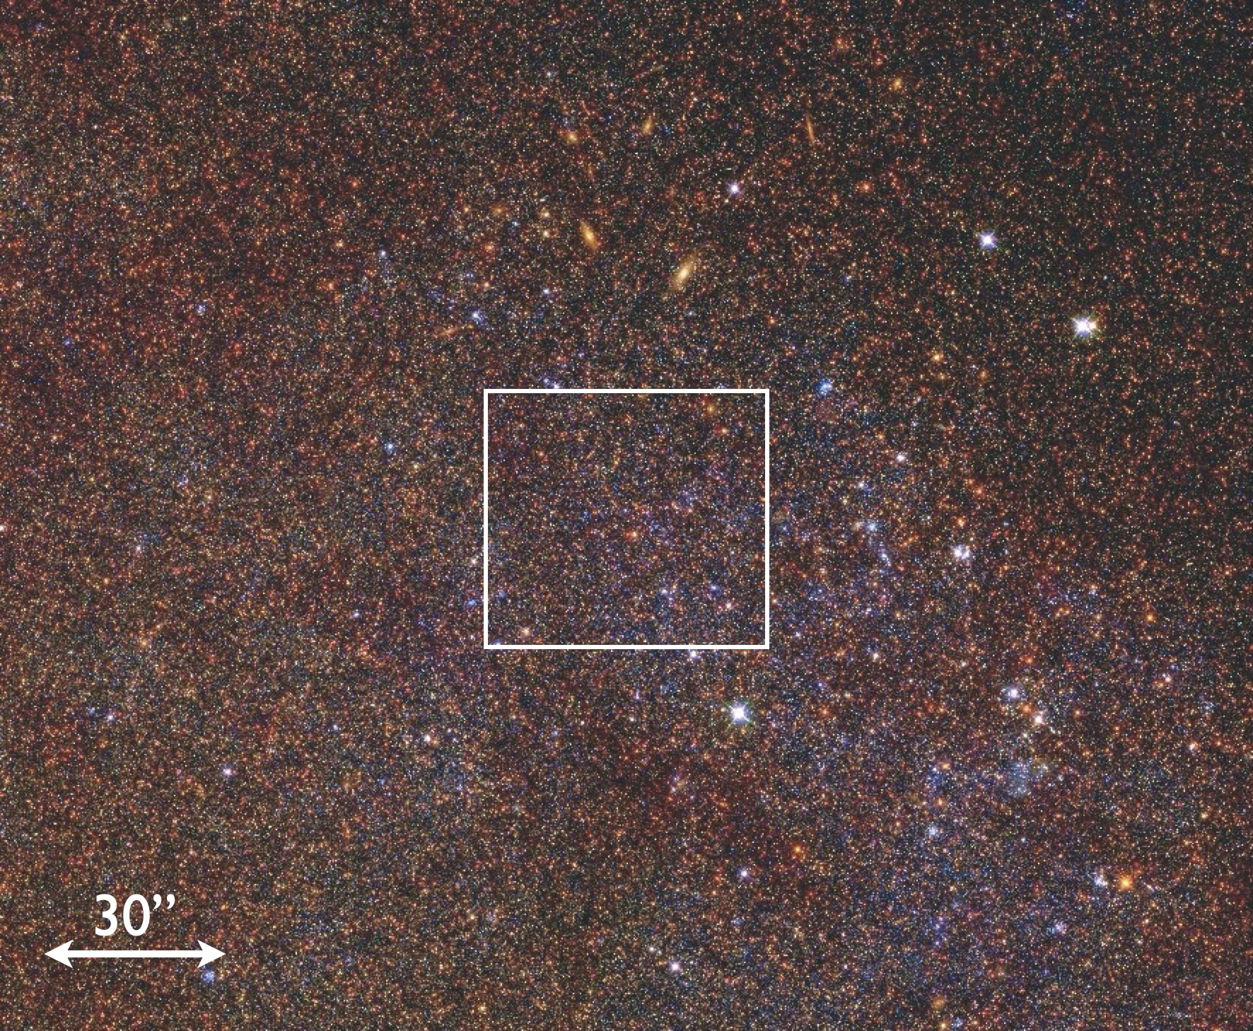
Resolving Andromeda into Stars
1” = 12 light years

Slide 12
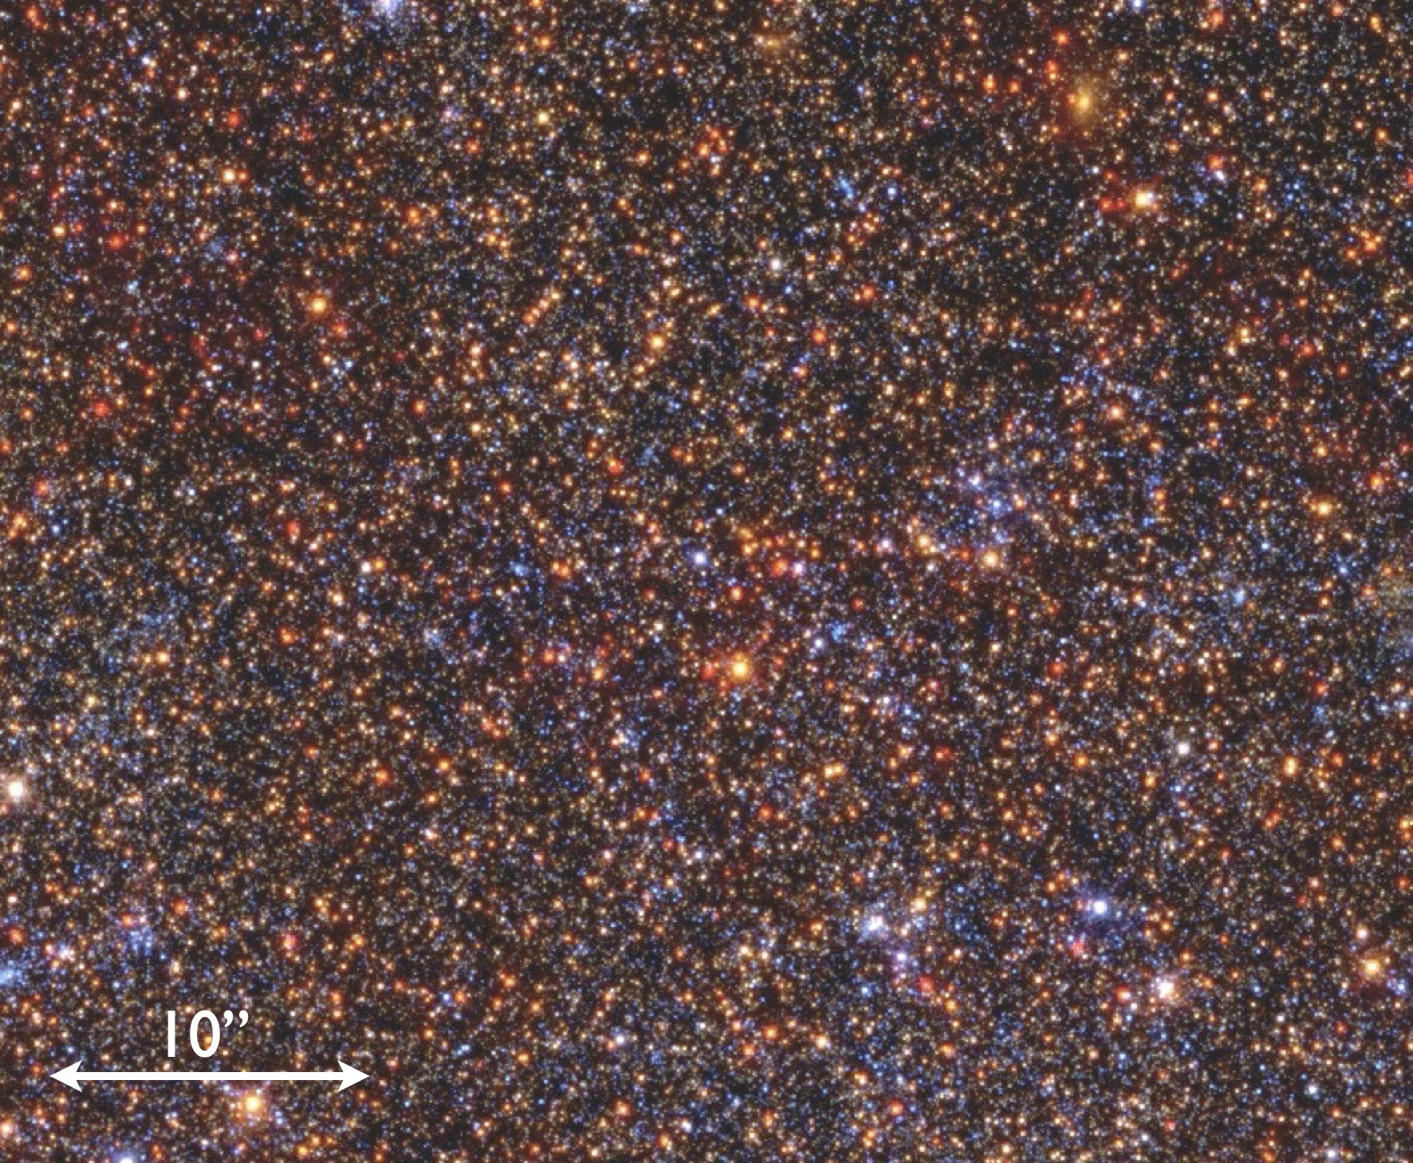
Resolving Andromeda into Stars
1” = 12 light years

Slide 13
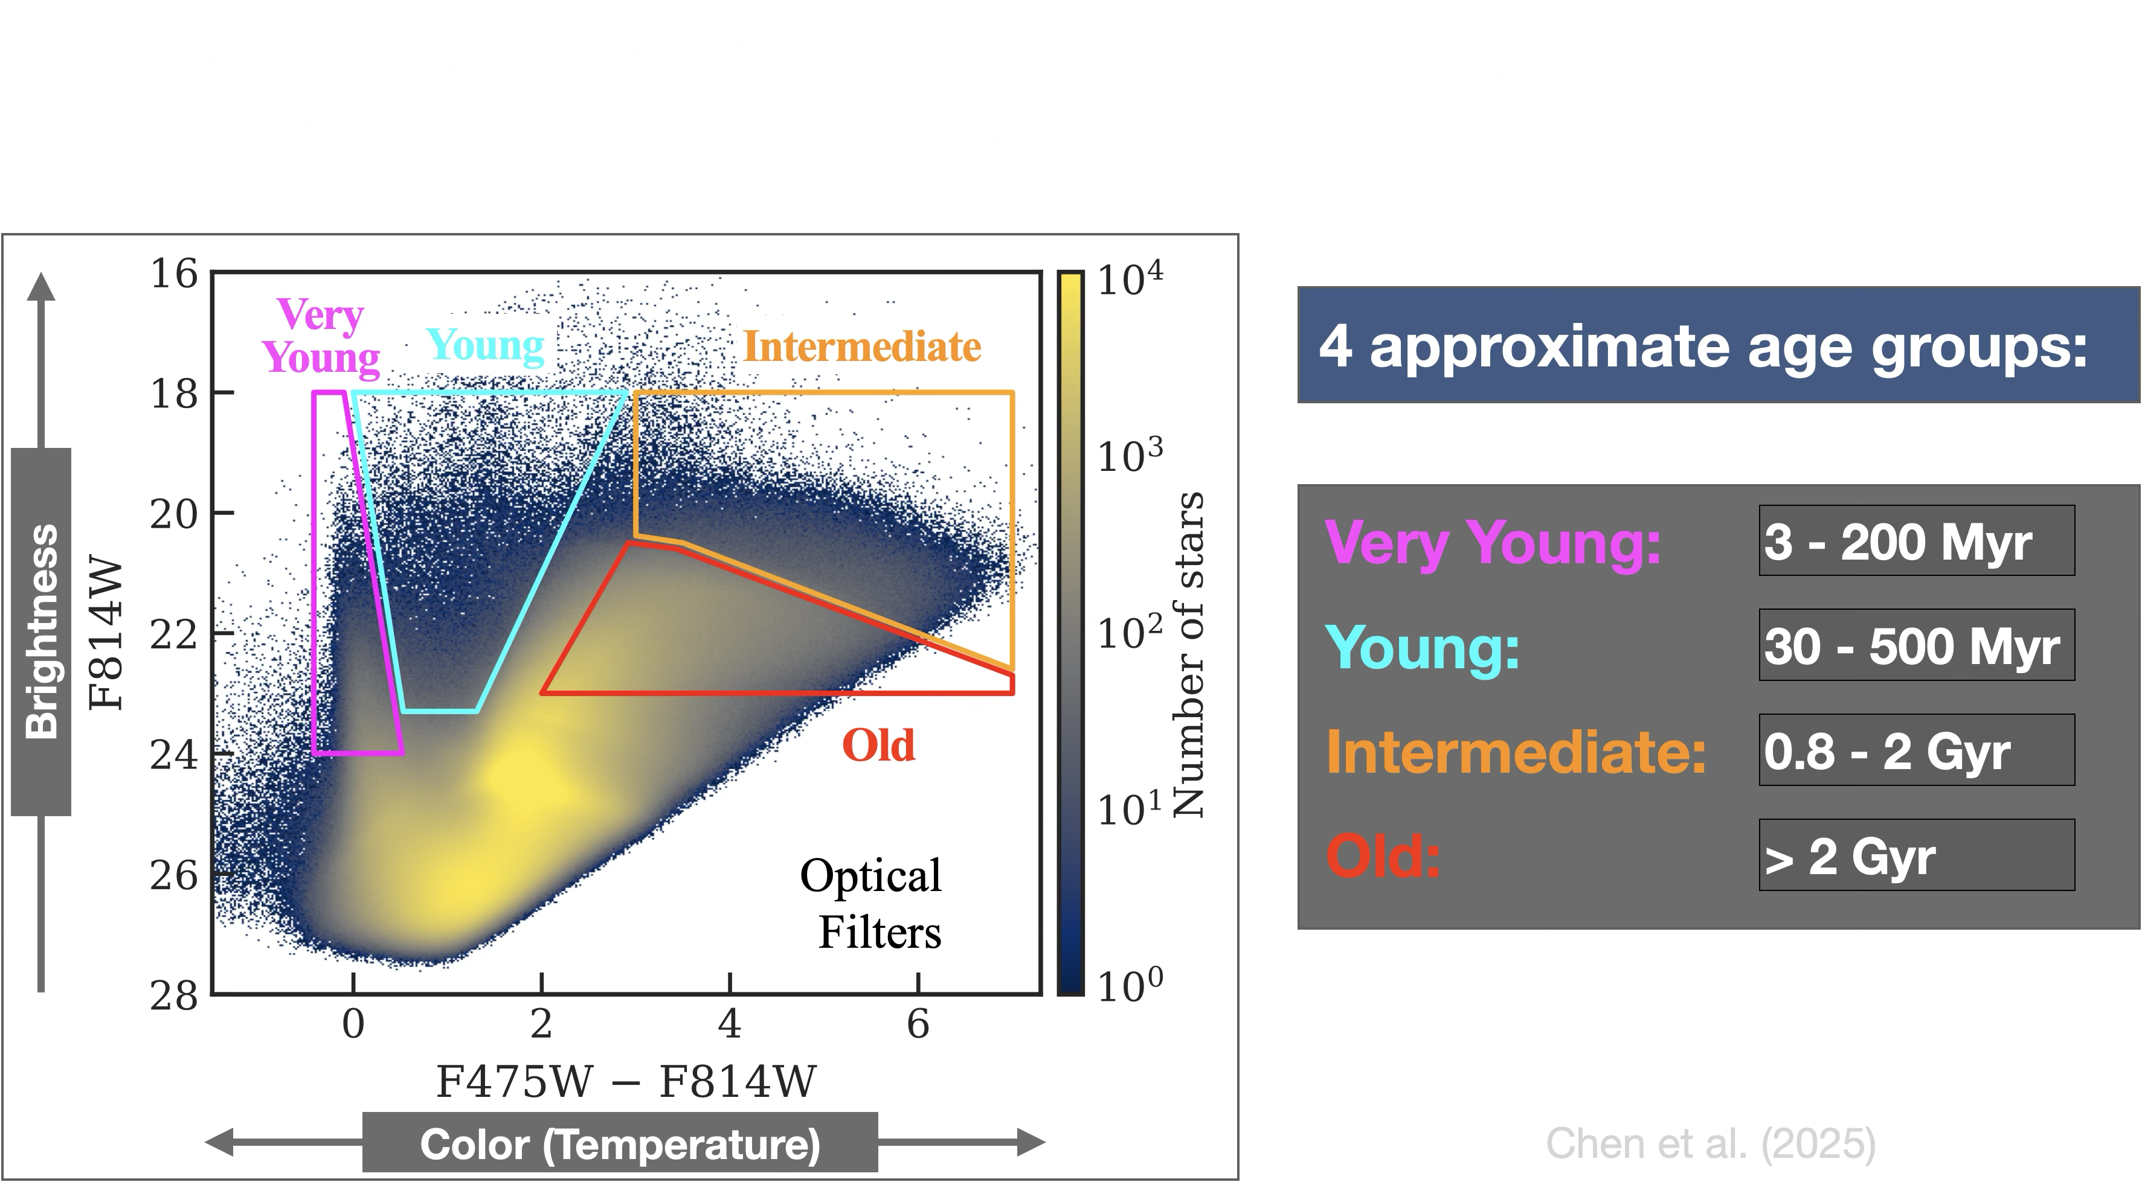

Slide 14
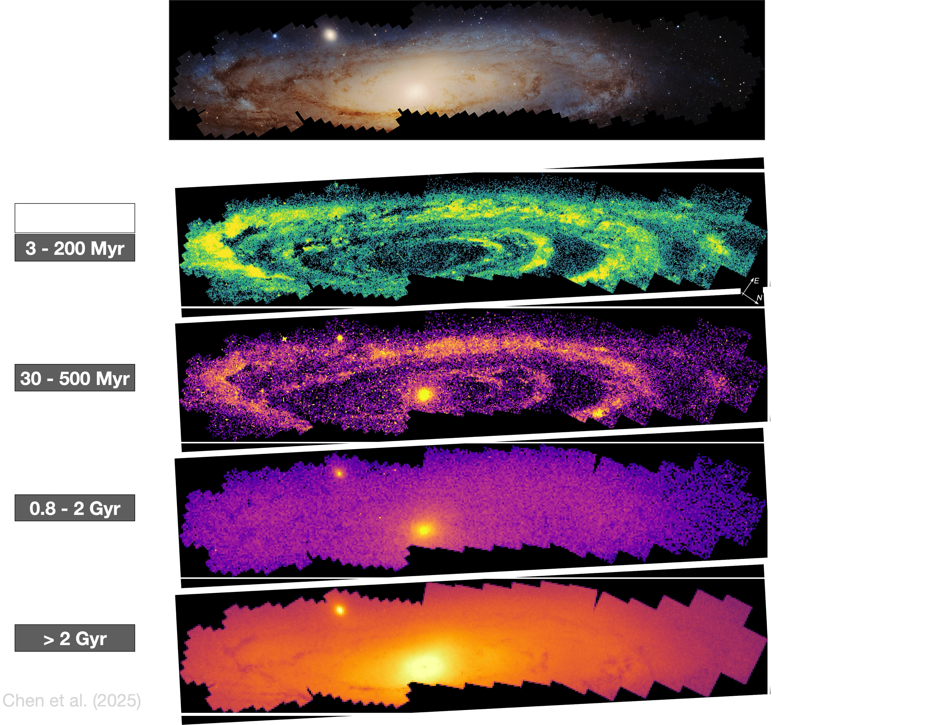

Slide 15
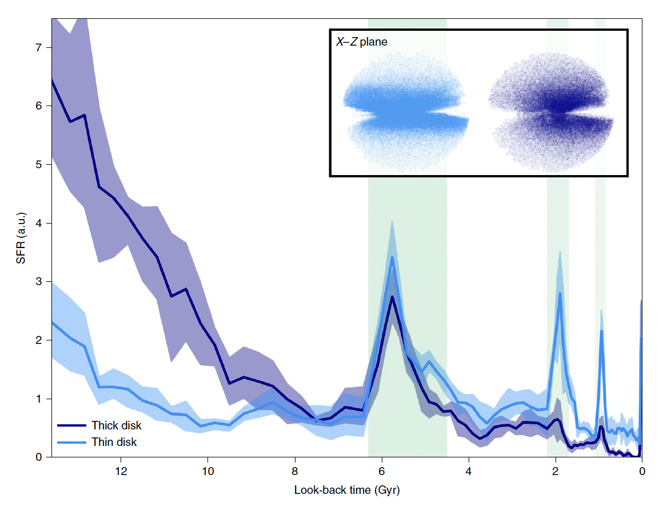
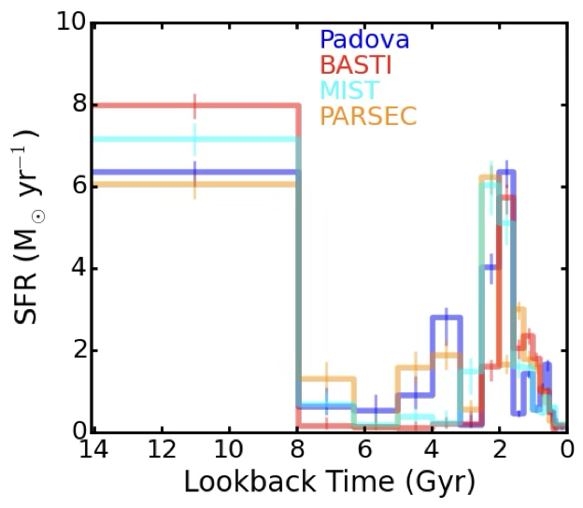
The Milky Way and Andromeda
Milky Way (Ruiz-Lara et al. 2020)
M31 (Williams et al. 2017)

Slide 16
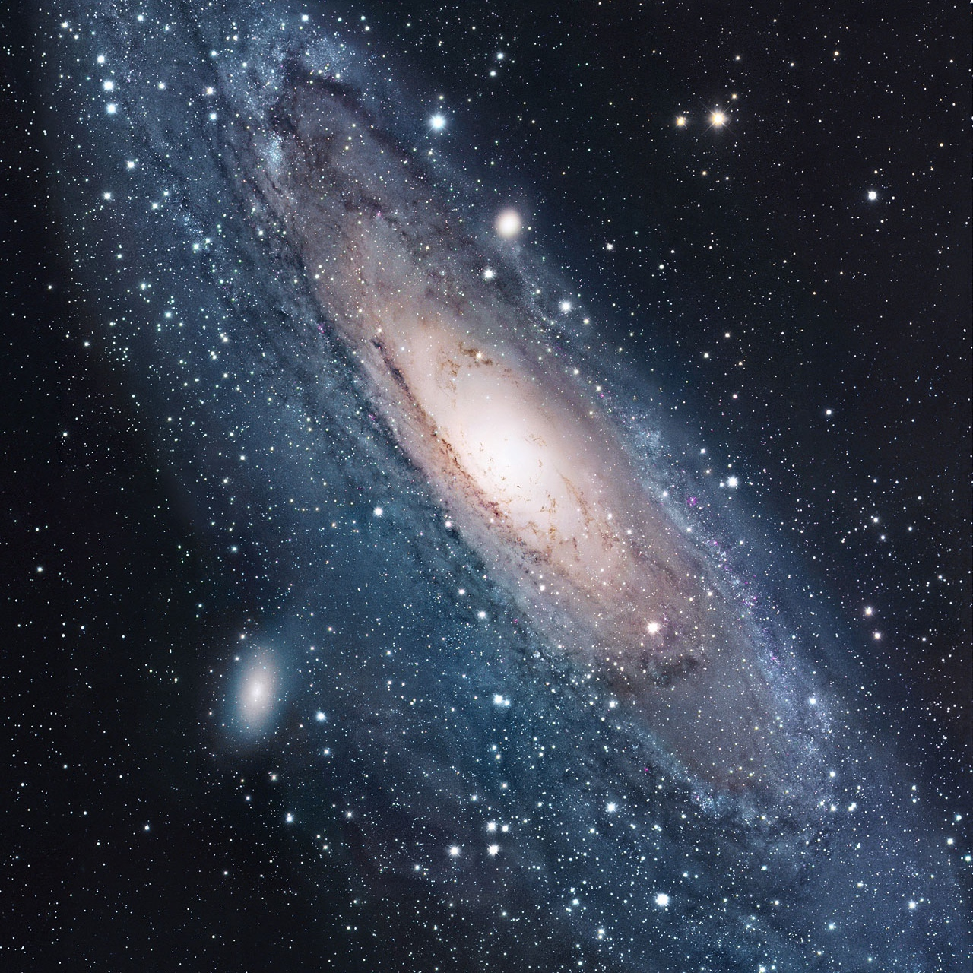

Stellar streams and unusual satellite galaxies around our spiral neighbour, Andromeda
Dr Michelle Collins
Associate Professor, University of Surrey
The Andromeda galaxy, focusing on the disk region. Already you can make out two satellite galaxies, one in the lower left, and one in the upper center.
Andromeda galaxy, 2002 R. Gendler, Photo by R. Gendler

Slide 17

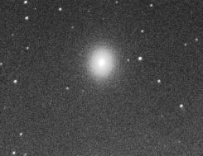
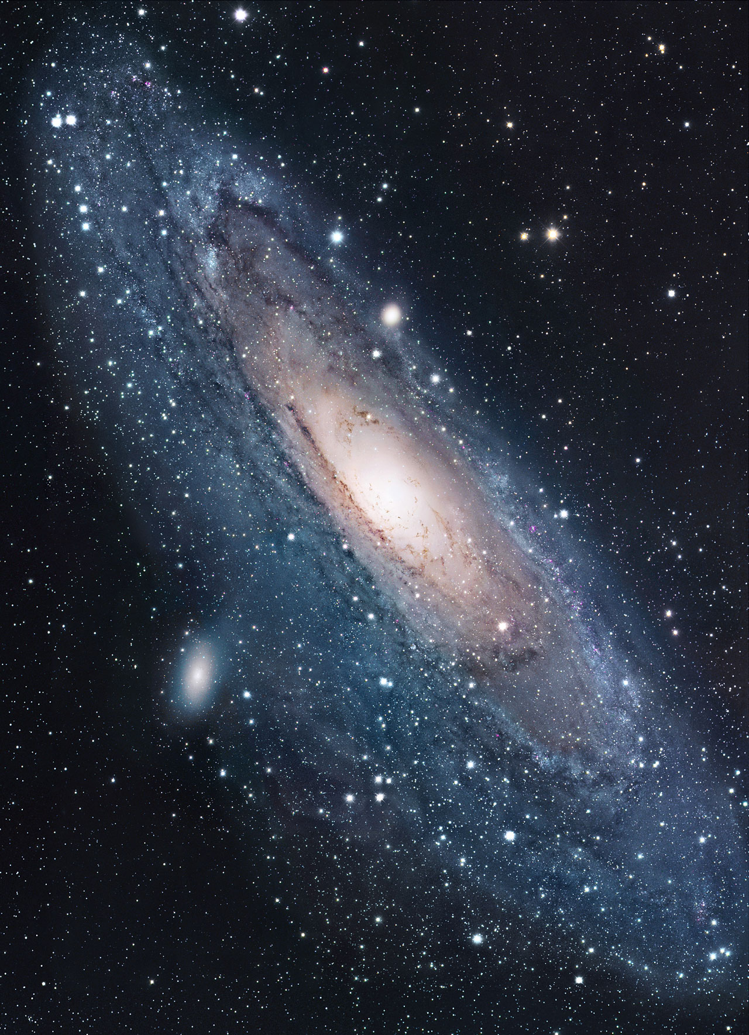
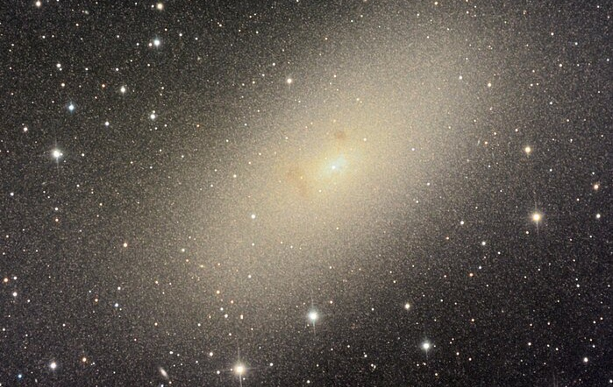
Andromeda as an ecosystem
Andromeda, spiral galaxy, stellar mass:
M* ~ 150,000,000,000 M_{sun}
M32
M* = 400,000,000 M_{sun}
NGC 205
M* = 800,000,000 M_{sun}
Andromeda galaxy, 2002 R. Gendler, Photo by R. Gendler

Slide 18
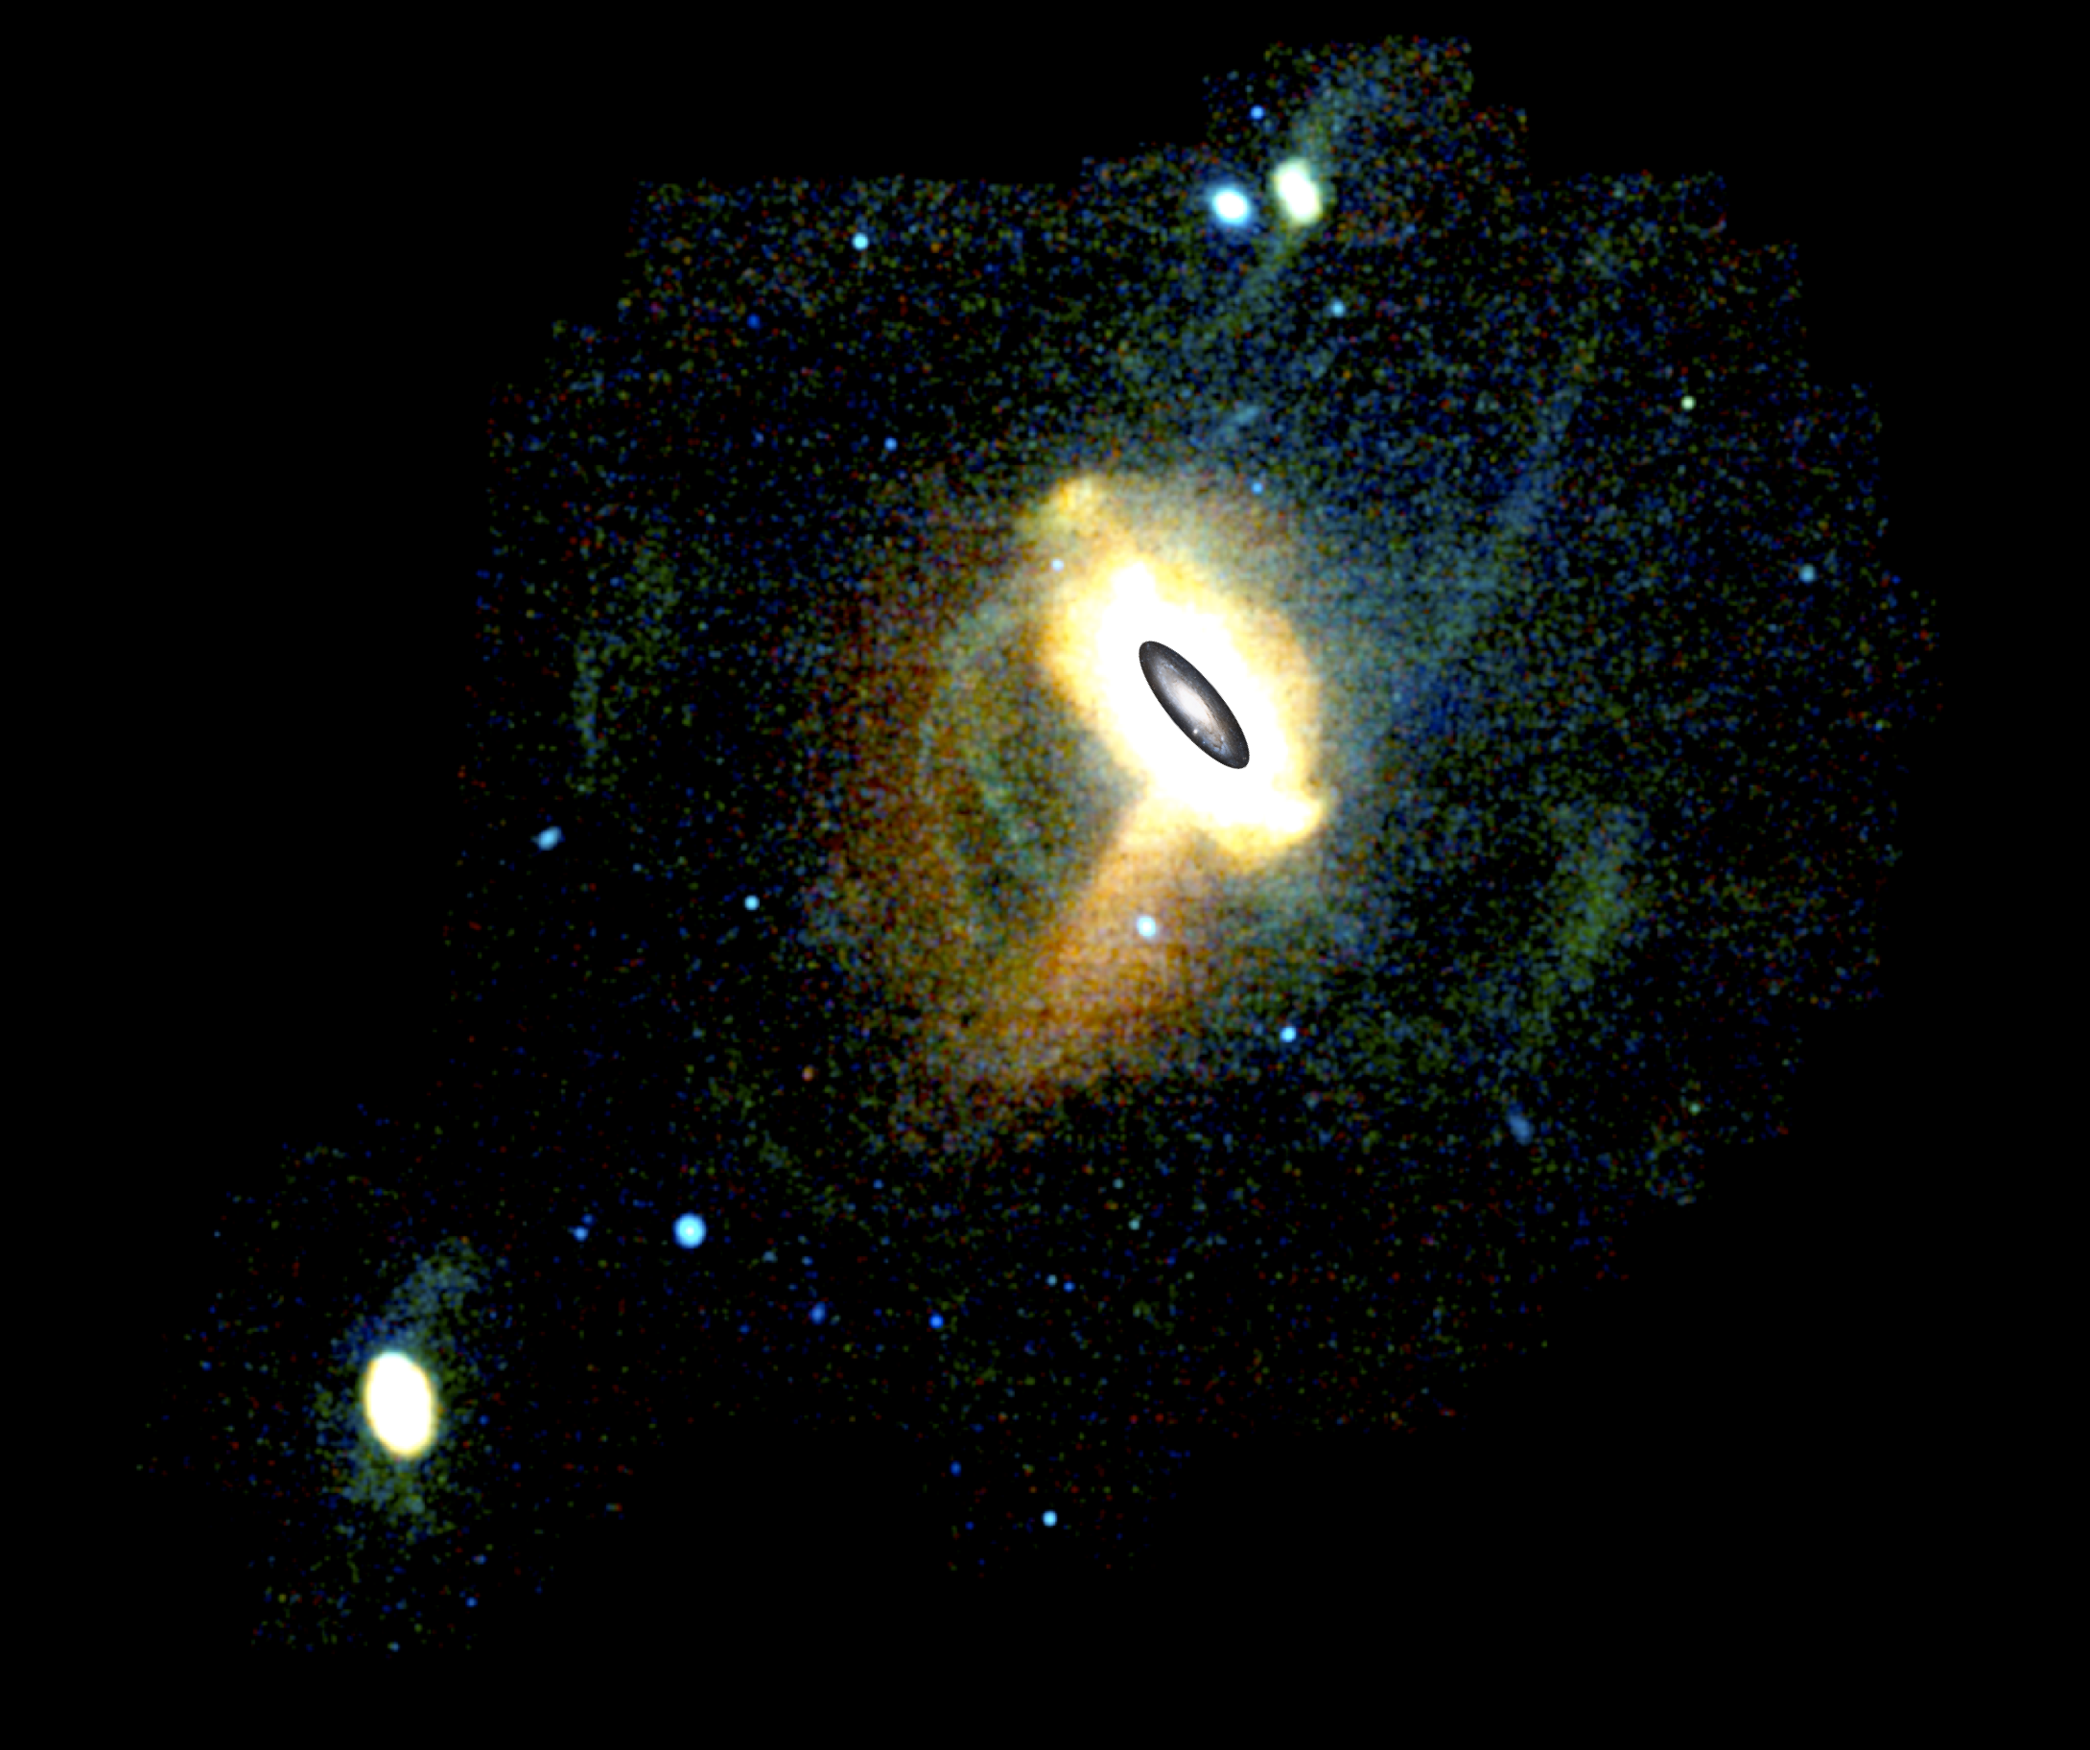

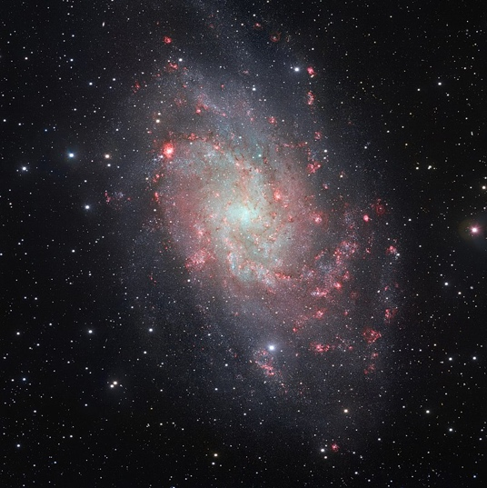
NGC 185 & NGC 147
The North West stream(s)
Streams B, C & D
The Giant Stellar Stream (GSS)
Triangulum (M33)
Pan-Andromeda Archaeological Survey, Martin et al (2013)

Slide 19
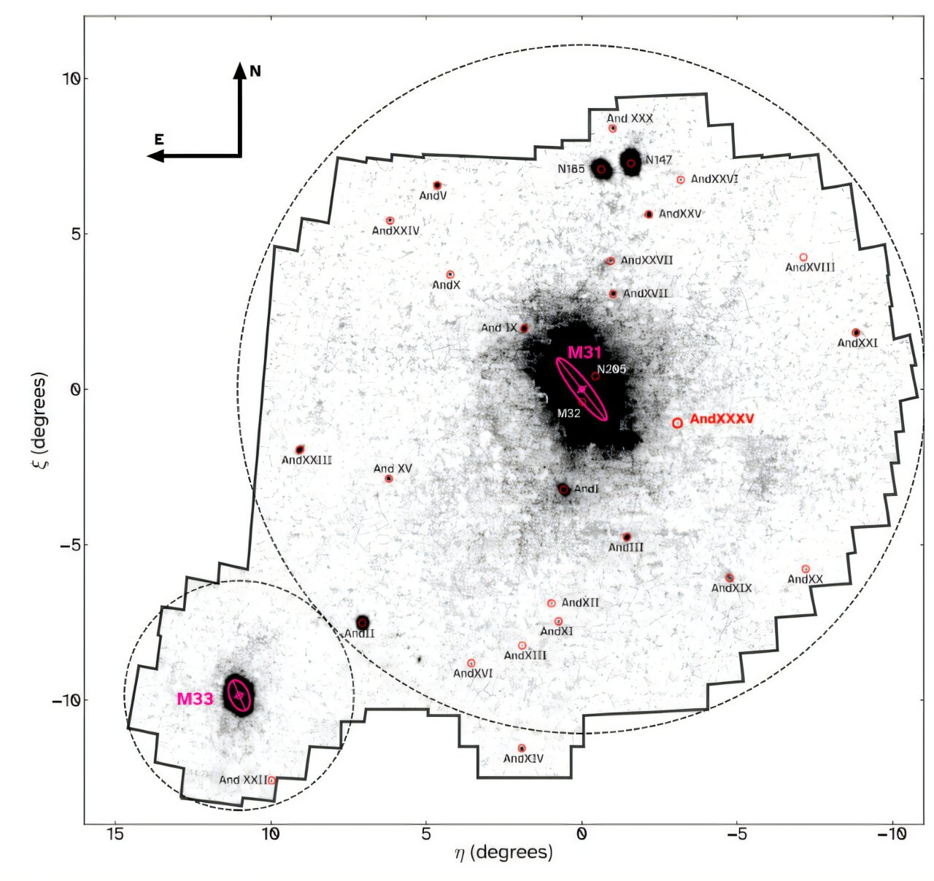
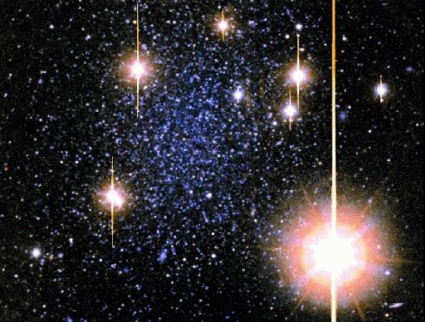
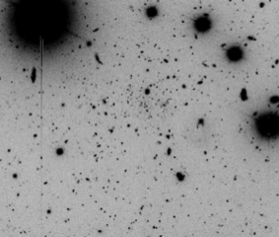

The 32 dwarf spheroidals
Andromeda VII
M* = 20,000,000 M_{sun}
(Credit: Eva Grebel)
Andromeda XXXIV
M* = 20,000 M_{sun}
(Credit: Collins et al. 2022)
J. M. Arias et al. Astrophys. J. Lett. (2025)

Slide 20


Each galaxy inhabits a massive dark matter halo
1
There is 5 times more dark matter in the Universe than regular matter
2
We’re unsure what it is, but we can measure its presence through its gravitational force on stars
3
Dwarf spheroidals are very dark matter dominated galaxies and have 10−1000 times more dark matter than stars.
4
Can use their few stars to trace out the distribution of dark matter
Could dwarf galaxies unlock the mysteries of dark matter?

Slide 21
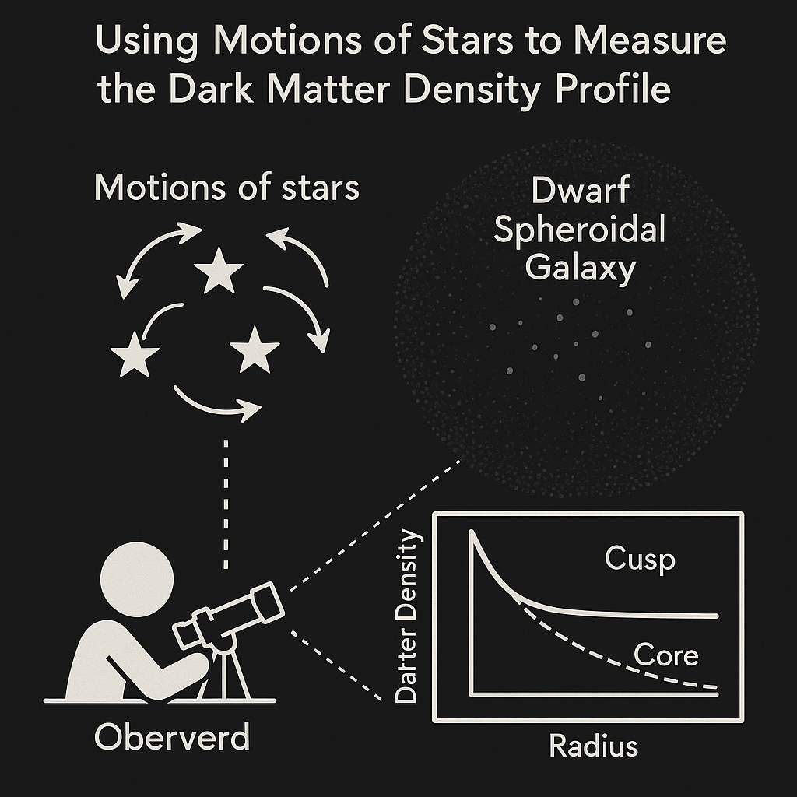
Different dark matter models predict different behaviour
1
Cold dark matter predicts very dense central ‘cusps’
2
This can be softened into a less dense ‘core’ by star formation
3
But Andromeda has a number of dwarf galaxies that are not dense enough. What does this mean?
Mysterious star formation process? New dark matter model? Tidal effects…?

Slide 22
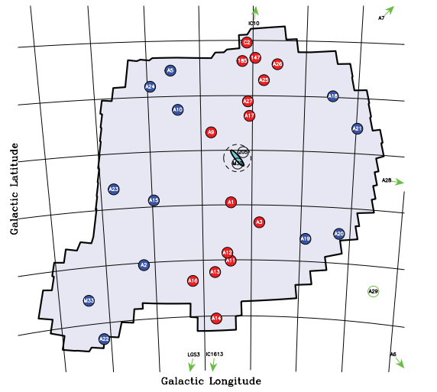
And why are they distributed the way they are?
50% of M31’s dwarf galaxies are in a thin, extended, rotating plane.
Not expected from simulations.
What causes this?
22

Slide 23
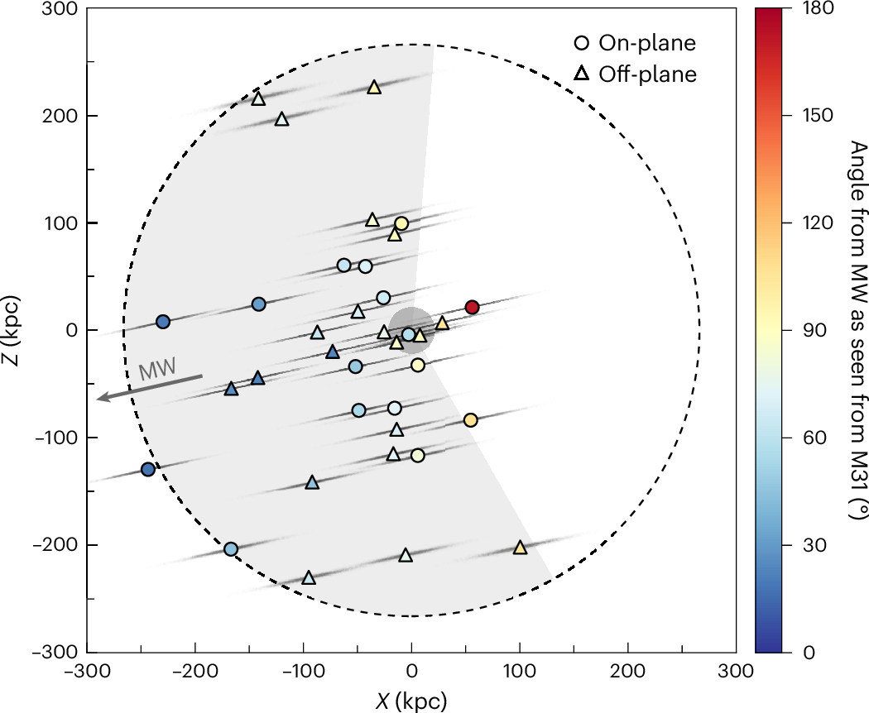
And why are they distributed the way they are?
And, almost all of its satellites are on one side of the galaxy.
They lie between the Milky Way and Andromeda
How has this happened?
Kanehisa, Pawlowski & Libeskind, 2025
23

Slide 24
Could it be Andromeda’s turbulent past?
M32?
The Giant Stellar Stream (GSS)
M33?

Slide 25
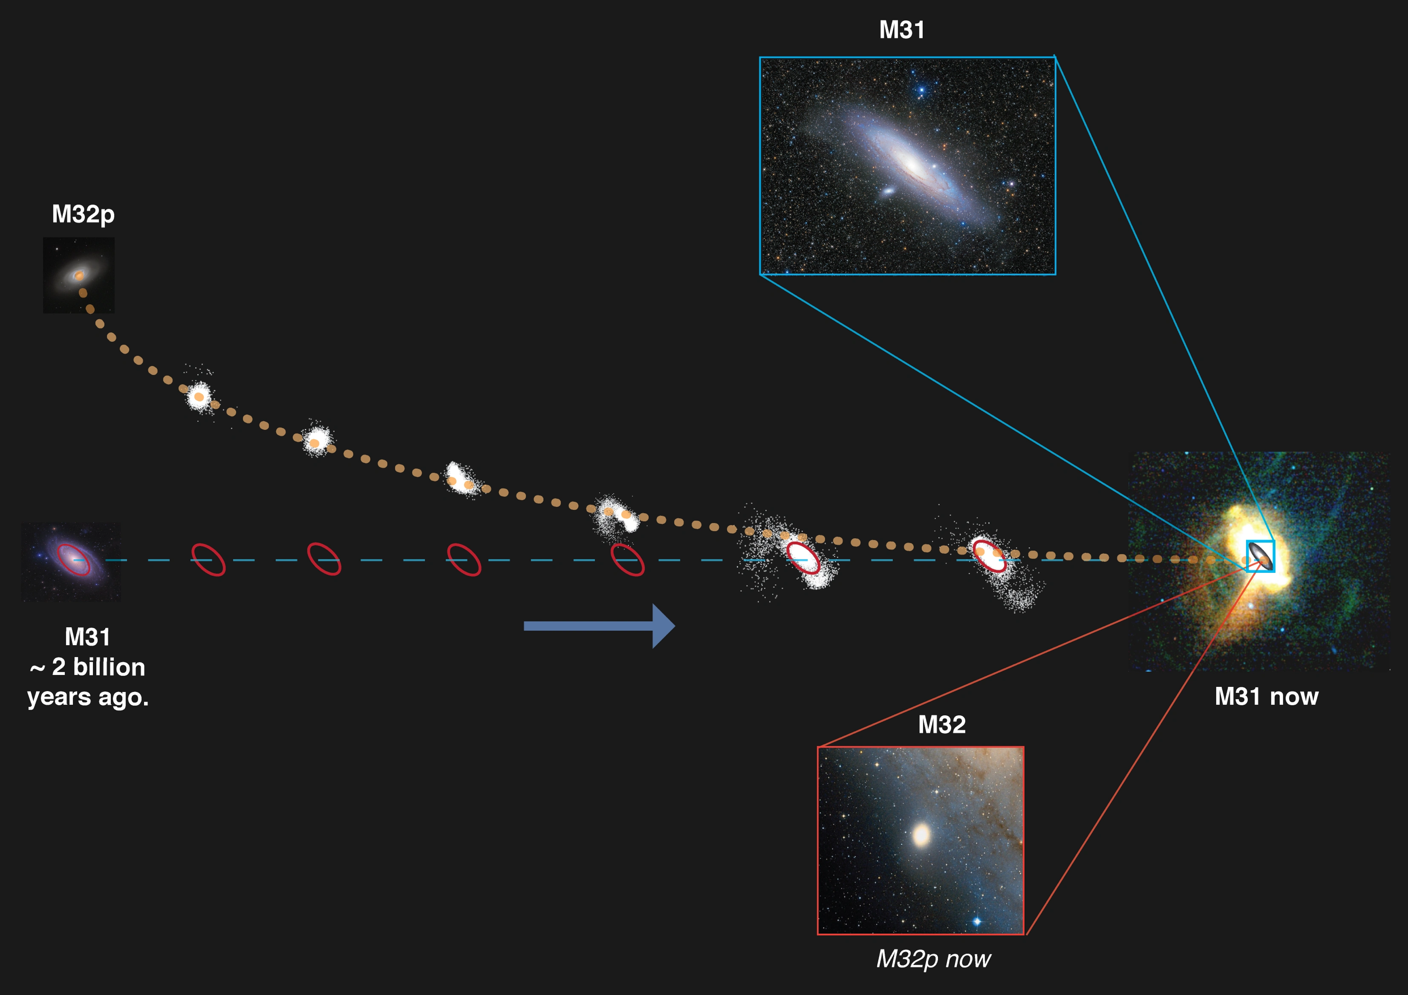
Interaction with M32p, creating the GSS
D’Souza & Bell 2018

Slide 26
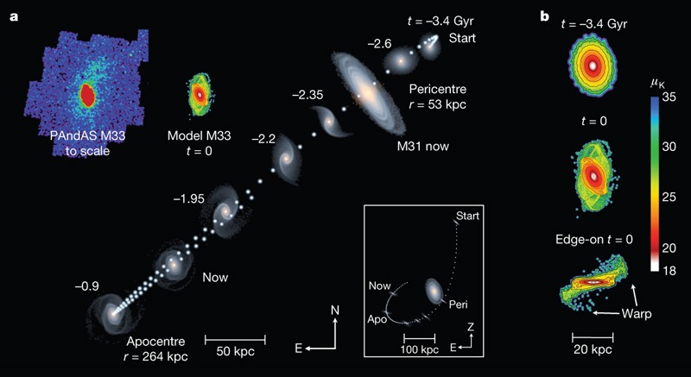
Interaction with M33 affecting halo?
McConnachie et al 2009

Slide 27

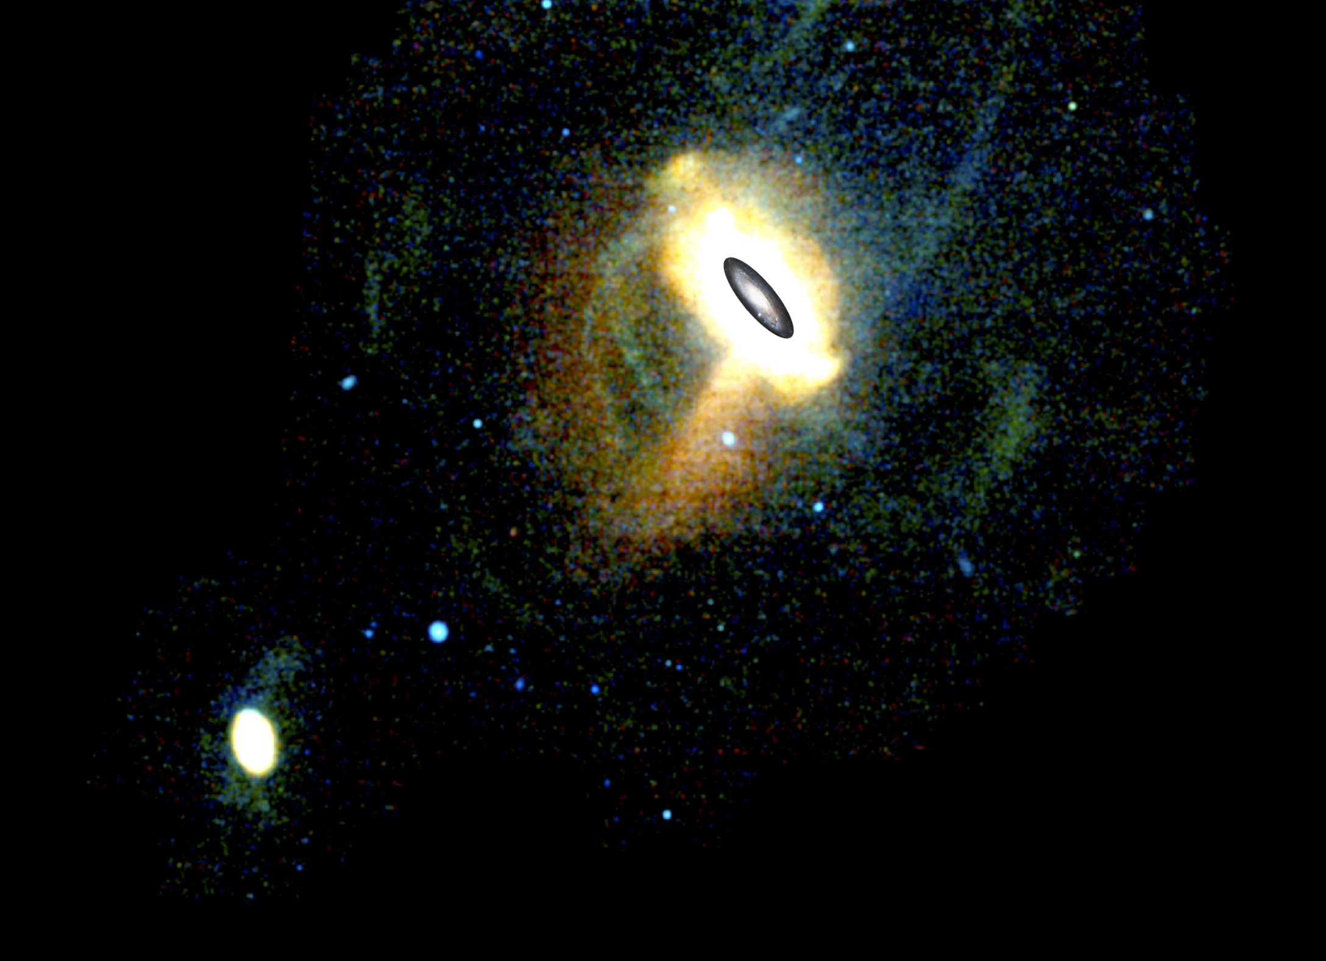
Andromeda as an ecosystem
1
Andromeda has a rich population of dwarf galaxy satellites and streams
2
Its merger history has been much more turbulent than the Milky Way
3
Its dwarf galaxies are unusual in their densities and positions – what does this tell us?
4
Are the mergers and unusual dwarf properties linked?
27

Slide 28
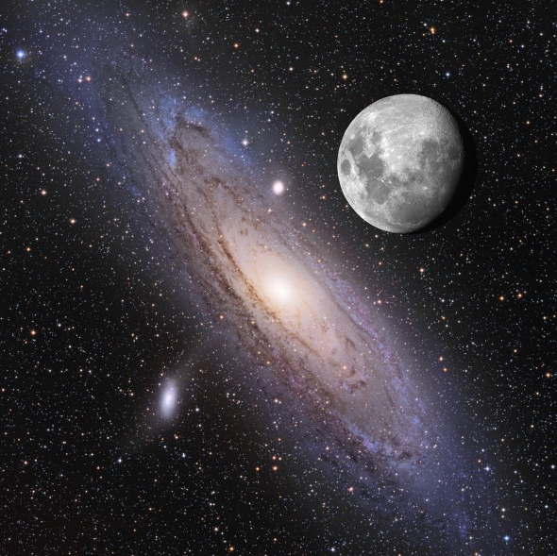


Elemental Abundances and Stellar Kinematics in the Andromeda Galaxy
Ivanna Escala
Space Telescope Science Institute (STScI)
The size of Andromeda on the sky compared to the moon. Andromeda has a large number of stars over a large area tracing different stellar structures
NASA APOD: Adam Block & Tim Puckett

Slide 29
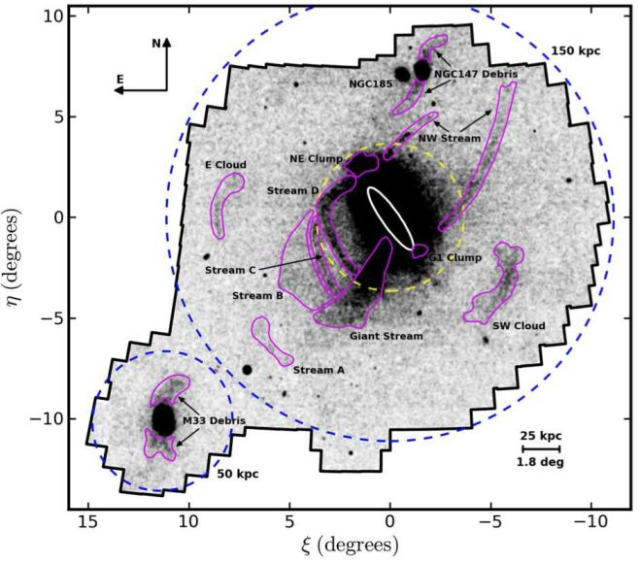
How did the Andromeda galaxy form and evolve over cosmic time?
Andromeda, like all massive
galaxies, formed from the
merging of smaller galaxies
and gas clouds.
Some stars in Andromeda today
were born elsewhere – and
others were born in place.
North-south relative to Andromeda (degrees)
East-West Relative to Andromeda (degrees)
Image credit: PAndAS collaboration, A. Ferguson & D. Mackey

Slide 30
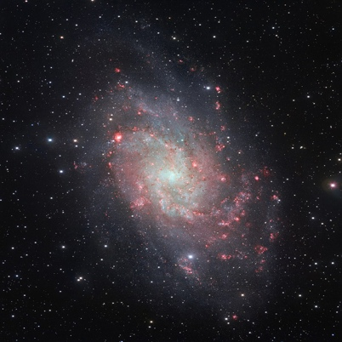
Different stellar structures in Andromeda have different origins
Intact satellite galaxies
(see Michelle’s talk)
North-south relative to Andromeda (degrees)
North-south relative to Andromeda (degrees)
East-West Relative to Andromeda (degrees)
Image credit: PAndAS collaboration, A. Ferguson & D. Mackey

Slide 31

Different stellar structures in Andromeda have different origins
Intact satellite galaxies
(see Michelle’s talk)
North-south relative to Andromeda (degrees)
North-south relative to Andromeda (degrees)
Stellar streams
(see Ben & Michelle’s talks)
East-West Relative to Andromeda (degrees)
Image credit: PAndAS collaboration, A. Ferguson & D. Mackey

Slide 32
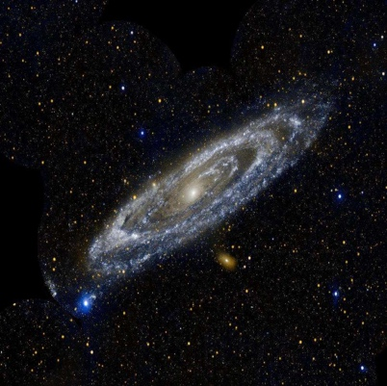
Different stellar structures in Andromeda have different origins
Intact satellite galaxies
(see Michelle’s talk)
North-south relative to Andromeda (degrees)
North-south relative to Andromeda (degrees)
Stellar streams
(see Ben & Michelle’s talks)
Stellar disk (see Ben’s talk)
East-West Relative to Andromeda (degrees)
Image credit: PAndAS collaboration, A. Ferguson & D. Mackey

Slide 33
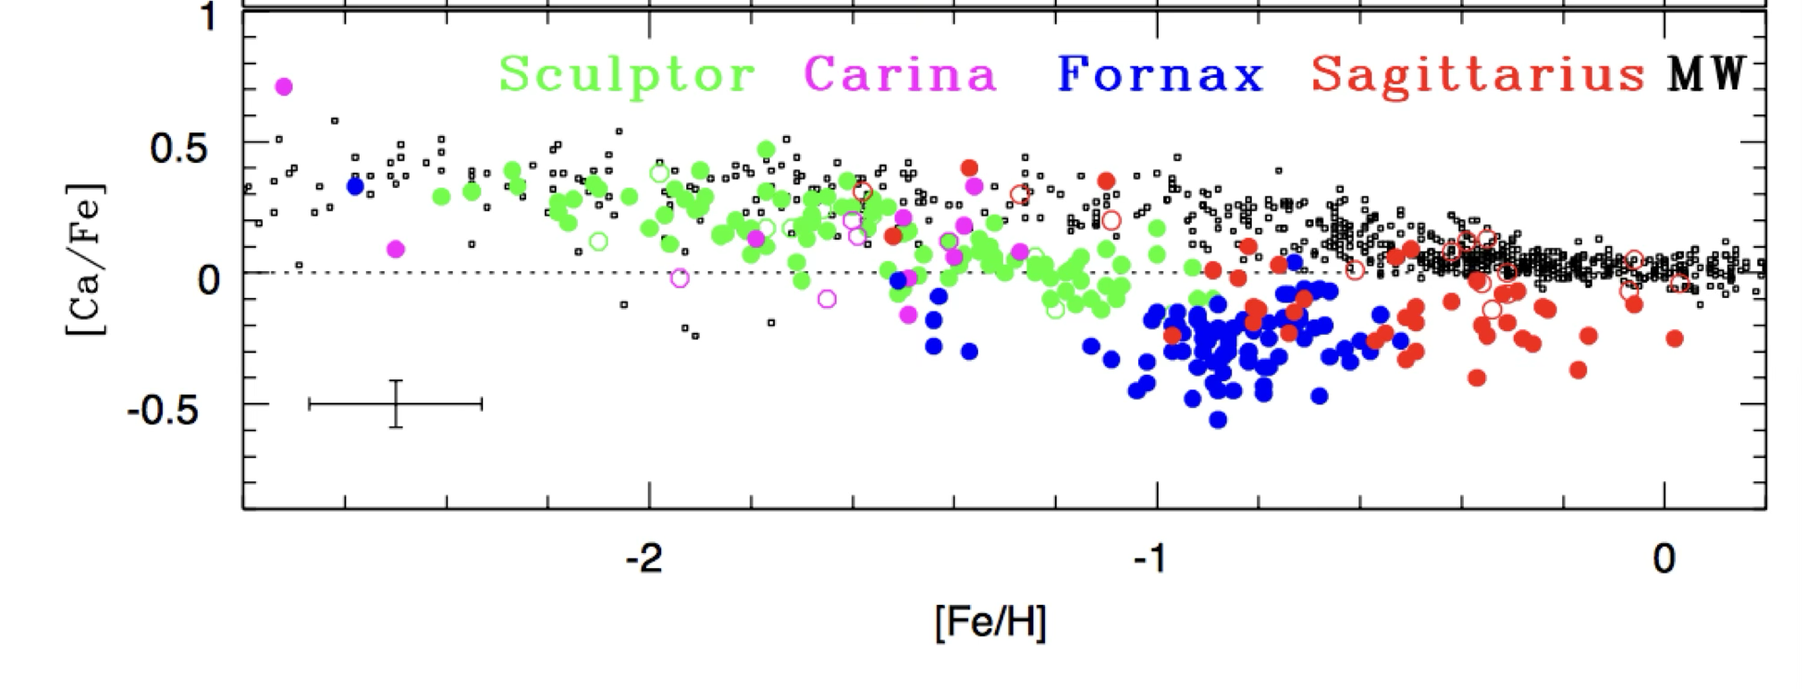
The chemical composition of a stellar population reveals its origin
Better at
forming stars
”Alpha” elements
formed in the explosions
of massive stars
Worse at
forming stars
Formed stars for
a short time
Formed stars
for a long time
Metallicity (Heavy Element Content > He)

Slide 34
The chemical composition of a stellar population reveals its origin
Better at
forming stars
”Alpha” elements
formed in the explosions
of massive stars
Worse at
forming stars
Formed stars for
a short time
Formed stars
for a long time
Metallicity (Heavy Element Content > He)

Slide 35
The chemical composition of a stellar population reveals its origin
Better at
forming stars
”Alpha” elements
formed in the explosions
of massive stars
Worse at
forming stars
Formed stars for
a short time
Formed stars
for a long time
Metallicity (Heavy Element Content > He)

Slide 36
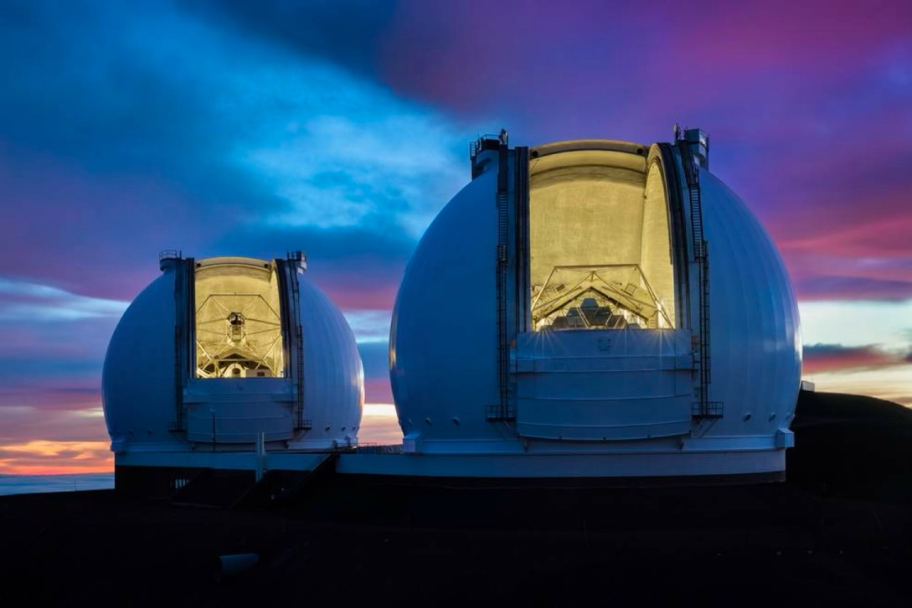
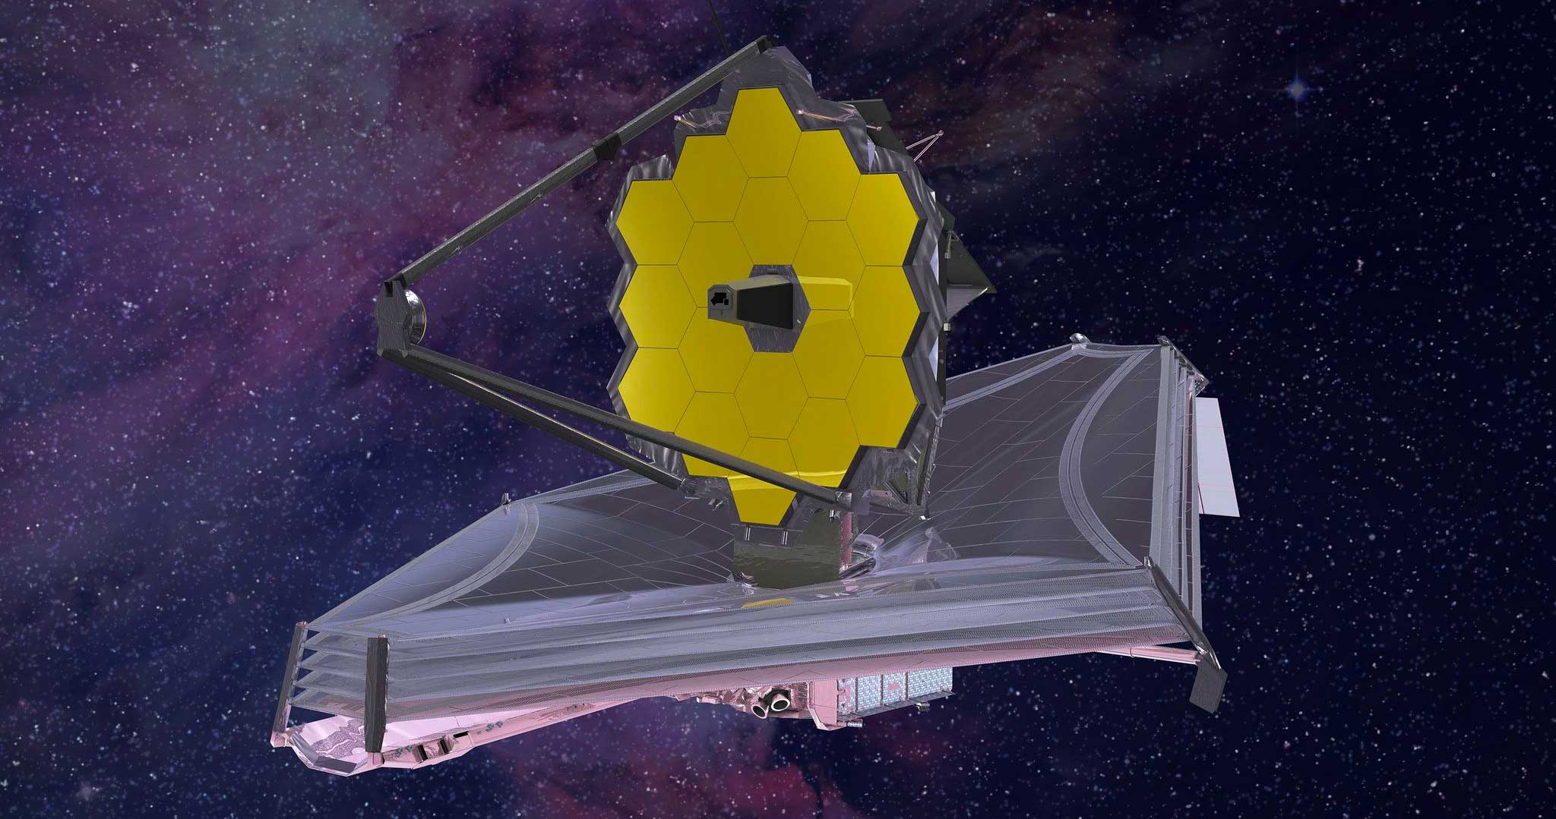
We measure the chemical compositions (and motions) of stars from their spectra
Keck
JWST
Ethan Tweedie Photography / W.M. Keck Observatory
Northrup Grumman

Slide 37
We measure the chemical compositions (and motions) of stars from their spectra
Keck
Spatial Dimension
JWST
Image credit: Evan Kirby

Slide 38
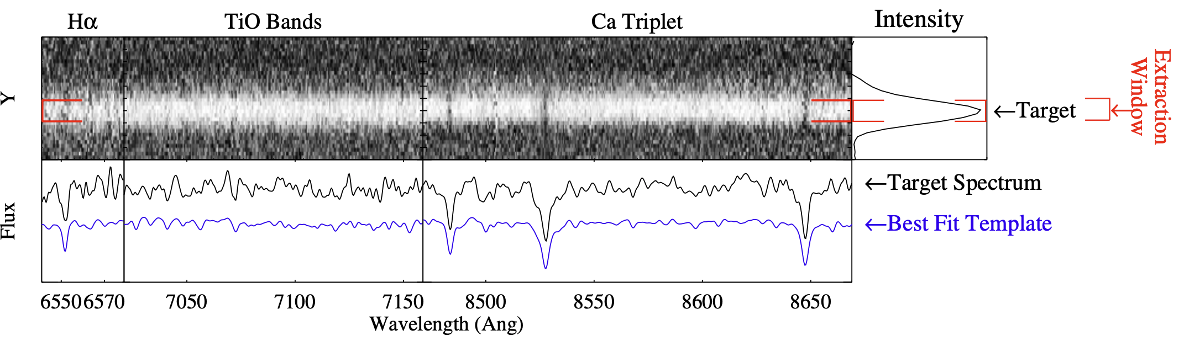
Measuring velocities of faint stars in the Andromeda galaxy
Star in Andromeda
Star in Andromeda
Best Fit Standard Star
(with known velocity)
Bluer light
Redder light
Howley et al. 2013, ApJ, 765, 22

Slide 39
Measuring chemical abundances of faint stars in the Andromeda galaxy
Alpha elements
tracing massive
star explosions
(Mg, Ca, Si)
Adapted from Escala et al. 2019, ApJ, 878, 42

Slide 40
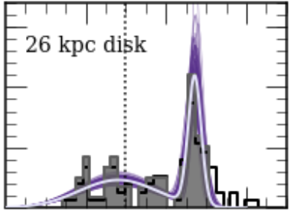
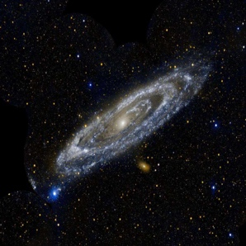
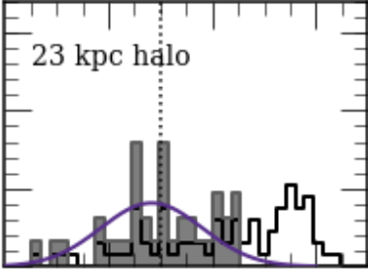
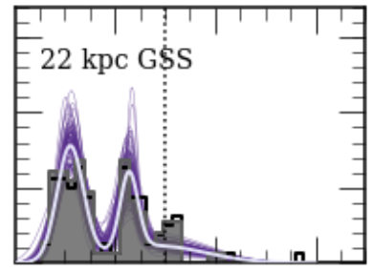
Identifying distinct stellar populations in Andromeda using stellar velocities
North-south relative to Andromeda (degrees)
East-West Relative to Andromeda (degrees)
PAndAS collaboration, A. Ferguson & D. Mackey

Slide 41
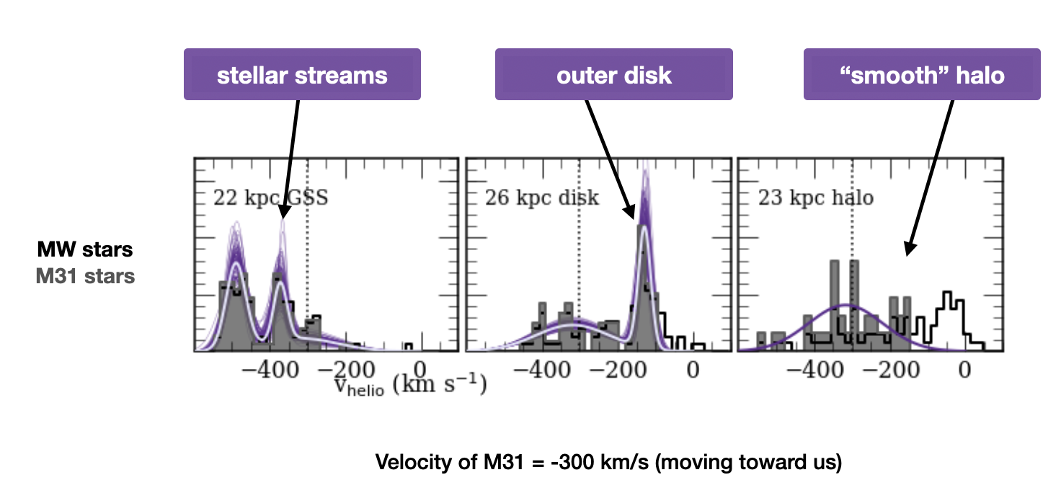
Identifying distinct stellar populations in Andromeda using stellar velocities
Stars in Andromeda
Velocity ~ -400 km/s
moving toward us even faster
Velocity of Andromeda: -300 km/s
moving toward us
Velocity ~ 0 km/s
not moving relative to us
Adapted from Escala et al. 2020, 889, 177

Slide 42
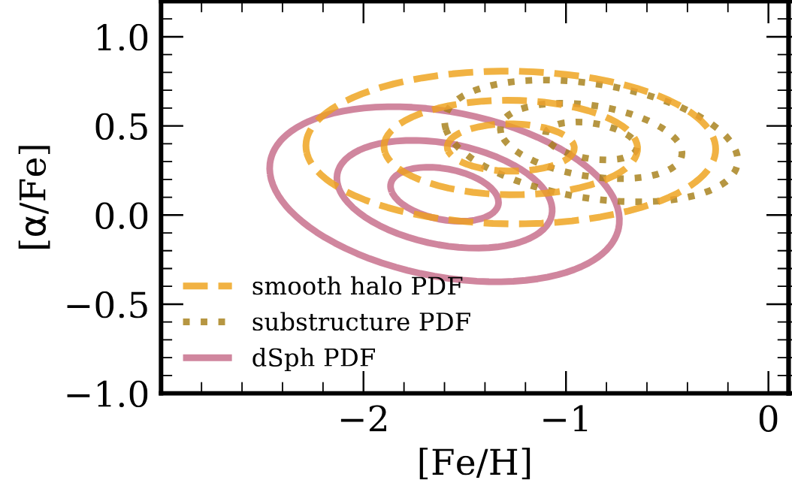
The history of Andromeda’s formation from chemical abundances
Like the Milky Way, Andromeda’s stellar
halo could NOT have formed from its
dwarf galaxies
1
”Alpha” elements
formed in the explosions
of massive stars
2
3
Metallicity (Heavy Element Content > He)
Adapted from Escala et al. 2020, 902, 51

Slide 43
The history of Andromeda’s formation from chemical abundances
Like the Milky Way, Andromeda’s stellar
halo could NOT have formed from its
dwarf galaxies
1
”Alpha” elements
formed in the explosions
of massive stars
Andromeda’s stellar halo was better
at forming stars than the Milky Way
halo (from big mergers?)
2
2
2
3
Metallicity (Heavy Element Content > He)
Adapted from Escala et al. 2020, 902, 51

Slide 44
The history of Andromeda’s formation from chemical abundances
Like the Milky Way, Andromeda’s stellar
halo could NOT have formed from its
dwarf galaxies
1
”Alpha” elements
formed in the explosions
of massive stars
Andromeda’s stellar halo was better
at forming stars than the Milky Way
halo (from big mergers?)
2
2
2
The giant stream in Andromeda was
at least as big as the large dwarf galaxy
M33, and even better at forming stars!
3
3
Metallicity (Heavy Element Content > He)
Adapted from Escala et al. 2020, 902, 51

Slide 45
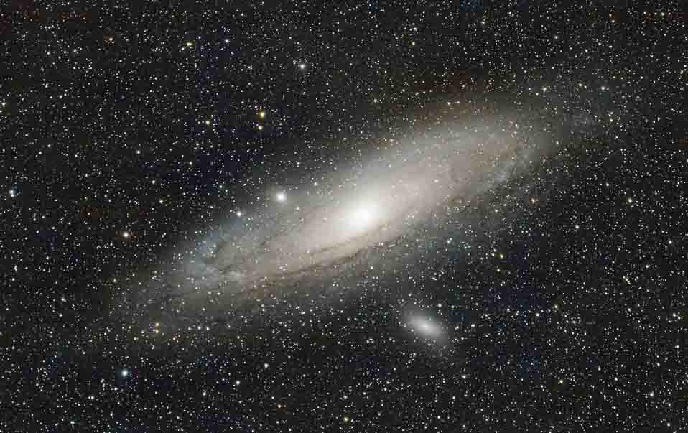
ADDITIONAL RESOURCES
Andromeda Galaxy – Informational
Andromeda Galaxy: Facts About Our Closest Galactic Neighbor
Information and bibliography links about the Andromeda Galaxy.
Andromeda Galaxy
Facts and figures about Andromeda.
ViewSpace Videos
Short informational videos related to the Andromeda Galaxy.
Mattia Verga/Pixabay

Slide 46
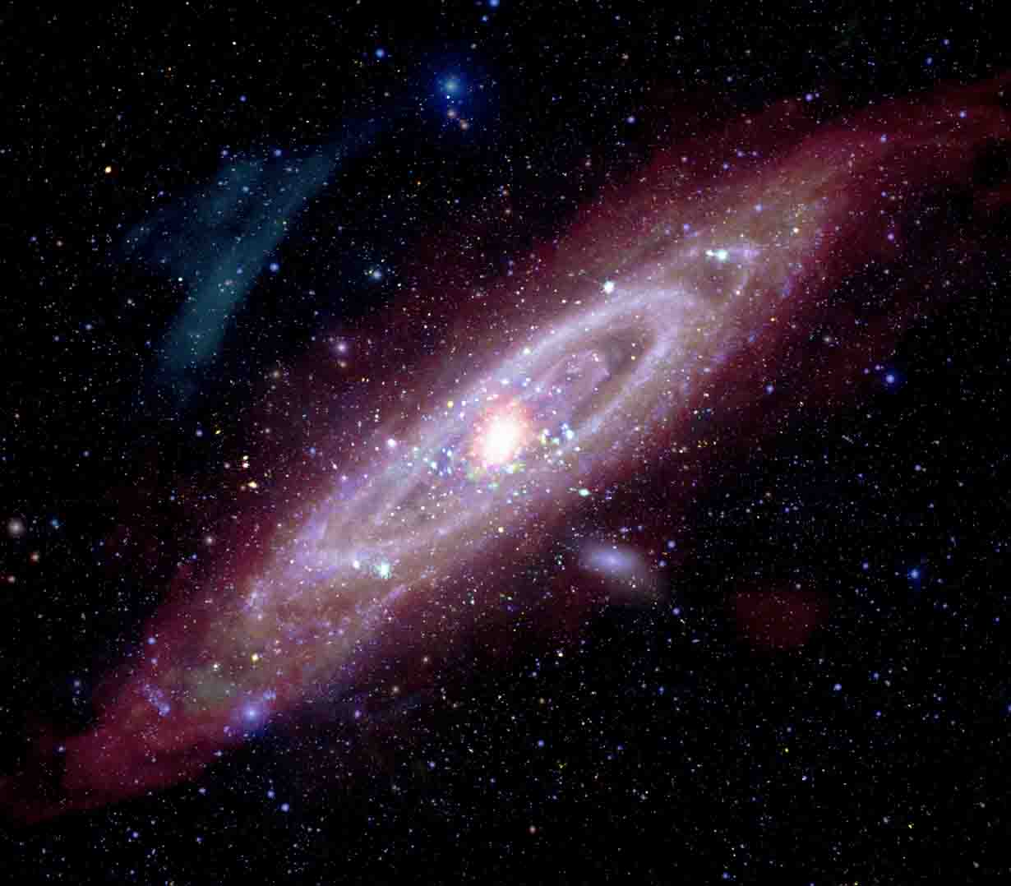
ADDITIONAL RESOURCES
Andromeda Galaxy – Imagery/Sound
Multiwavelength Views Plus A Sonification
Chandra shares new views of Andromeda, including multiwavelength imagery and a sonification.
NASA’s Hubble Traces Hidden History of Andromeda Galaxy
Evidence of collisions and periods of rapid star formation.
NASA: Take a "Swift" Tour of the Andromeda Galaxy
Video tour of the Swift ultraviolet image of Andromeda.
NASA/CXO/JPL-Caltech/ESA/NSF et. al.

Slide 47
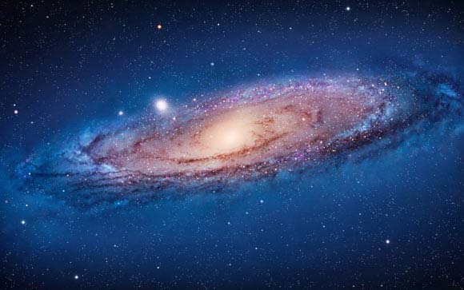
ADDITIONAL RESOURCES
Andromeda - Articles
Andromeda Galaxy – Black Hole Candidates
Chandra identifies black hole candidates in the disk.
NASA’s Hubble Provides Bird’s-Eye View of Andromeda Galaxy’s Ecosystem
Andromeda’s unusual swarm of satellites.
NASA

Slide 48
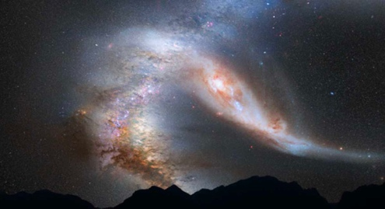
ADDITIONAL RESOURCES
Will Andromeda and the Milky Way Collide?
Interacting Galaxies: Future of the Milky Way
An interactive slider set on the approach and possible merger of Andromeda and the Milky Way.
Crash of the Titans: Milky Way and Andromeda Collision (Frame Sets)
Video of a simulated collision and merger of the two galaxies.
100,000 Computer Simulations Reveal Milky Way's Fate
Video about the uncertainties of a collision.
NASA/ESA et.al.

Slide 49

ADDITIONAL RESOURCES
August 7 Science Briefing Page
Find additional resources here.
ESA/NASA/JPL-Caltech/GBT/WSRT/IRAM/C. Clark (STScI)

Slide 50

Feedback?
Your responses help our team to better support you in your work as an educator
https://bit.ly/SciBriefPOST

