Slide 1
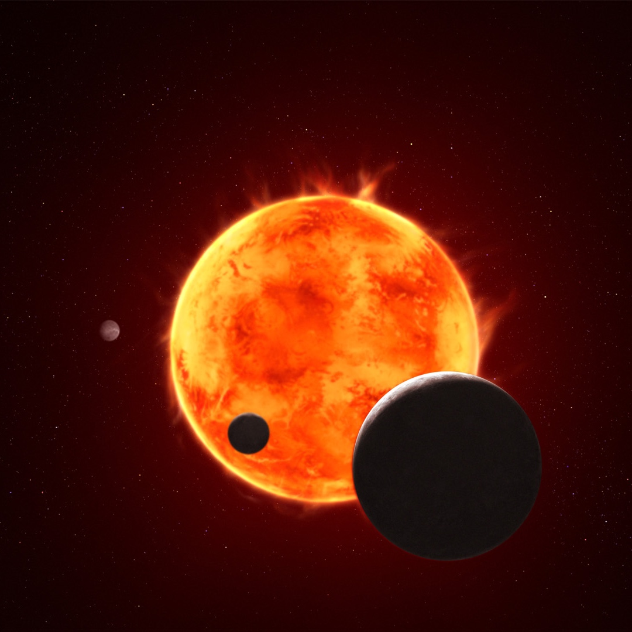




New Insights into Rocky Exoplanets with the James Webb Space Telescope
Natalie Allen
Johns Hopkins University
Jegug Ih
Space Telescope Science Institute
Hannah Diamond-Lowe
Space Telescope Science Institute
Kelly Lepo
Space Telescope Science Institute
TRAPPIST-1 e (Artist’s Concept)
Credit: NASA, ESA, CSA, STScI, Joseph Olmsted (STScI)

Slide 2
Outline of this Science Briefing
Natalie Allen
  Johns Hopkins University
  The TRAPPIST-1 System with JWST
Jegug Ih
  Space Telescope Science Institute
  Modelling Exoplanet Atmospheres: aka Observables and How We Interpret Them
Hannah Diamond-Lowe
  Space Telescope Science Institute
  The Rocky Worlds DDT Program: Exploring the atmospheres of M dwarf rocky planets
Q&A
Kelly Lepo
  Space Telescope Science Institute
  Science and Education Resources

Slide 3
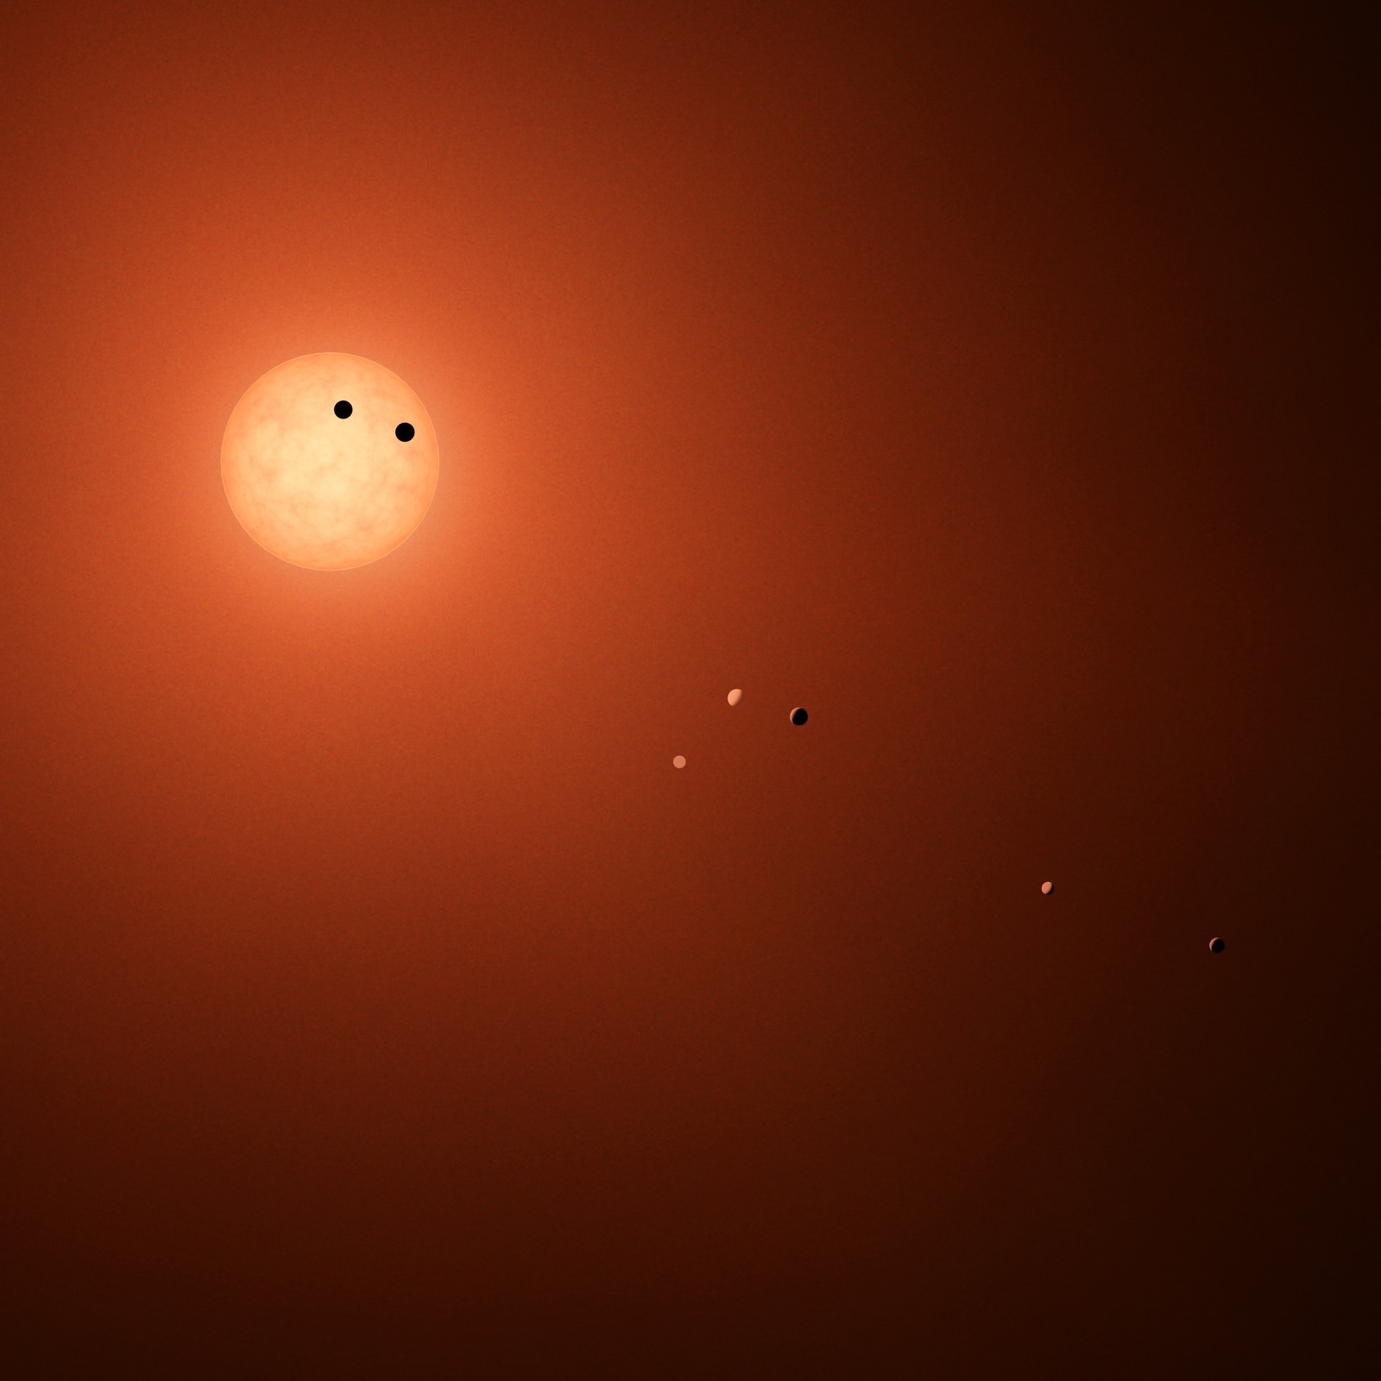

The TRAPPIST-1 System with JWST
Natalie H. Allen
Johns Hopkins University
Transit Illustration of TRAPPIST-1
Credit: NASA/JPL-Caltech/R. Hurt (IPAC)

Slide 4
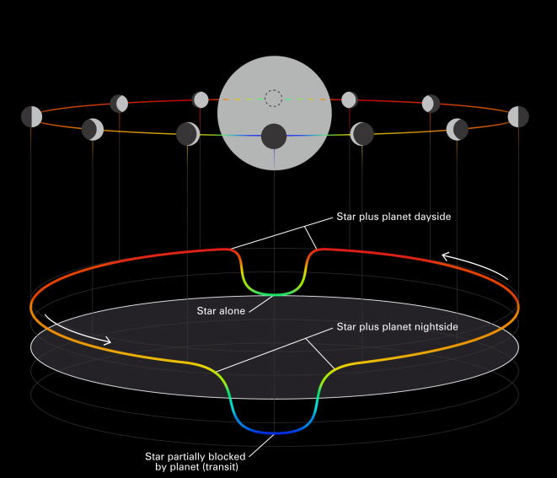
Geometry of Transiting Exoplanets
NASA

Slide 5
Geometry of Transiting Exoplanets
depends on the relative size of the planet and star
NASA

Slide 6
Geometry of Transiting Exoplanets
depends on the relative temperature of the planet and star
depends on the relative size of the planet and star
NASA

Slide 7
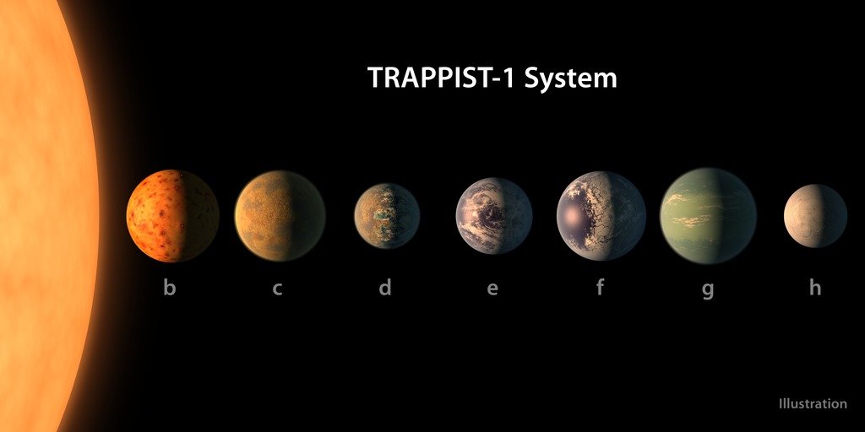
TRAPPIST-1
NASA

Slide 8
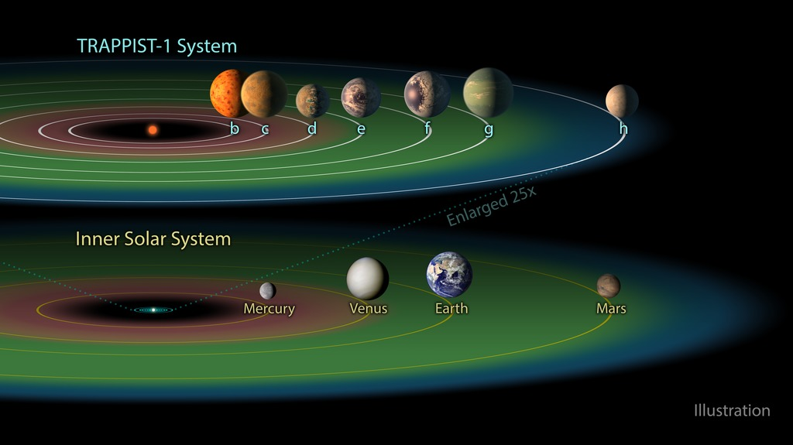
TRAPPIST-1
NASA

Slide 9
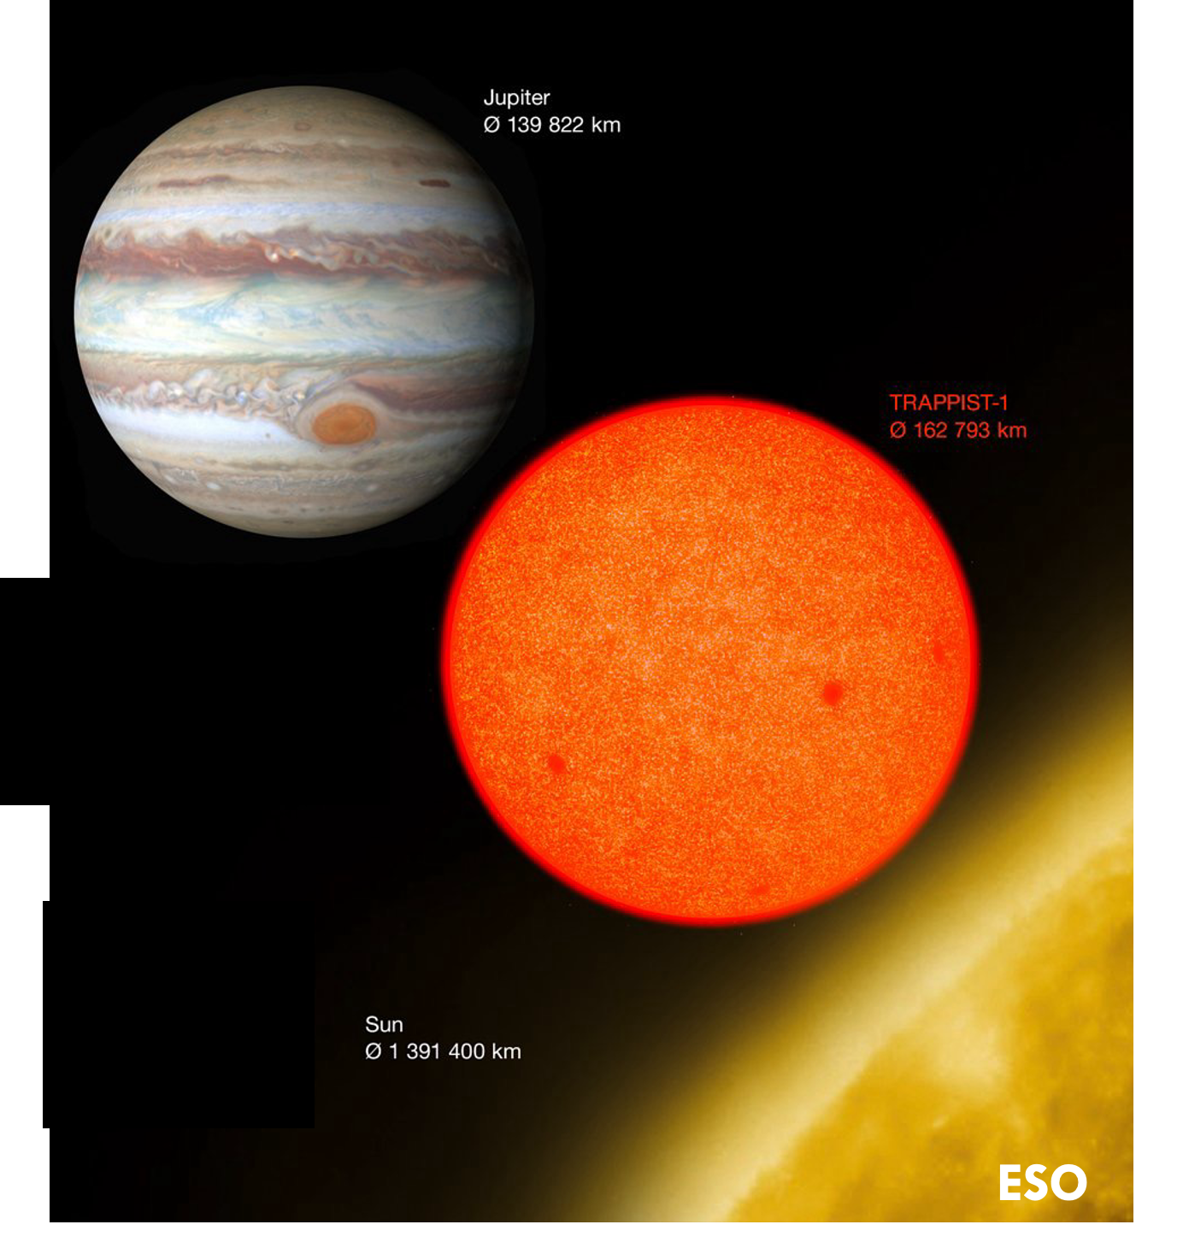
TRAPPIST-1
extremely small and cold
NASA

Slide 10
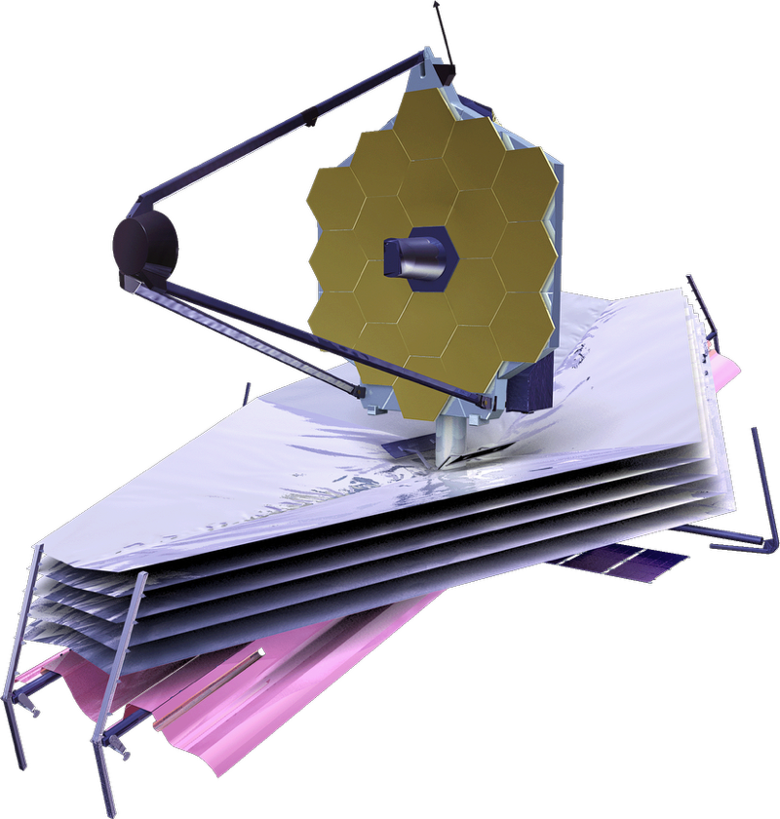
TRAPPIST-1
Every (known) planet in the system has been observed with JWST
NASA

Slide 11

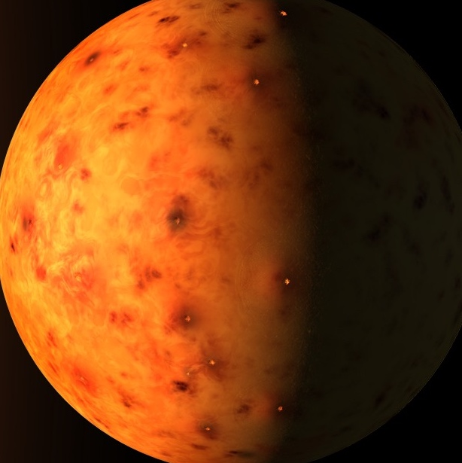
What we know about TRAPPIST-1
TRAPPIST-1 b: 1.1x Earth radius, equilibrium temperature +145 K Earth’s
(Artist’s impression)

Slide 12
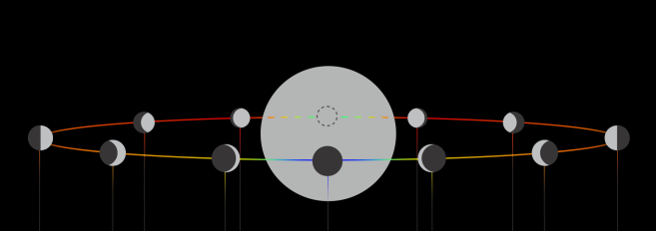
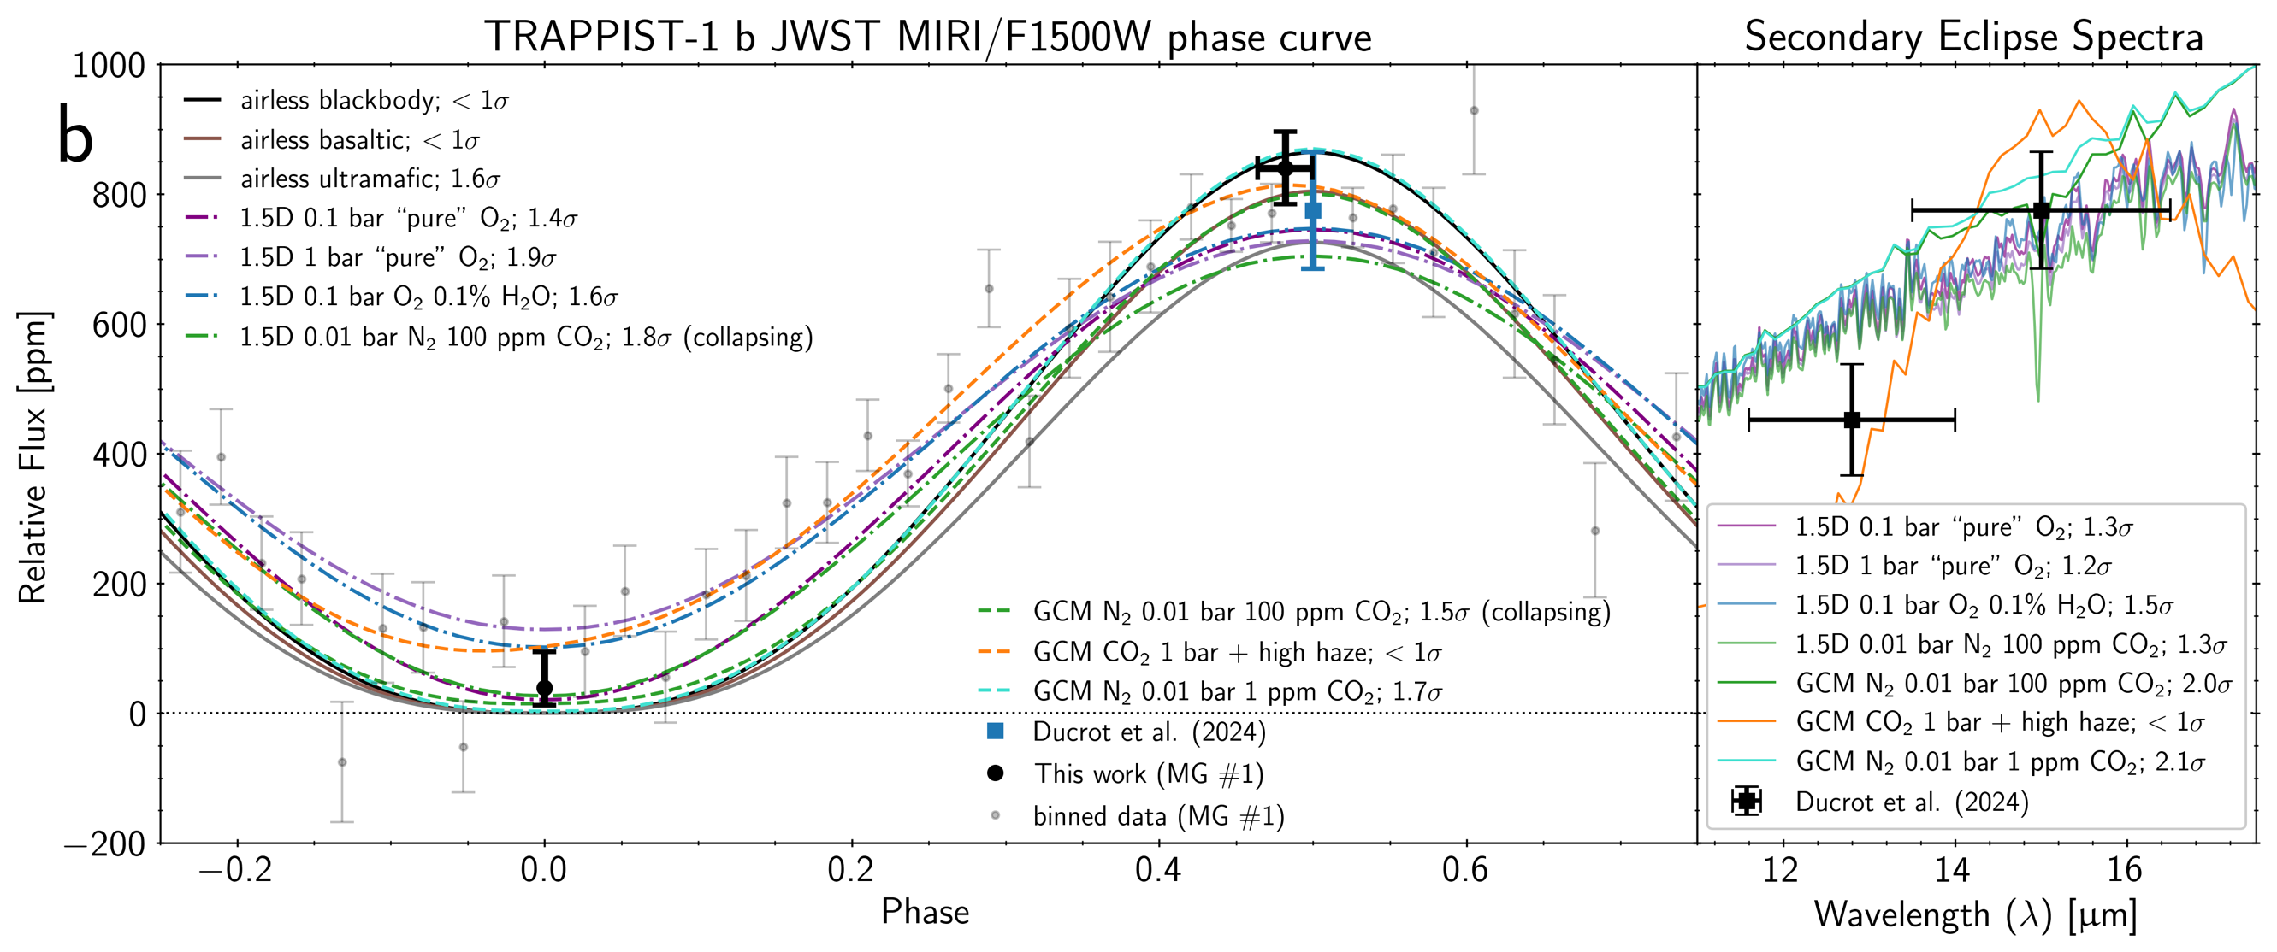
What we know about TRAPPIST-1
TRAPPIST-1 b: 1.1x Earth radius, equilibrium temperature +145 K Earth’s
Phase curve and eclipse observations most consistent with emission from a bare rock with no atmosphere
Gillon+2025
Consistent with observations in transmission*
(Artist’s impression)

Slide 13
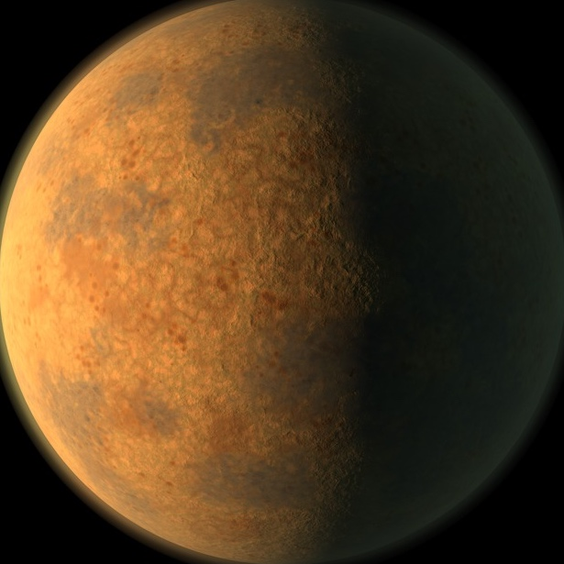
What we know about TRAPPIST-1
TRAPPIST-1 c: 1.1x Earth radius, equilibrium temperature +85 K Earth’s
(Artist’s impression)

Slide 14
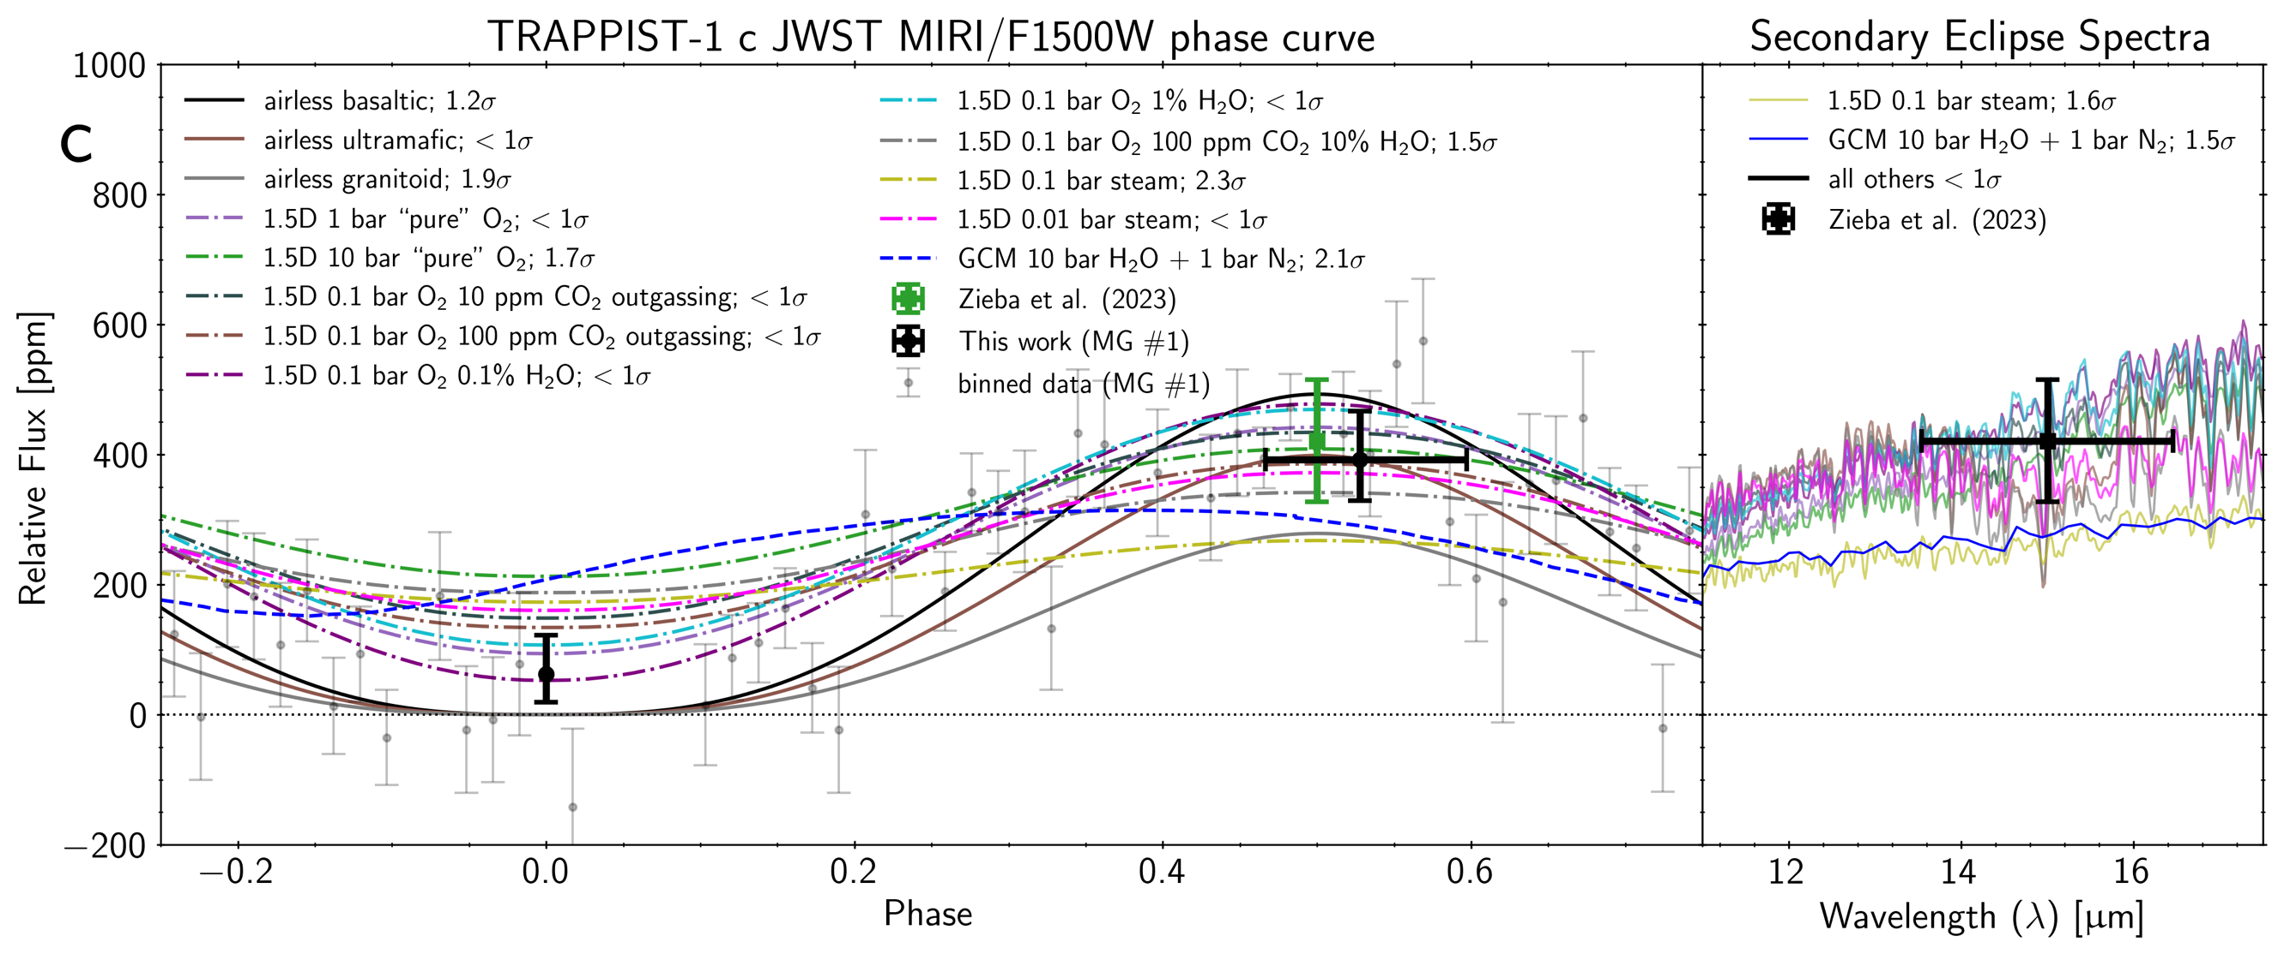
What we know about TRAPPIST-1
TRAPPIST-1 c: 1.1x Earth radius, equilibrium temperature +85 K Earth’s
Phase curve and eclipse observations most consistent with emission from a bare rock with no atmosphere or a very thin atmosphere
Gillon+2025
Consistent with observations in transmission*
(Artist’s impression)

Slide 15
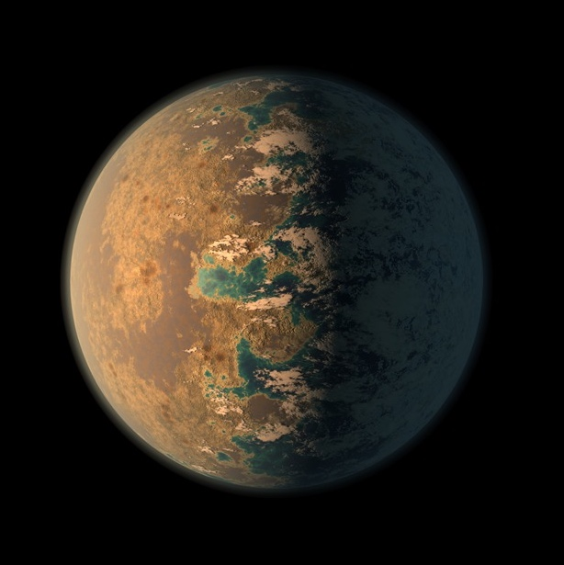
What we know about TRAPPIST-1
TRAPPIST-1 d: 0.8x Earth radius, equilibrium temperature +35 K Earth’s
(Artist’s impression)

Slide 16
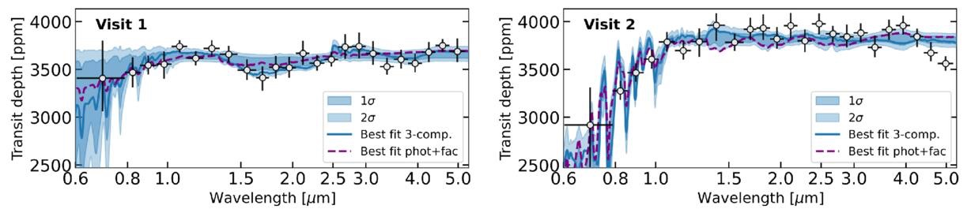
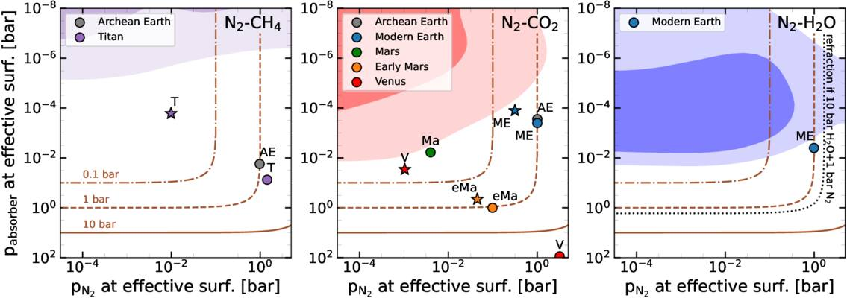
What we know about TRAPPIST-1
TRAPPIST-1 d: 0.8x Earth radius, equilibrium temperature +35 K Earth’s
Transmission observations can rule out clear Solar System analog atmospheres, are still consistent with cloudy or thin atmospheres, or an airless rock. Observations are complicated by stellar contamination.
cloud
clear
Piaulet-Ghorayeb+2025
(Artist’s impression)

Slide 17
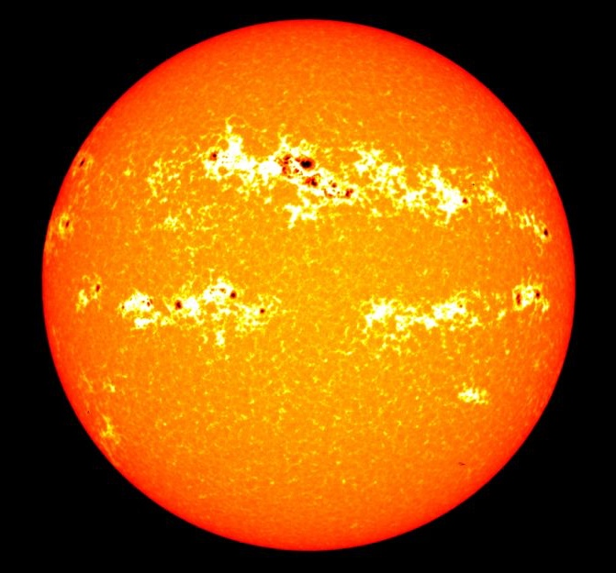
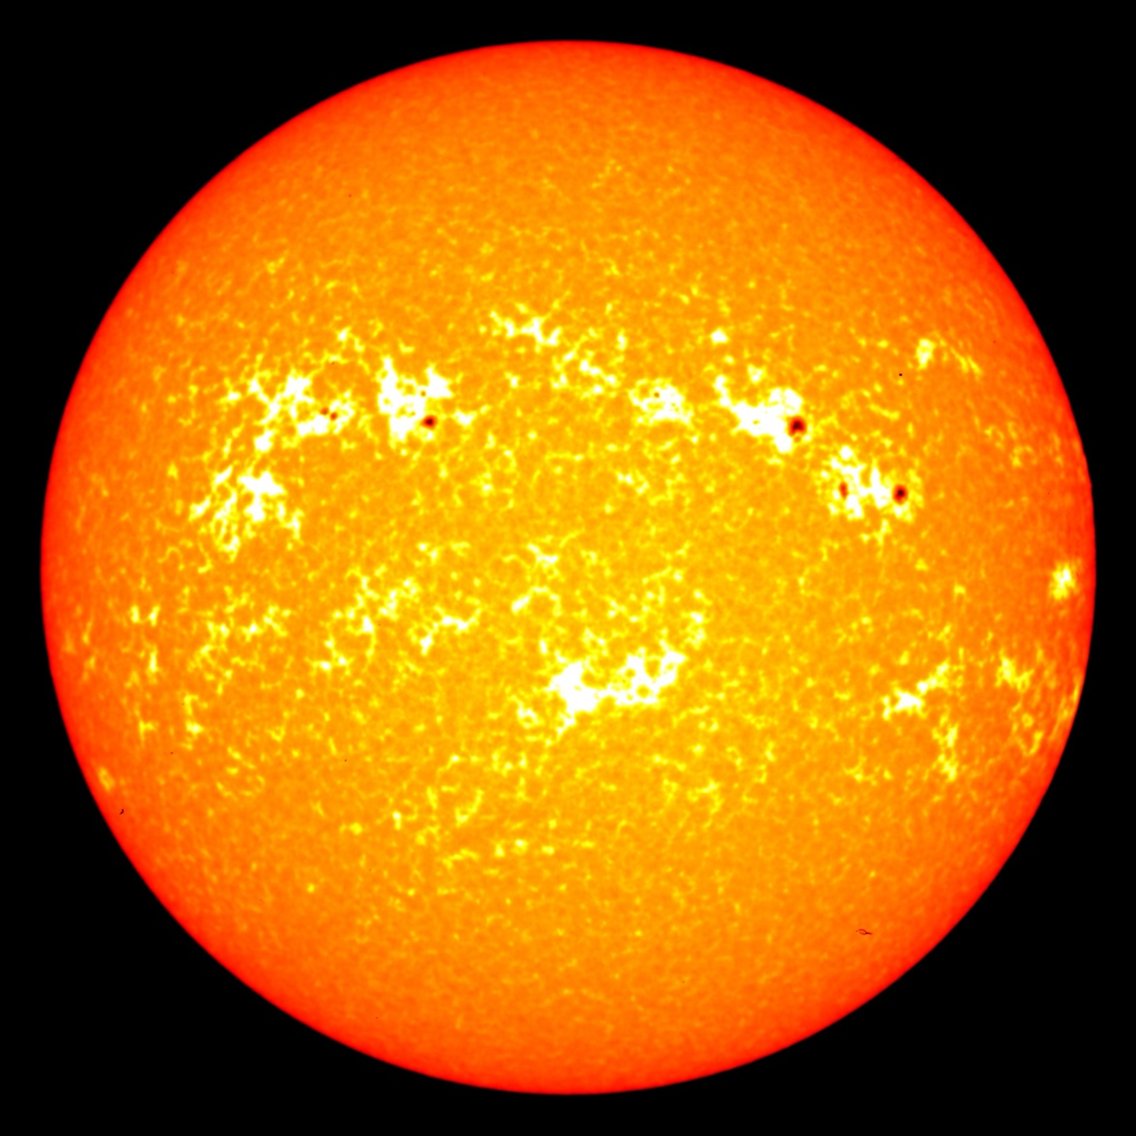
What we know about TRAPPIST-1
TRAPPIST-1 d: 0.8x Earth radius, equilibrium temperature +35 K Earth’s
Transmission observations can rule out clear Solar System analog atmospheres, are still consistent with cloudy or thin atmospheres, or an airless rock. Observations are complicated by stellar contamination.
observed signal changes as host star surface evolves
(Artist’s impression)

Slide 18
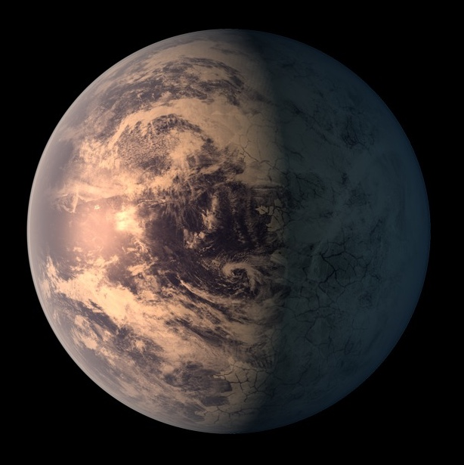
What we know about TRAPPIST-1
TRAPPIST-1 e: 0.9x Earth radius, equilibrium temperature same as Earth’s
(Artist’s impression)

Slide 19
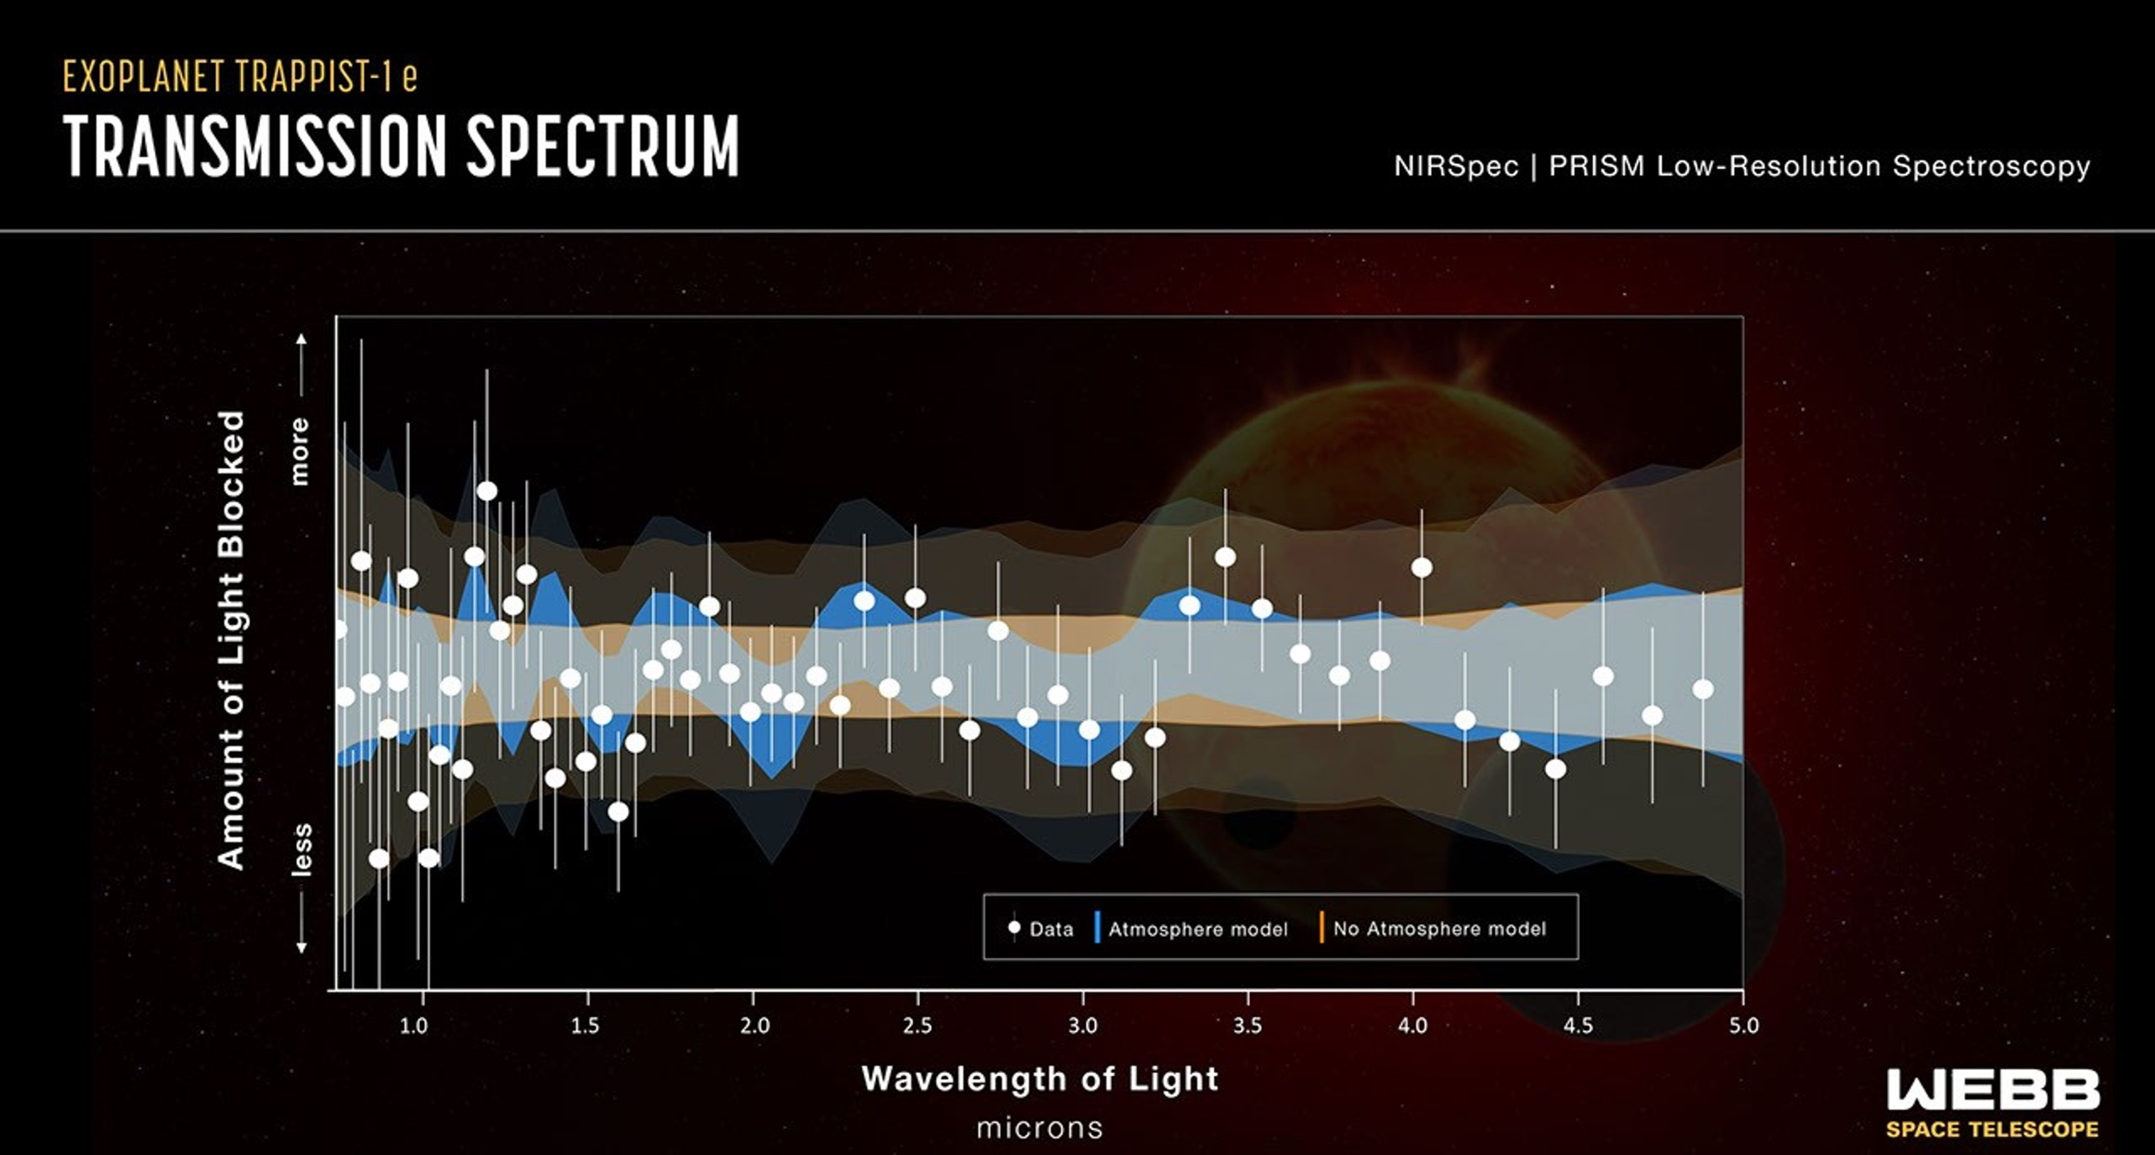
What we know about TRAPPIST-1
TRAPPIST-1 e: 0.9x Earth radius, equilibrium temperature same as Earth’s
Transmission observations show a consistent signal that could be due to a planetary atmosphere, but could also be due to the active host star
Espinoza, Allen+2025
(Artist’s impression)

Slide 20
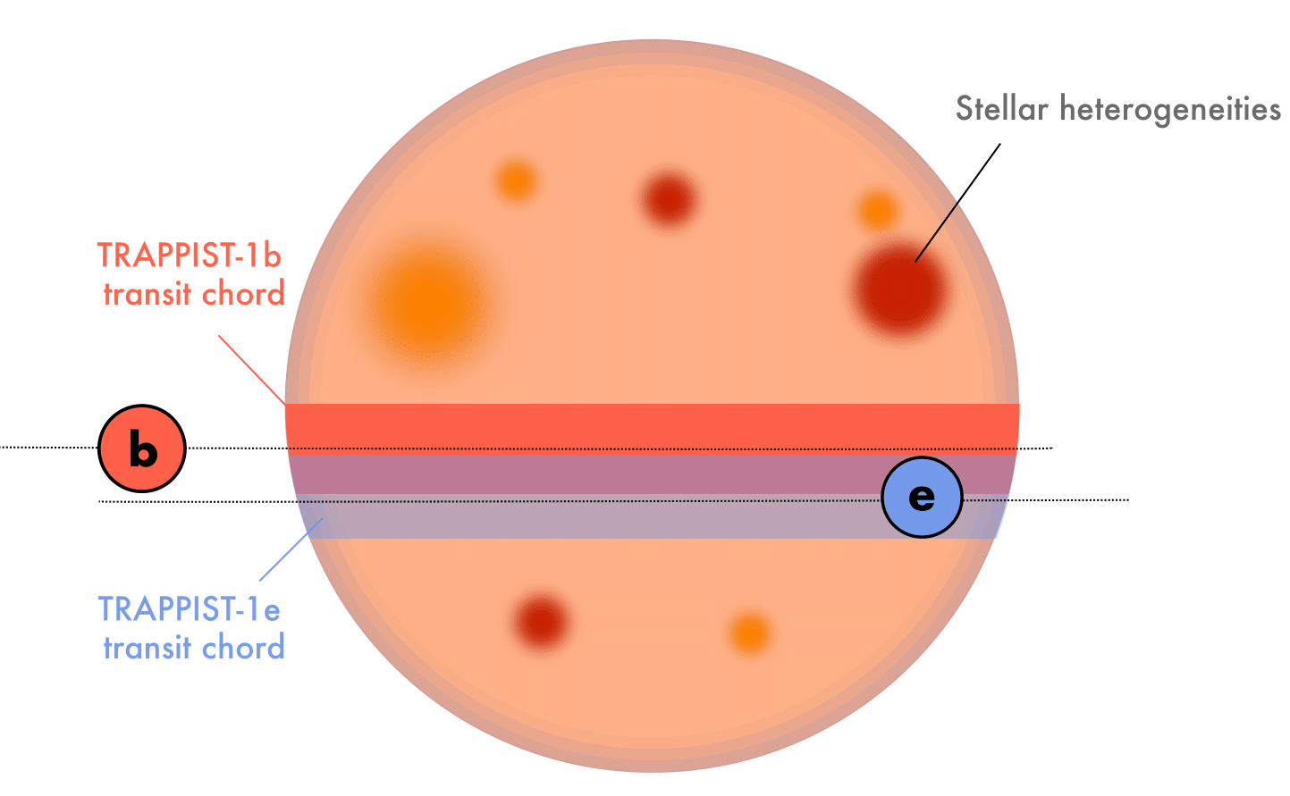
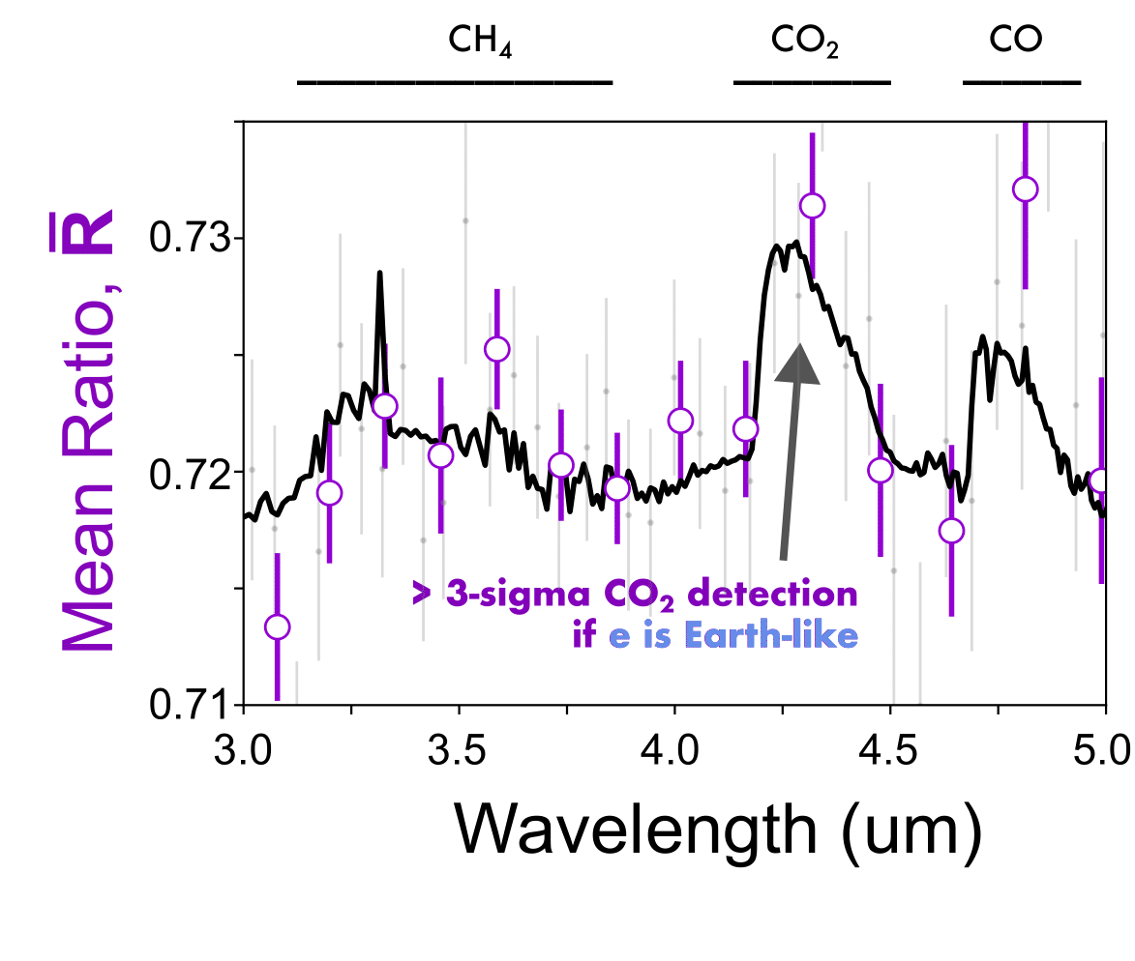
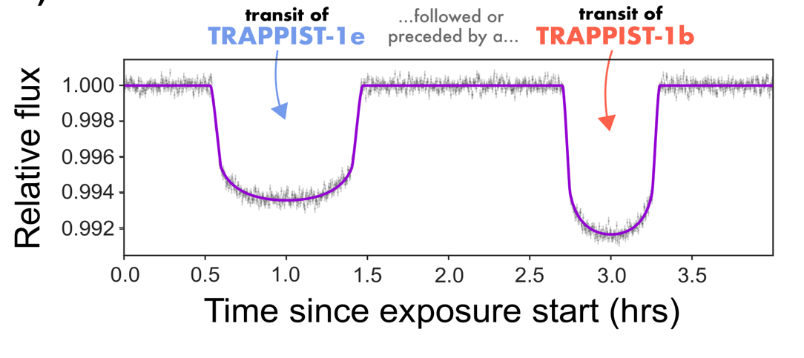
What we know about TRAPPIST-1
TRAPPIST-1 e: 0.9x Earth radius, equilibrium temperature same as Earth’s
We are following up this potential signal with a dedicated 130-hour JWST observing campaign utilizing a novel observing technique to remove the signal from the host star
PIs: Allen & Espinoza
can constrain Earth-like atmospheres
(Artist’s impression)

Slide 21


What we know about TRAPPIST-1
1
TRAPPIST-1 b is likely to be an airless rock
2
TRAPPIST-1 c is either an airless rock or has a very thin atmosphere
3
TRAPPIST-1 d is also consistent with either an airless rock or either thin atmospheres or high-altitude clouds
4
TRAPPIST-1 e shows potential atmospheric signals that we are currently following up with a large dedicated observing campaign
5
Observations have been taken for outer planets TRAPPIST-1 f, g, and h but have not yet been published

Slide 22
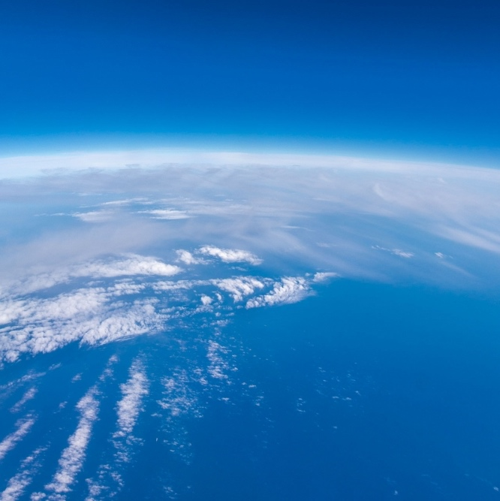

Modelling Exoplanet Atmospheres
aka Observables and How We Interpret Them
Jegug Ih
Space Telescope Science Institute
jih@stsci.edu
Earth’s atmosphere from space (ESA)

Slide 23
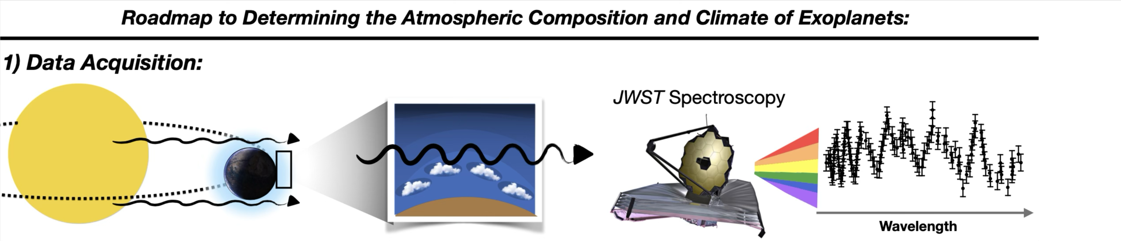
Why we need models to interpret observations
Credit: N. E. Batalha

Slide 24
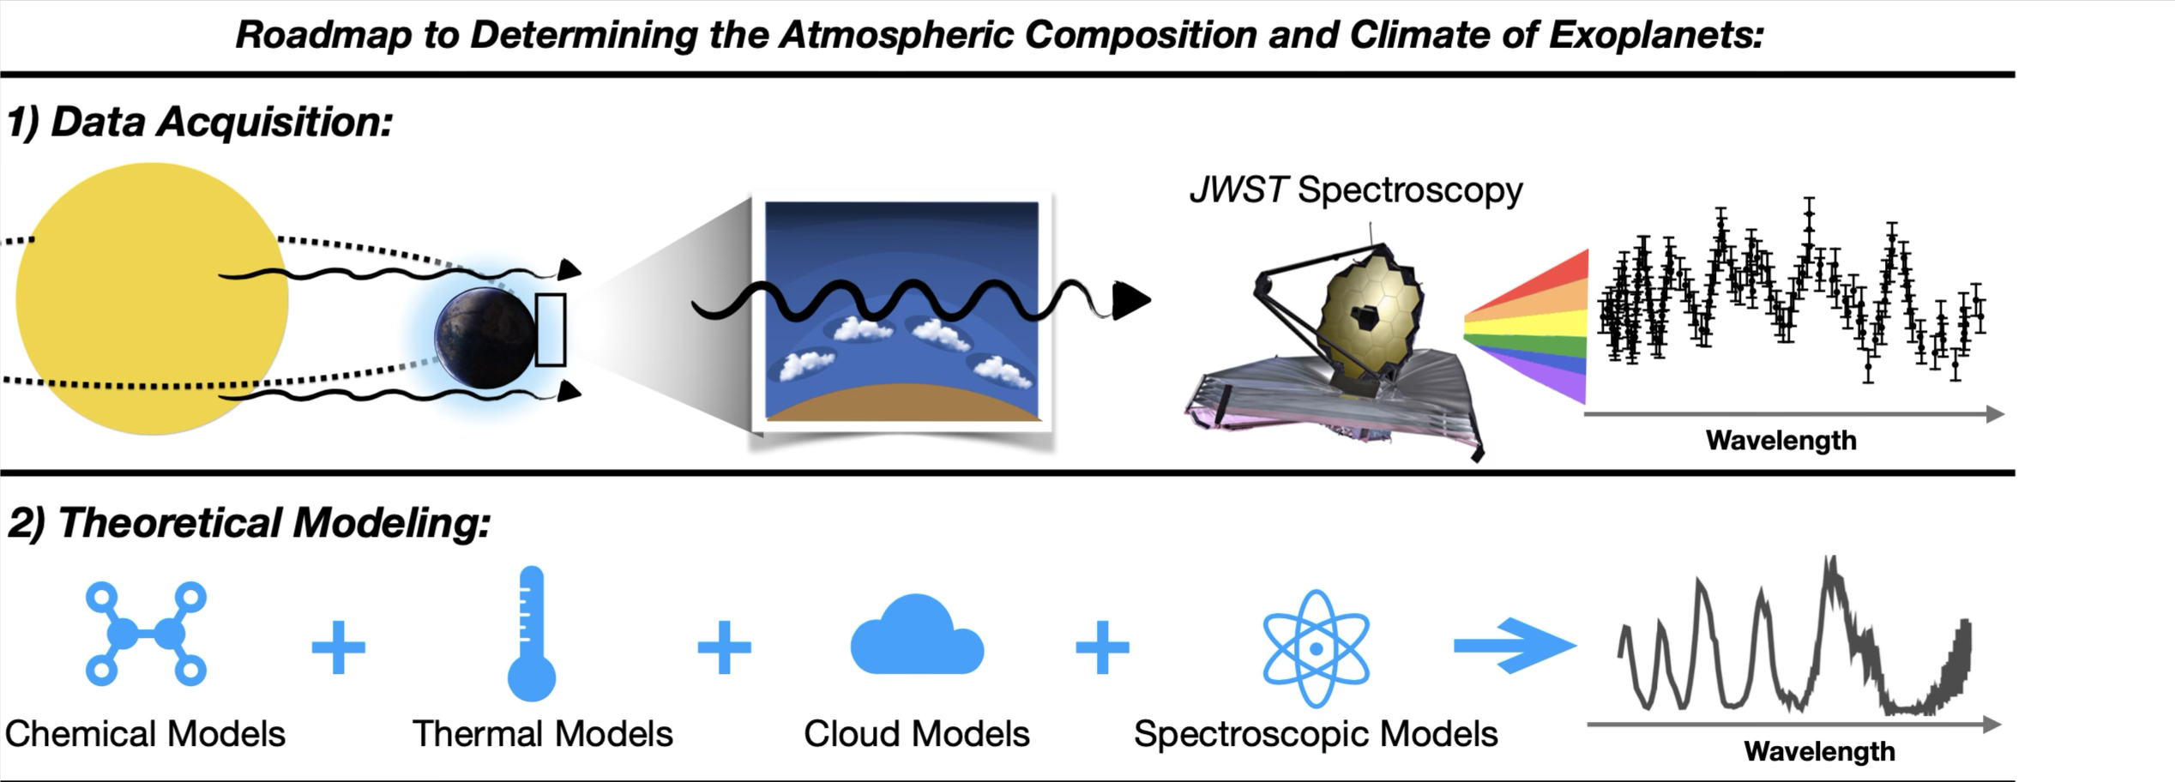
Why we need models to interpret observations
Credit: N. E. Batalha

Slide 25
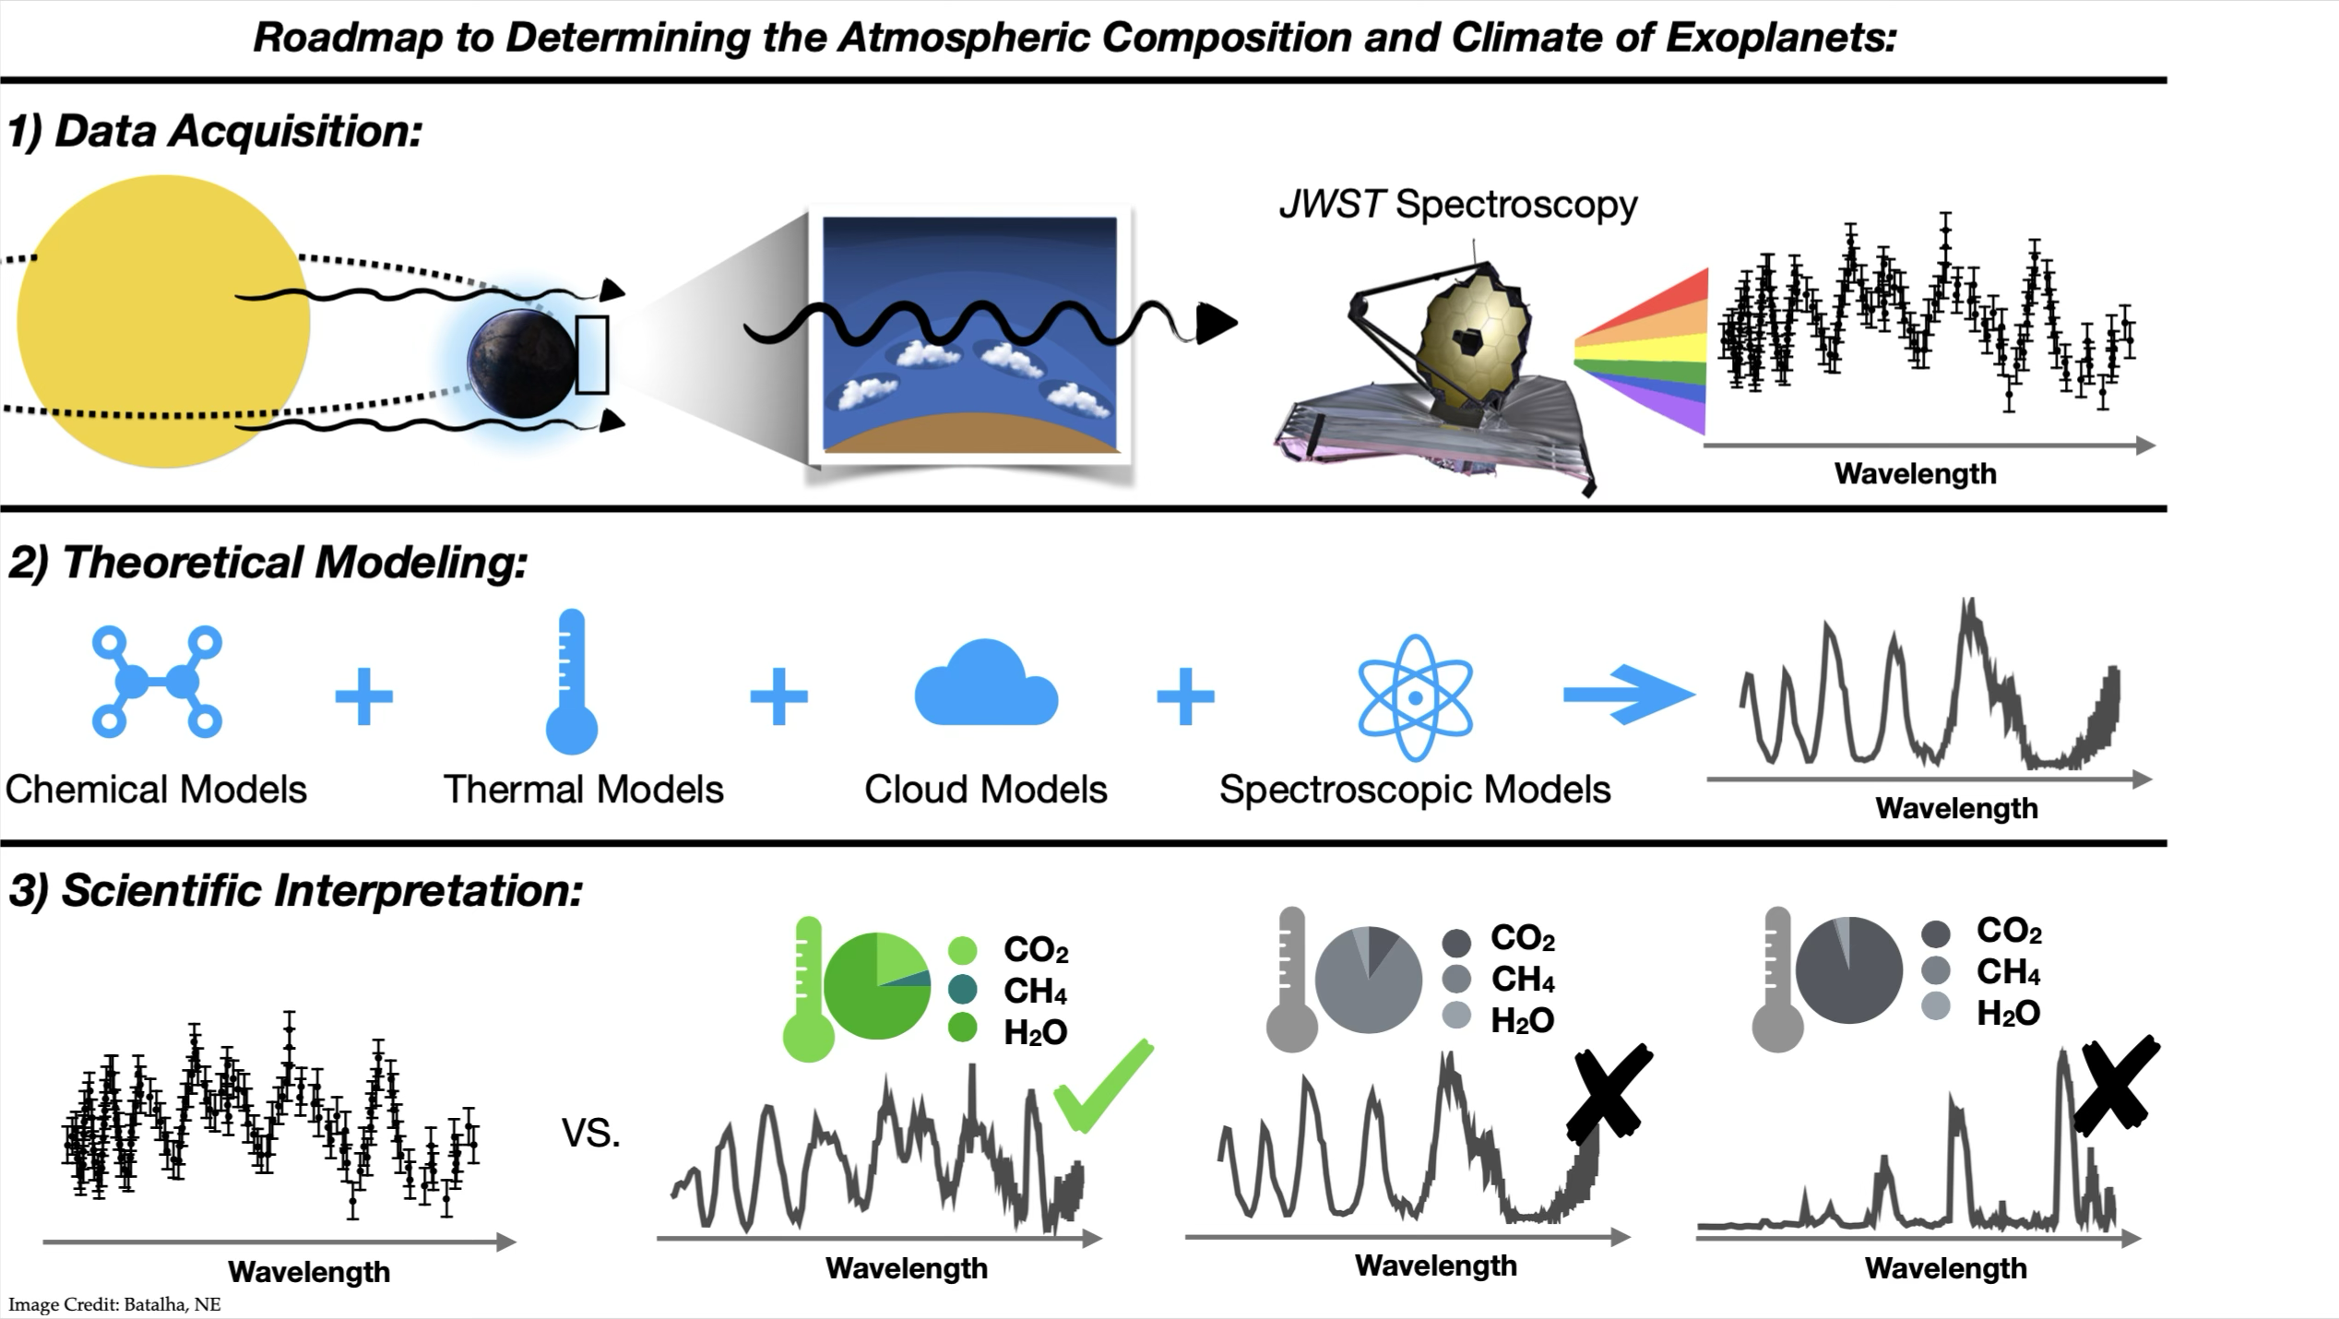
Why we need models to interpret observations
Credit: N. E. Batalha

Slide 26
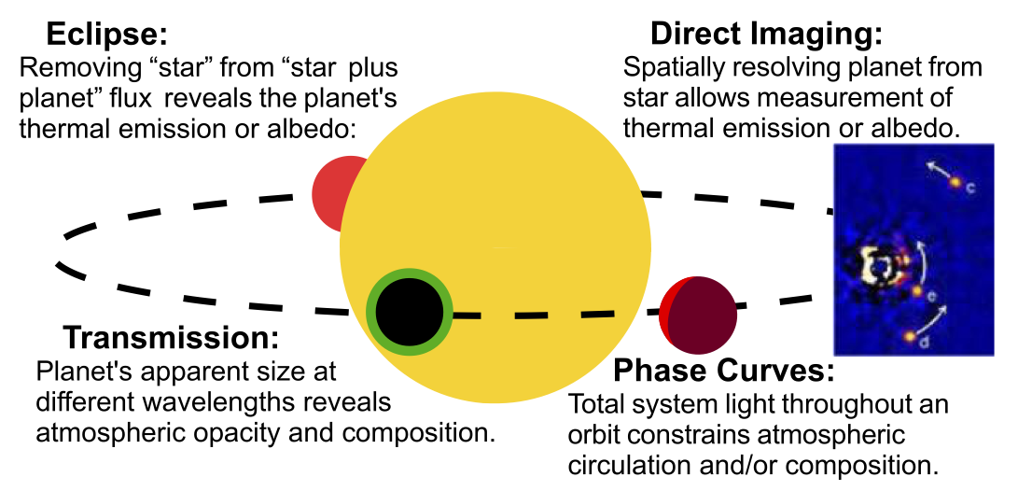
Observables of transiting exoplanets

Slide 27
Observables of transiting exoplanets

Slide 28
Observables of transiting exoplanets
We see the thermal emission from the dayside of the planet.
We probe primarily vertically through the atmospheric column from the top of the atmosphere to the bottom, possibly down to the planetary surface.
We are most sensitive to the vertical thermal structure of the atmosphere.

Slide 29
Observables of transiting exoplanets
We see the thermal emission from the dayside of the planet.
We see the transmission of the starlight filtered through the atmosphere.
The planet appears to be different sizes at different wavelengths as molecules absorb the starlight.
We are most sensitive to the chemical composition of the atmosphere (at ~1 mbar).

Slide 30
Observables of transiting exoplanets
When we look at…
If there is an atmosphere…
Emission
Observed dayside temperature is generally cooler.
Vertical thermal structure of the atmosphere
Transmission
Observed transmission spectrum generally shows wiggles.
Chemical composition of the atmosphere

Slide 31
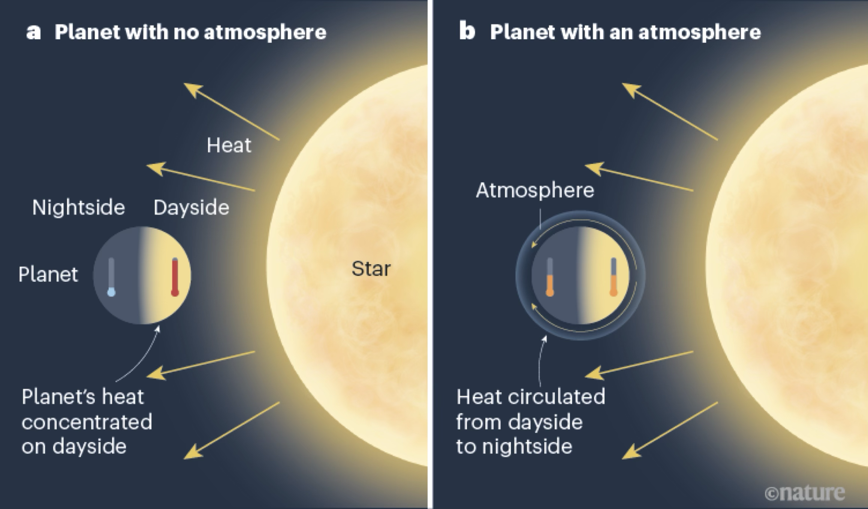
Modelling Exoplanet Atmospheres in Emission
Credit: L. Kreidberg
Atmospheres transport incident heat away to the nightside

Slide 32

Modelling Exoplanet Atmospheres in Emission
Atmospheres transport incident heat away to the nightside
But also…
1
Create molecular absorption or emission features
2
Change the thermal structure (e.g. greenhouse warming)
Credit: L. Kreidberg

Slide 33
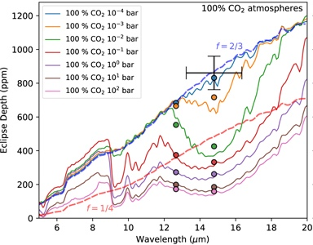
TRAPPIST-1 b: Observations vs Models
Thicker atmosphere
Credit: Ih+23
From this we can rule out atmospheres as thick as Mars (0.01 bar)

Slide 34
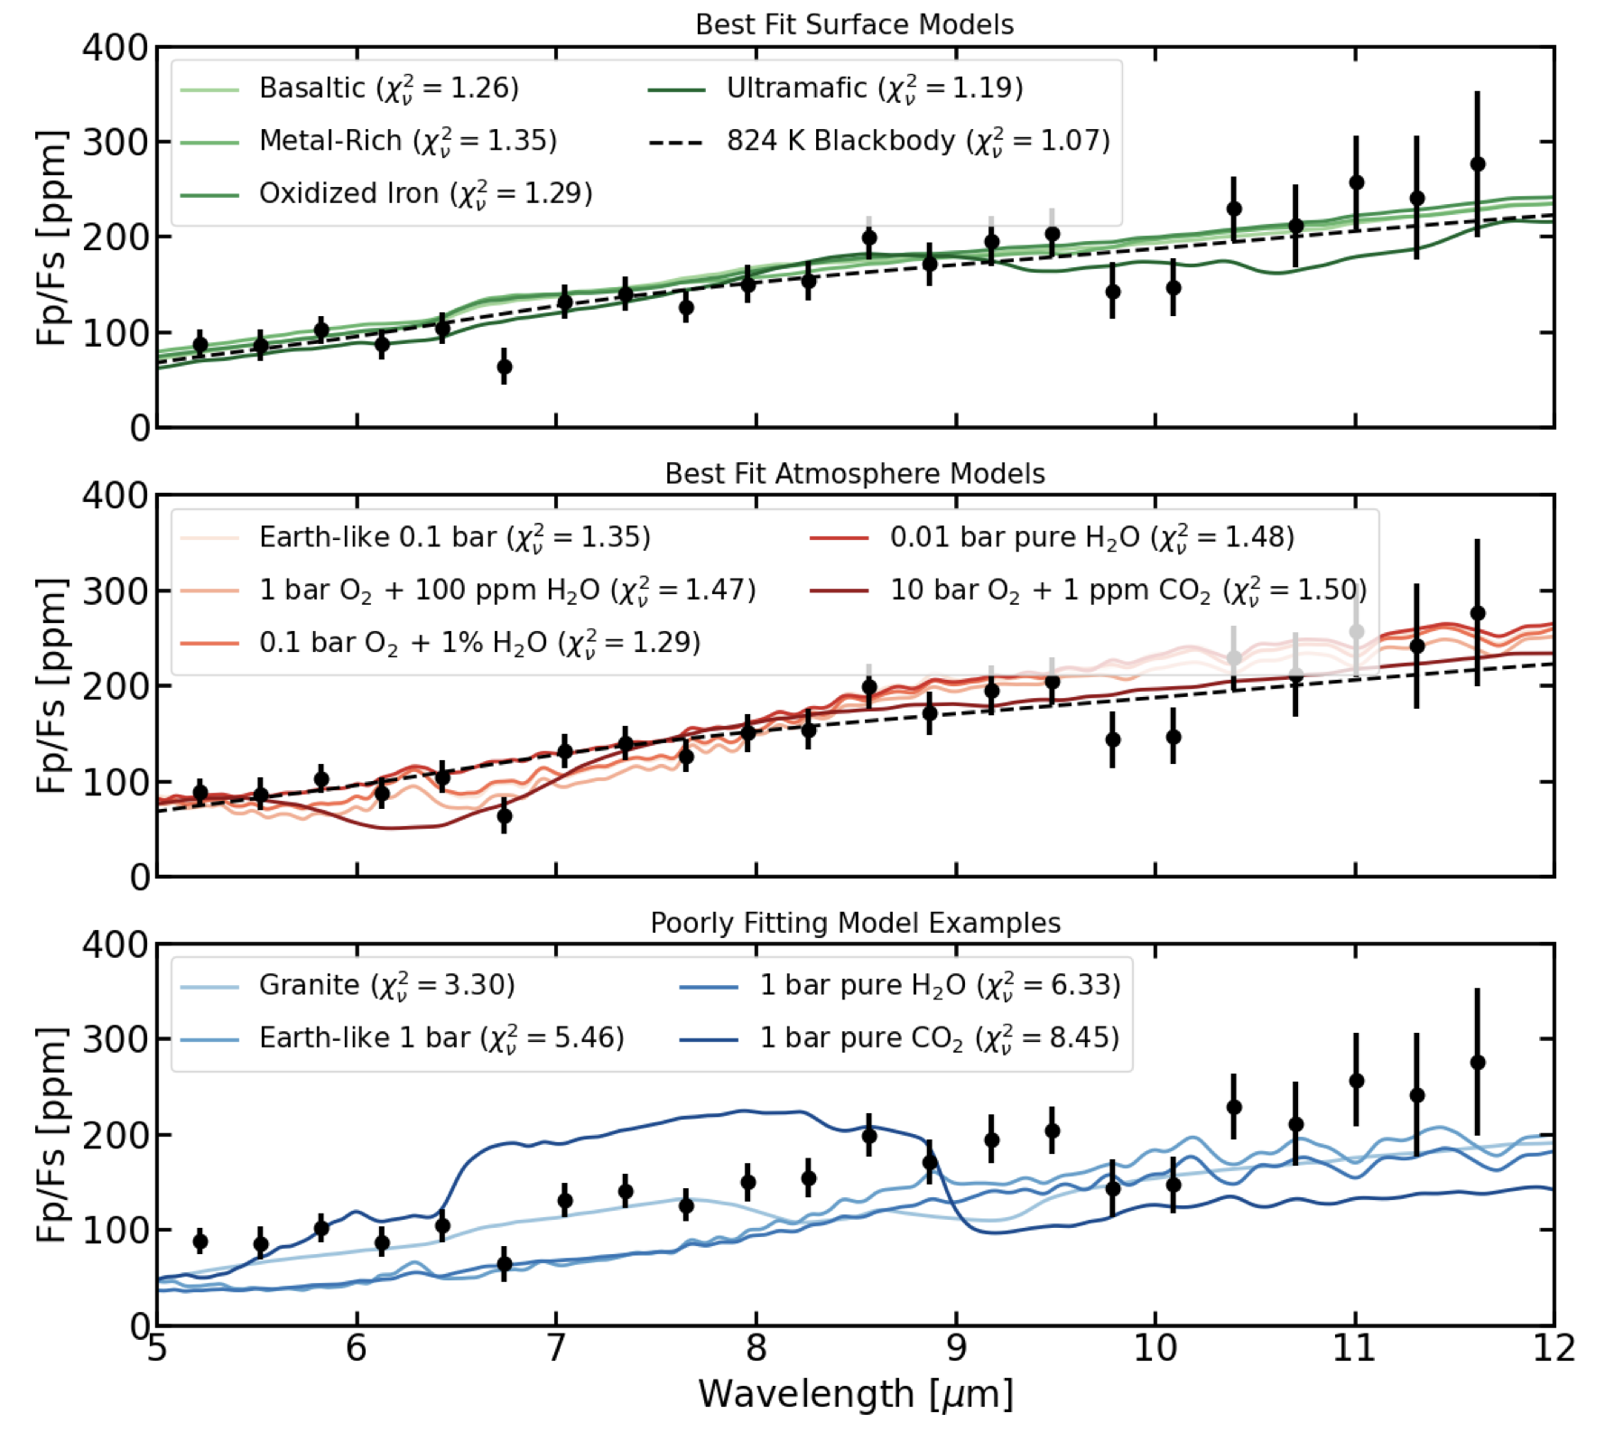
Gl 486 b: Observations vs Models
Dark, bare rocks match the observations…
…as do thin atmospheres…
…but not thick atmospheres or bright surfaces.
Weiner Mansfield+ (2024)

Slide 35
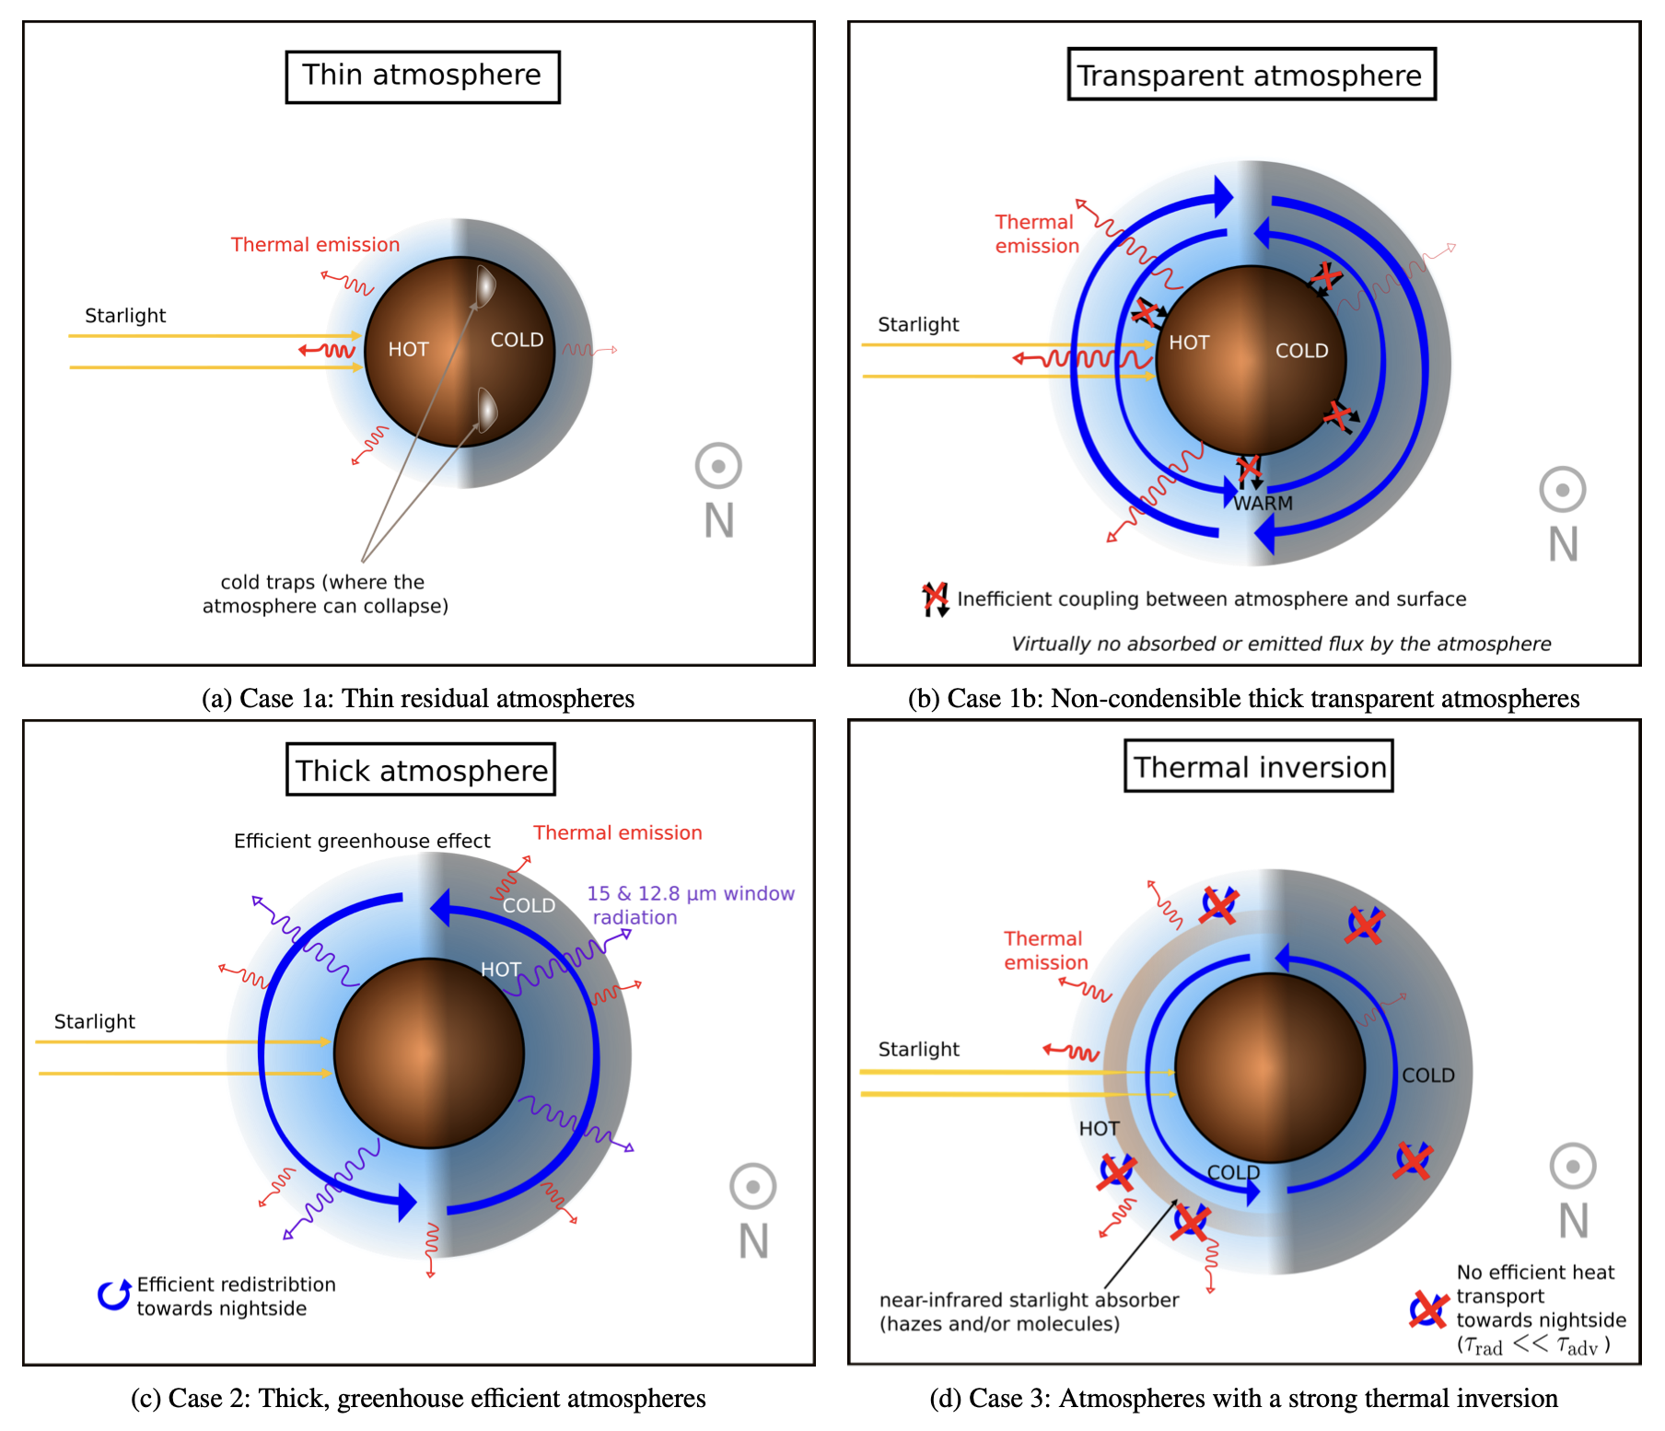
Challenges—False negatives for atmospheres
Can an atmosphere NOT lead to a cooler observed dayside?
Maybe. Depends on how exotic you believe these scenarios are.
Maurel+ (2025)

Slide 36
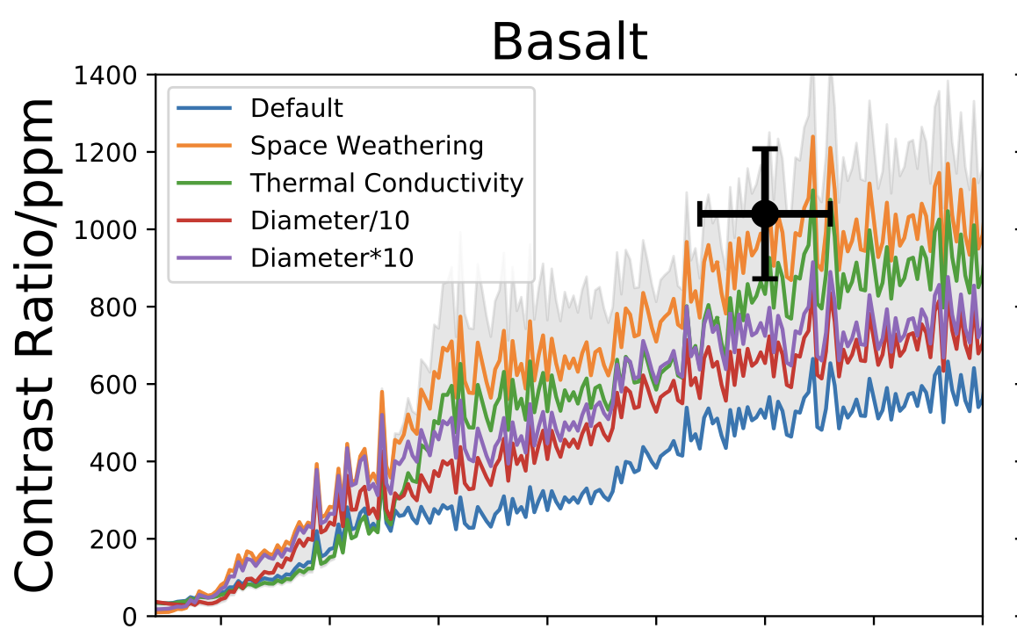

Challenges—False positives for atmospheres
Can a bare surface lead to a cooler observed dayside?
Probably. Surface processes are rather complicated.
Lyu+ (2025)

Slide 37
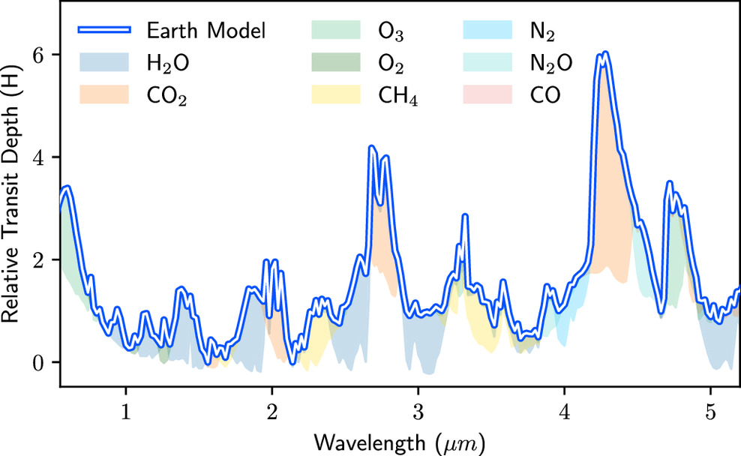
Modelling Exoplanet Atmospheres in Transmission
Lustig-Yaeger+ (2023)

Slide 38
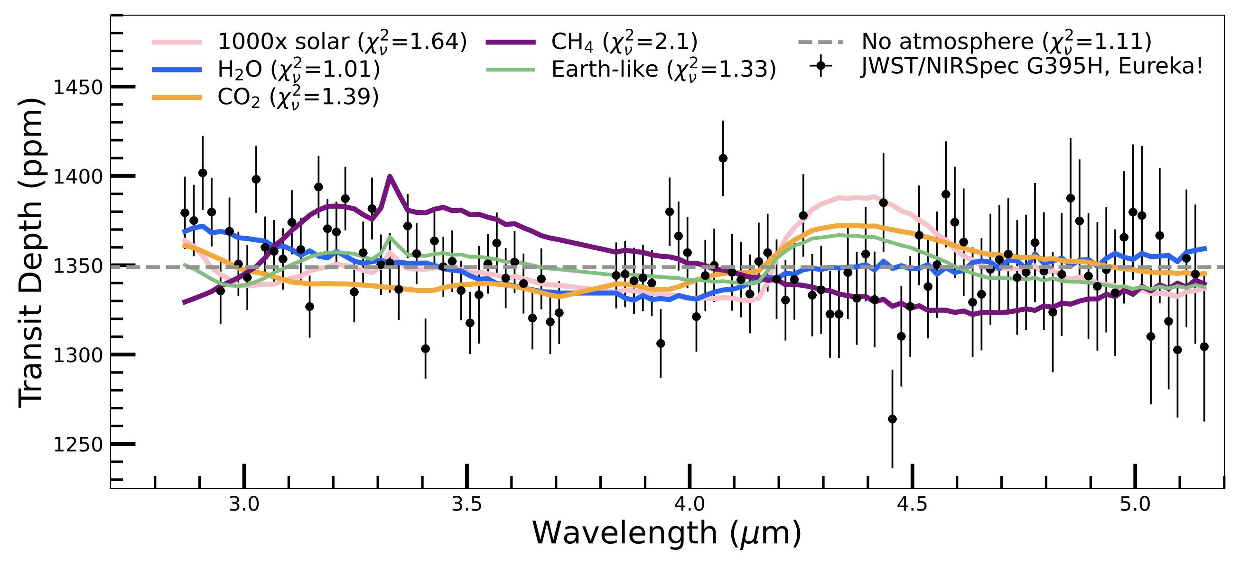
Gl 486 b: Observations vs Models
Moran & Stevenson+ (2023)
Transmission spectrum is consistent with no atmosphere or with an H₂O atmosphere

Slide 39
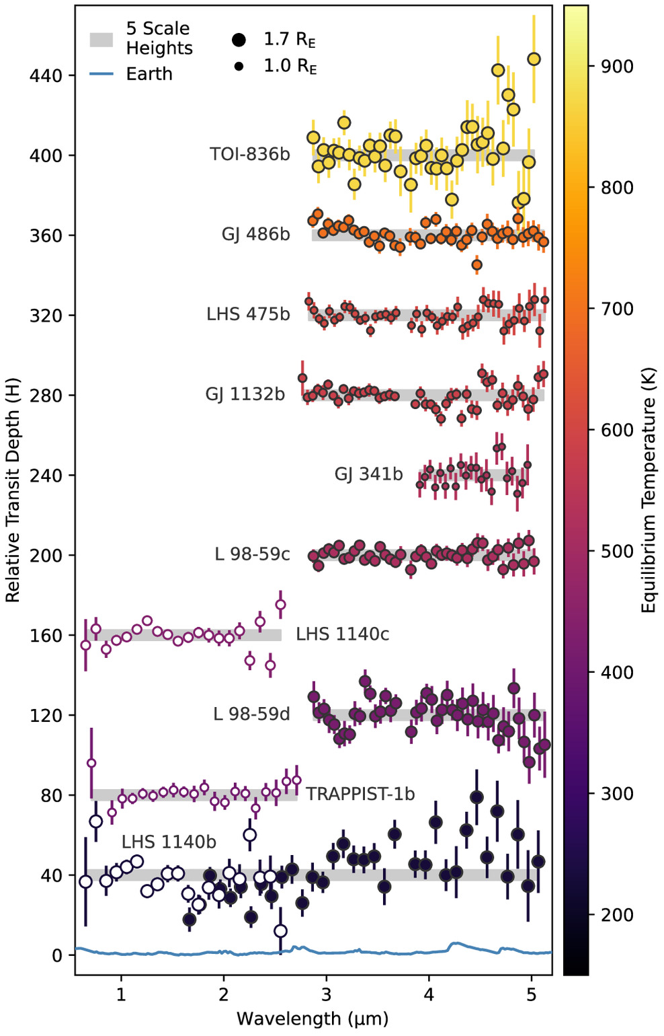
Challenges—Small Signal Size
Interpreting transmission spectra of rocky planets is intrinsically harder!
1
Planets are smaller
2
Atmospheres are more compact (made of heavier molecules)
Kreidberg & Stevenson (2025)

Slide 40
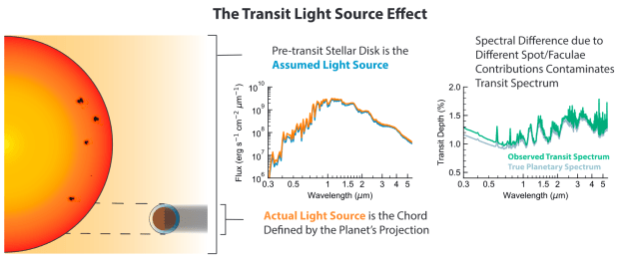
Challenges—Stellar Contamination
Rackham (2018)

Slide 41
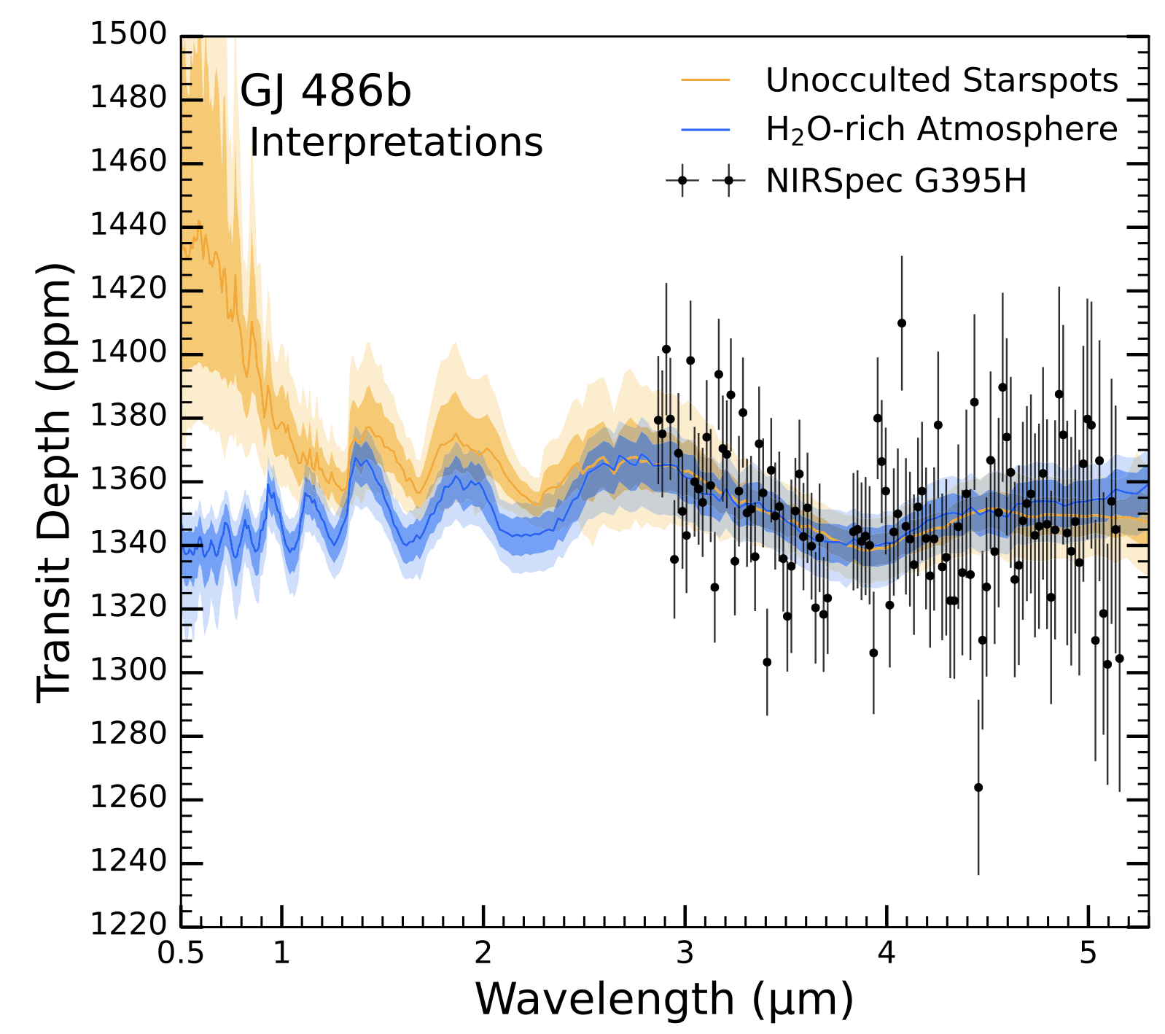
Challenges—Stellar Contamination
The spectral slope around 3 micron can be both explained by:
Stellar contamination
H₂O-rich atmosphere
Moran & Stevenson+ (2023)

Slide 42


Summary: how do we interpret observations?
1
Atmospheric and surface observations are interpreted by comparison to models.
Emission observations are sensitive to thermal structure. We look for atmospheres via looking for cooler dayside temperatures.
2
Transmission observations are sensitive to atmospheric chemical compositions. We look for atmospheres via looking for spectral features in the atmosphere.
3

Slide 43
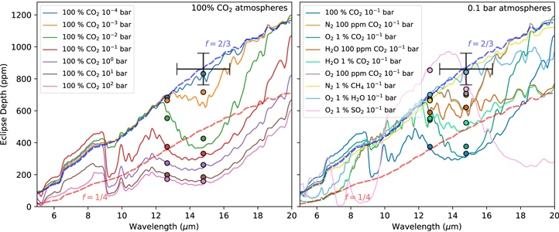
TRAPPIST-1 b: more atmospheres
1
2
Credit: Ih+23

Slide 44
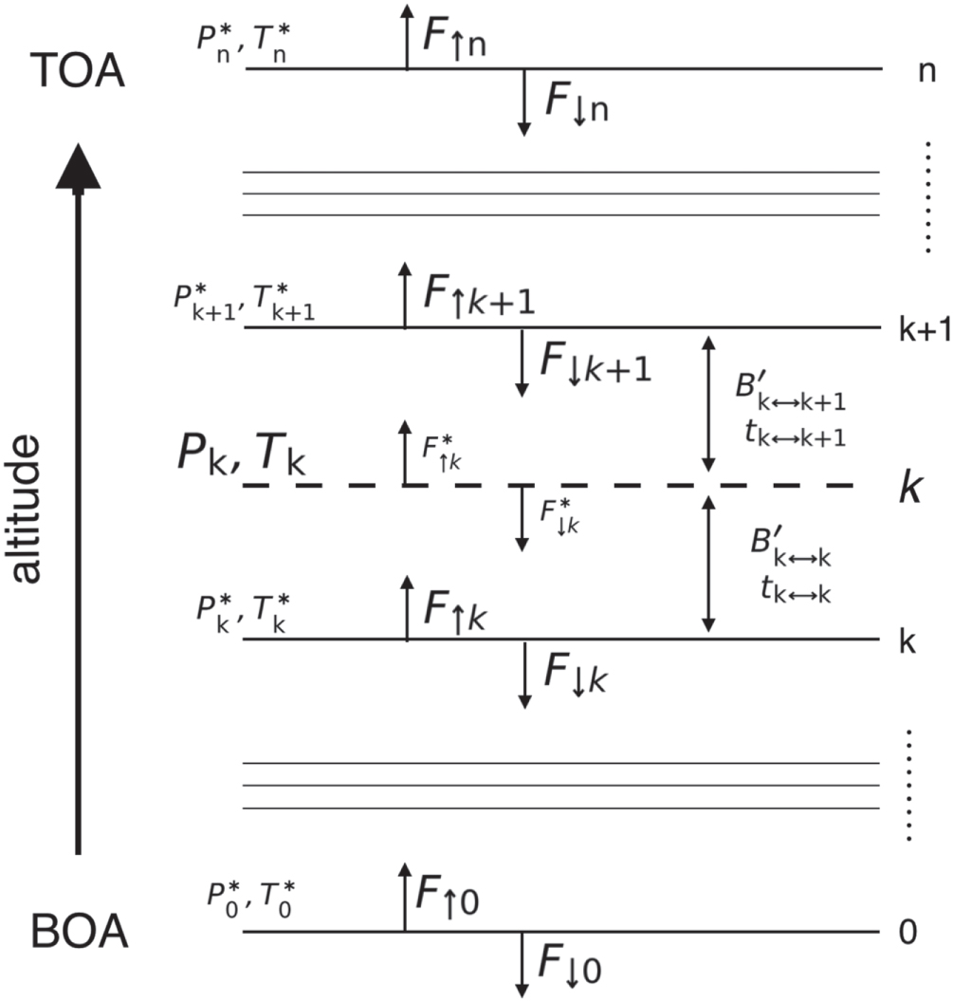
RCE: radiative equilibrium
Malik+19

Slide 45
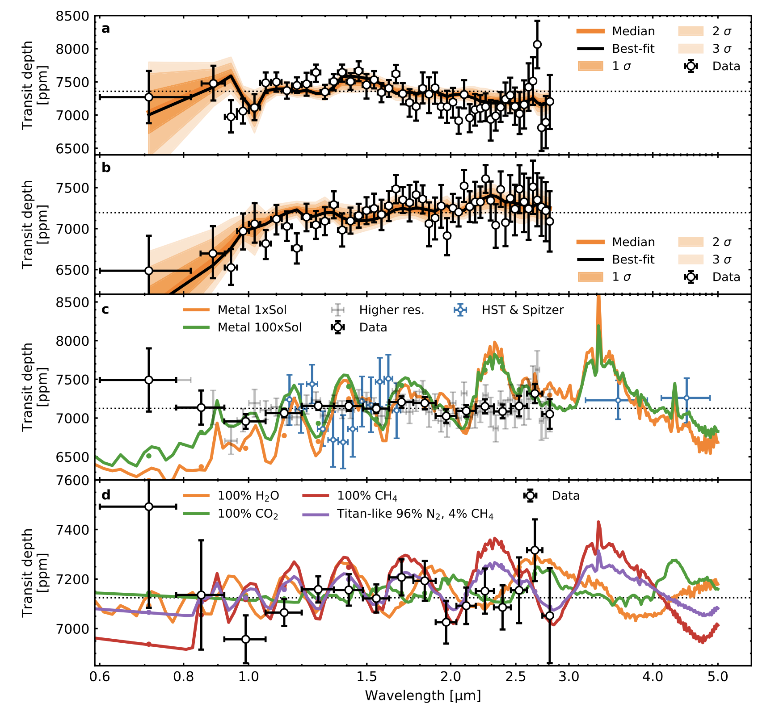
TRAPPIST-1 b: NIRISS Transmission
Credit: Lim+23

Slide 46
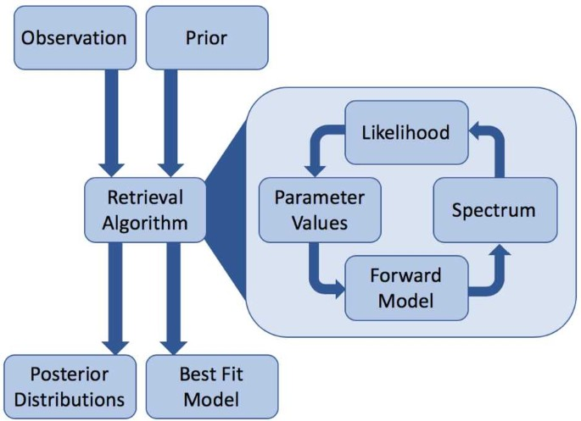
Retrieval schematics
Barstow+21

Slide 47
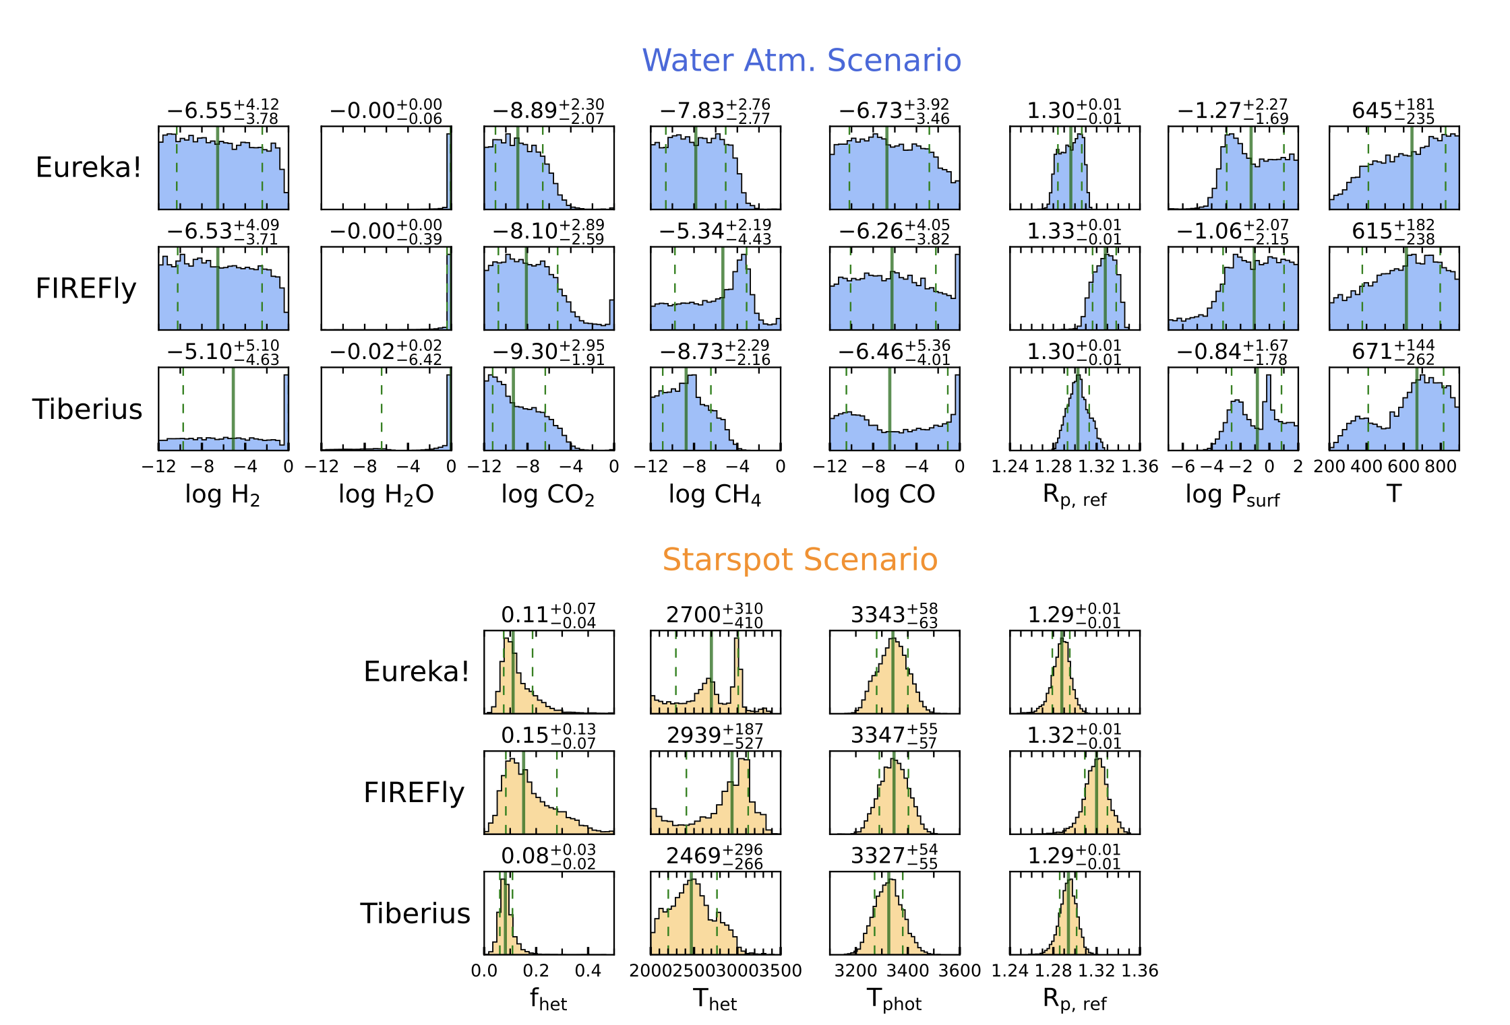
Gl 486 b: Retrieved posteriors

Slide 48



The Rocky Worlds DDT Program
Exploring the atmospheres of M dwarf rocky planets
Hannah Diamond-Lowe

Slide 49
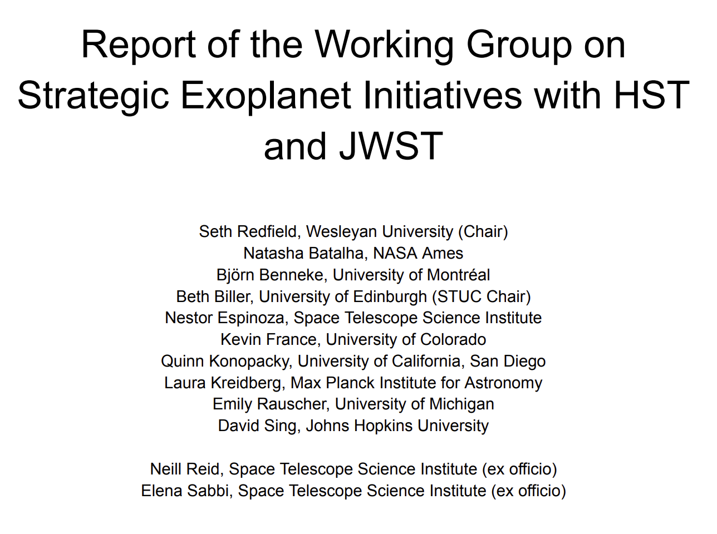
What is a “DDT” program?
A Director’s Discretionary Time (DDT) program is a big, bold initiative
The Rocky Worlds DDT was a direct recommendation from the…
Based on the results of
75 survey responses
42 white papers
3 town halls
from the
exoplanet research community
Redfield, et al., 2024

Slide 50
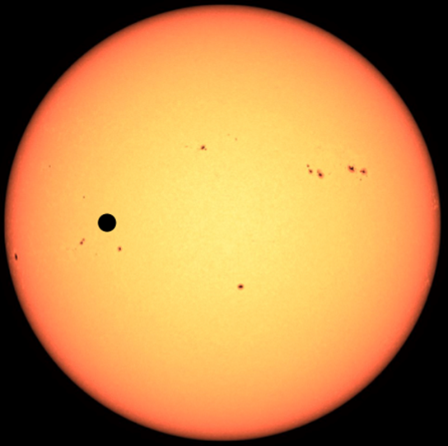
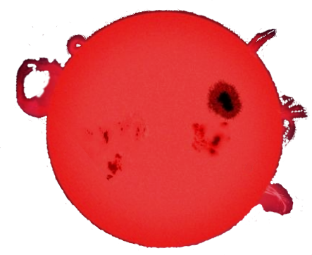


The “M dwarf Opportunity”
A rocky planet orbiting…
Few nearby
G stars
an M dwarf
a Sun-like star
Many nearby M dwarfs!
Large
signal
Small
signal

Slide 51
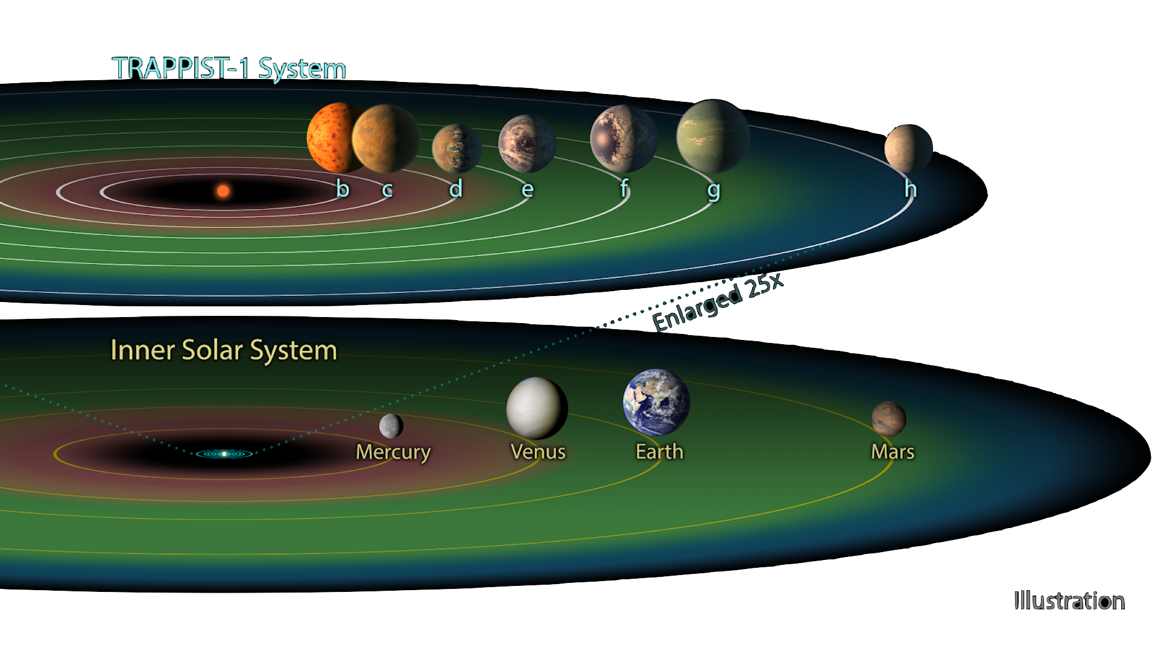
A great “M dwarf Opportunity”:
The TRAPPIST-1 System
The TRAPPIST-1 planets
7 rocky world
Orbital periods range from
36 hours to 20 days
Several planets in the “habitable zone”
Image adapted from NASA/JPL-Caltech

Slide 52
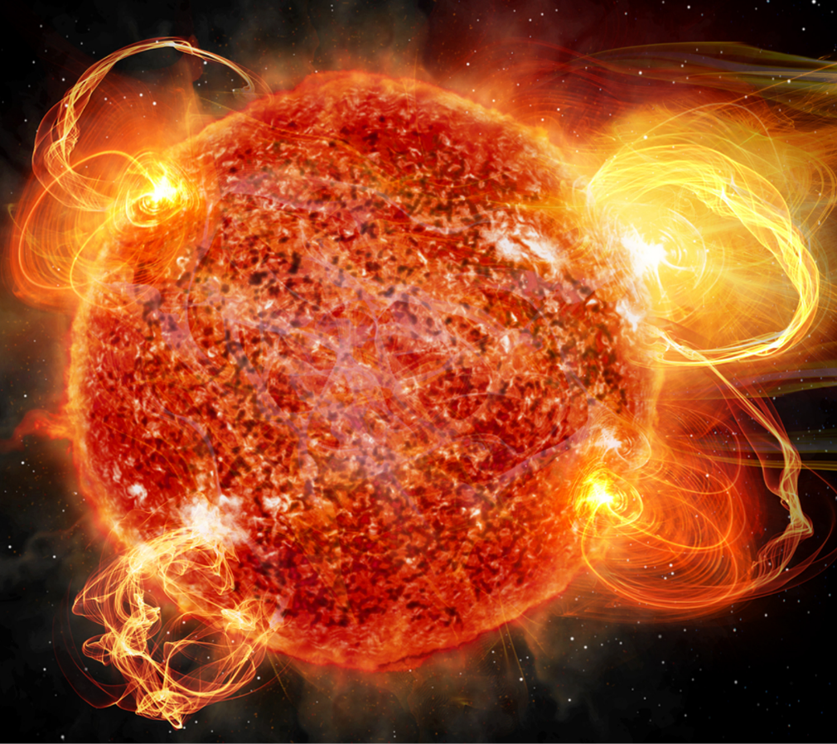
The “M dwarf Opportunity??”
M dwarfs are dangerous
Spend a long time in active states
Closely orbiting planets receive large amounts of high-energy radiation
We don’t know if M dwarf rocky planets can retain atmospheres
Image from the Keck Institute for Space Studies Report on Planetary Magnetic Fields: Planetary Interiors and Habitability

Slide 53
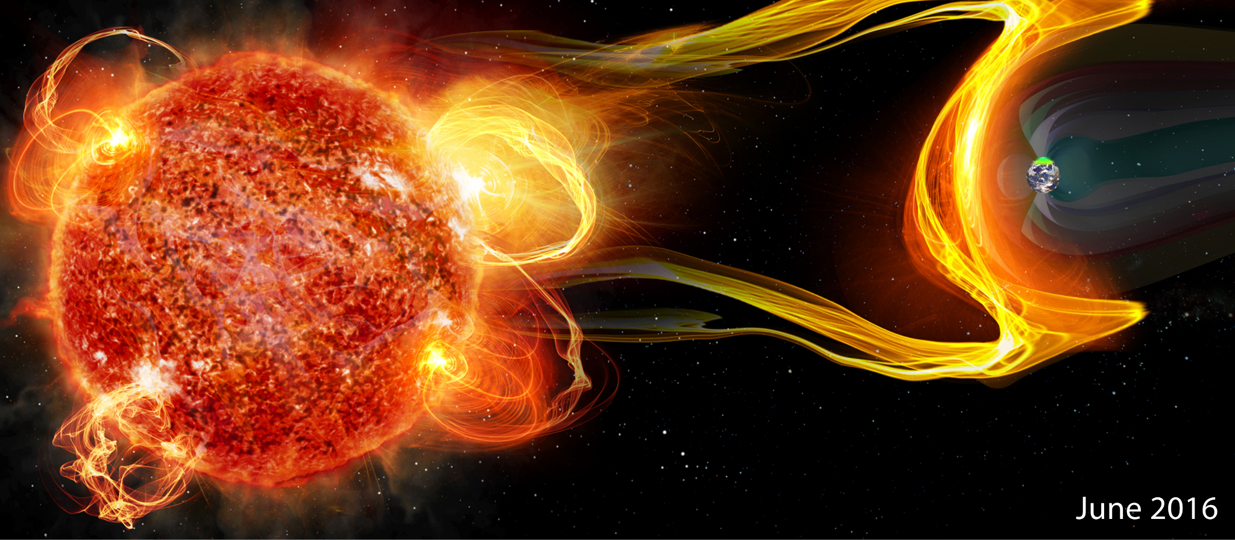
The “M dwarf Opportunity??”
Do rocky planet atmospheres survive M dwarf hosts?
Image from the Keck Institute for Space Studies Report on Planetary Magnetic Fields: Planetary Interiors and Habitability

Slide 54
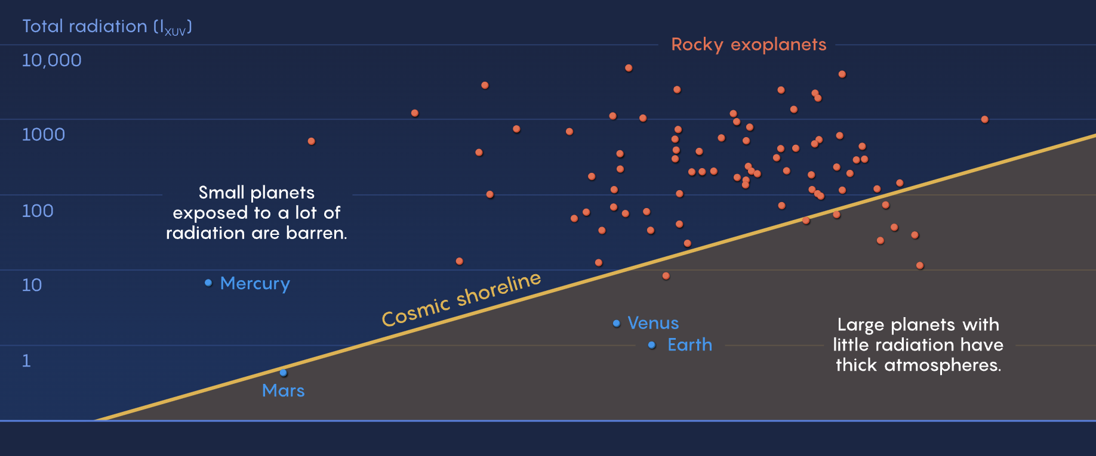
Introducing the Cosmic Shoreline
Image adapted from Mark Belan/Quanta Magazine | Source: STScI

Slide 55
Introducing the Cosmic Shoreline
Solar System
Image adapted from Mark Belan/Quanta Magazine | Source: STScI

Slide 56
Introducing the Cosmic Shoreline
M dwarf
Solar System
Image adapted from Mark Belan/Quanta Magazine | Source: STScI

Slide 57

Introducing the Cosmic Shoreline
M dwarf
Solar System
Image adapted from Mark Belan/Quanta Magazine | Source: STScI

Slide 58
How do we hunt for atmospheres?
Observing rocky worlds in secondary eclipse

Slide 59
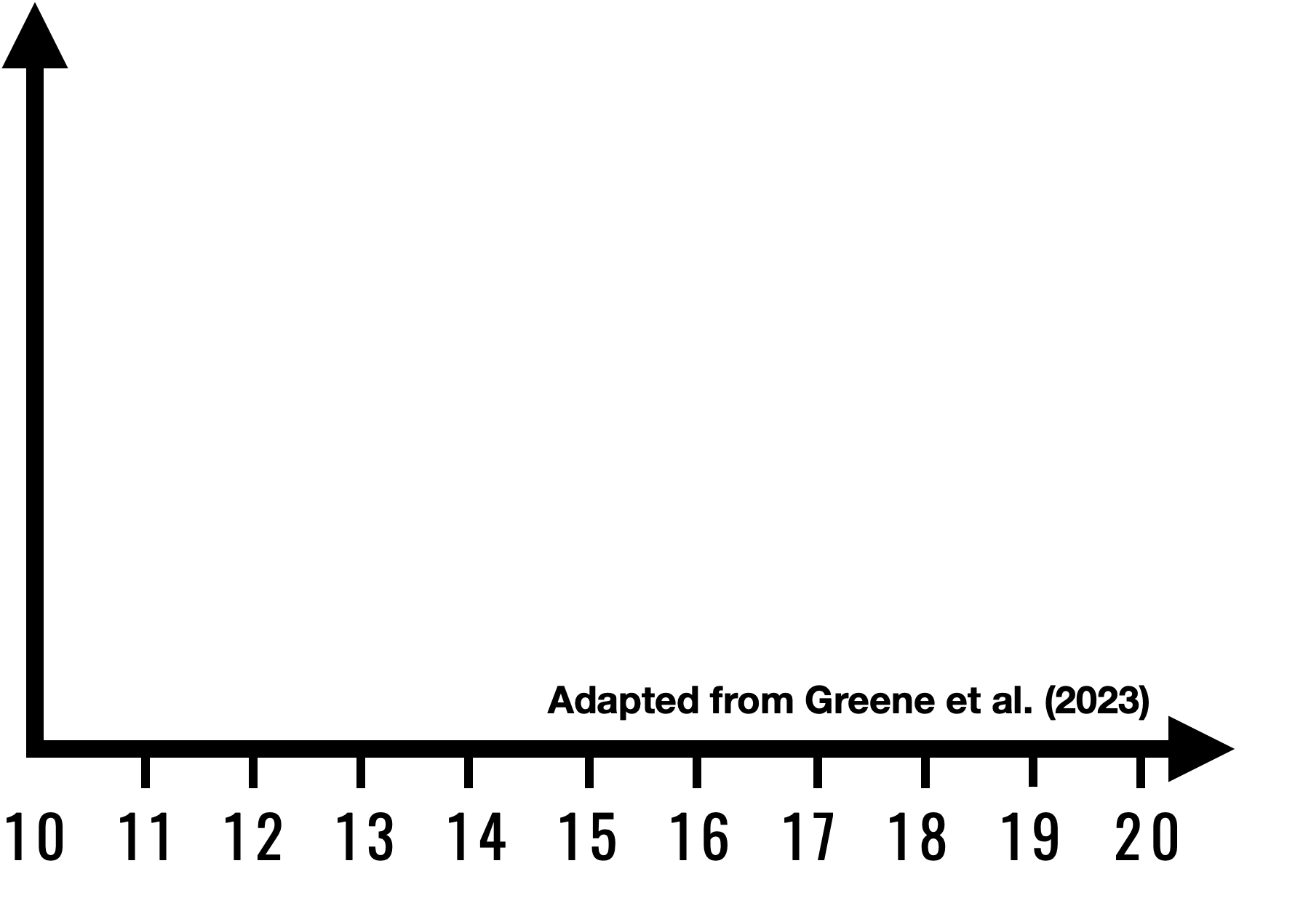

How do we hunt for atmospheres?
Observing rocky worlds in secondary eclipse
Koll+2019, Mansfield+2019
Exoplanet’s
Dayside Flux
Dayside Flux
Wavelength (microns)

Slide 60
How do we hunt for atmospheres?
Observing rocky worlds in secondary eclipse
Koll+2019, Mansfield+2019
Exoplanet’s
Dayside Flux
Case 1: high dayside flux
Dayside Flux
Wavelength (microns)

Slide 61

How do we hunt for atmospheres?
Observing rocky worlds in secondary eclipse
Koll+2019, Mansfield+2019
Exoplanet’s
Dayside Flux
Case 1: high dayside flux
Dayside Flux
Eclipse
BIG DEPTH
Normalized Flux
Likely a rock
Wavelength (microns)
Time

Slide 62
How do we hunt for atmospheres?
Observing rocky worlds in secondary eclipse
Koll+2019, Mansfield+2019
Exoplanet’s
Dayside Flux
Case 1: high dayside flux
Case 2: low dayside flux
Dayside Flux
Eclipse
Normalized Flux
Wavelength (microns)
Time

Slide 63
How do we hunt for atmospheres?
Observing rocky worlds in secondary eclipse
Koll+2019, Mansfield+2019
Energy recirculation
Exoplanet’s
Dayside Flux
Case 1: high dayside flux
Case 2: low dayside flux
Dayside Flux
Eclipse
Normalized Flux
Wavelength (microns)
Time

Slide 64
How do we hunt for atmospheres?
Observing rocky worlds in secondary eclipse
Koll+2019, Mansfield+2019
Energy recirculation
Exoplanet’s
Dayside Flux
Case 1: high dayside flux
Case 2: low dayside flux
Dayside Flux
Eclipse
SMALL DEPTH
Normalized Flux
Likely an
atmosphere
Wavelength (microns)
Time

Slide 65
How do we hunt for atmospheres?
Observing rocky worlds in secondary eclipse
Koll+2019, Mansfield+2019
Energy recirculation
Exoplanet’s
Dayside Flux
Case 1: high dayside flux
Case 2: low dayside flux
Dayside Flux
15μm CO2 bonus
Eclipse
SMALLER DEPTH
Normalized Flux
More likely an
atmosphere
Wavelength (microns)
Time

Slide 66

How do we hunt for atmospheres?
Observing rocky worlds in secondary eclipse
Energy recirculation
Exoplanet’s
Dayside Flux
Eclipse
JWST will get
eclipses at 15 μm
SMALLER DEPTH
Normalized Flux
More likely an
atmosphere
To answer: is it an atmosphere or bare rock?
Time

Slide 67


How do we monitor the host stars?
Observing M dwarf hosts in the ultraviolet
Exoplanet’s
Dayside Flux
Example of an
M dwarf flare
observed in the UV
HST will get stellar
UV irradiation
To answer: why is it an atmosphere or bare rock?

Slide 68


Focus on secondary eclipses
of rocky exoplanets
orbiting M dwarfs
JWST MIRI
HST UV
To characterize the host stars
To characterize the exoplanets
+
rockyworlds.stsci.edu

Slide 69

ADDITIONAL RESOURCES
Exploring the Science
Rocky Worlds Director’s Discretionary Time (DDT) Program
Looking for atmospheres of rocky planets around red dwarf stars.
Can Rocky Worlds Orbiting Red Dwarf Stars Maintain Atmospheres?
Explainer article about the Rocky Worlds DDT program.
NASA Exoplanet Catalog
6,000+ confirmed exoplanets with visualizations and data.
NASA, ESA, CSA, J. Olmsted (STScI), T. P. Greene (NASA Ames), T. Bell (BAERI), E. Ducrot (CEA), P. Lagage (CEA)

Slide 70

ADDITIONAL RESOURCES
Digging into Data
DIY Planet Search
Analyze star images, make light curves, look for transiting planets.
Eyes on Exoplanets
Explore a 3D data base of 6,000+ exoplanets and their star systems.
Sonification of Webb's Transmission Spectrum of Exoplanet WASP-96 b
An exoplanet’s atmospheric spectrum turned into sound.
NASA/Ames

Slide 71

ADDITIONAL RESOURCES
Doing Activities
Exoplanet Detectives: A Transit Method Activity
Explore how planets passing in front of their stars can block starlight.
Make Your Own Exoplanet Model
Design and create a planet based on plausible descriptions.
Exoplanet Variety
Manipulate Viewspace sliders to learn about different kinds of exoplanets.
NASA/UoL

Slide 72

ADDITIONAL RESOURCES
Linking to Resources
30 Years of Exoplanets: Facilitators Guide
Use a narrative and targeted resources to guide learners’ understanding of exoplanets.
Cosmic Canvas: Exoplanets Program Guide & Resources
Combine art and science to understand exoplanets.
Other Solar Systems, Other Earths Resource Guide
Extensive links to a variety of resources.
NASA/ESA/G. Bacon(STScI)

Slide 73

ADDITIONAL RESOURCES
December 4 Science Briefing Page
Find additional resources here.
NASA

Slide 74

Feedback?
Your responses help our team to better support you in your work as an educator
https://bit.ly/SciBriefPOST

