Slide 1
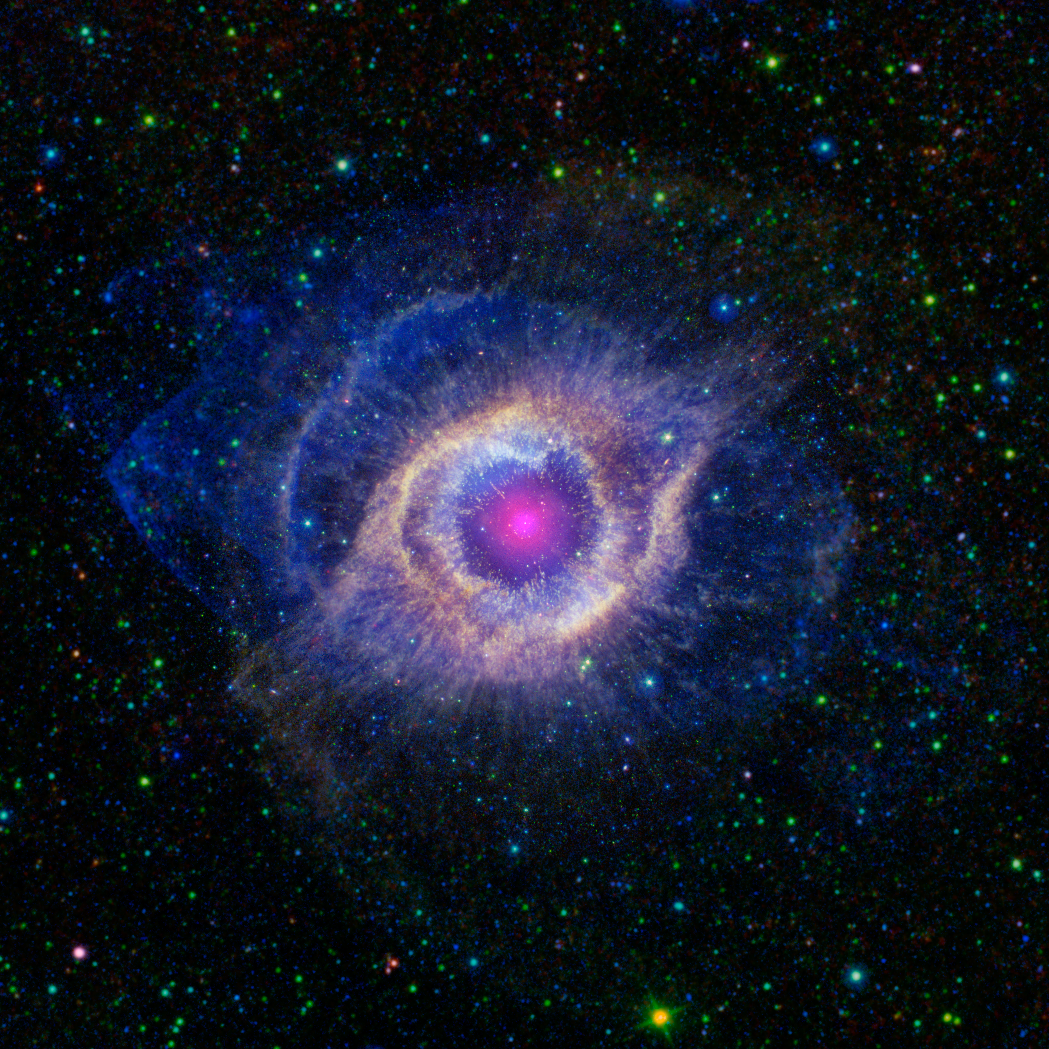
The Electromagnetic Spectrum
Image credit: NASA/JPL-Caltech/SSC/STScI(M. Meixner)/ESA/NRAO(T.A. Rector)/K. Su
Notes:
1. Onscreen before presentation begins and during introduction
These slides are available for you to customize for your presentation. Please feel free to add or remove slides as necessary to tailor the presentation for your event.
In this notes pane area you will find key points that for each slide, as well as links to additional background information.
Participant Takeaway Points:
Participants will learn during this presentation that:
There are different types of light
Our eyes can only see a type of light called “visible” light
The electromagnetic spectrum contains all types of light: Gamma rays, X-rays, ultraviolet light, visible light, infrared light, microwaves, and radio waves
Objects in the universe can emit different types of light
Objects in the universe can appear differently when detected using different kinds of light
Light is how astronomers gather information from objects in space. Telescopes are designed to detect specific types of light
Light can carry information about an object’s composition, temperature, movement, and other characteristics
By studying astronomical objects in different types of light (multiwavelength astronomy), we can learn more about them
More Background Information:
Program Theme - The Electromagnetic Spectrum https://www.universe-of-learning.org/contents/products/program-theme-1-electromagnetic-spectrum
Spectrum Overview - NASA: https://www.nasa.gov/directorates/somd/space-communications-navigation-program/spectrum-overview/
NASA Tour of the Electromagnetic Spectrum: https://science.nasa.gov/ems
Image source: https://www.astropix.org/image/spitzer/sig12-011
Last Updated: December 2024

Slide 2
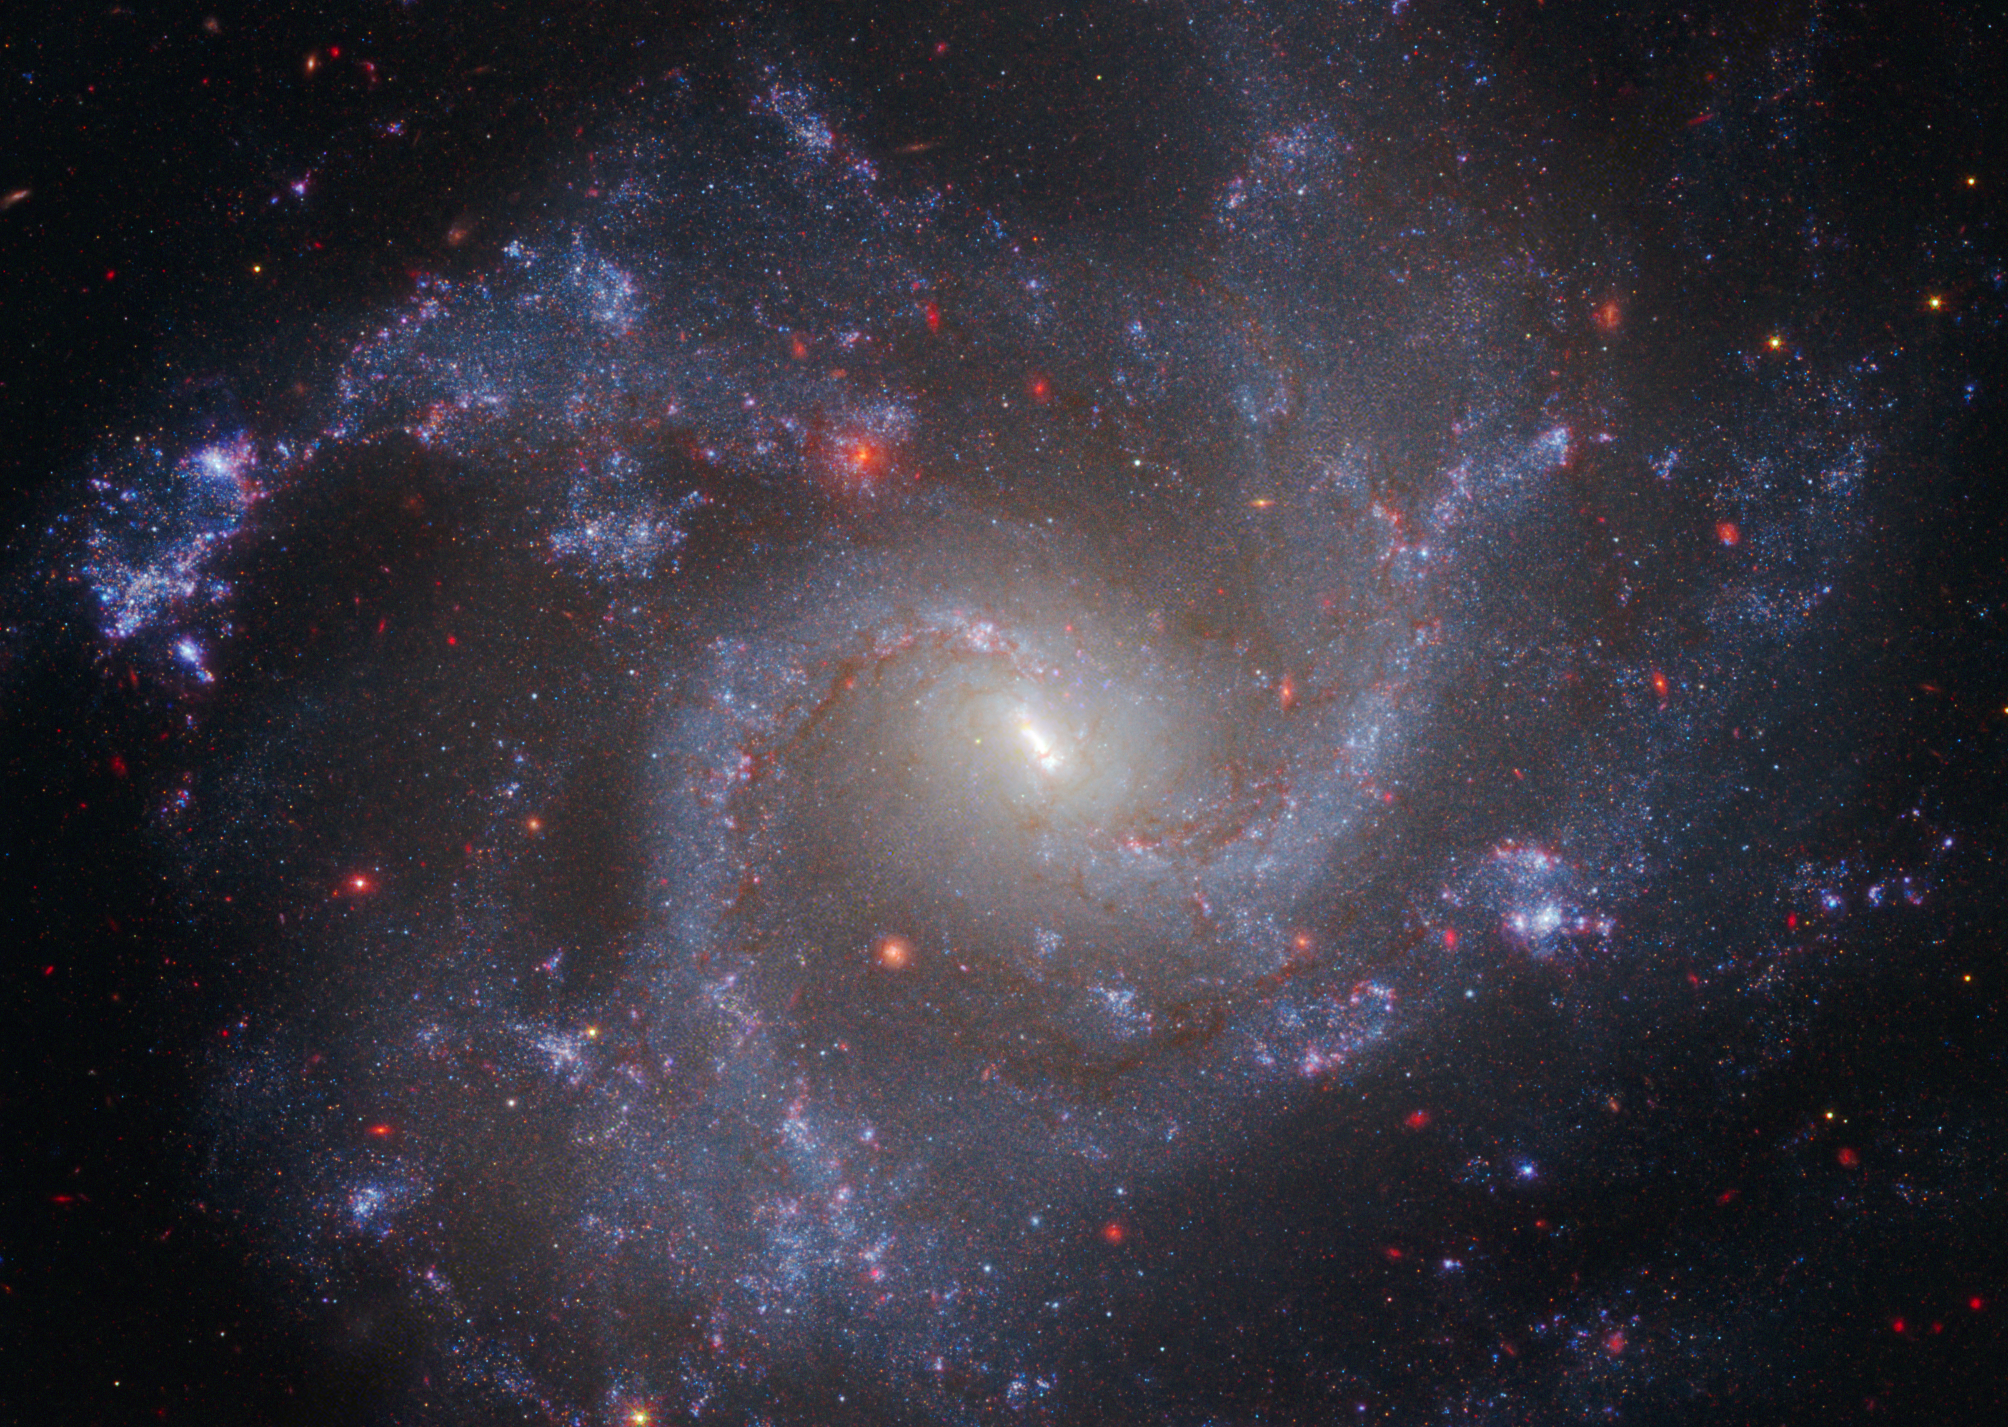
Light is energy that moves in waves
Light (electromagnetic radiation) is a form of energy made of photons that travels in extremely fast waves
Light from objects (like the galaxy shown here) travels great distances to reach Earth
Image credit: NASA, ESA, CSA, STScI, Adam G. Riess (JHU, STScI)
Notes:
2. Introduce the concept
Key points to address:
Light, or electromagnetic radiation, can be described as a stream of tiny packets of energy, called photons. Light travels in waves, similar to the undulating waves you find in the ocean, but light waves move extremely quickly. In fact, light travels up to about 300,000 kilometers, or 186,000 miles, per second, which means it could circle the Earth 7.5 times in only one second!
Fun Fact: Despite traveling so fast, light can still take billions of years to travel from other galaxies to Earth because of how far away they are. Light from the spiral galaxy shown on this slide, called NGC 5468, took about 130 million years to reach us.

Slide 3
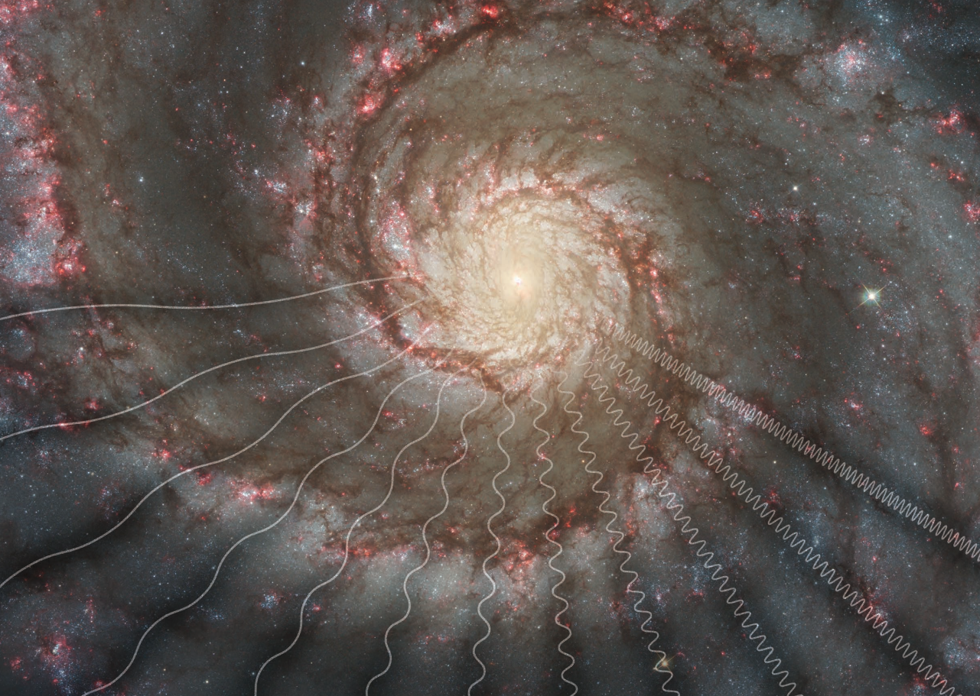
Electromagnetic Radiation
Key Vocabulary
A form of energy that travels through space as waves; also called radiation or light.
Image credit: NASA, ESA, STScI
Notes:
3. Define vocabulary
Electromagnetic radiation: A form of energy that travels through space as waves; also called radiation or light.
Image description: This image shows the Whirlpool Galaxy in visible light, as seen by the Hubble Space Telescope. The wavy lines have been added on top of the image to represent electromagnetic radiation, or light waves, travelling from the distant galaxy.
Image source: https://www.universe-of-learning.org/files/live/sites/uol/files/home/resources/resource-catalog/_documents/EMSPosterCombined2012.pdf

Slide 4
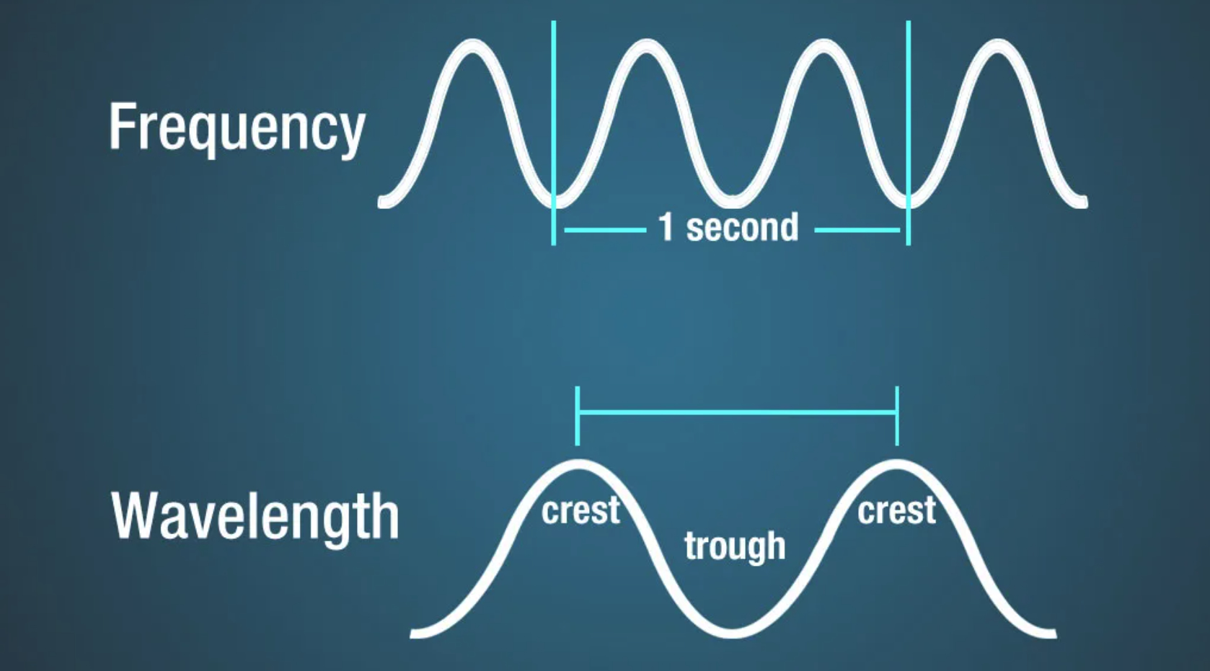
Light waves vary in length (wavelength) and frequency
Image credit: NASA, Science Mission Directorate (2010)
Notes:
4. Wave properties
Key points to address:
Light waves vary in wavelength (the distance from the crest of one wave to the crest of the next) and frequency (the number of waves that pass by a specific point per unit of time, generally in one second).
More Background Information:
Anatomy of an Electromagnetic Wave – NASA: https://science.nasa.gov/ems/02_anatomy/

Slide 5
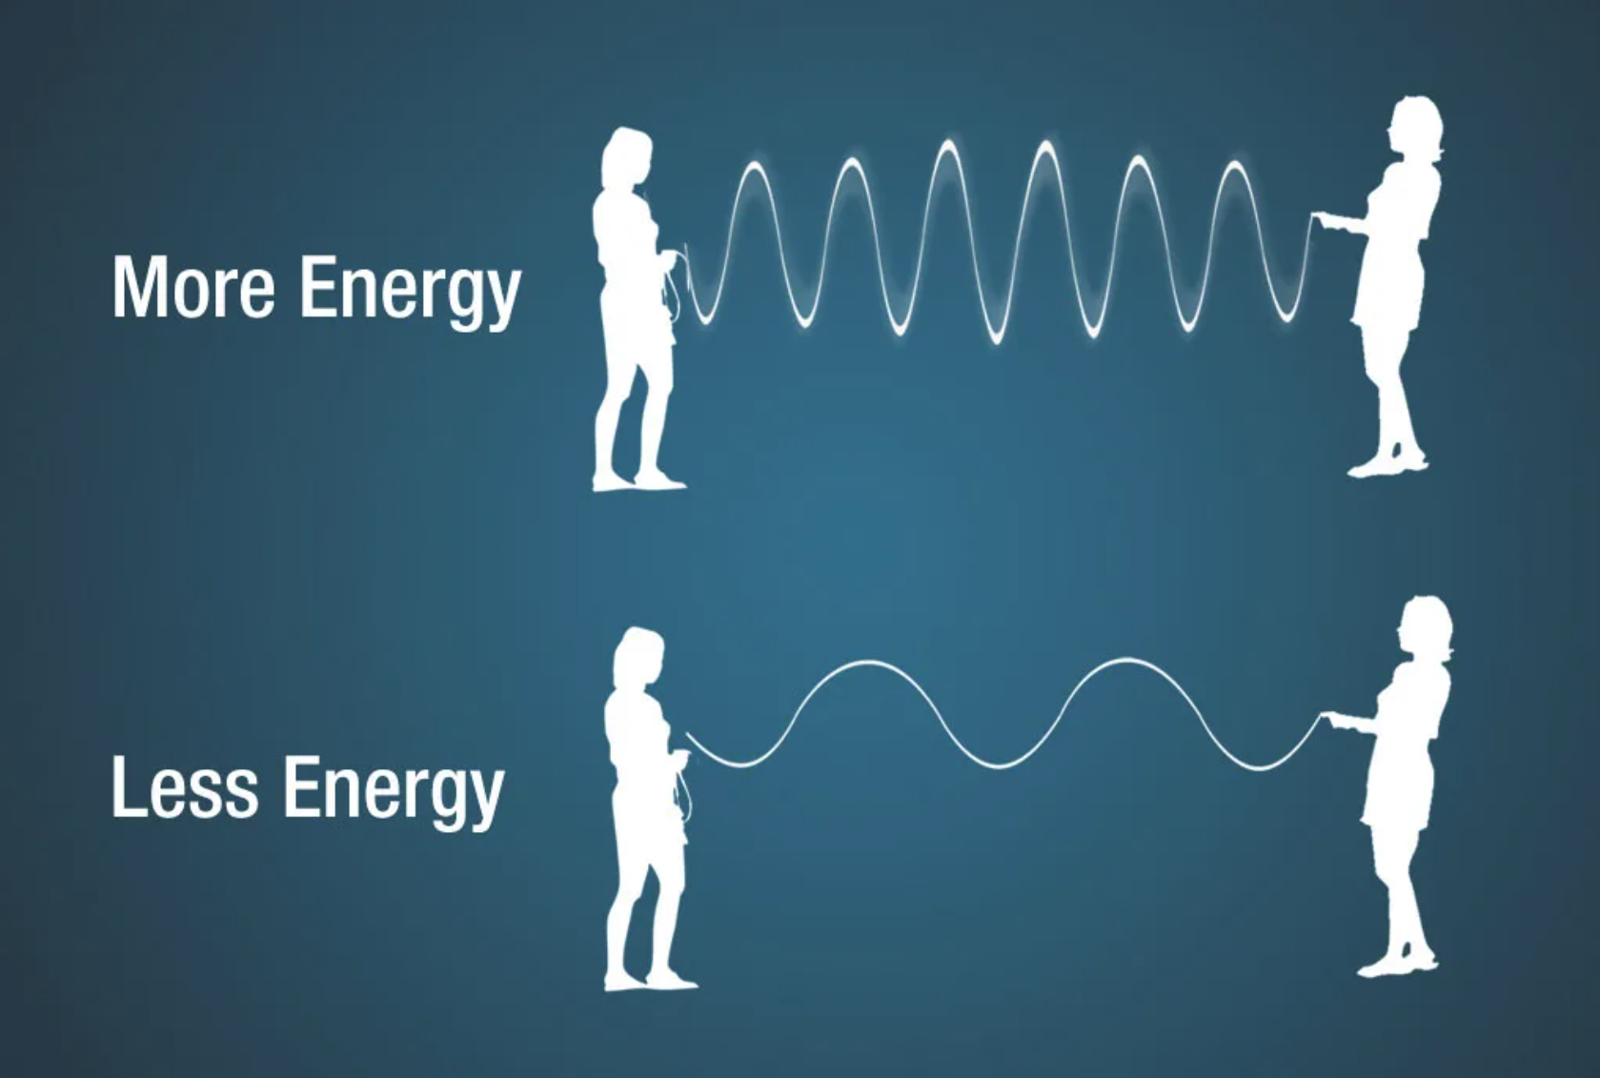
Light with shorter wavelengths (higher frequency) carries more energy
Image credit: NASA, Science Mission Directorate (2010)
Notes:
5. Wave Properties (cont.)
Key points to address:
Light traveling as shorter wavelengths has higher frequency, and carries more energy.
Consider this scenario (as shown on the slide)… you and a friend are each holding one end of a rope. While one of you keeps your end steady, the other moves their end up and down, causing waves to travel along the rope. If you want to make more waves along the rope, you'll need to move your end up and down faster, requiring more energy. This represents a high frequency of waves.
More Background Information:
Anatomy of an Electromagnetic Wave – NASA: https://science.nasa.gov/ems/02_anatomy/
Image source: https://science.nasa.gov/ems/02_anatomy/

Slide 6
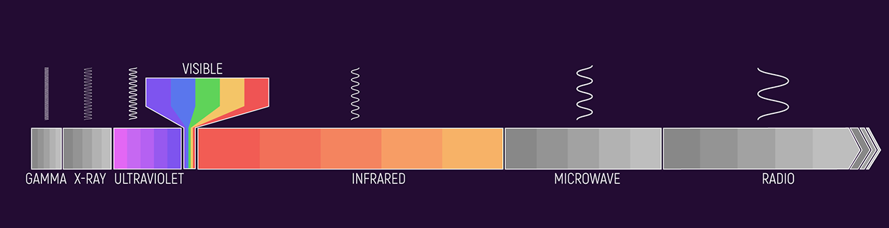
The electromagnetic spectrum contains all types, or wavelengths, of light.
Image credit: NASA, ESA, CSA, Joseph Olmsted (STScI)
Notes:
6. Different types of light
Key points to address:
The electromagnetic spectrum contains all types, or wavelengths, of light.
From the shortest to the longest wavelengths of light (shown from left to right in the diagram above), the electromagnetic spectrum includes: 1) gamma rays, 2) X-rays, 3) ultraviolet (or “UV”) light, 4) visible light, 5) infrared light, 6) microwaves, and 7) radio waves.
On Earth, objects like fireflies and lightbulbs give off, or emit, light, and materials like water and mirrors can reflect light from other sources. Objects in space – such as distant stars and planets - can also emit and/or reflect light. Emitted and reflected light travels across space and can be detected on Earth or by telescopes in space.
Different wavelengths of light carry different information, so this spectrum is the main tool astronomers use to study faraway objects.
Since we are not able to travel to other stars or take samples from faraway planets, we depend on electromagnetic radiation — light — to carry information to us.
More Background Information:
Spectroscopic Observations of Different Wavelengths of Light in Astronomy: https://science.nasa.gov/asset/webb/spectroscopic-observations-of-different-wavelengths-of-light-in-astronomy/
Image source: https://science.nasa.gov/asset/webb/spectroscopic-observations-of-different-wavelengths-of-light-in-astronomy/

Slide 7
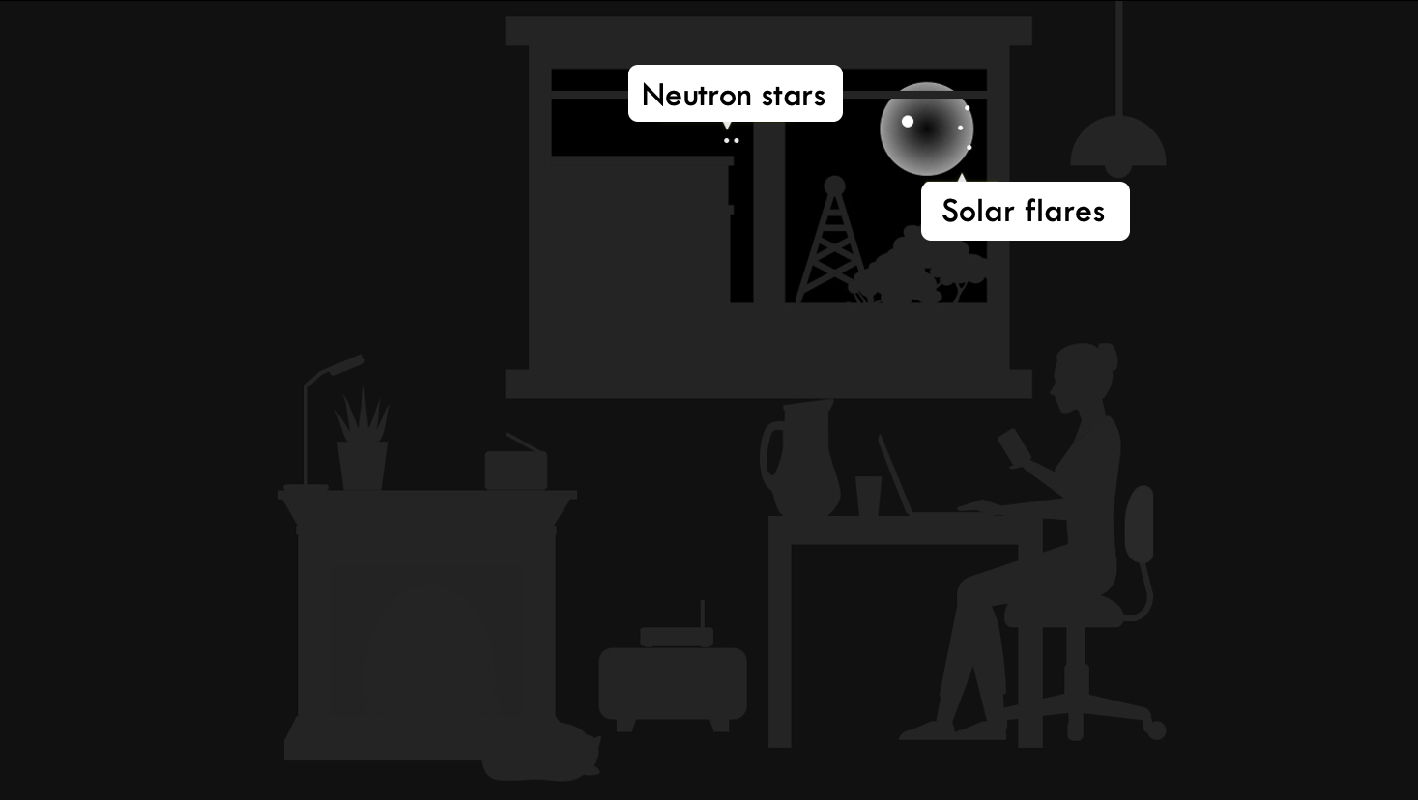
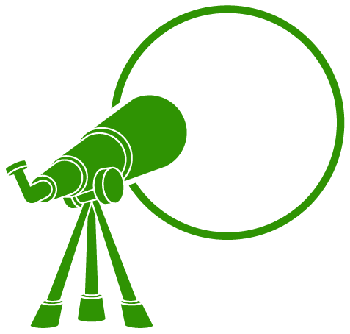





Gamma rays
Other Astrophysical Phenomena
Accretion around black holes and cosmic rays
Image credit: ViewSpace.org
Notes:
7. Gamma Rays
In the following slides, we explain the different types of light (or electromagnetic radiation) in the electromagnetic spectrum.
We start with the wavelengths with higher frequencies, and therefore shorter wavelengths.
Key points to address:
The different types of light each have distinct properties and behaviors.
Gamma rays are the shortest and most energetic wavelengths of light. On Earth, lightning storms can produce gamma rays, and doctors sometimes use devices that emit gamma rays to look for and treat cancer.
In space, every so often eruptions of energy from the Sun, called solar flares, can be energetic enough to emit gamma rays. Gamma rays are also produced by the hottest and most energetic objects in the universe, like exploding stars, colliding neutron stars and powerful winds launched near black holes.
More Background Information:
What’s Made in a Thunderstorm and Faster Than Lightning? Gamma Rays! – NASA: https://science.nasa.gov/universe/whats-made-in-a-thunderstorm-and-faster-than-lightning-gamma-rays/
Gamma Rays – NASA: https://science.nasa.gov/ems/12_gammarays/
Radiation from Solar Activity – NASA: https://www.epa.gov/radtown/radiation-solar-activity
Image source: https://viewspace.org/interactives/unveiling_invisible_universe/forms_of_light/electromagnetic_spectrum

Slide 8
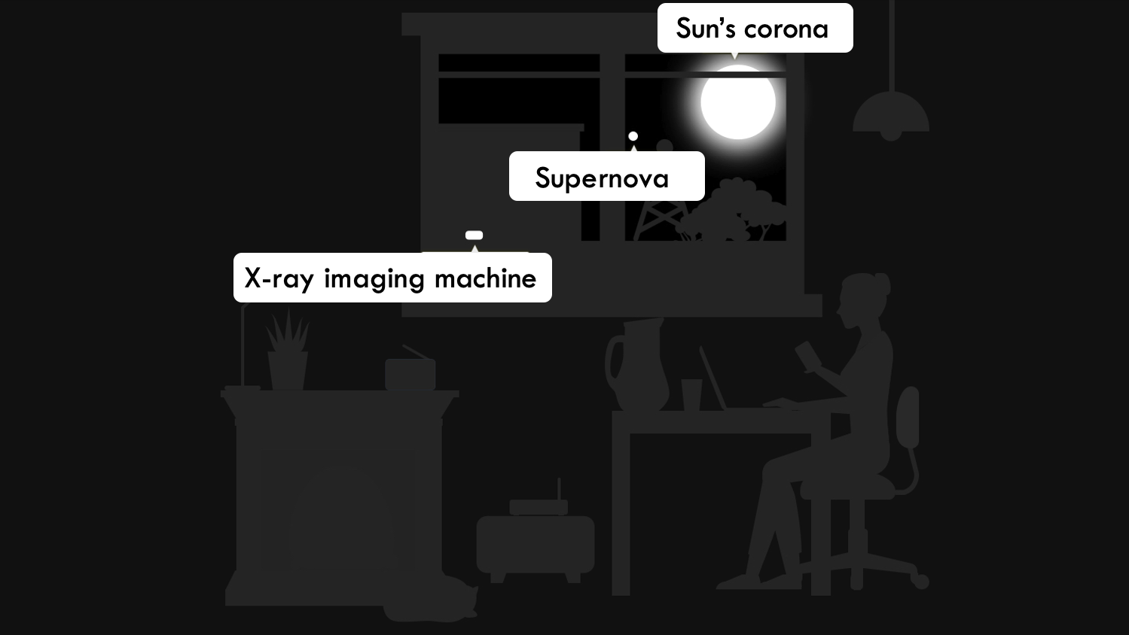
X-rays
Other Astrophysical Phenomena
Superheated clouds of gas, materials around black holes, neutron star centers
Image credit: ViewSpace.org
Notes:
8. X-rays
Key points to address:
X-rays have slightly longer wavelengths than gamma rays, and therefore are slightly less energetic.
Dentists use X-rays to image your teeth.
The outermost layer of our Sun – called the corona – also shines brightly in X-ray.
X-rays are also emitted from superheated materials around black holes, the collapsed center of very massive stars (known as neutron stars), and clouds of gas heated to millions of degrees.
More Background Information:
X-Rays – NASA: https://science.nasa.gov/ems/11_xrays
Image source: https://viewspace.org/interactives/unveiling_invisible_universe/forms_of_light/electromagnetic_spectrum

Slide 9
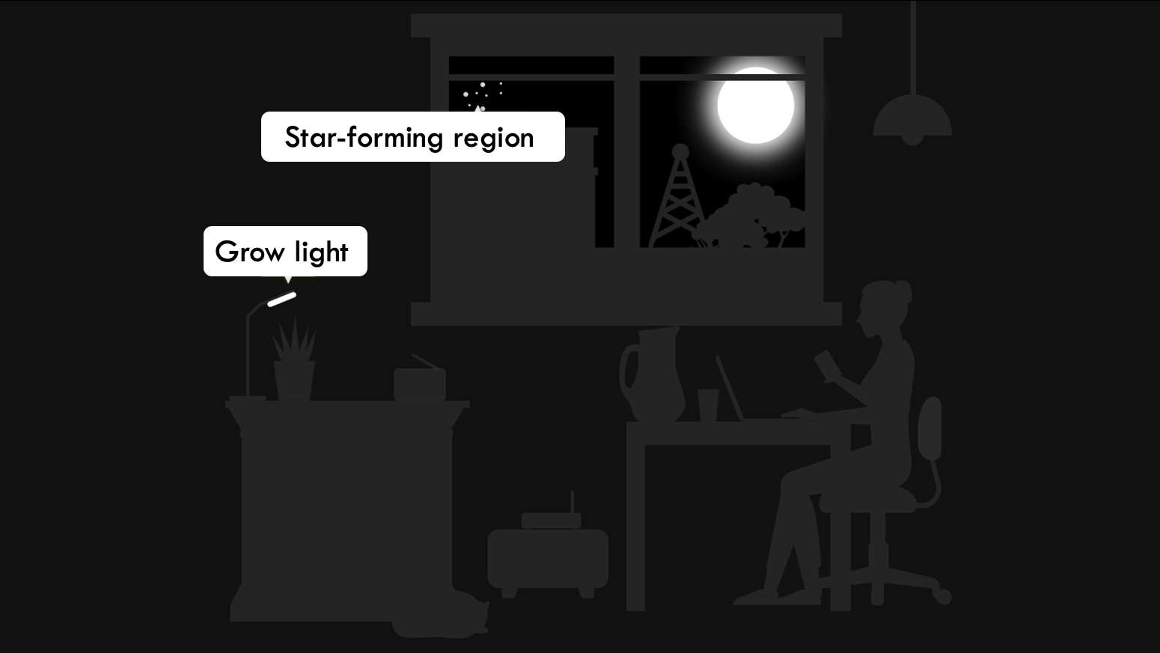
Ultraviolet (UV) light
Other Astrophysical Phenomena
Hot, young stars and quasars
Image credit: ViewSpace.org
Notes:
9. Ultraviolet light
Key points to address:
Ultraviolet radiation (also called UV light) has wavelengths slightly shorter than the visible light we can see.
UV light is, for example, emitted by our Sun and can cause sunburns and tans. It is also emitted by UV lamps, such as grow lights used for growing plants indoors. Although UV light waves are invisible to human eyes, some insects, such as bumblebees, can see them. This is similar to how a dog can hear the sound of a whistle just outside our hearing range.
Ultraviolet light is often emitted by very hot, young stars embedded in large clouds of dust and gas, called star-forming regions. UV light is also emitted by quasars, which are extremely bright and distant objects powered by matter falling inside a supermassive black hole.
More Background Information:
Ultraviolet Waves – NASA: https://science.nasa.gov/ems/10_ultravioletwaves/
Image source: https://viewspace.org/interactives/unveiling_invisible_universe/forms_of_light/electromagnetic_spectrum

Slide 10
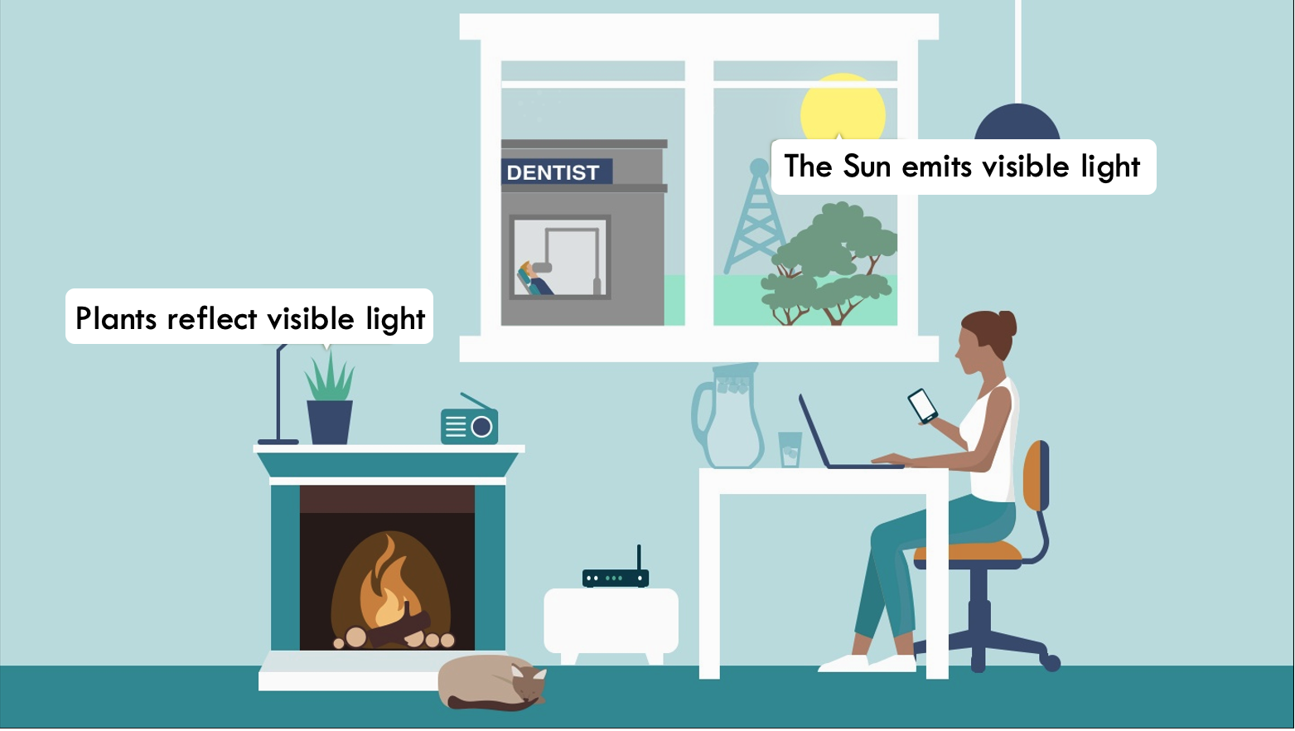
Visible light
Other Astrophysical Phenomena
Stars, planets, galaxies, etc.
Image credit: ViewSpace.org
Notes:
10. Visible light
Key points to address:
Visible light is only a small fraction of all light and has wavelengths roughly the size of a virus.
Human eyes can only see visible light. Some animals, like birds and reptiles, are able to detect wavelengths slightly longer or shorter than humans can.
Humans see the different wavelengths of visible light as different colors of the rainbow, ranging from violet (shorter wavelengths) to red (longer wavelengths).
Stars (like our Sun) emit a significant amount of their energy as visible light. Hotter stars emit higher energy (or shorter wavelengths) of visible light, making them appear bluer. On the other hand, stars at lower temperatures emit lower energy (longer wavelengths) of visible light, making them appear redder. (One way to remember this is to picture the flame of a candle or a campfire. The hottest part of the flame – usually at its center – may appear bluish.)
More Background Information:
Visible Light – NASA: https://science.nasa.gov/ems/09_visiblelight/
Image source: https://viewspace.org/interactives/unveiling_invisible_universe/forms_of_light/electromagnetic_spectrum

Slide 11
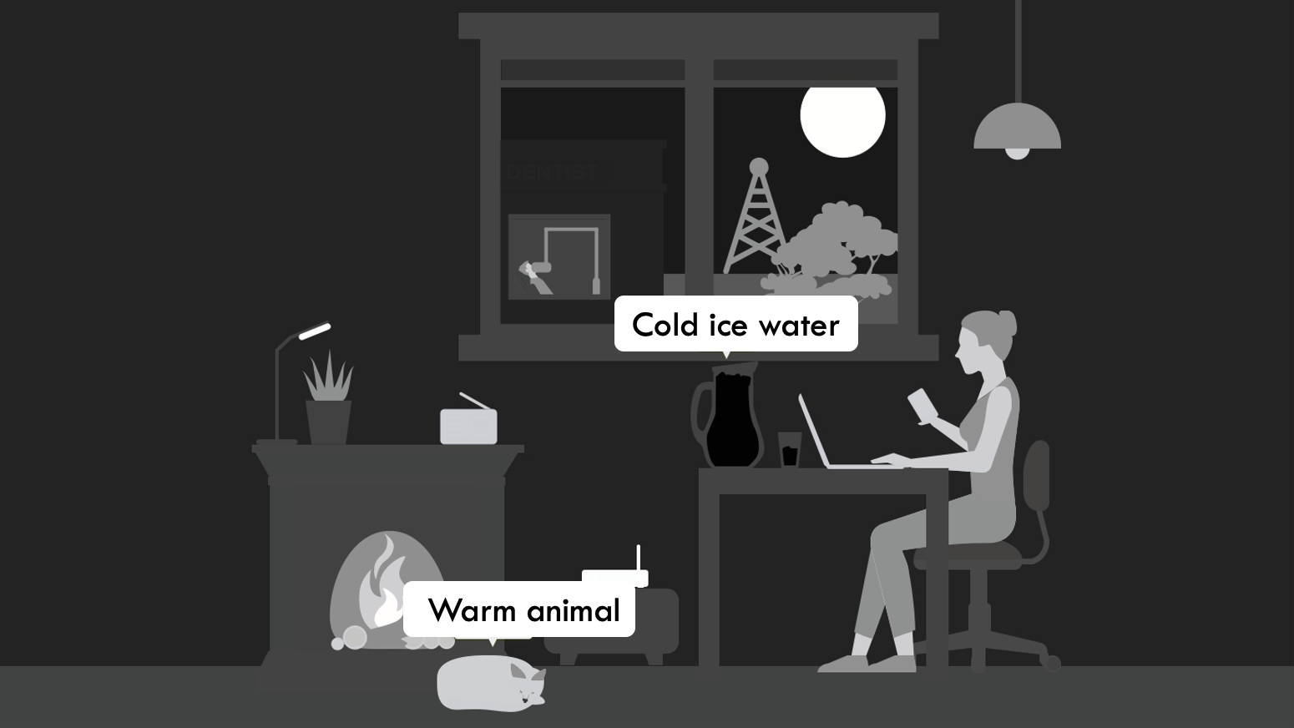
Infrared light
Star-forming clouds made of gas and dust, red dwarf stars, exoplanets
Other Astrophysical Phenomena
Image credit: ViewSpace.org
Notes:
11. Infrared Light
Key points to address:
Infrared light wavelengths are slightly longer than visible light and humans sense them it as heat.
With night vision goggles and thermal imaging cameras, you can see infrared light emitted by our skin and other objects that produce heat. The hotter an object is, the brighter it glows in infrared light.
Infrared light is most often emitted by objects cooler than those emitting visible light, such as red dwarf stars, exoplanets (planets outside of our solar system) and star-forming clouds of gas and dust.
Infrared light can help scientists detect specific molecules, such as water or carbon dioxide, in the atmospheres of planets.
More Background Information:
Infrared Waves – NASA: https://science.nasa.gov/ems/07_infraredwaves/
Image source: https://viewspace.org/interactives/unveiling_invisible_universe/forms_of_light/electromagnetic_spectrum

Slide 12
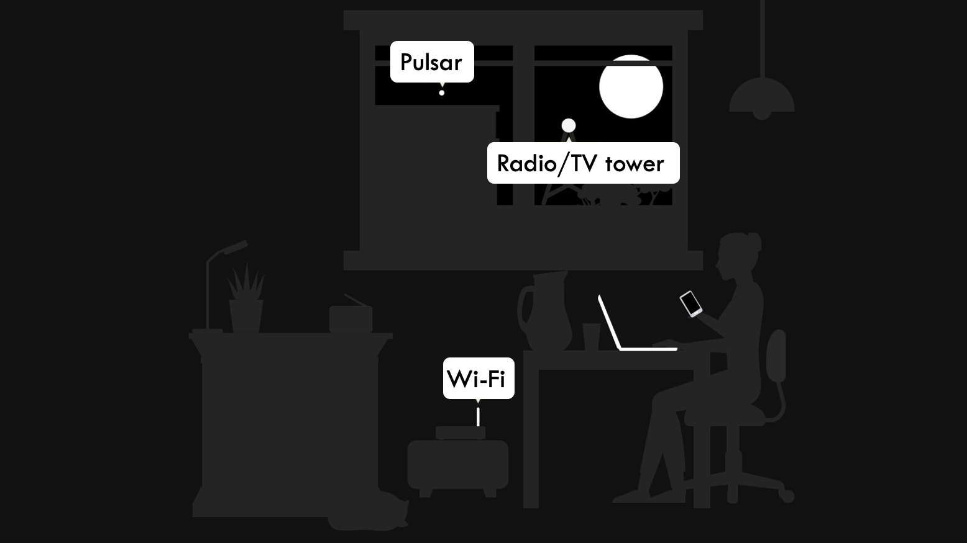
Microwaves and radio waves
Other Astrophysical Phenomena
Pulsars, cosmic background radiation
Image credit: ViewSpace.org
Notes:
12. Microwaves and radio waves
Key points to address:
Microwaves and radio waves have the lowest energies and longest wavelengths.
Microwave radiation has a longer wavelength than infrared light. Its sizes range from about as long as a loaf of bread to about as small as an ant.
Microwaves are used to heat up food in microwaves and to locate aircraft around airports.
Radio waves have wavelengths longer than the length of a football field, and therefore are longer than microwaves.
On Earth, radio waves are used for radio broadcasting, television signals, and Wi-Fi.
Detecting these forms of light allows scientists to peer through dense clouds to see the motion of cooler gases.
Microwave radiation is observed in the cosmic microwave background, the oldest light in the universe. It is the cooled leftover radiation from the Big Bang, which marks the time when the universe began.
Radio pulsars, rapidly spinning remains of massive stars, emit lots of radio waves (alongside other forms of light).
More Background Information:
Microwaves – NASA: https://science.nasa.gov/ems/06_microwaves/
Radio Waves – NASA: https://science.nasa.gov/ems/05_radiowaves/
Image source: https://viewspace.org/interactives/unveiling_invisible_universe/forms_of_light/electromagnetic_spectrum

Slide 13
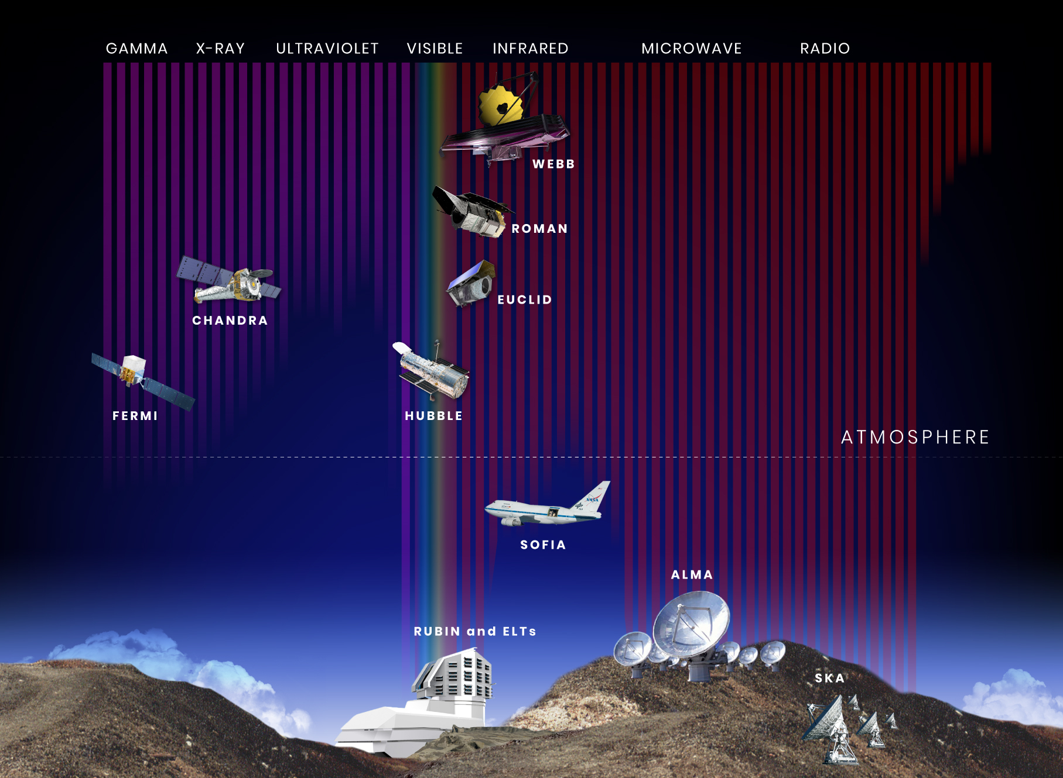
We build telescopes to detect other types of light
Image credit: NASA, STScI
Notes:
13. Why do we need telescopes?
Key points to address:
Astronomers use telescopes on the ground and in space to collect light.
Because light comes in many forms beyond what we can detect with our eyes, we build telescopes equipped with specialized detectors to capture and analyze the light traveling from distant objects to help scientists better understand our universe.
Telescopes are designed to detect certain types of light, including the types of light that our eyes cannot see.
Most electromagnetic radiation from space is unable to reach Earth’s surface because Earth’s protective atmosphere can block, absorb, reflect, and scatter light. Some infrared and ultraviolet light, and most X-rays and gamma rays, are absorbed by the Earth’s atmosphere before they reach the ground.
Because not all light can pass through our atmosphere, we place some telescopes in space, like the James Webb Space Telescope (which detects infrared light), Fermi (which detects gamma rays), Chandra (which detects X-rays), and Roman (which detects infrared light). Together, these telescopes paint a more complete view of our universe along with observatories on the ground.
More Background Information:
Observatories – NASA: https://science.nasa.gov/universe/observatories/
Image source: https://science.nasa.gov/asset/webb/wavelength-sensitivity-of-hubble-webb-roman-and-other-observatories/

Slide 14
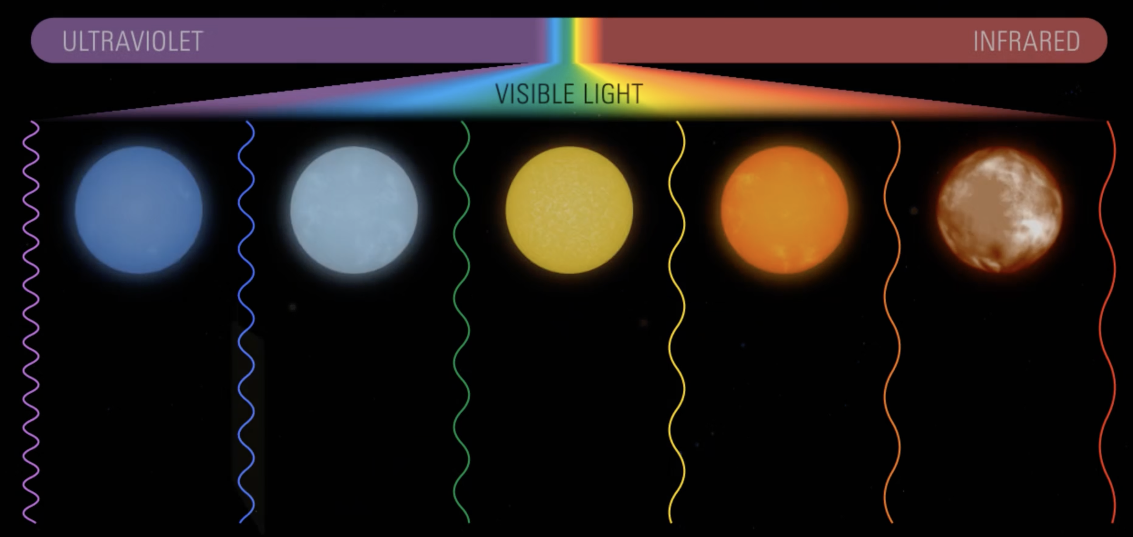
Light carries information about faraway celestial objects
Yellow or white stars, like our Sun, have temperatures in between
Very cool stars appear red
Very hot stars appear blue
Image credit: ViewSpace.org
Notes:
14. Light carries information about objects in our universe
Key points to address:
The wavelengths of light that are absorbed and/or emitted by an object can tell us about their temperature, what they are made of (their composition), and other characteristics, such as how far away they are or how they are moving in space.
For example, objects that emit primarily infrared wavelengths of light are often cooler than those emitting ultraviolet and X-ray light. Within the visible light range, stars that appear bluer are hotter, cooler stars appear red because they give off longer red-wavelengths of light, and stars like our Sun appear yellow or white because they have temperatures in between.
Image source: https://viewspace.org/video_library/videos/202-322871404?tags=149

Slide 15
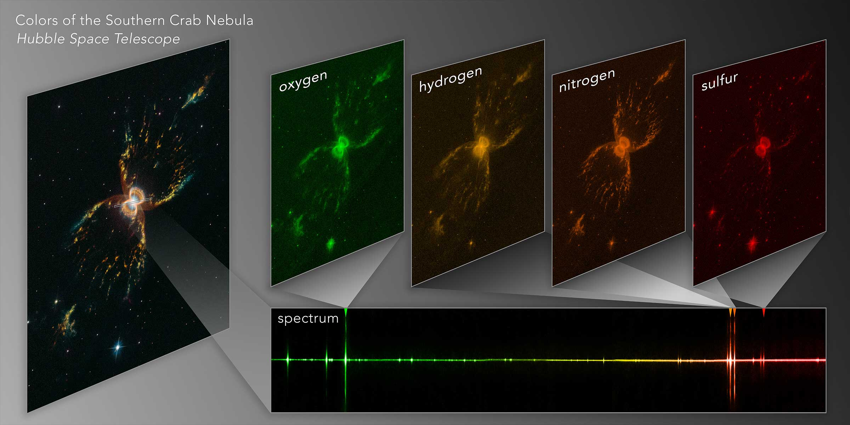
Light carries information about faraway celestial objects
Image credit: NASA, ESA, and J. DePasquale (STScI)
Notes:
15. Light carries information about objects in our universe: Composition
Key points to address:
Different materials emit and absorb light at different wavelengths.
By observing which wavelengths of light an object does and doesn’t emit across various wavelengths, astronomers can determine its composition.
For example, molecules like water, carbon dioxide, and methane absorb and emit specific wavelengths of light, creating a unique pattern of light across wavelengths, called a spectra. These unique patterns act like fingerprints, helping astronomers identify specific molecules and elements in faraway objects like stars or atmospheres of distant planets.
About the Image: This diagram shows how the Hubble Space Telescope used observations of different light wavelengths to study the chemicals that make up of the Southern Crab Nebula. Hubble Space Telescope divided the light from the nebula to record the light emitted from oxygen (assigned a green color), hydrogen (assigned a yellow color), nitrogen (assigned an orange color), and sulfur (assigned a red color). These different types of light revealed which gases are present and where they are found across the nebula. Note: To make wavelengths of light that our eyes cannot see visible, image developers assign colors to these wavelengths using a color palette, where each color represents a different range of wavelengths.

Slide 16
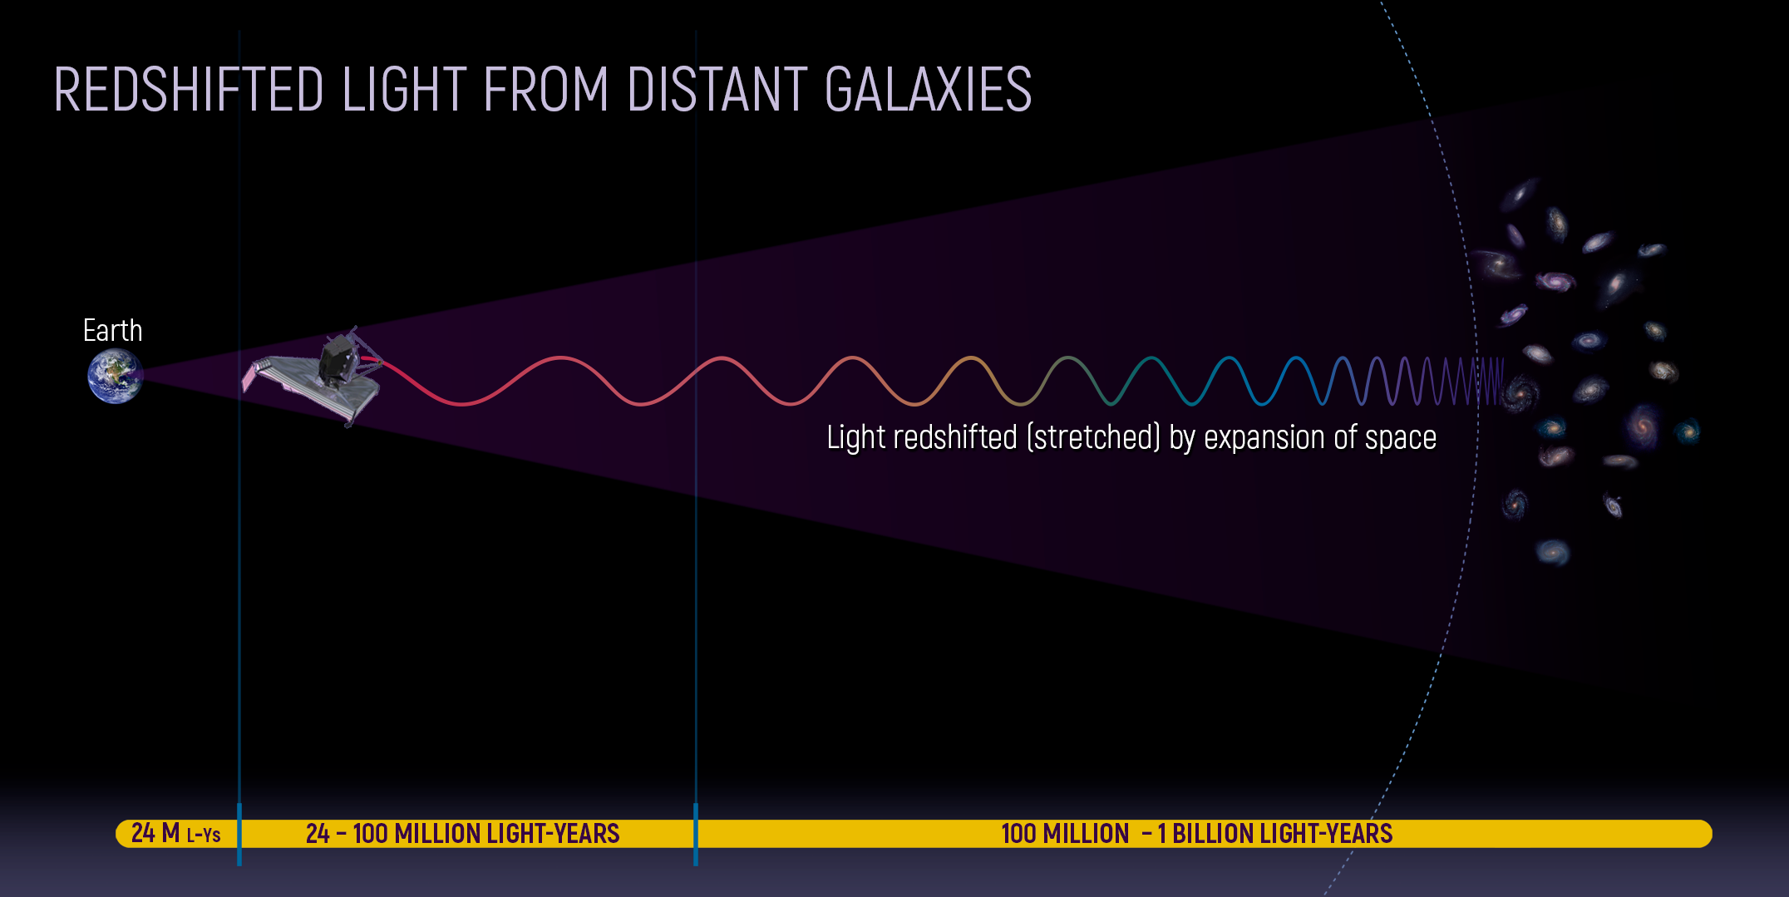
Light carries information about faraway celestial objects
Image credits: NASA, ESA, CSA, Ann Feild (STScI)
Notes:
16. Light carries information about objects in our universe: Redshift
Key points to address:
The wavelengths of light emitted by objects like stars and galaxies can also indicate their distance and motion through a phenomenon called redshift. If the light they emit is shifted towards the red/ longer wavelength end of the spectrum (redshift), the object is moving away from us, while a shift towards the blue end of the spectrum, corresponding to shorter wavelengths (blueshift) means it is approaching.
How does redshift work?
Imagine that you and a friend are each holding one end of a slinky. If you both start stepping away from each other, the bends in the slinky will stretch. This is similar to what is happening to the wavelength of light - which increases - from an object that is moving away from us (redshift).
The degree of redshift can also be used to estimate an object's distance. More distant galaxies have greater redshifts because the universe is expanding.
Image source: https://science.nasa.gov/asset/webb/redshifted-light-from-distant-galaxies/

Slide 17
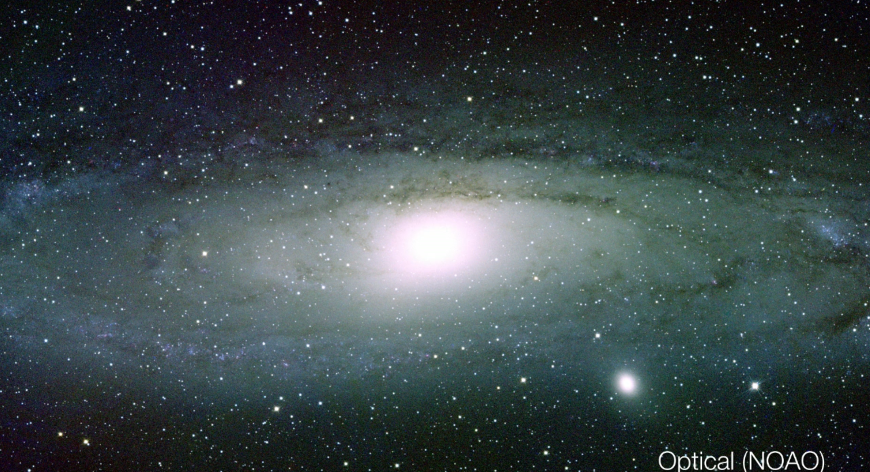
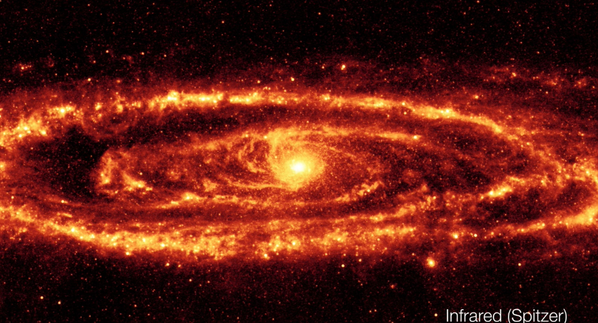
Objects can look very different in different wavelengths of light
Visible Light (Hubble Space Telescope)
Infrared Light (Spitzer Space Telescope)
Image credits: NOAO, AURA/NSF
Image credits: NASA, JPL-Caltech, K. Gordon (University of Arizona)
Notes:
17. How objects look like in different types of light
Key points to address:
The same object can look very different if observed in different types of light.
Image description: The two images above show the Andromeda Galaxy (NGC 224) in visible light (left) and infrared light (right). In the infrared light detected by the Spitzer Space Telescope, the gas and dust-filled arms of the spiral galaxy appear bright, revealing areas where new stars are forming. In contrast, these arms appear dark in the visible light captured by the Hubble Space Telescope, whereas the globe-like area at the galaxy’s center shines bright because it contains a dense cluster of older stars. Additionally, observing the same galaxy in other wavelengths of light, like radio waves, may reveal more energetic events, such as supermassive black holes, at the galaxy’s center.
Source of images: https://science.nasa.gov/asset/webb/infrared-universe-andromeda-galaxy/

Slide 18
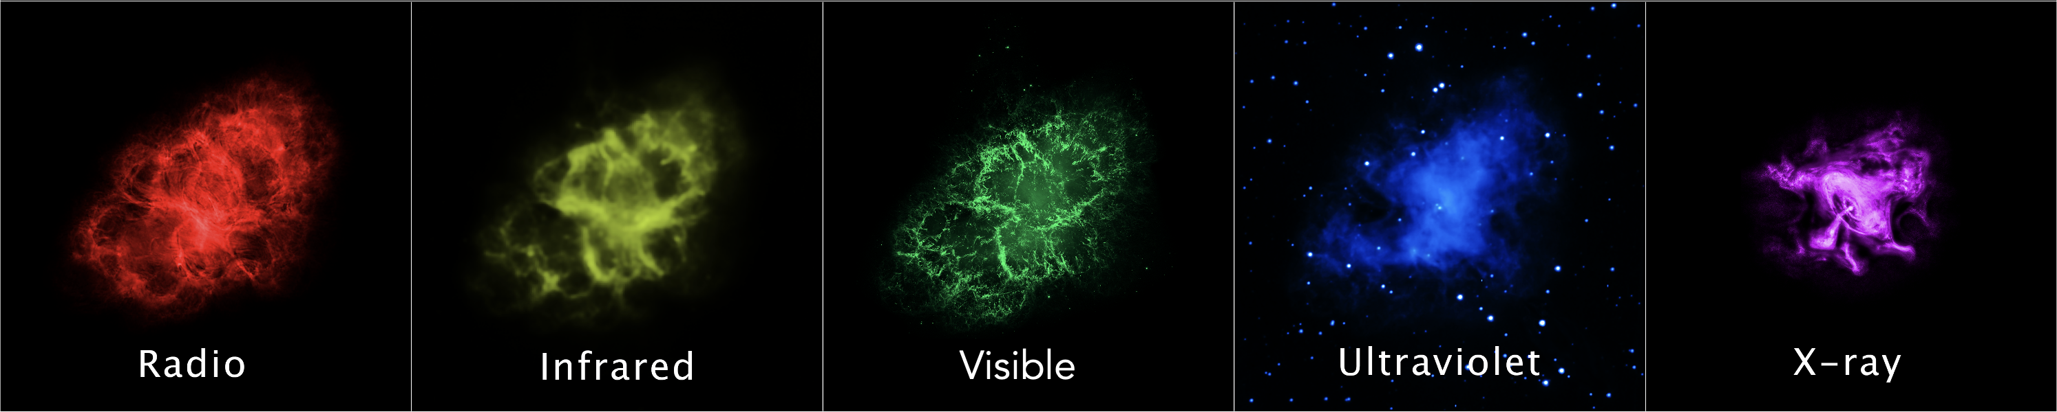
By studying objects in different wavelengths, we learn much more about them
The Crab Nebula in different wavelengths of light
Image credits: NASA, ESA, G. Dubner (IAFE, CONICET-University of Buenos Aires) et al.; A. Loll et al.; T. Temim et al.; F. Seward et al.; VLA/NRAO/AUI/NSF; Chandra/CXC; Spitzer/JPL-Caltech; XMM-Newton/ESA; and Hubble/STScI
Notes:
18. What is multi-wavelength astronomy?
Key points to address:
By observing an object in multiple wavelengths, a process called multiwavelength astronomy, scientists can uncover additional details, such as an object’s temperature, structure, composition, and movement, that are undetectable if viewed in only one wavelength of light.
Description of the Image: These images show a supernova remnant nebula called the Crab Nebula, which is a cloud of gas and dust created after an old, massive star explodes. Each image was created from observations made by a different telescope that collected light from a different part of the electromagnetic spectrum. The telescopes, and the types of light they detected were: The Very Large Array (radio) shown in red; Spitzer Space Telescope (infrared) shown in yellow; Hubble Space Telescope (visible) shown in green; XMM-Newton (ultraviolet) shown in blue; and Chandra X-ray Observatory (X-ray) shown in purple.

Slide 19
Kahoot Quiz
www.kahoot.it
Replace the QR code accordingly and insert the code to join the Kahoot
Notes:
Kahoot Quiz
Replace the QR code with your own to host this Kahoot Quiz and/or insert the code to join.
Note that you will need to have a Kahoot account in order to host it.
This is the link for the host: https://create.kahoot.it/share/the-electromagnetic-spectrum/1927a6b5-f1a0-4509-bfc2-6c2dc266fd1a

