Slide 1
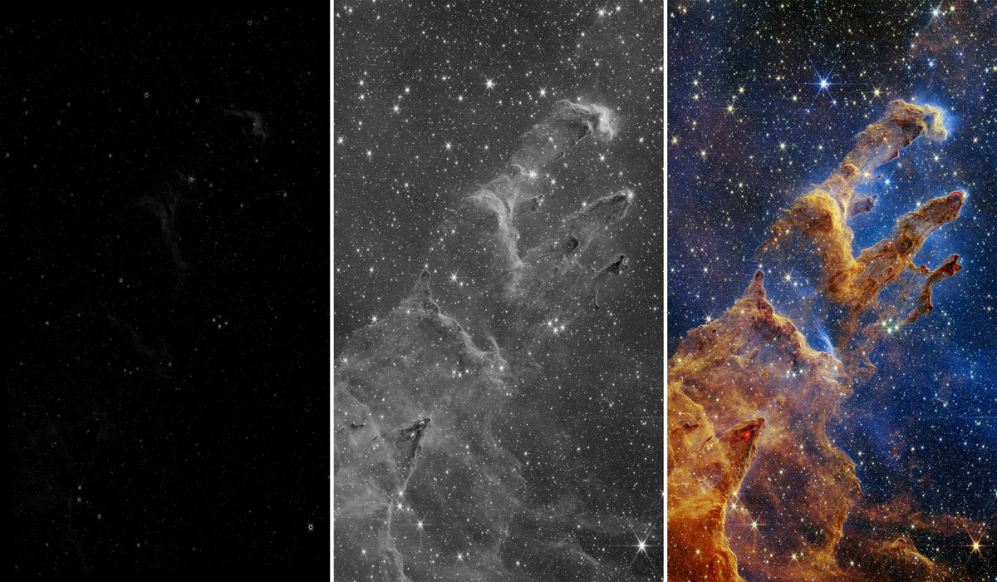
Data and Image Processing
Notes:
1. Onscreen slide before the presentation begins and during the introduction
These slides are available for you to customize for your presentation. Please feel free to add or remove slides as necessary to tailor the presentation for your event.
In this notes pane area, you will find key points for each slide, as well as links to additional background information.
Participant Takeaway Points:
Participants will learn during this presentation that:
Astronomical information and resulting images help inform scientists about phenomena and characteristics of objects in space.
Astronomical images are produced from data.
The data is typically collected from light gathered by telescopes.
Telescopes use filters to observe astronomical objects in different wavelengths of light.
Astronomical data is recorded and transmitted in binary code – a system that uses only 1s and 0s.
Making astronomical images is a multi-step process, a translation of information from one form to another.
More Background Information:
Program Theme: Data and Image Processing: https://www.universe-of-learning.org/contents/products/program-theme-2-data-and-imaging-processing
NASA Science Space Place: What’s the secret code for talking to spacecraft?: https://spaceplace.nasa.gov/binary-code/en/
Imagine the Universe: How Scientists Get Data: https://imagine.gsfc.nasa.gov/observatories/data/
How Are Webb’s Full-Color Images Made? https://science.nasa.gov/mission/webb/science-overview/science-explainers/how-are-webbs-full-color-images-made/
How to Talk to a Spacecraft? https://chandra.si.edu/binary/images/nametag.pdf
Recoloring the Universe: https://chandra.cfa.harvard.edu/edu/pencilcode/index.html
Image source: https://science.nasa.gov/mission/webb/science-overview/science-explainers/how-are-webbs-full-color-images-made/
Last Updated: December 2024

Slide 2
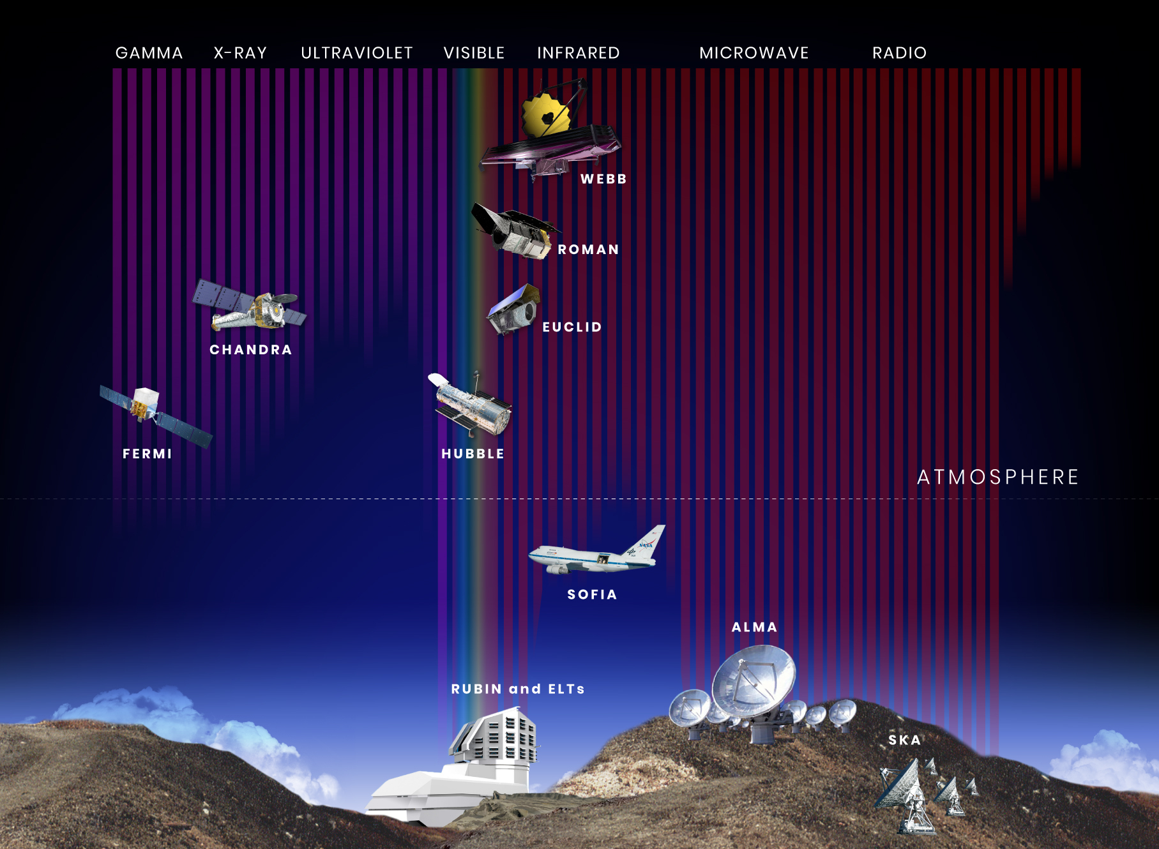
Astronomers use telescopes on Earth and in space to collect data from celestial objects
Image credit: NASA and STScI
Notes:
2. Introduce the tools astronomers use P.1
Key points to address:
Scientists study distant stars, planets, galaxies, nebulae, and other celestial objects by gathering and analyzing data from observatories on Earth and in its atmosphere, as well as from space-based telescopes, like the James Webb Space Telescope.
Astronomers primarily use different types of electromagnetic radiation (or light) as the main data to study celestial objects.
Astronomers combine data about these different types of light to get a better understanding of the objects they study, often using multiple telescopes and instruments that are sensitive to different parts of the electromagnetic spectrum.
When light from an object is spread out into its component colors (a spectrum), it can help reveal details about a celestial objects’ composition (what chemicals they are made of), temperature, motion, and more!
More Background Information:
Observatories – NASA: https://science.nasa.gov/universe/observatories/
Image source: https://science.nasa.gov/asset/webb/wavelength-sensitivity-of-hubble-webb-roman-and-other-observatories/

Slide 3
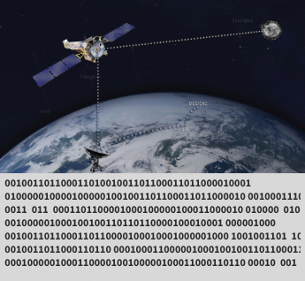
Key Vocabulary
Data
Information collected to study an object or a phenomenon.
In modern astronomy, data is mainly digital, meaning it is encoded in a format that it can be stored, transmitted, and processed by computers and other electronic devices.
Image credit: NASA/CXC/SAO
Notes:
3. Define Vocabulary
Data is information collected to study an object or a phenomenon.
In modern astronomy, data is mainly digital.
“Digital” means that the information is encoded in a format that can be stored, transmitted and processed by computers and other electronic devices.
The observations of different types of light (wavelengths) taken by telescopes are data.
Astronomers analyze this data (observations) to study the universe.
Image source: https://chandra.harvard.edu/resources/handouts/lithos/how-to-talk-like-a-spacecraft-binary-code.pdf

Slide 4
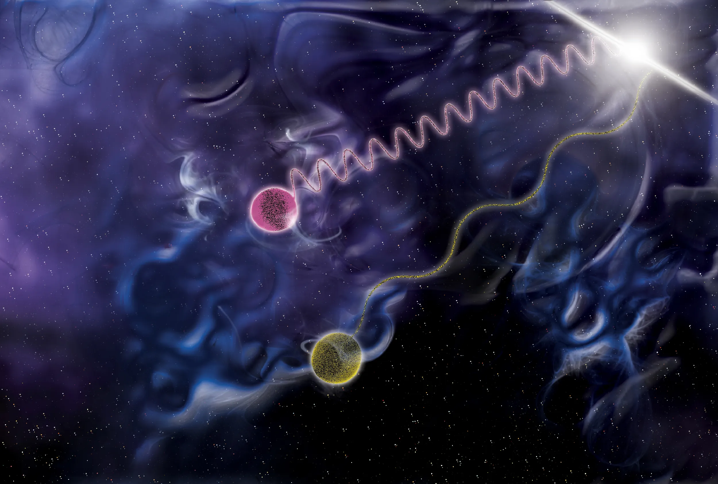
Key Vocabulary
Photon
A packet of light, characterized by either its wavelength, frequency, or energy.
Image credit: NASA/Sonoma State University/Aurore Simonnet
Notes:
4. Define Vocabulary
Photon: A packet of light, characterized by its wavelength, frequency, or energy.
Note: Telescopes like the James Webb Space Telescope detect and record photons of light that hit their detectors, using special filters to isolate light of specific wavelengths.
Image description: In this illustration, one photon (shown in purple) carries a million times the energy of another (shown in yellow). The squiggly lines behind each photon represent the photons’ different wavelengths.
Image source: https://www.nasa.gov/universe/fermi-telescope-caps-first-year-with-glimpse-of-space-time/

Slide 5
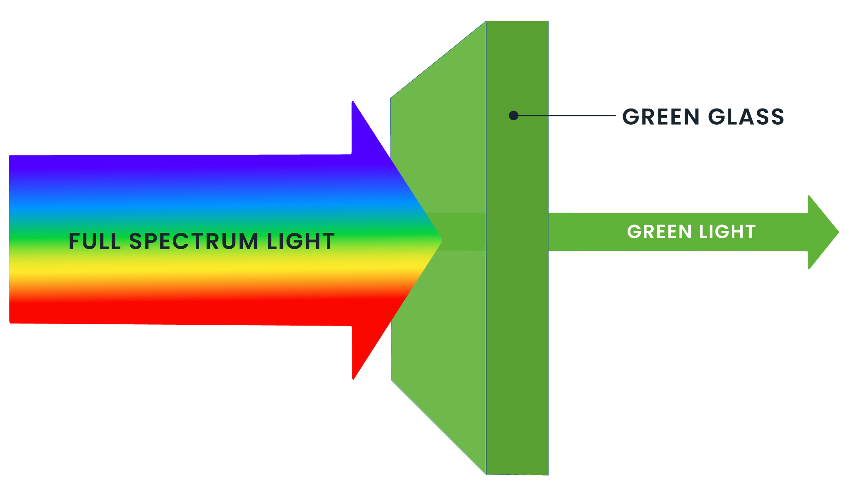
Key Vocabulary
Filter
A device or material that absorbs certain colors of light (wavelengths), while allowing others to pass through. Filters are used on telescopes to observe how celestial objects appear in certain colors (or wavelengths) of light, or to reduce the light of exceptionally bright objects.
Image credit: NASA and STScI
Notes:
5. Define Vocabulary
Filter: A device or material that absorbs certain colors of light (or wavelengths), while allowing others to pass through. Filters are used on telescopes to observe how celestial objects appear in certain colors (or wavelengths) of light, or to reduce the light of exceptionally bright objects.
Note: Astronomers use different filters to reveal different information about distant objects. For example, the colors of stars can indicate their temperature, and observations of galaxies in different filters can reveal their composition and whether stars are forming.
More background information:
Webb’s Scientific Instruments: https://science.nasa.gov/mission/webb/science-overview/science-explainers/webbs-scientific-instruments/

Slide 6
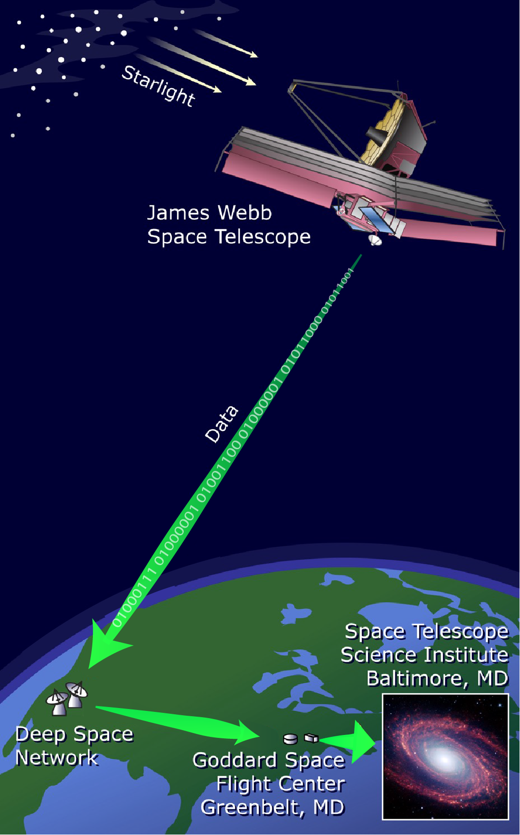

Telescopes collect and filter light from celestial objects
Image credit: STScI
Notes:
6. Introduce the tools astronomers use P.2
Key points to address:
Lenses & mirrors: Telescopes use a lens (in refracting telescopes) or mirror (in reflecting telescopes) to gather and focus light from distant objects.
Detectors: When a telescope observes an object in space, its detectors record light particles called photons. These detectors are highly sensitive to even the faintest light.
Filters: Telescopes use filters to allow only certain colors or wavelengths of light to pass through while blocking others. For example, one filter might allow only red light, while another might allow only blue light, and some filters only allow ultraviolet light. Each filtered image captures different information about the object being studied.
Image description: The James Webb Space Telescope collects light from an astronomical object.
Image source: https://imagine.gsfc.nasa.gov/observatories/data/images/data_to_ground.jpg

Slide 7
Telescopes then transmit the data to Earth
Image credit: STScI
Notes:
7. Explain how data is transmitted to Earth
Key points to address:
When a space telescope captures light from a celestial object, it does not arrive as an assembled snapshot.
When a space telescope’s detectors capture photons from an astronomical object, these photons are converted into electrical signals and are then digitized by turning – or encoding - the information into a series of numbers.
The digitized information is in the form of 1s and 0s, called binary code.
The binary code is transmitted to Earth via radio waves, which are received by antennae. Once received, the data is stored, analyzed, and processed using computers to create astronomical images.
Image description: The James Webb Space Telescope sends data to ground stations on Earth, which route the data to the Space Telescope Science Institute for processing and distribution.
Image source: https://imagine.gsfc.nasa.gov/observatories/data/images/data_to_ground.jpg

Slide 8

Key Vocabulary
Coding
In data and image processing, coding means turning information into a format that computers can understand and work with. It involves using special rules and instructions to change or improve data and pictures, making it easier for computers to analyze, store, or share them.
Image credit: Kang/STScI
Notes:
8. Define Vocabulary
Key points to address:
In data and image processing, coding means turning information into a format that computers can understand and work with. It involves using special rules and instructions to change or improve data and pictures, making it easier for computers to analyze, store, or share them.
Note: When processing astronomical images, we use coding to adjust the color, saturation, and other aspects of the data that composes an image file.
Image source: https://chandra.harvard.edu/edu/pencilcode/

Slide 9
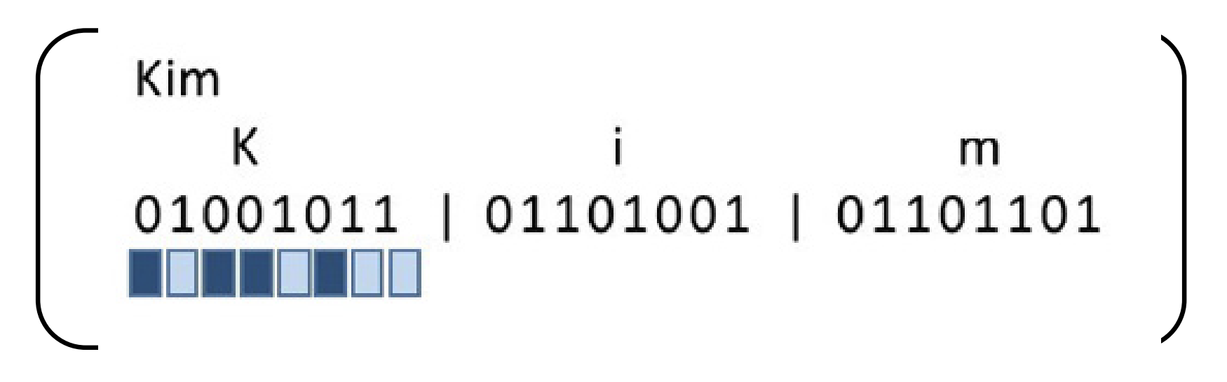
Key Vocabulary
Binary code
A system that uses only two digits (generally 1s and 0s) to represent things, like text, numbers, images, or computer instructions.
Note: “Bi” means two.
Image credit: NASA’s Universe of Learning
Notes:
9. Define Vocabulary
Binary code: A system that uses only two digits (generally 1s and 0s) to represent things, like text, numbers, images, or computer instructions. Note: “Bi” means two.
While we typically use decimal notation (using digits 0 to 9) to write numbers, computers and telescopes use binary notation (generally 1s and 0s).
Example: In the image above, the 0s and 1s of binary code can be translated into corresponding letters of the alphabet and/or dark and light blue, respectively. By stringing together sections of this code, you could spell out someone’s name, words, and entire messages.

Slide 10
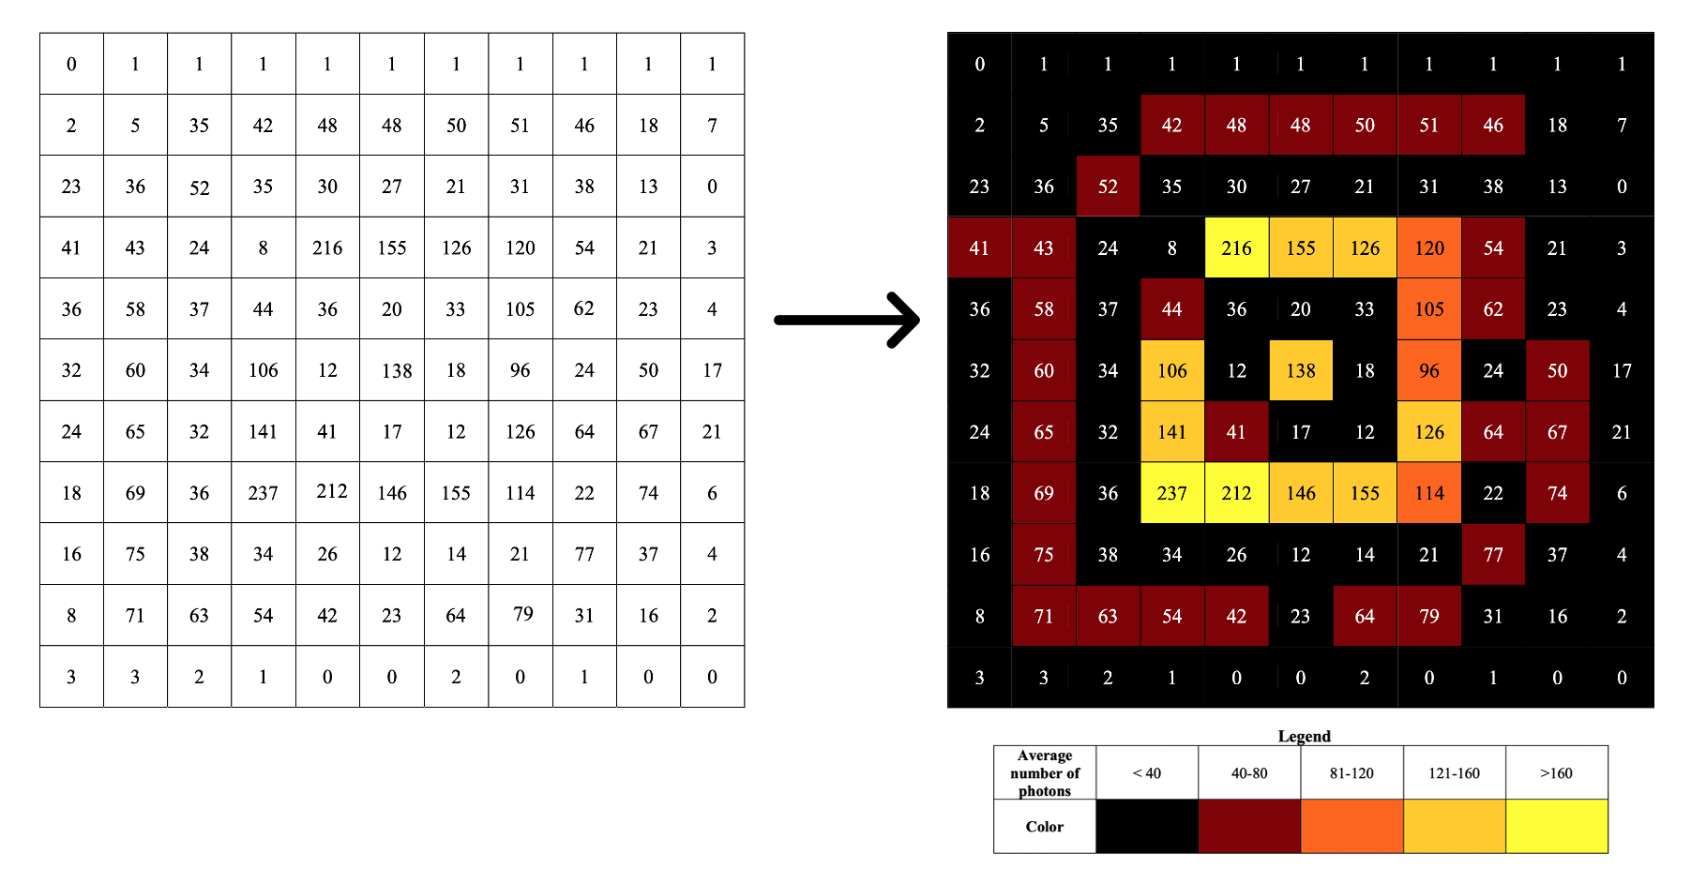
Computers translate binary code data into a table that can be processed further
Image credits: NASA’s Universe of Learning
Notes:
10. Explain that computers translate binary code into a table
Key points to address:
Computer software translates the binary code data into a table that contains the time, energy, and position of each photon that struck the detector during the observation. This table is further processed to form images of the object(s).
Image description: The left image shows a grid of cells, each containing a number that represents the average number of photons detected in that area, translated from binary code. The corresponding image on the right displays the same grid, with each cell color-coded based on its average photon count. In the right-hand image, the color-coding reveals the emerging shape of a supernova remnant.
More background information:
Coloring The Universe – Chandra: https://chandra.harvard.edu/imaging/
Decoding Space Images With the DSN: https://www.jpl.nasa.gov/edu/teach/activity/decoding-space-images-with-the-dsn/
Image source: https://www.universe-of-learning.org/files/live/sites/uol/files/home/resources/projects/gawn/_documents/event/8-13-24/Image_Processing_Materials.pdf

Slide 11
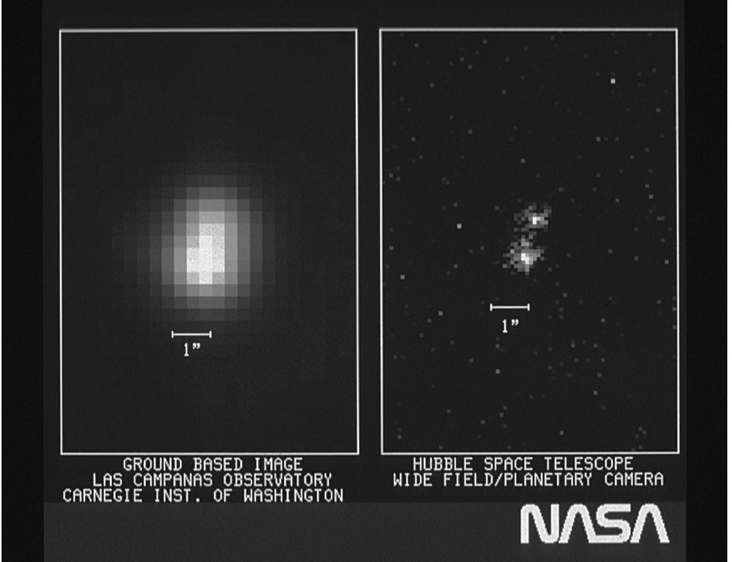
Key Vocabulary
Pixels
Rectangles (often squares) that form images on screens and computer displays, and are the smallest controllable elements of on-screen images.
You can think of pixels as sections of a paint-by-number image, where the canvas is divided into sections, each marked with a number corresponding to a particular color (or value).
Image credit: NASA, ESA, and STScI (Ground Image: E. Persson (Las Campanas Observatory, Chile)/ Observatories of the Carnegie Institution of Washington
Notes:
11. Define Vocabulary
Pixels: Rectangles (often squares) that form images on screens and computer displays, and are the smallest controllable elements of on-screen images.
Note: You can think of pixels as sections of a paint-by-number image, where the canvas is divided into sections, each marked with a number corresponding to a particular color (or value).
Image description: The image on the right is a portion of the first image returned by the Wide Field/Planetary Camera on the Hubble Space Telescope (HST). On the left is a ground-based image of the same area of the sky. The object shown in these images is a double star: the pair of stars is well separated in the HST image but blurred together in the ground-based image due to differences in the size of the pixels.

Slide 12
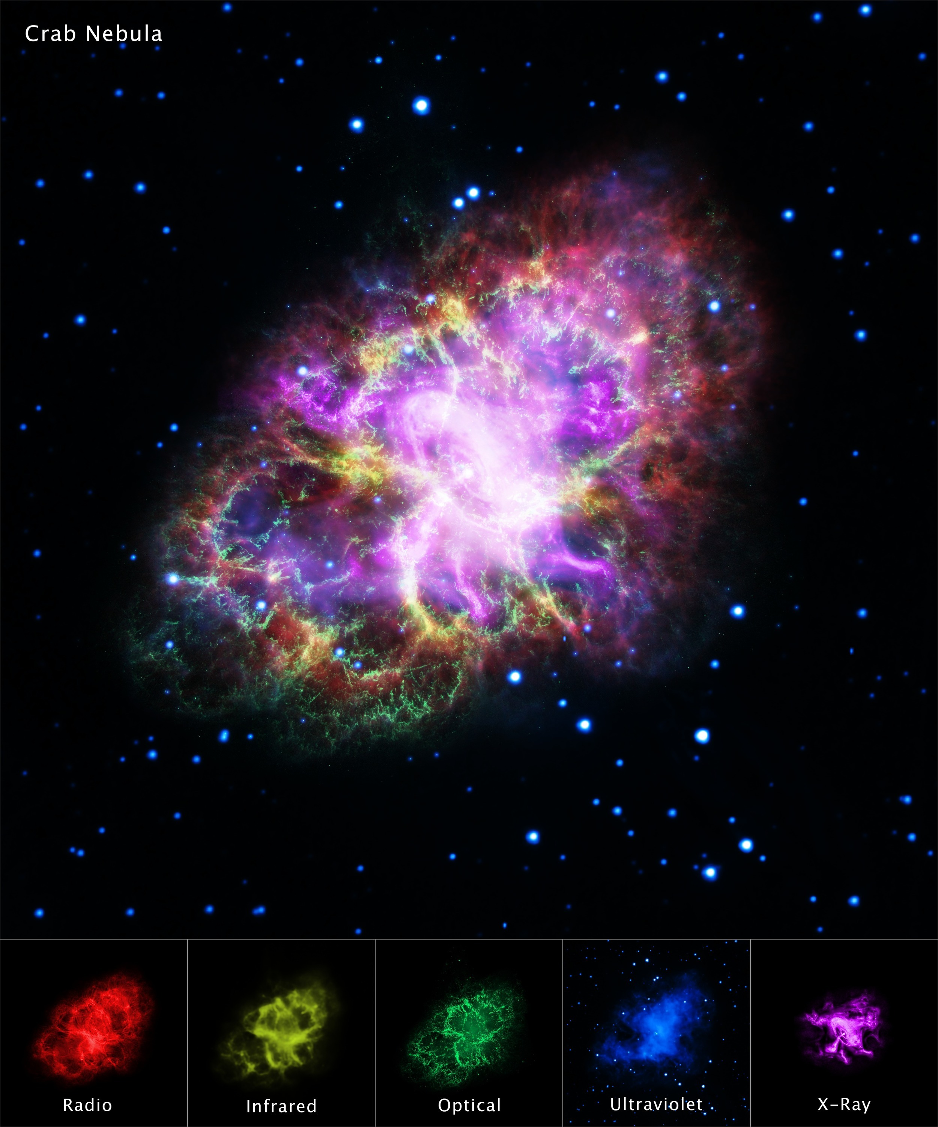
Telescope images are a visual representation of data collected across one or more wavelengths of light
Image credit: X-ray: NASA/CXC/SAO; Optical: NASA/STScI; Infrared: NASA/JPL/Caltech; Radio: NSF/NRAO/VLA; Ultraviolet: ESA/XMM-Newton
Notes:
12. Explain what telescope images are
Telescope images are visual representations of data measured across different wavelengths of light, including radio, infrared, visible (also called optical), ultraviolet, X-rays, and gamma rays.
Telescope images can show a single type of light – such as radio waves or infrared light – or many different wavelengths of light.
Data visualization specialists play an important role in transforming the data into the stunning images we see. Since telescope detectors can capture light in wavelengths beyond the visible spectrum (such as ultraviolet and infrared), the data needs to be translated into colors we can see.
Image description: The larger image at the top combines data from five different telescopes: the VLA (radio, shown in red in the bottom right), the Spitzer Space Telescope (infrared, shown in yellow), the Hubble Space Telescope (visible light, shown in green), XMM-Newton (ultraviolet, shown in blue), and the Chandra X-Ray Observatory (X-ray, shown in purple). Together, these observations reveal the structure of the Crab Nebula—a giant, expanding shell of gas and dust created by the explosion of a massive star.
More background information:
Did You Know: How Images Are Made? Video: https://viewspace.org/video_library/videos/1377-899305803?tags=214
How Are Webb’s Full-Color Images Made?: https://science.nasa.gov/mission/webb/science-overview/science-explainers/how-are-webbs-full-color-images-made/
Adding Color to Chandra Images: https://chandra.harvard.edu/photo/false_color.html
Image source: https://chandra.harvard.edu/photo/2017/crab/more.html

Slide 13
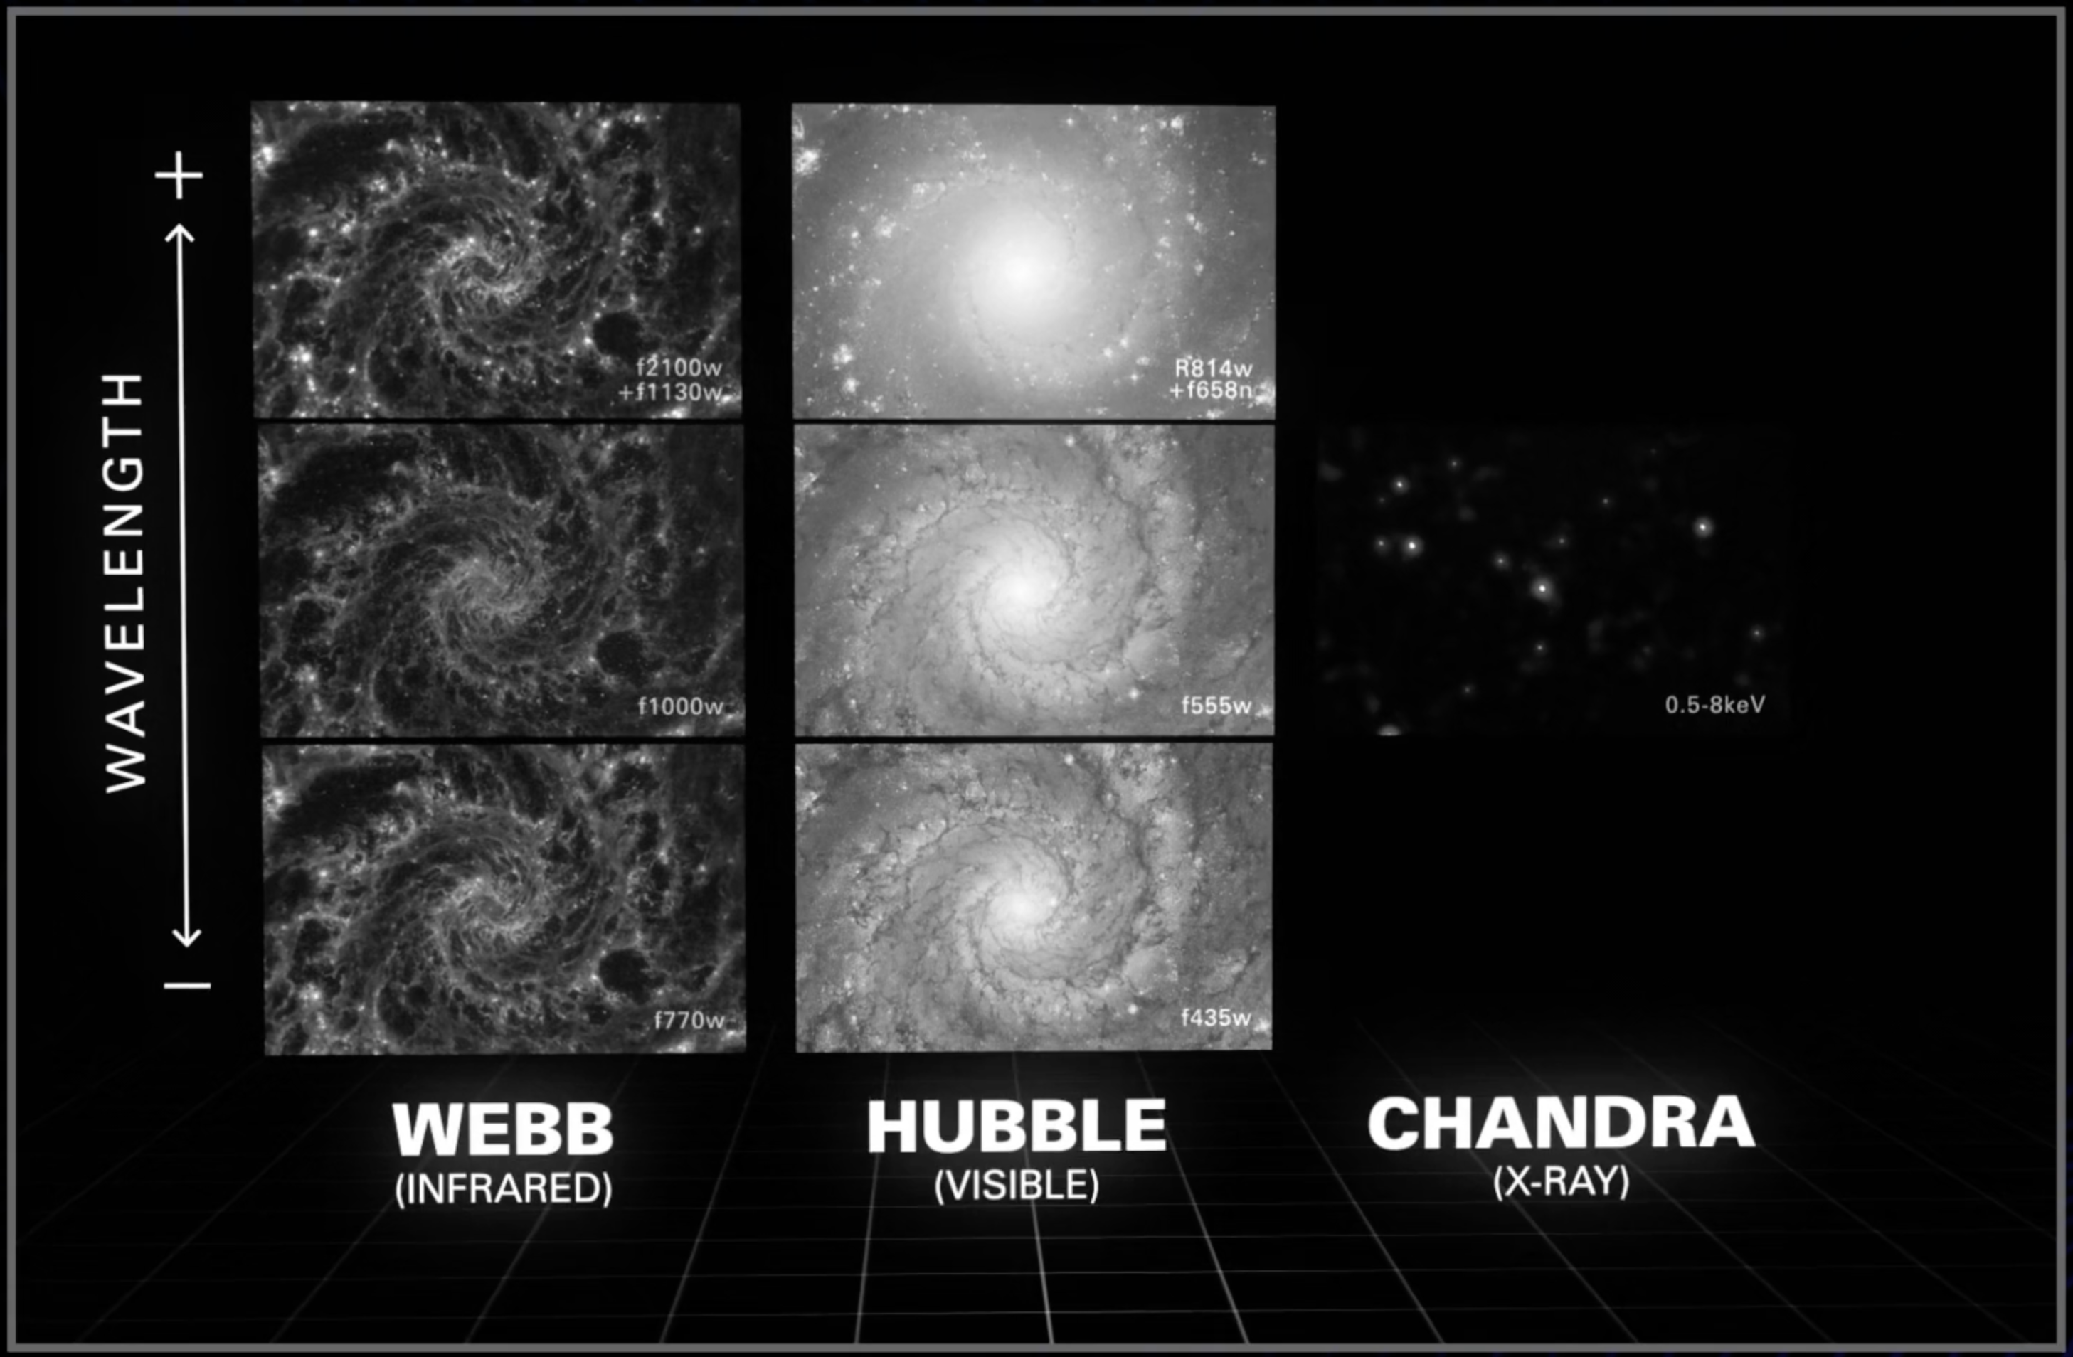
By combining images captured with different filters, we can create full-color astronomical images
Notes:
13. Image Processing P. 1
Key points to address:
Telescopes use filters that allow only specific colors of light through.
A full-color image is assembled from separate black-and-white images created using colored filters.
Most modern observatories have many filters they can use. For example, in addition to visible light, the Hubble Space Telescope uses filters in ultraviolet and near-infrared light, which are invisible to the human eye. These filters help reveal details about the objects being observed.
Image description: The images correspond to galaxy M74, or the Phantom Galaxy, as captured by the Webb, Hubble, and Chandra telescopes using various filters (listed in the lower right of each individual image). The vertical line on the left shows increasing wavelengths from bottom to top. The images show how different types of light reveal different features in the galaxy.
Image source: https://viewspace.org/video_library/videos/1377-899305803?tags=214
More background information:
Did You Know: How Images Are Made? Video: https://viewspace.org/video_library/videos/1377-899305803?tags=214
How Are Webb’s Full-Color Images Made?: https://science.nasa.gov/mission/webb/science-overview/science-explainers/how-are-webbs-full-color-images-made/
Adding Color to Chandra Images: https://chandra.harvard.edu/photo/false_color.html

Slide 14
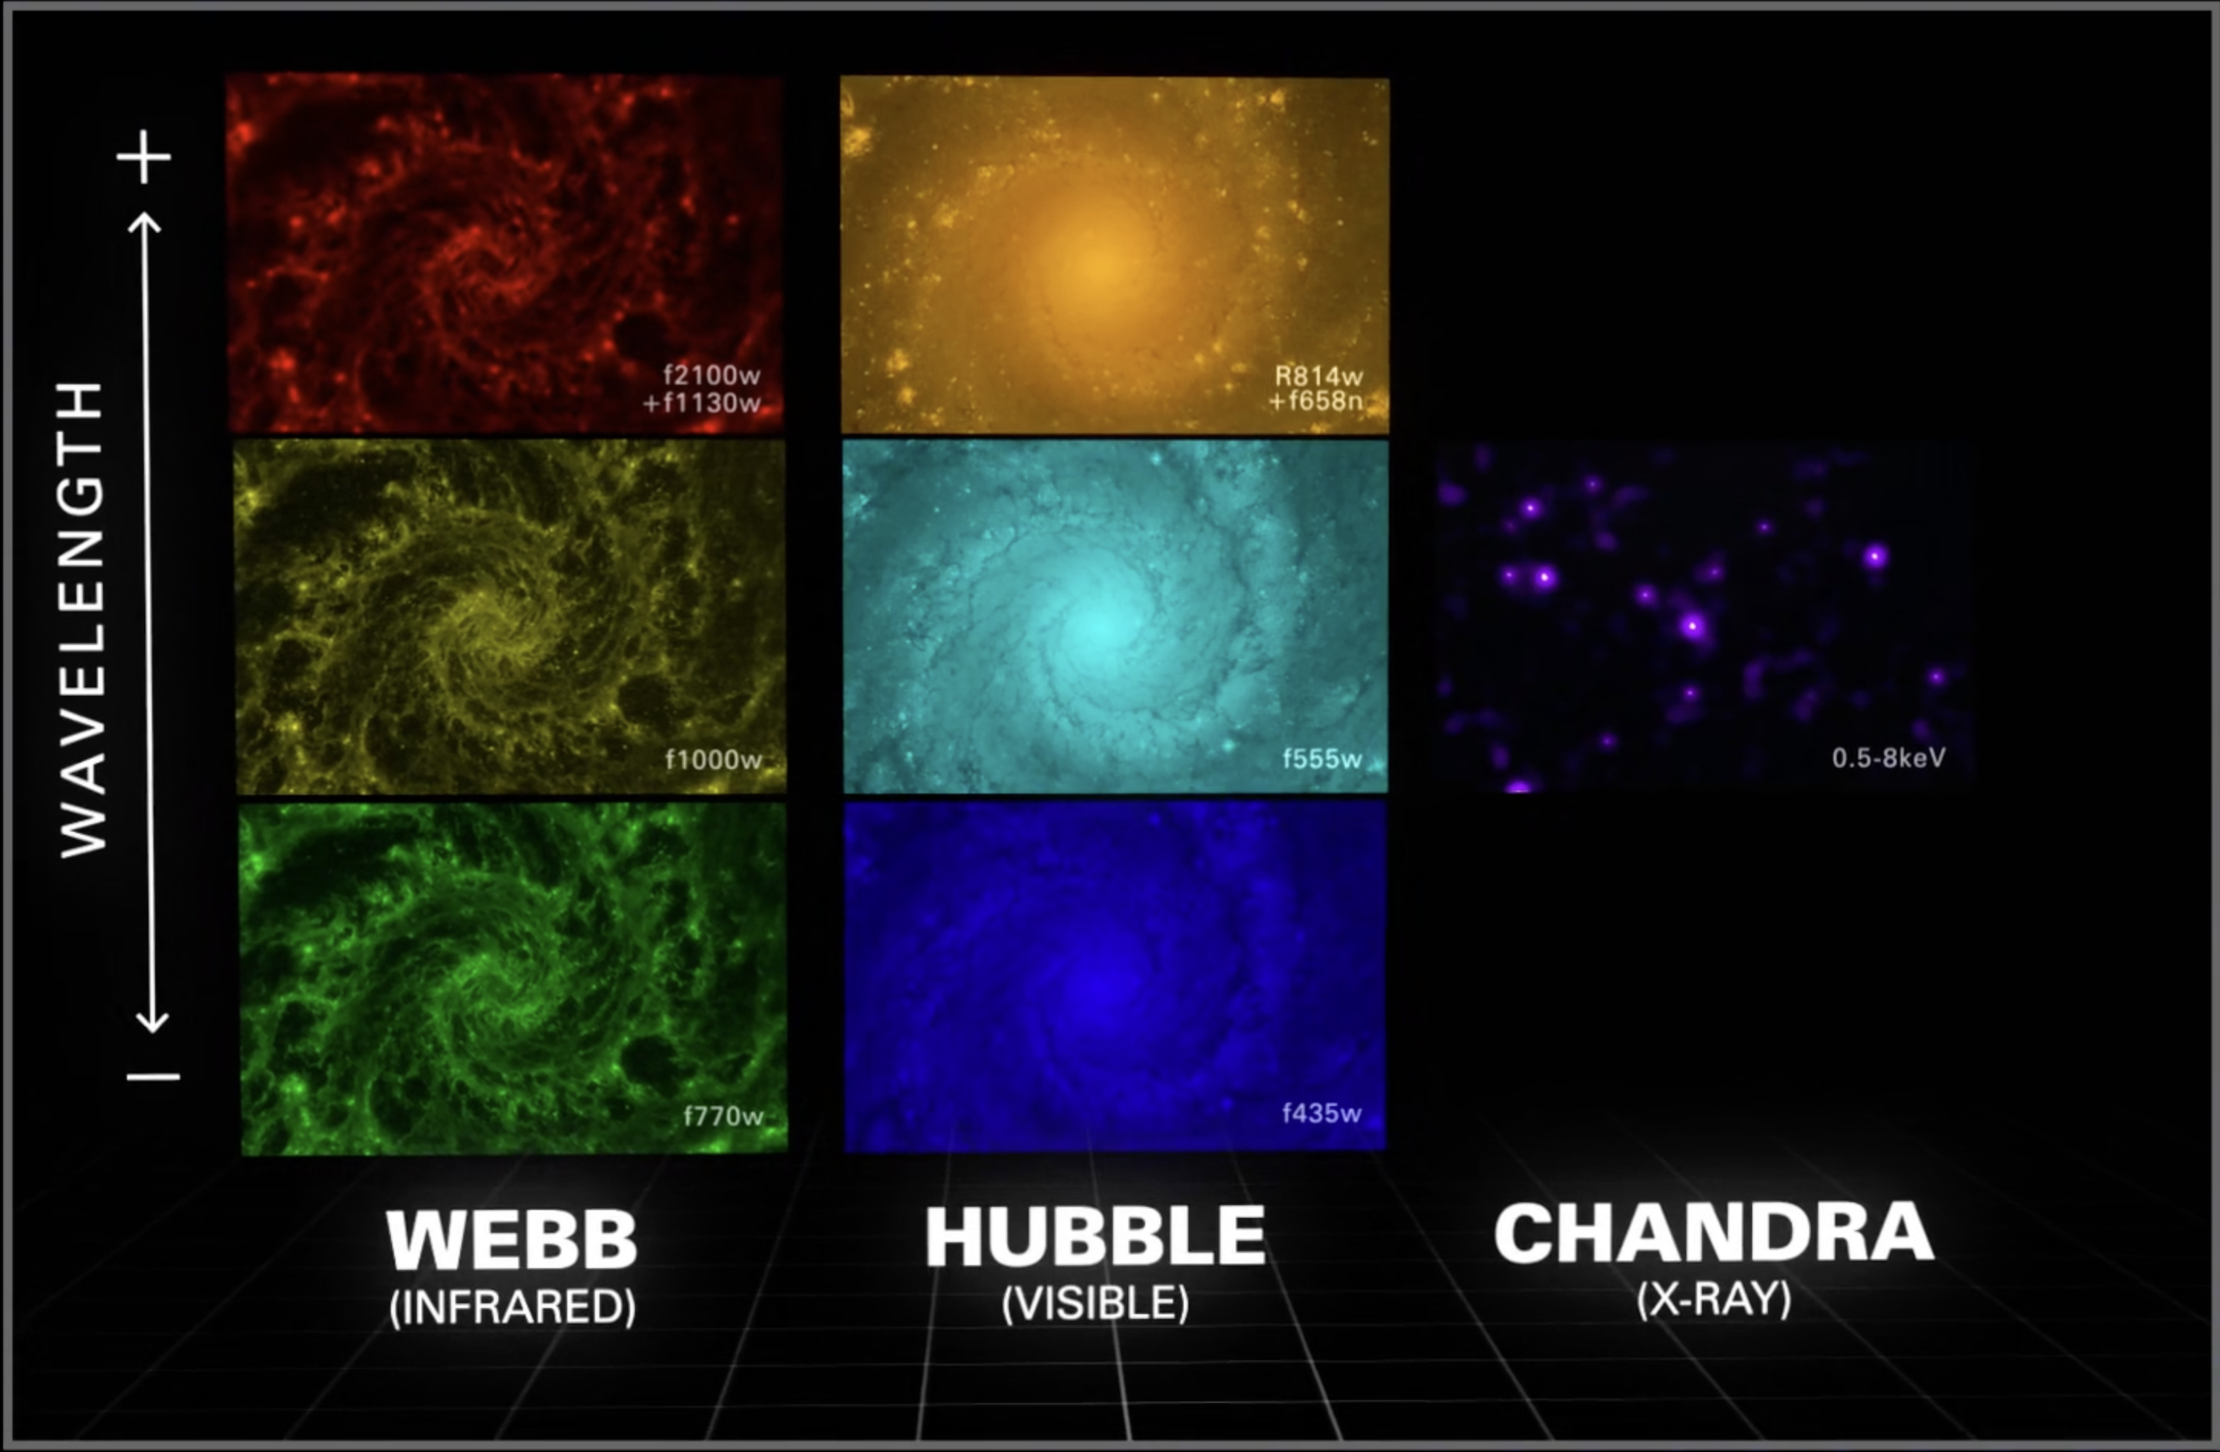
By combining images captured with different filters, we can create full-color astronomical images
Notes:
14. Image Processing P. 2
Key points to address:
Images obtained using three or more filters can be mapped to red, green, and blue (RGB) channels to produce a color image.
Generally, longer wavelengths are assigned redder colors and shorter wavelengths are assigned bluer colors.
The chosen colors help highlight specific details, making it easier for scientists to study the physical properties, structures, and processes happening in and around the object being observed.
Image description: The images correspond to galaxy M74, or the Phantom Galaxy, as captured by the Webb, Hubble, and Chandra telescopes using various filters (listed in the lower right of each individual image). The vertical line on the left shows increasing wavelengths from bottom to top. The images show how different types of light reveal different features in the galaxy. In these images, colors have been assigned to the images taken by different filters following scientific principles.
Image source: https://viewspace.org/video_library/videos/1377-899305803?tags=214
More background information:
Did You Know: How Images Are Made? Video: https://viewspace.org/video_library/videos/1377-899305803?tags=214
How Are Webb’s Full-Color Images Made?: https://science.nasa.gov/mission/webb/science-overview/science-explainers/how-are-webbs-full-color-images-made/
Adding Color to Chandra Images: https://chandra.harvard.edu/photo/false_color.html

Slide 15
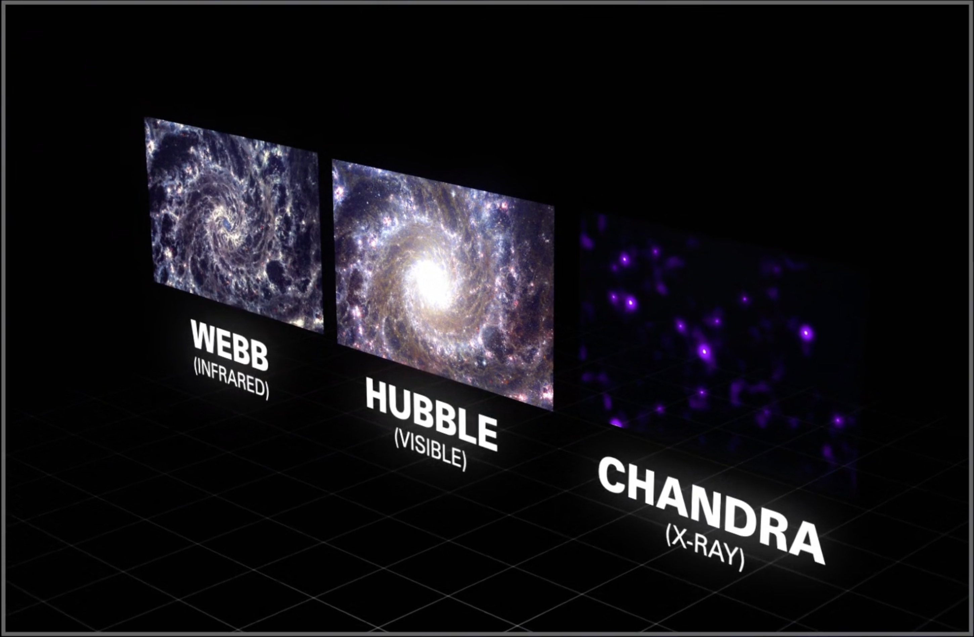
By combining images captured with different filters, we can create full-color astronomical images
Notes:
15. Image Processing P. 3
Key points to address:
Full-color astronomical images are made by combining images captured with different filters.
Image description: The images correspond to galaxy M74, or the Phantom Galaxy, as captured by the Webb, Hubble, and Chandra telescopes using various filters (listed in the lower right). The vertical line on the left shows increasing wavelengths from bottom to top. The images show how different types of light reveal different features in the galaxy. In these images colors have been assigned to the images taken by different filters following scientific principles.
Image source: https://viewspace.org/video_library/videos/1377-899305803?tags=214
More background information:
Did You Know: How Images Are Made? Video: https://viewspace.org/video_library/videos/1377-899305803?tags=214
How Are Webb’s Full-Color Images Made?: https://science.nasa.gov/mission/webb/science-overview/science-explainers/how-are-webbs-full-color-images-made/
Adding Color to Chandra Images: https://chandra.harvard.edu/photo/false_color.html

Slide 16
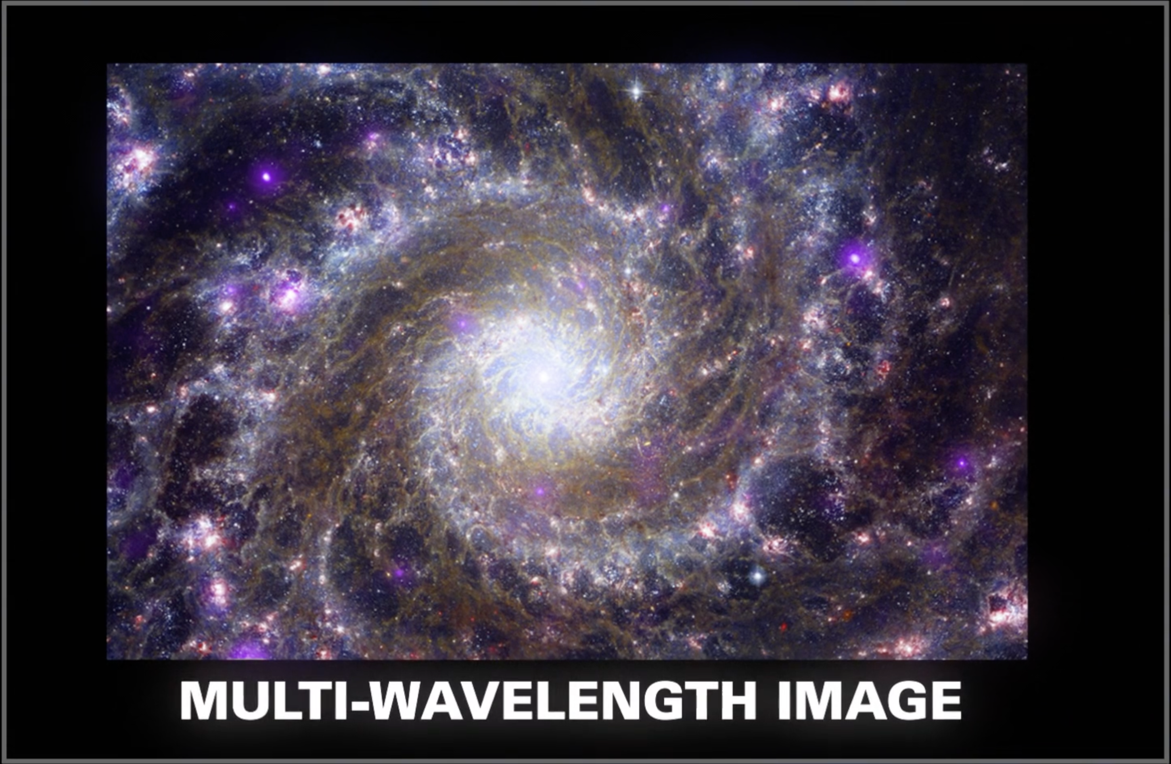
By combining images captured with different telescopes we can create a more detailed image
Notes:
16. Image Processing P. 4
Key points to address:
Images captured using different telescopes at various wavelengths can be combined to create a more detailed picture of an astronomical object.
These images are called multi-wavelength images.
Image description: Multi-wavelength image of galaxy M74, or the Phantom Galaxy, as captured by the Webb, Hubble, and Chandra Telescopes.
Image source: https://viewspace.org/video_library/videos/1377-899305803?tags=214
More background information:
Did You Know: How Images Are Made? Video: https://viewspace.org/video_library/videos/1377-899305803?tags=214
How Are Webb’s Full-Color Images Made?: https://science.nasa.gov/mission/webb/science-overview/science-explainers/how-are-webbs-full-color-images-made/
Adding Color to Chandra Images: https://chandra.harvard.edu/photo/false_color.html

Slide 17
Kahoot Quiz
www.kahoot.it
Replace the QR code accordingly and insert the code to join the Kahoot
Notes:
Kahoot Quiz
Replace the QR code with your own to host this Kahoot Quiz and/or insert the code to join.
Note that you will need to have a Kahoot account in order to host it.
This is the link for the host: https://create.kahoot.it/share/data-and-image-processing-updated/b2556a10-5a46-411f-b8d8-e278075bdc15

