Slide 1
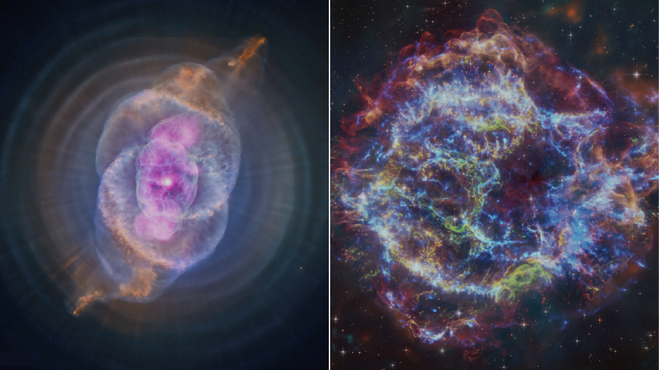
Stars
All images are credited to NASA, unless otherwise specified
Notes:
1. Onscreen slide before the presentation begins and during the introduction
These slides are available for you to customize for your presentation. Please feel free to add or remove slides as necessary to tailor the presentation for your event.
In this notes pane area, you will find key points for each slide, as well as links to additional background information.
Participant Takeaway Points:
Participants will learn during this presentation that:
Stars form from clouds of dust and gas.
Stars have life cycles.
A star’s life cycle depends on its mass.
More Background Information:
Program Theme: Stars: https://www.universe-of-learning.org/contents/products/program-theme-4-stars
Star basics – NASA: https://science.nasa.gov/universe/stars/
Stars – NASA Imagine the Universe: https://imagine.gsfc.nasa.gov/science/objects/stars1.html
Stars Infographics: https://science.nasa.gov/asset/webb/life-cycles-of-sun-like-and-massive-stars/
Image credits and sources (left to right):
Cat’s Eye (X-ray: NASA/CXC/SAO; Optical: NASA/ESA/STScI; Image Processing: NASA/CXC/SAO/J. Major, L. Frattare, K. Arcand): https://chandra.harvard.edu/photo/2024/ar/
Cas A (X-ray: NASA/CXC/SAO; Optical: NASA/ESA/STScI; IR: NASA/ESA/CSA/STScI/Milisavljevic et al., NASA/JPL/CalTech; Image Processing: NASA/CXC/SAO/J. Schmidt and K. Arcand): https://chandra.harvard.edu/photo/2024/casa/
Last Updated: December 2024

Slide 2
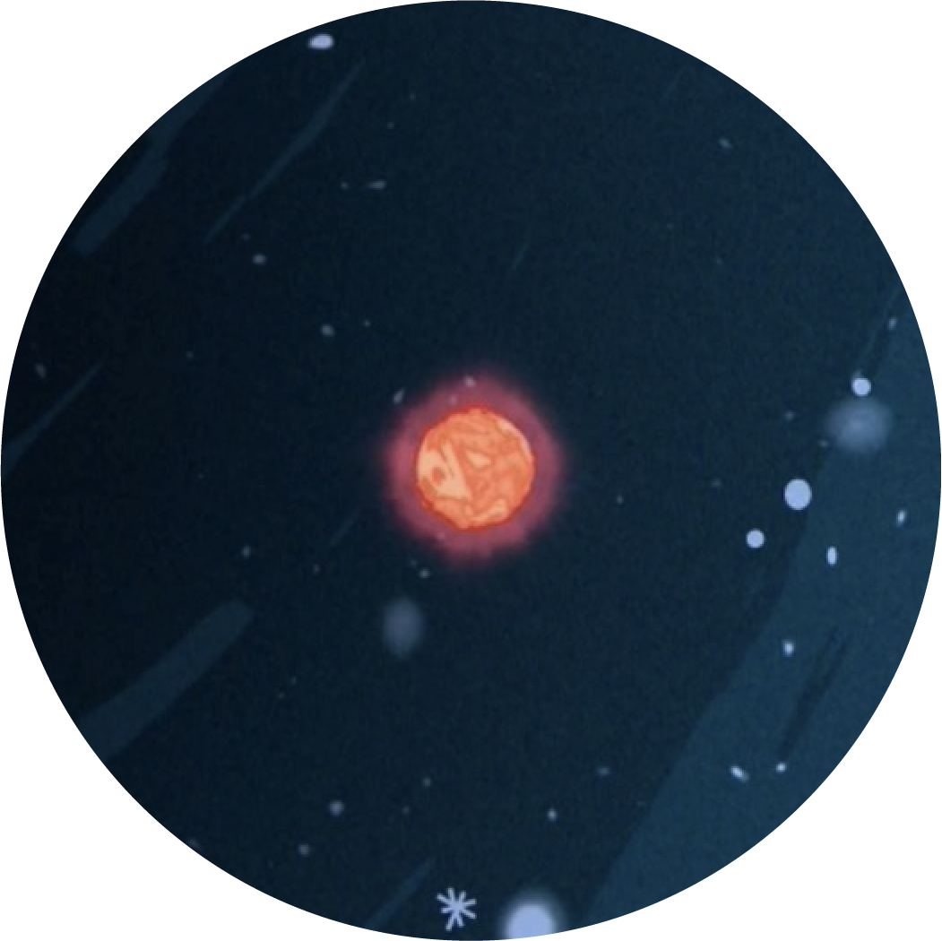
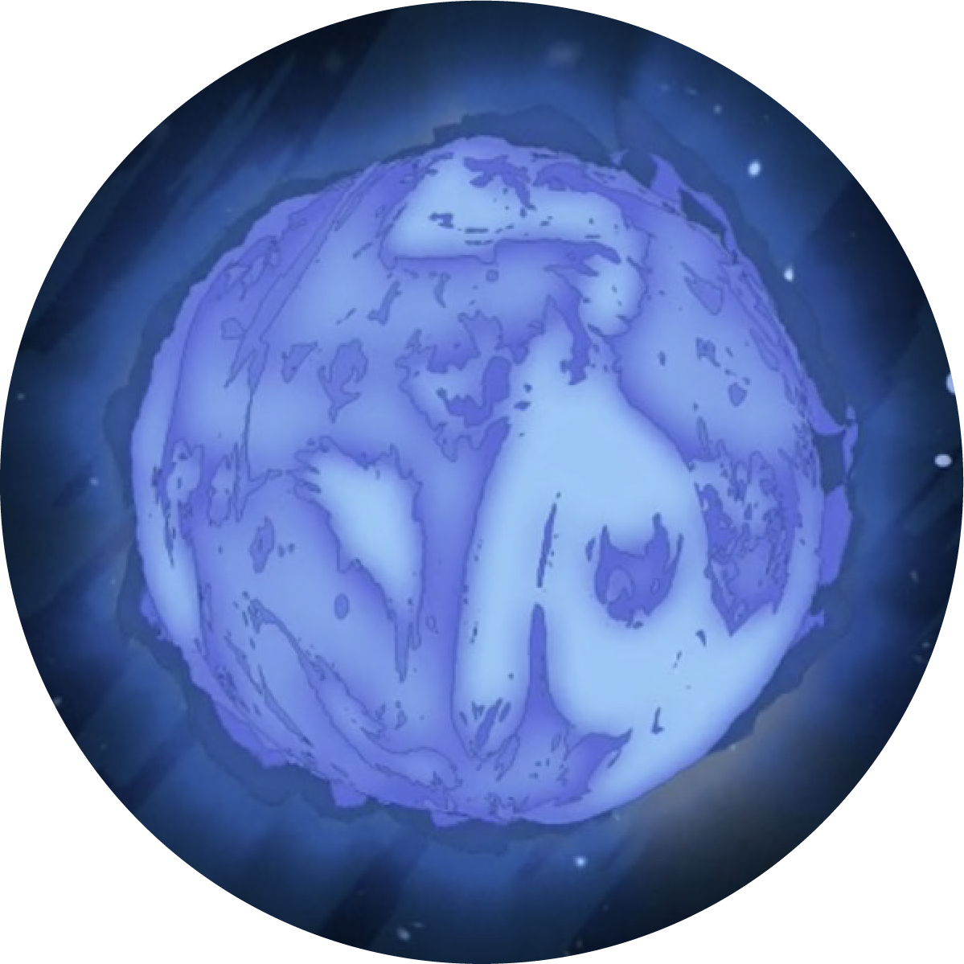
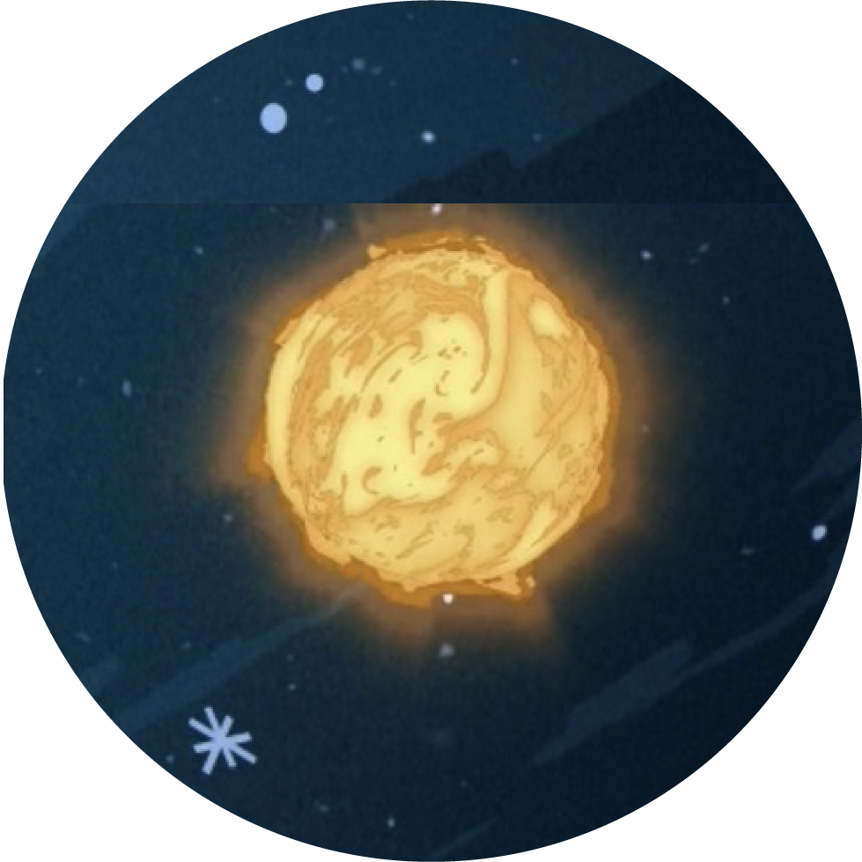
There’s a variety of stars and they can be classified according to their mass
Sun-like Stars
Low-mass Stars
Massive Stars
Have masses lower than 2 times the mass of the Sun.
Have more than 8 times the mass of our Sun.
Intermediate-mass Stars
Have masses between 2 and up to 8 times the mass of our Sun.
Image credit: STScI
Notes:
2. Explain what stars are and how astronomers classify them
Key points to address:
A star is a giant ball of gas — mainly hydrogen — held together by its own gravity.
There’s a variety of stars and one way in which astronomers classify* them is according to the amount of mass they have when they are born.
Our Sun is an example of a low-mass star.
These stars have lower temperatures.
The cooler they are, the redder they appear.
Low- and intermediate-mass stars evolve in a similar way. From here onwards, we will refer to them as Sun-like stars.
Massive stars have higher temperatures. Their intense heat causes them to emit light with shorter wavelengths, which our eyes perceive as blue.
To start the conversation: Ask participants if they know any stars. You can also ask if they know of any constellations, which are groups of stars that form recognizable patterns.
* Stars can also be classified based on their characteristics, like their temperature, which we estimate by analyzing the light they emit when split into a spectrum (like a rainbow). This classification includes different types of stars listed from hottest to coolest: O, B, A, F, G, K, and M. Our Sun is a type G star.
More background information:
Reading the Rainbow: Temperature: https://science.nasa.gov/asset/webb/reading-the-rainbow-temperature/
Spectral classification of Stars – NASA: https://spacemath.gsfc.nasa.gov/weekly/5Page43.pdf
Images source: https://science.nasa.gov/asset/webb/reading-the-rainbow-temperature/

Slide 3
Mass
Key Vocabulary
A measure of the total amount of matter — total amount of “stuff” — within an object.
Notes:
3. Define Vocabulary
Use this slide to define vocabulary as needed.
More background information:
Mass vs. Weight – NASA: https://www.nasa.gov/stem-content/mass-vs-weight-activities/

Slide 4


The Life Cycle of Humans
Prenatal Development
Infancy
Childhood
Adolescence
Adulthood
Elderly Years
Death
The average human lifetime is over 70 years
Notes:
4. Start by explaining what a life cycle is using humans as an example
Key points to address:
A life cycle is the series of stages something goes through from beginning to end.
Humans have a life cycle, and go through different stages: We are born, grow older, and eventually die.
Each of these stages lasts different lengths of time.
Engage: You can ask participants which other life cycles they know. Examples include the life cycle of a butterfly or a plant.

Slide 5
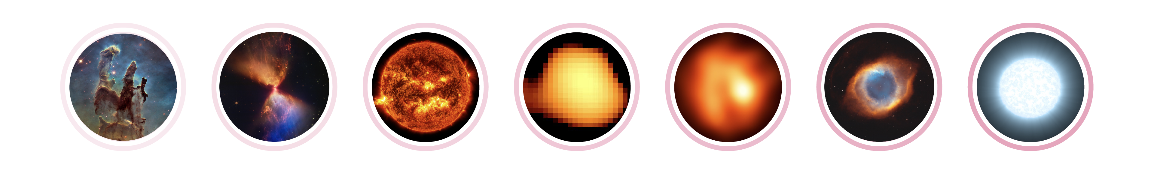

The Life Cycle of Sun-like Stars
Illustration
Credit: ESO/M. Wittkowski (ESO)
Star-forming clouds
Protostar
Main Sequence
Red Giant
Post-red Giant
Planetary Nebula
White Dwarf
Tens of millions of years
Billions of years
A few billion years
Hundreds of thousands of years
Tens of thousands of years
A Sun-like star's lifetime spans billions of years
Images not to scale
Notes:
5. The life cycle of stars (Part 1)
Key points to address:
Like humans, stars have a life cycle, but compared to that of humans, their life cycles are millions to billions of times longer.
A star like our Sun will live for billions of years and go through different stages during its lifetime.
Each of these stages lasts different lengths of time.
Image credits and sources (left to right):
Pillars of Creation (NASA, ESA/Hubble and the Hubble Heritage Team): https://esahubble.org/images/heic1501a/
Protostar L1527 (NASA, ESA, CSA, STScI; Image processing: NASA, ESA, CSA, STScI): https://science.nasa.gov/asset/webb/l1527-and-protostar-nircam-image/
Sun (NASA/Goddard/SDO): https://science.nasa.gov/image-detail/amf-gsfc_20171208_archive_e001435/
Mira (Margarita Karovska [Harvard-Smithsonian Center for Astrophysics], and NASA/ESA): https://esahubble.org/images/opo9726a/
R Sculptoris (ESO/M. Wittkowski [ESO]): https://www.astropix.org/image/eso/potw1807a
Helix Nebula (NASA, NOAO, ESA, the Hubble Helix Nebula Team, M. Meixner [STScI], and T.A. Rector [NRAO]): https://esahubble.org/images/heic0307a/
White dwarf (illustration, NASA's Goddard Space Flight Center): https://svs.gsfc.nasa.gov/13852/

Slide 6
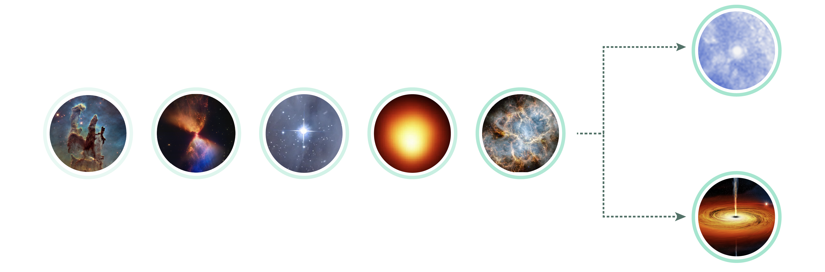

The Life Cycle of Massive Stars
Less massive stars
Neutron Star
Star-forming clouds
Protostar
Main Sequence
Red supergiant
Supernova
More massive stars
Hundreds of thousands of years
Hundreds of thousands to a few millions of years
Seconds to minutes
Illustration
Millions of years
Stellar-mass Black Hole
A massive star's lifetime spans millions of years
Images not to scale
Notes:
6. The life cycle of stars (Part 2)
Key points to address:
Massive stars will live shorter lifetimes, of the order of millions of years.
Although some stages will be similar to those of Sun-like stars, overall, each will be shorter.
Image credits and sources (left to right and top to bottom):
Pillars of Creation (NASA, ESA/Hubble and the Hubble Heritage Team): https://esahubble.org/images/heic1501a/
Protostar L1527 (NASA, ESA, CSA, STScI; Image processing: NASA, ESA, CSA, STScI): https://science.nasa.gov/asset/webb/l1527-and-protostar-nircam-image/
Star cluster NGC 602 (NASA): https://science.nasa.gov/missions/hubble/bright-blue-stars/
Betelgeuse (Andrea Dupree [Harvard-Smithsonian CfA], Ronald Gilliland [STScI], NASA and ESA): https://science.nasa.gov/solar-system/skywatching/night-sky-network/meet-the-workaholic-star-betelgeuse/
Crab Nebula (NASA, ESA, CSA, STScI, T. Temim [Princeton University]; Image processing: Joseph DePasquale [STScI]): https://science.nasa.gov/asset/webb/crab-nebula-nircam-and-miri-image/
Cygnus X-1 (illustration, NASA/CXC/M.Weiss): https://chandra.harvard.edu/photo/2011/cygx1/
Crab Nebula (neutron star, X-ray: NASA/CXC/SAO; Image processing: NASA/CXC/SAO/J. Schmidt, J. Major, A. Jubett, K. Arcand): https://chandra.harvard.edu/photo/2024/timelapse/

Slide 7
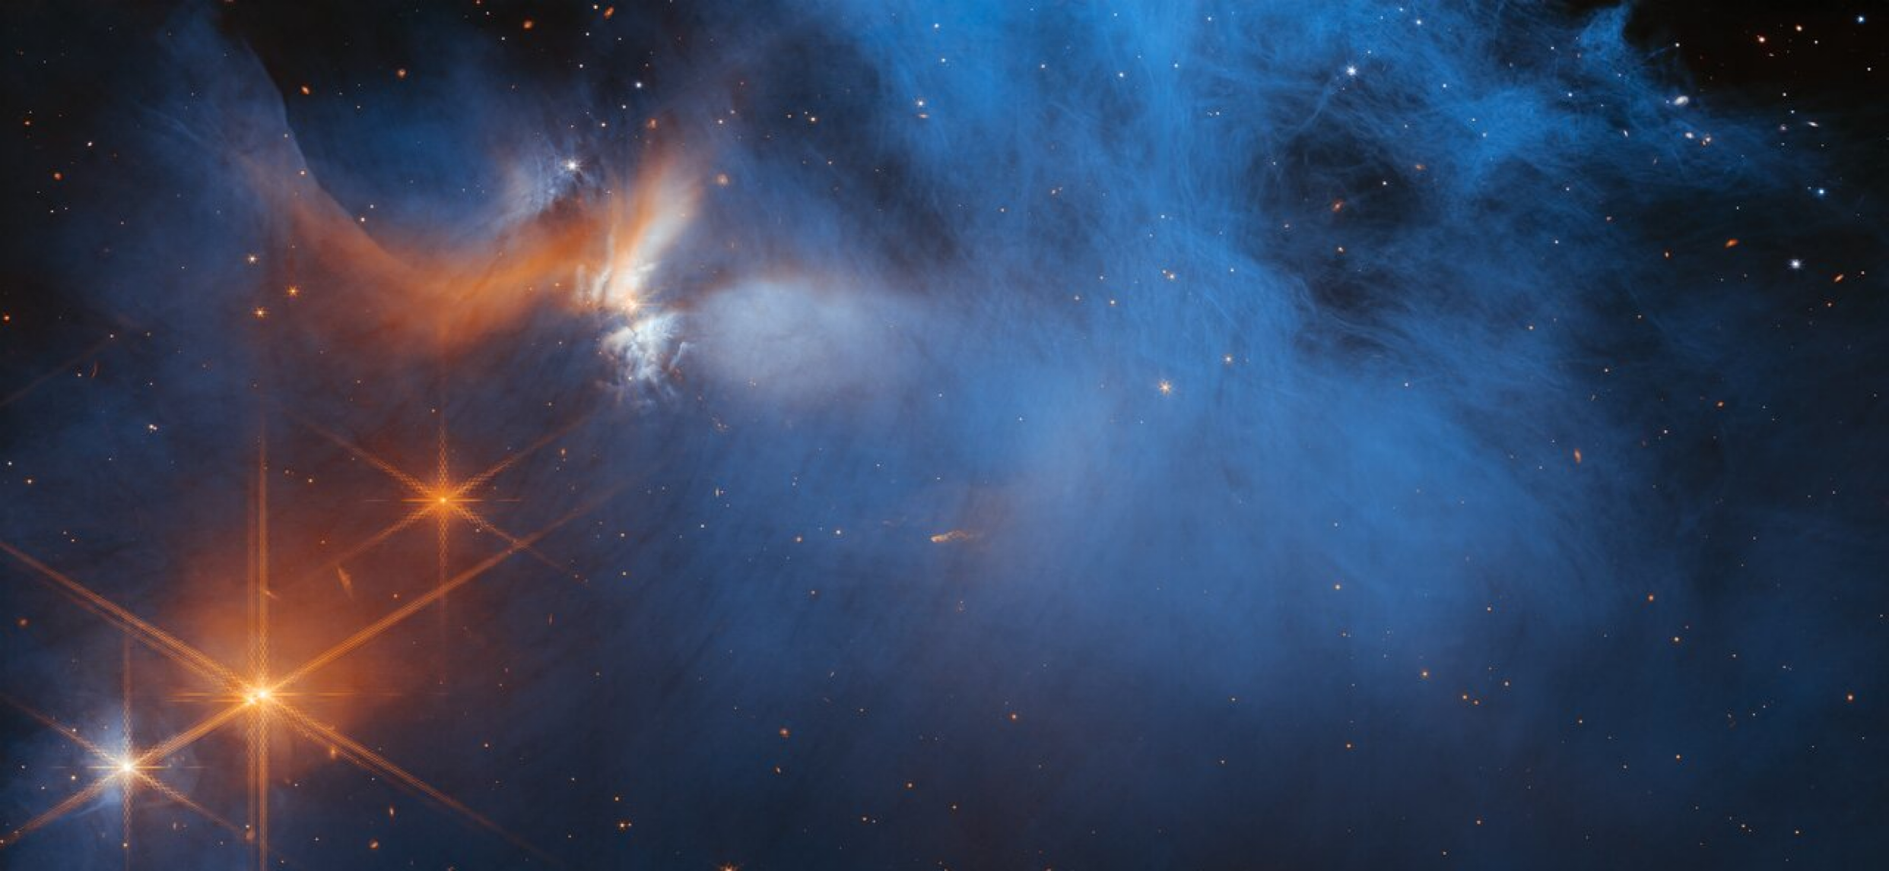
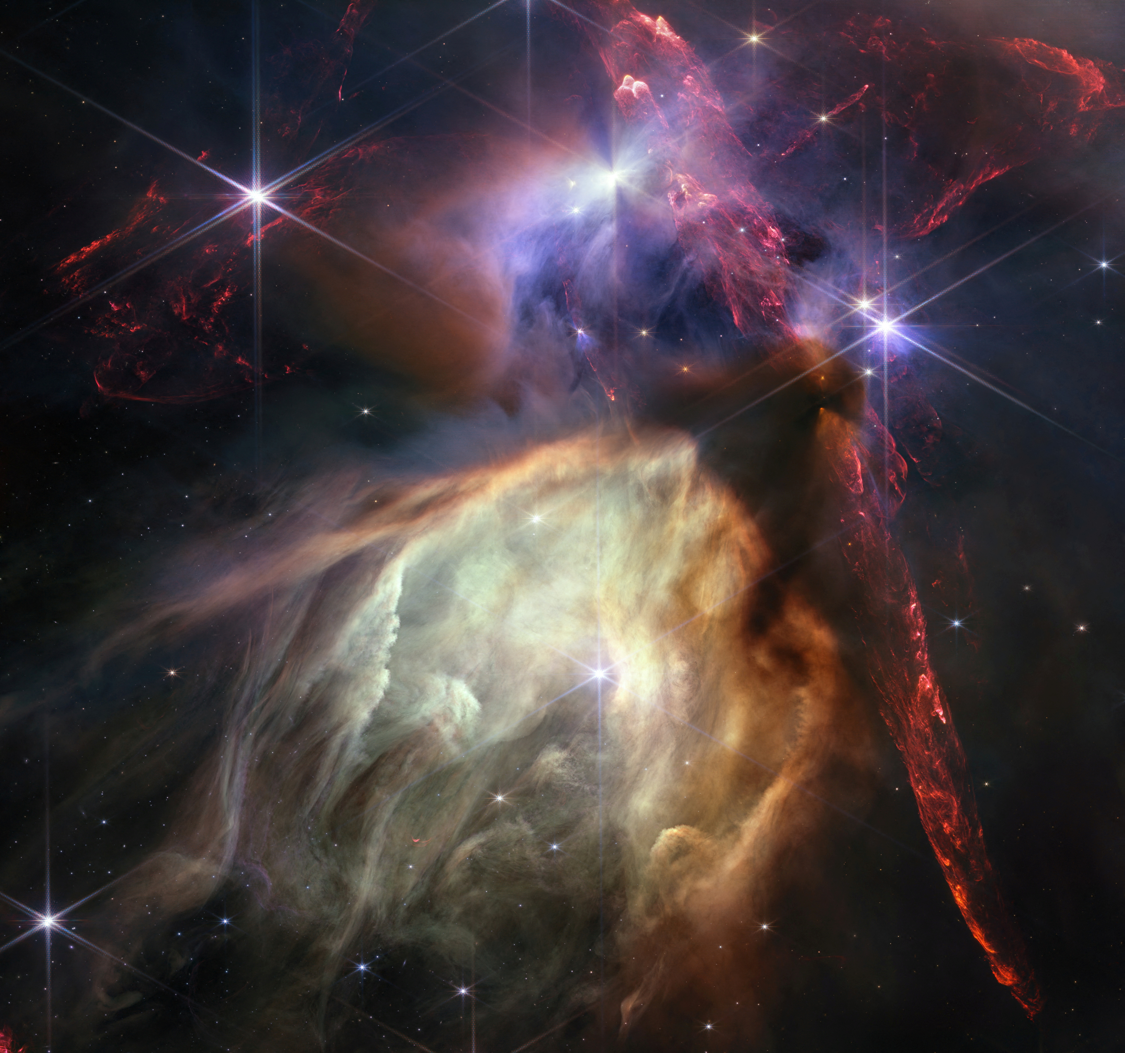
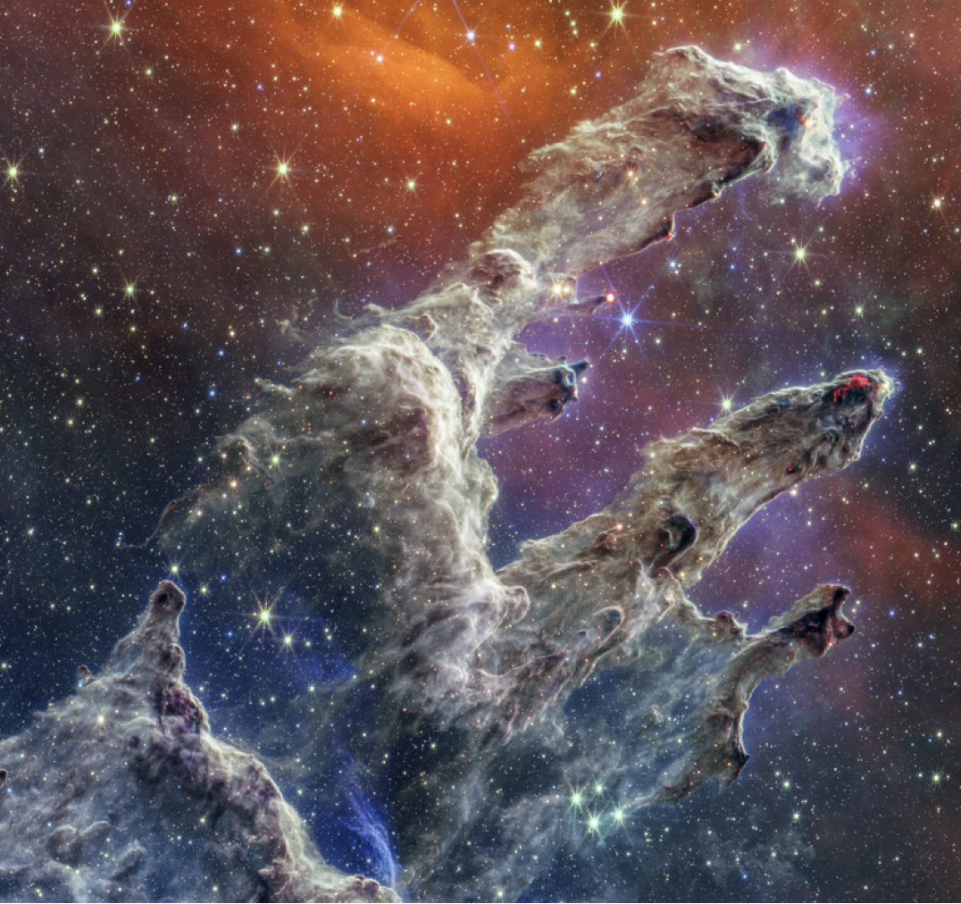
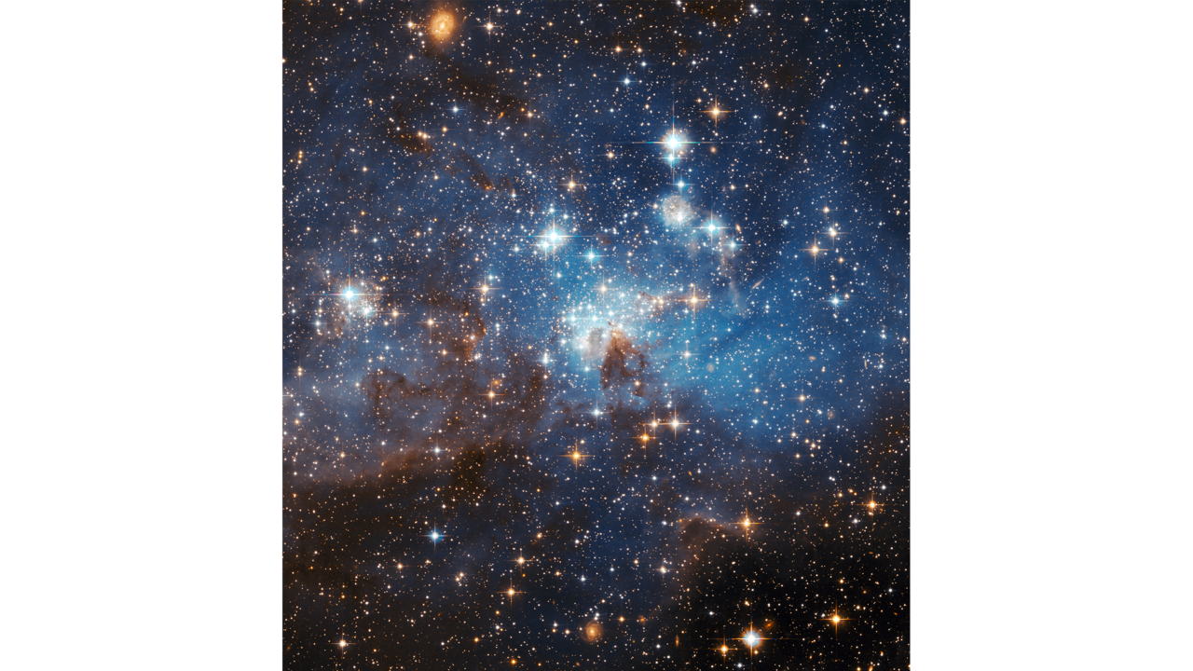
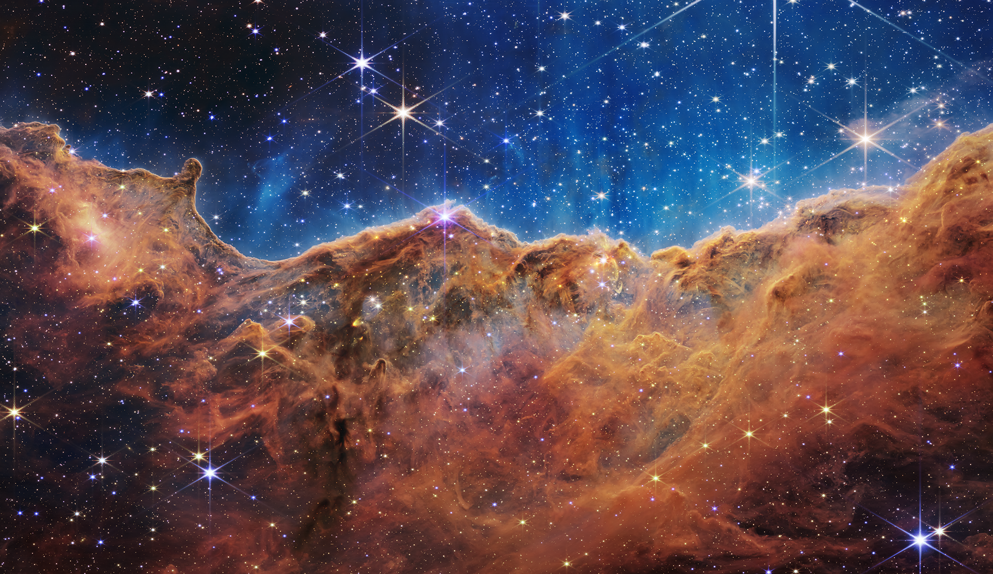
Star-forming Clouds: Where It All Begins
Notes:
7. The life stages of stars: Star-forming cloud
Key points to address:
All stars form from giant clouds of gas and dust, called molecular clouds, or nebulae.
These clouds can span from a few light-years to hundreds of light-years across and can have 1,000 to 10 million times the mass of our Sun.
Note: A light year is approximately 6 trillion miles. For reference, our Sun is about 8 light-minutes away from Earth. This means that light takes 8 minutes to get from the Sun to Earth.
When something disrupts these clouds — for example, shock waves from a nearby star that has exploded — gravity pulls material in the clouds close together.
This material starts to heat up and glow, eventually turning into a baby star, called a protostar.
Hundreds to hundreds of thousands of stars can be born in a very massive star-forming cloud.
Did you know? Batches of stars that have recently formed from molecular clouds are often called young stellar clusters, and star-forming clouds full of young stellar clusters are called stellar nurseries.
Image credits and sources (left to right and top to bottom):
Chamaeleon I (NASA, ESA, CSA): https://science.nasa.gov/asset/webb/chamaeleon-i-molecular-cloud-nircam-image/
Rho Ophiuchi (NASA, ESA, CSA, STScI, Klaus Pontoppidan [STScI]): https://science.nasa.gov/asset/webb/rho-ophiuchi-nircam-image/
Tarantula Nebula (X-ray: NASA/CXC/Penn State Univ./L. Townsley et al.; IR: NASA/ESA/CSA/STScI/JWST ERO Production Team) : https://chandra.harvard.edu/photo/2024/sonify9/
Pillars of Creation (NASA, ESA, CSA, STScI): https://science.nasa.gov/asset/webb/pillars-of-creation-miri-image/
LH 95 (NASA, ESA): https://esahubble.org/images/heic0607a/
NGC 3324 (NASA, ESA, CSA, and STScI): https://www.nasa.gov/image-article/nasas-webb-reveals-cosmic-cliffs-glittering-landscape-of-star-birth/

Slide 8
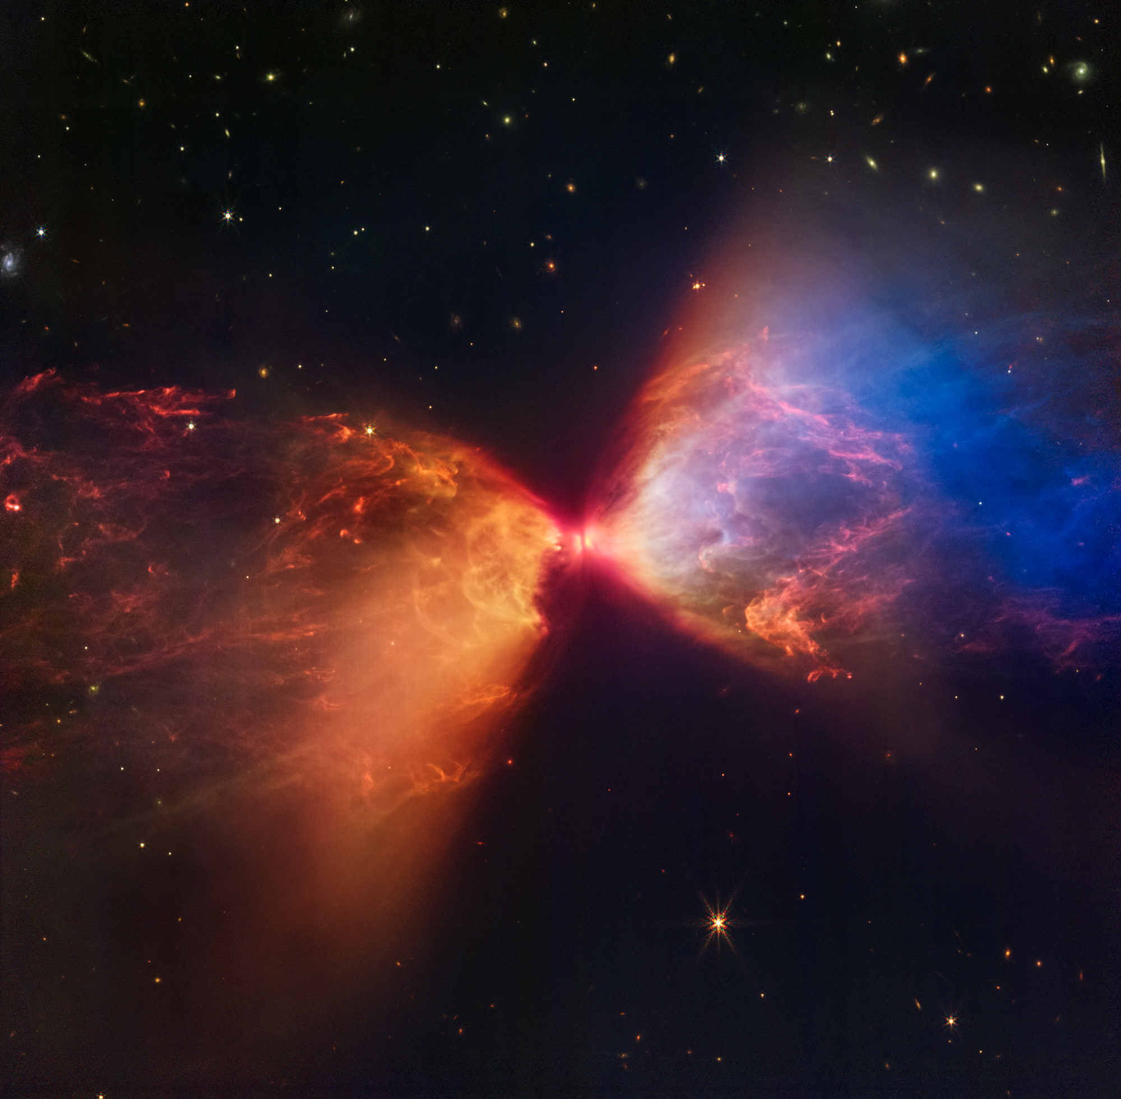
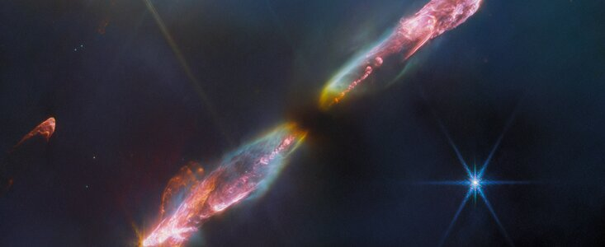
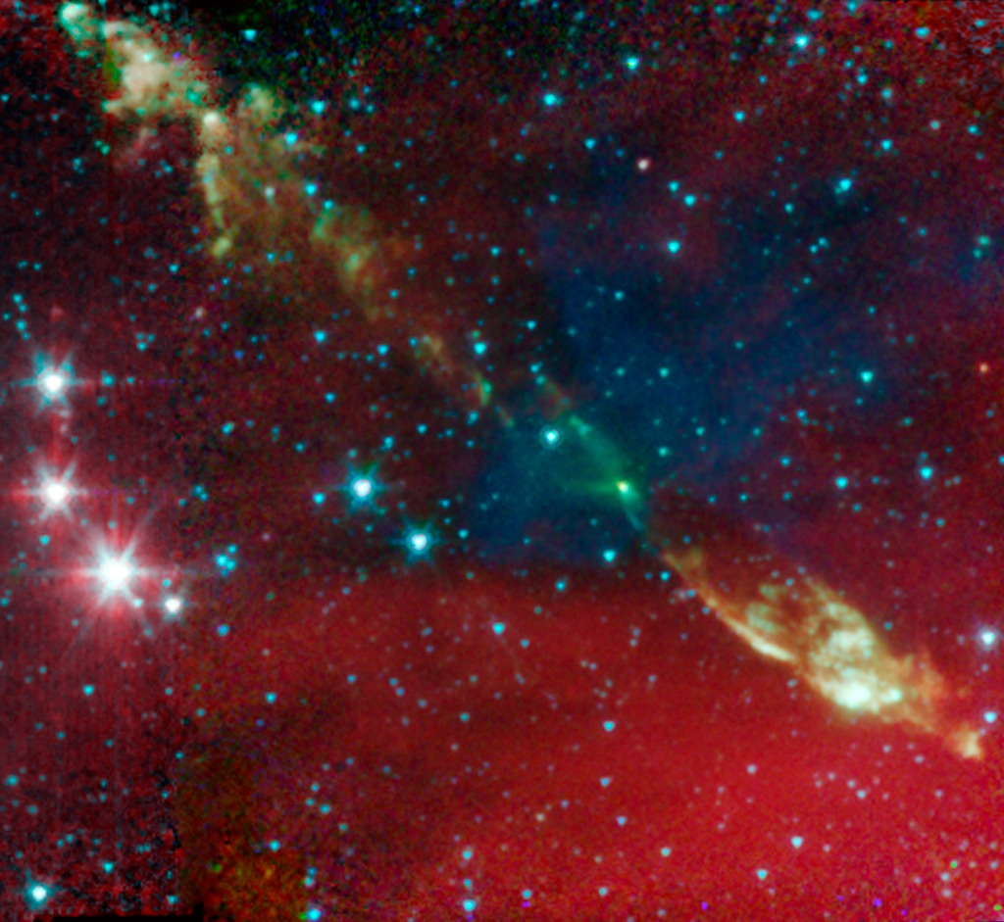
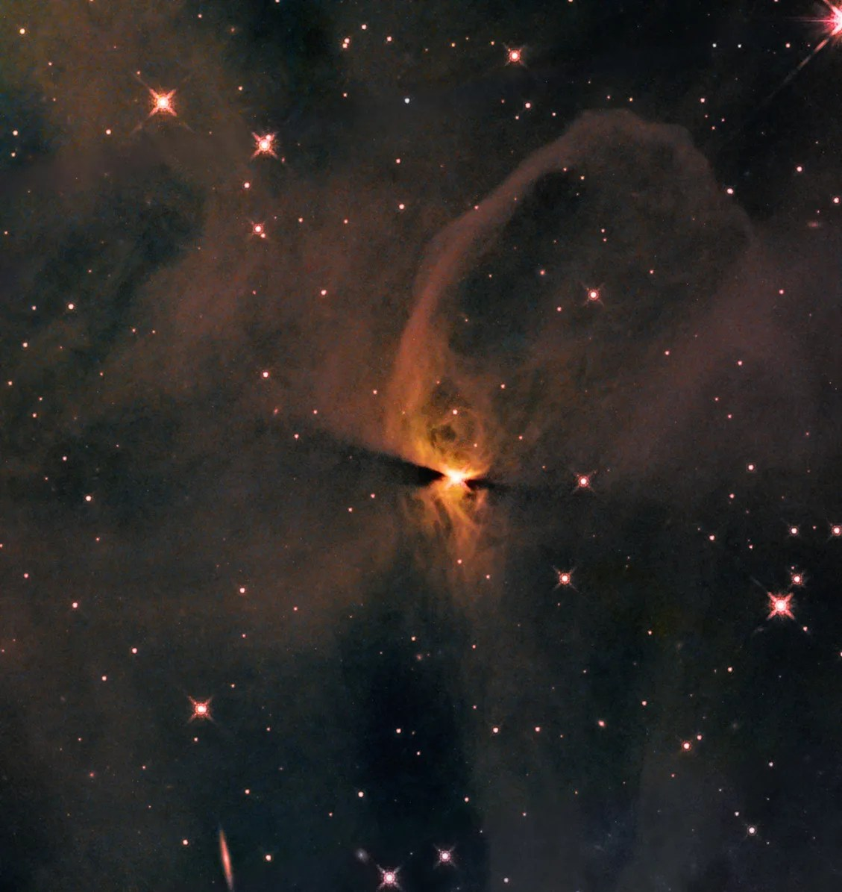
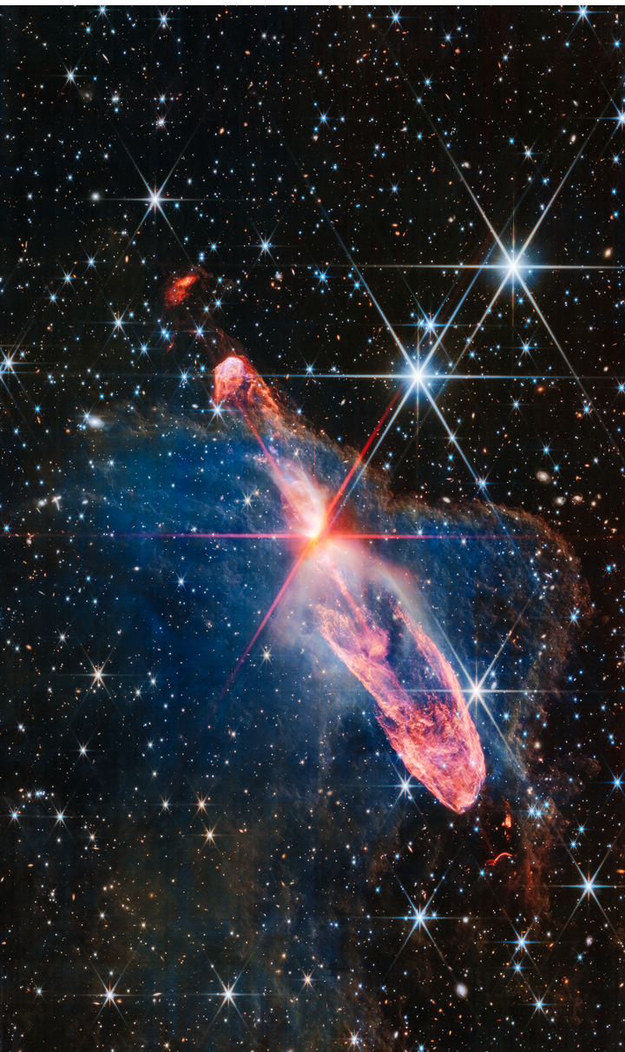
Protostars: Baby Stars
Notes:
8. The life stages of stars: Protostar
Key points to address:
If a smaller amount of material was pulled together, a Sun-like star will be born.
If a huge amount of material was pulled together, a massive star will be born.
While the star is forming, it might expel some material in jets, which we see in some of these images. The jets will stop once the star has settled.
Eventually the protostar collects enough material, and its core becomes hot and dense enough for nuclear fusion to begin. Then the transformation into a star is complete.
Image credits and sources (left to right and top to bottom):
HH 211 (ESA/Webb, NASA, CSA, T. Ray [Dublin Institute for Advanced Studies]): https://esawebb.org/news/weic2322/
IRAS 03282+3035 (NASA/JPL-Caltech/J. Tobin [University of Michigan]): https://www.spitzer.caltech.edu/image/sig10-006a-protostellar-envelope-and-jet-iras-03282-3035
IC 2631 (NASA, ESA, T. Megeath [University of Toledo], and K. Stapelfeldt [Jet Propulsion Laboratory]): https://science.nasa.gov/missions/hubble/hubble-spies-newly-forming-star-incubating-in-ic-2631/
Herbig-Haro 46/47 (NASA, ESA, CSA): https://science.nasa.gov/asset/webb/herbig-haro-4647-nircam-image/

Slide 9
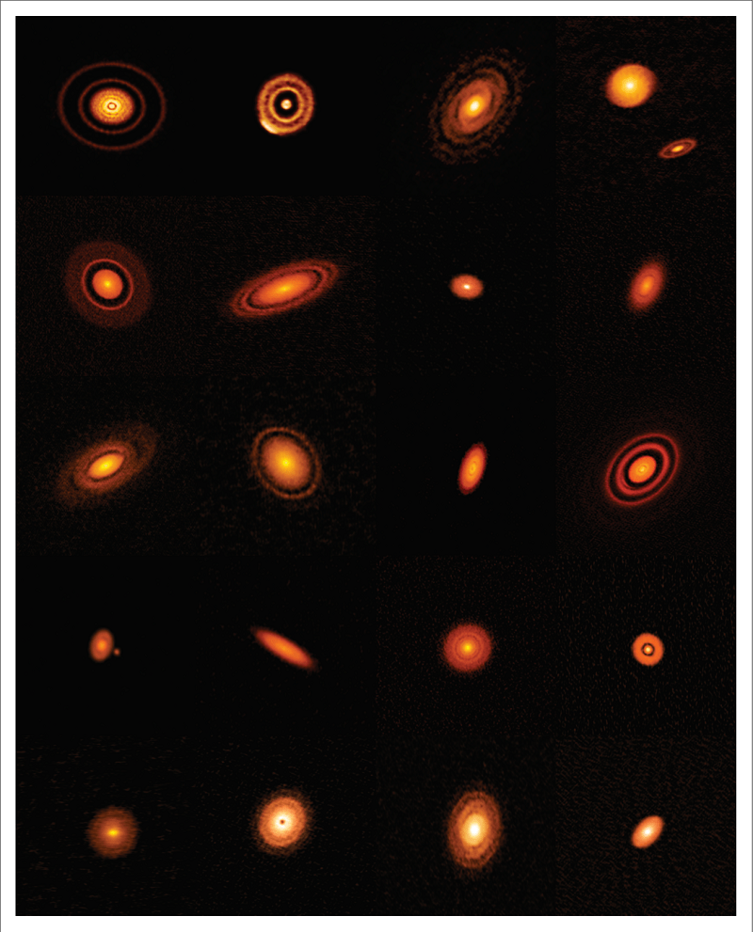
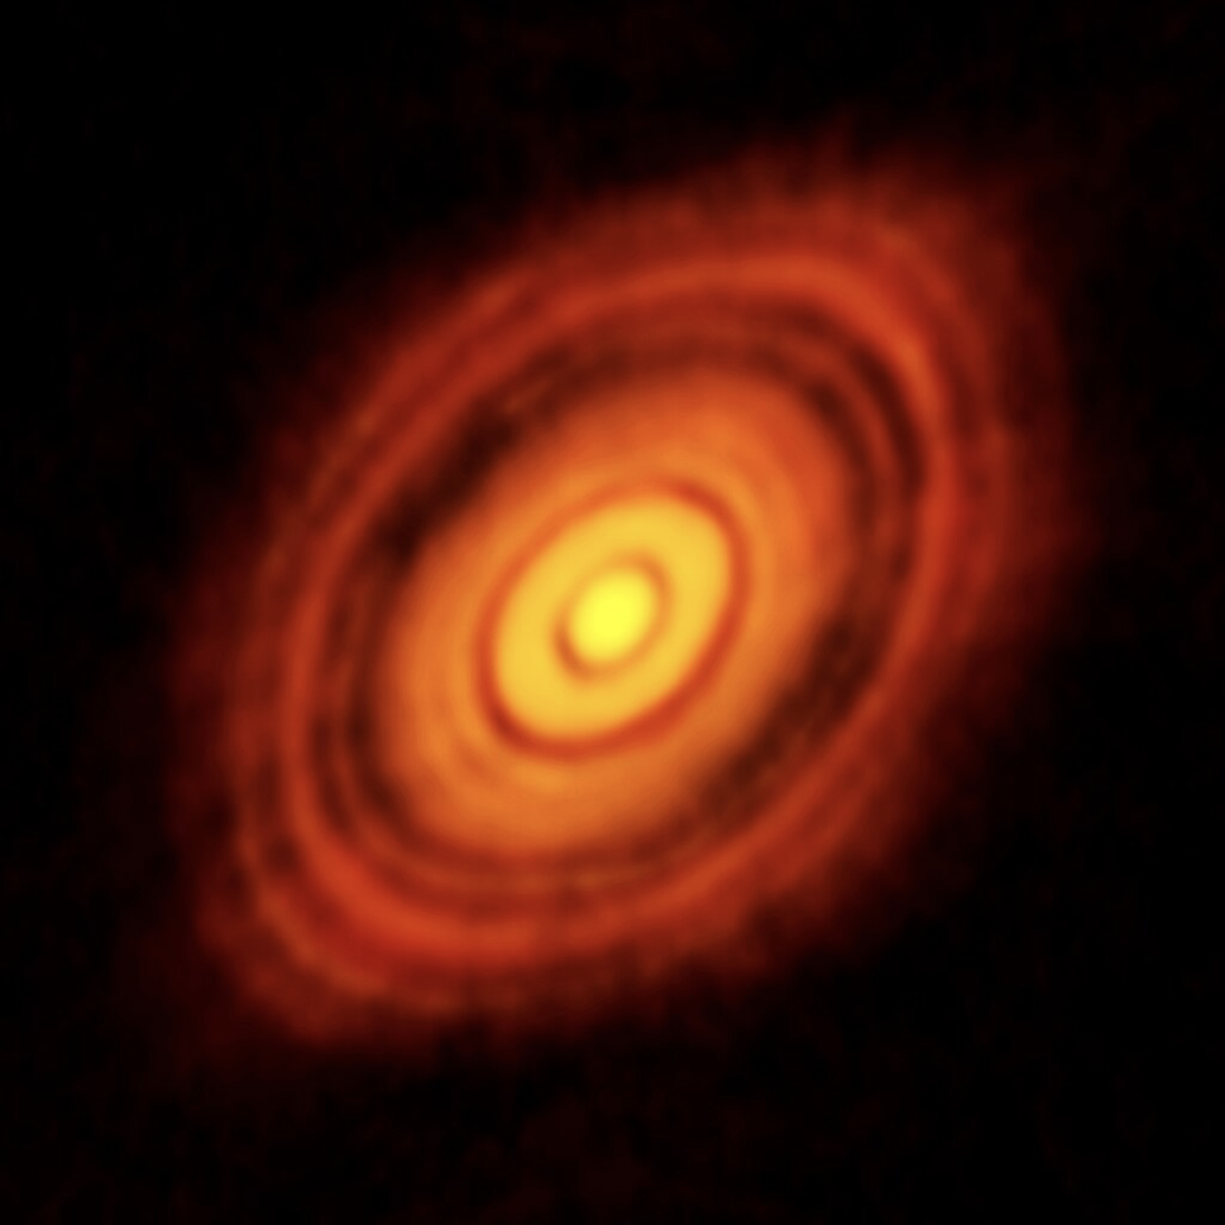
Protoplanetary Disk: Where Planets, Asteroids, and Other Small Bodies Form
Image Credits: ALMA (ESO/NAOJ/NRAO); ALMA (ESO/NAOJ/NRAO), S. Andrews et al.; NRAO/AUI/NSF, S. Dagnello
Notes:
9. The life stages of stars: Protoplanetary disk
Key points to address:
As the star forms, a rotating disk of leftover gas and dust from the star formation process surrounds it. This is called a protoplanetary disk.
As the dust and gas in the disk clump together over time, they form planets, moons, and other small celestial objects, like asteroids.
Image sources:
https://almascience.eso.org/alma-science/planet-forming-disks
https://public.nrao.edu/news/2018-alma-survey-disks/

Slide 10
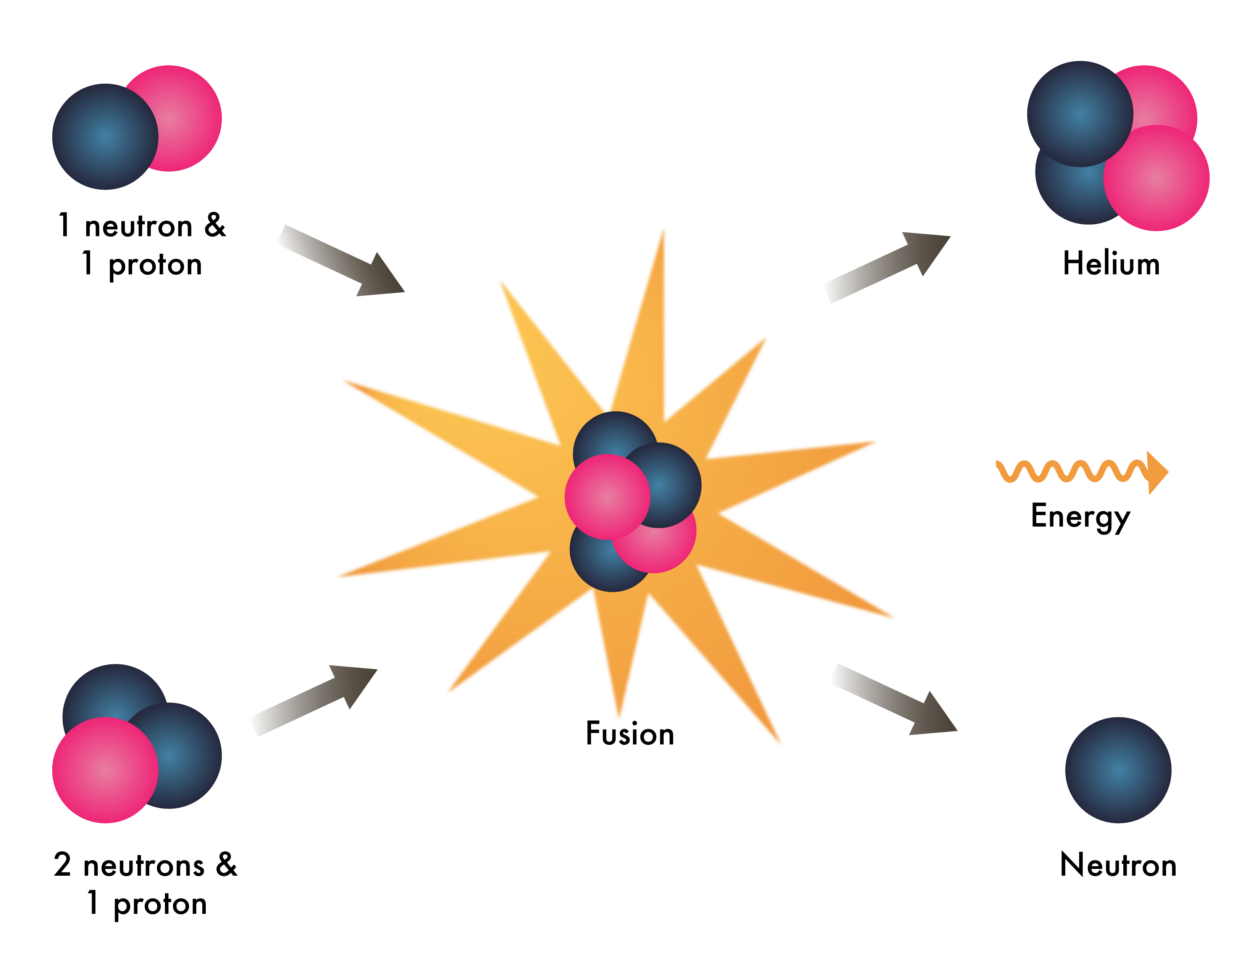
Nuclear Fusion
Key Vocabulary
A natural process that releases energy when the nuclei of two or more atoms combine to form a single heavier nucleus.
Notes:
10. Define Vocabulary
Use this slide to define vocabulary as needed.
Tip: For inexpert learners, introduce nuclear fusion as tiny particles smashing into each other and giving off a large amount of light and heat as they combine.

Slide 11
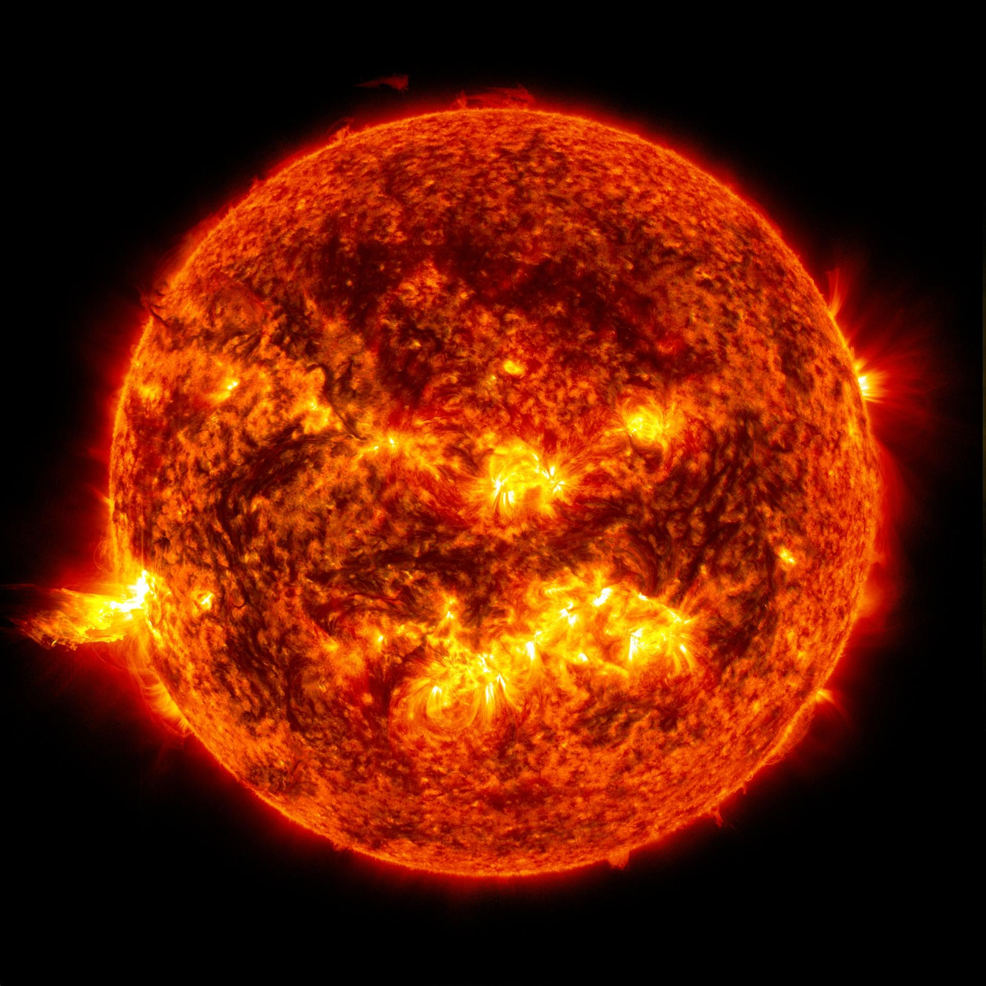
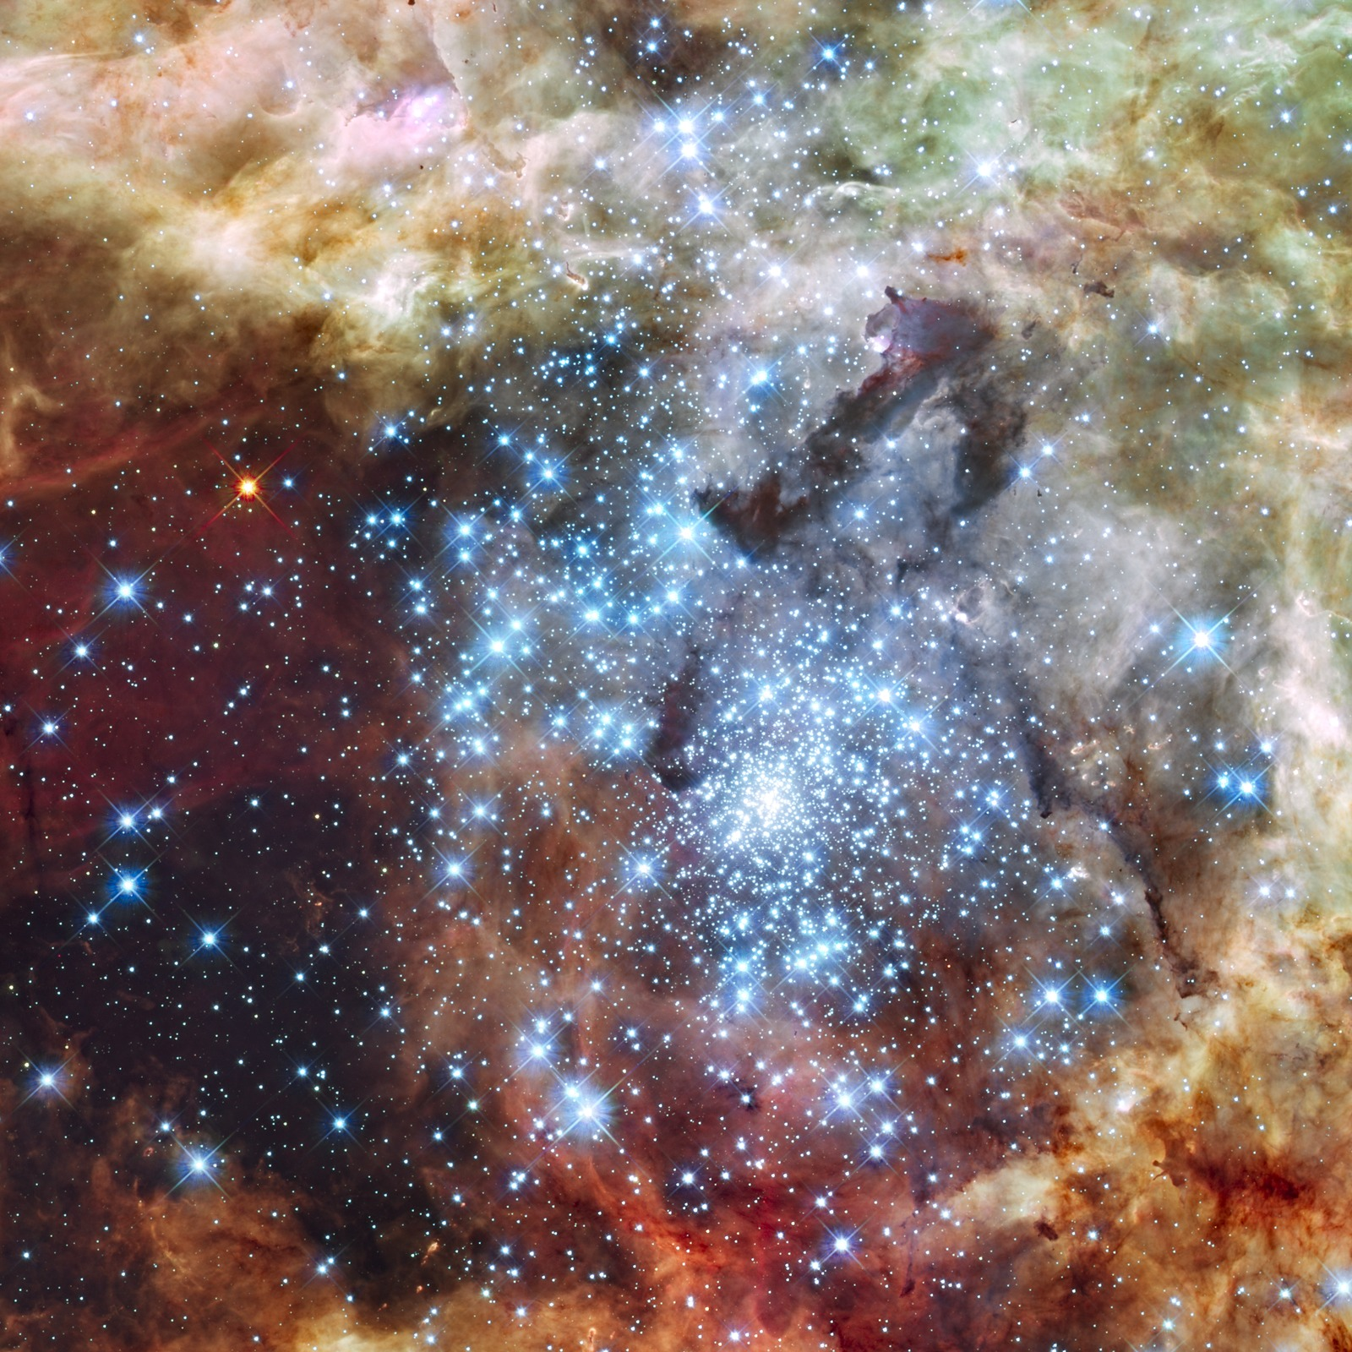


The Main Sequence: The Longest Life Stage of All Star Types
Sun-like Stars
Massive Stars
Images not to scale
Billions of years
Millions of years
Notes:
11. The life stages of stars: The main sequence
Key points to address:
As the baby star (protostar) gains mass, its core (center of the star) gets hotter and denser (more tightly packed). Eventually, the baby star’s core is hot and dense enough for hydrogen to start fusing into helium.
When the protostar starts fusing hydrogen, it enters the "main sequence" phase of its life.
Stars spend most of their life in the main sequence stage:
A Sun-like star will spend billions of years in this phase, burning hydrogen into helium in its center.
A massive star will spend its fuel faster, and therefore will remain in this phase for only a few millions years.
Note: The radiation and heat from the hydrogen fusion keeps the force of gravity from collapsing the star during the main sequence phase. Massive stars have stronger gravity acting inwards, which makes their cores hotter. This speeds up nuclear reactions, so they use up their fuel faster than Sun-like stars.
Image credits and sources:
Sun (left, NASA/Goddard/SDO): https://science.nasa.gov/image-detail/amf-gsfc_20171208_archive_e001435/
30 Doradus Nebula (right, NASA, ESA, and E. Sabbi [ESA/STScI]): https://esahubble.org/images/opo1235b/

Slide 12
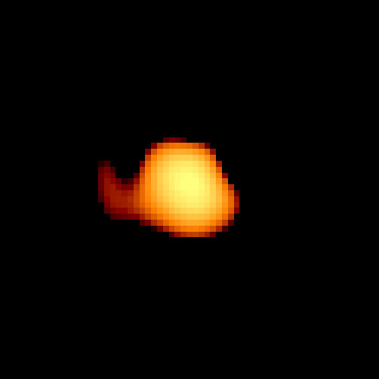
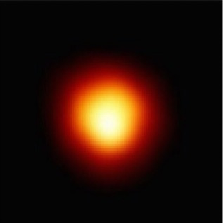
The Red Giant Phase
The Red Supergiant Phase
Sun-like Stars
Massive Stars
Images not to scale
A few billion years
Hundreds of thousands to a few million years
Notes:
12. The life stages of stars: The red giant phase (Sun-like stars) and the red supergiant phase (massive stars)
Key points to address:
As the star runs out of hydrogen, the outward pressure of fusion is overwhelmed by the inward pull of gravity.
The star’s inner layers begin collapsing, squishing the core and increasing its pressure and temperature.
Meanwhile, the outer layers expand and cool down, giving the star its red color:
Sun-like stars expand to a hundred times bigger.
Massive stars can expand up to a thousand times bigger.
At this point the star is called:
A red giant star for Sun-like stars
A red supergiant star for massive stars.
The star's hot, dense core initiates a new nuclear reaction, fusing helium into carbon and oxygen until it runs out of helium fuel.
Did you know? When our Sun reaches the red giant phase, it will expand to a size that could reach Mars’ orbit.
Image credits and sources:
Mira (left, Margarita Karovska [Harvard-Smithsonian Center for Astrophysics], and NASA/ESA): https://esahubble.org/images/opo9726a/
Betelgeuse (right, Andrea Dupree [Harvard-Smithsonian CfA], Ronald Gilliland [STScI], NASA and ESA): https://science.nasa.gov/solar-system/skywatching/night-sky-network/meet-the-workaholic-star-betelgeuse/

Slide 13
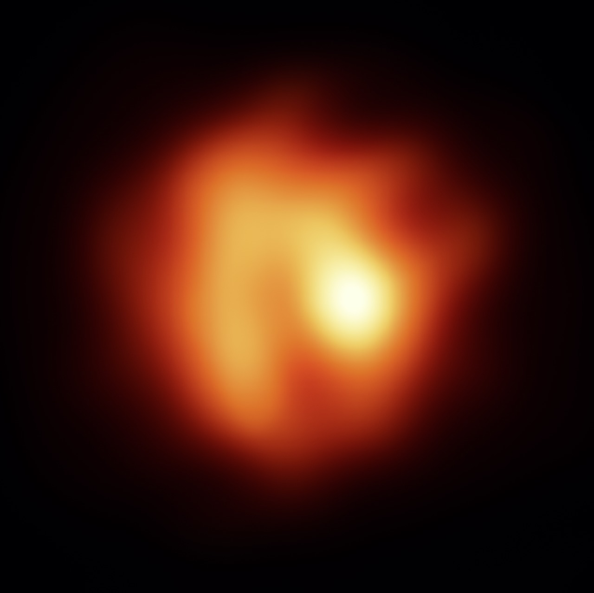
The Post-red Giant Phase
The Red Supergiant Phase
(cont.)
Sun-like Stars
Massive Stars
Image Credits: ESO/M. Wittkowski (ESO)
Images not to scale
Hundreds of thousands of years
Hundreds of thousands to a few million years
Notes:
13. The life stages of stars: The post-red giant phase (Sun-like stars) and the red supergiant phase (massive stars) continuation
Key points to address:
What happens next depends on the star’s mass:
Sun-like star:
Once the star runs out of helium fuel in its core, the star expands further and becomes extremely luminous.
Fusion now occurs in shells around a core (center) made of carbon and oxygen.
The star then undergoes pulsations that inflate and deflate it, ejecting some of its outer layers.
Massive star:
Once the star runs out of helium fuel in its core, the core will contract again, and become hotter and dense enough to fuse carbon into a heavier element, neon.
When carbon is used up, another fusion reaction occurs, which will produce another even heavier element. This will continue until the core is filled with iron atoms.
Up to this point, the fusion reactions produce enough energy to fight the gravitational force that would make it collapse. However, fusing iron requires an input of energy rather than producing excess energy.
With a core full of iron, the star will lose the fight against gravitational forces.
Image credits and sources:
R Sculptoris (left, ESO/M. Wittkowski [ESO]): https://www.eso.org/public/images/potw1807a/
Betelgeuse (right, Andrea Dupree [Harvard-Smithsonian CfA], Ronald Gilliland [STScI], NASA and ESA): https://science.nasa.gov/solar-system/skywatching/night-sky-network/meet-the-workaholic-star-betelgeuse/

Slide 14
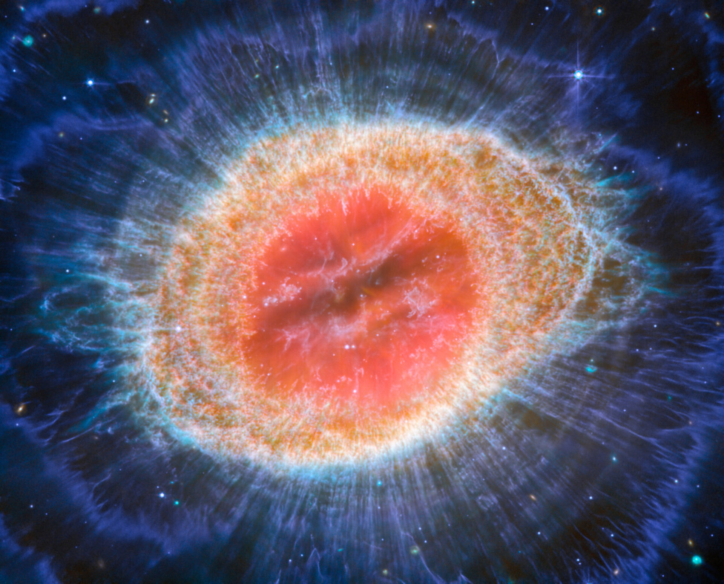
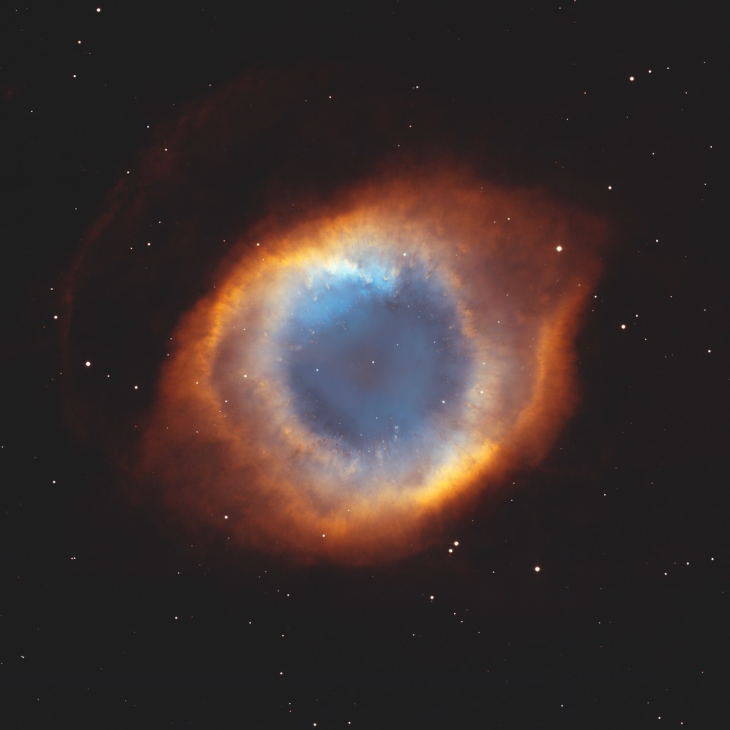
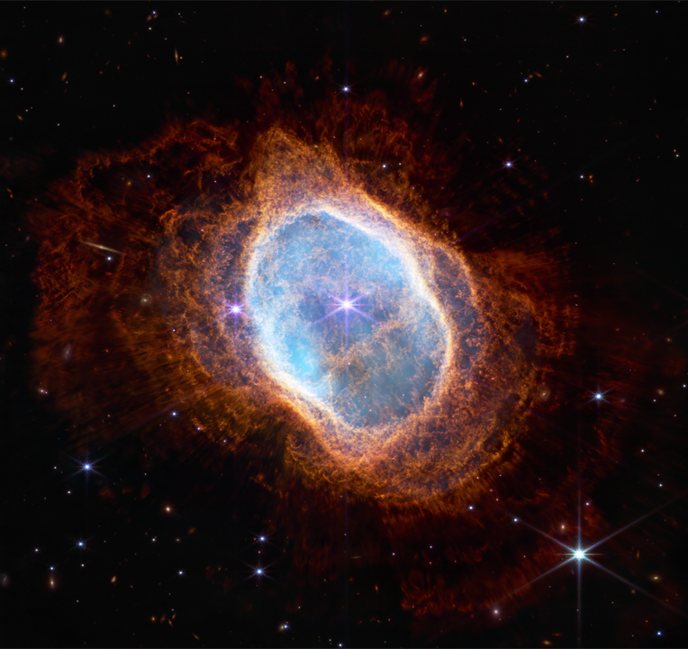
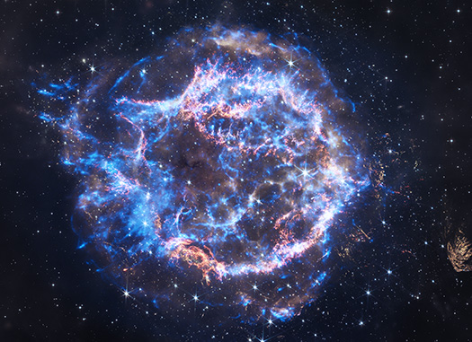
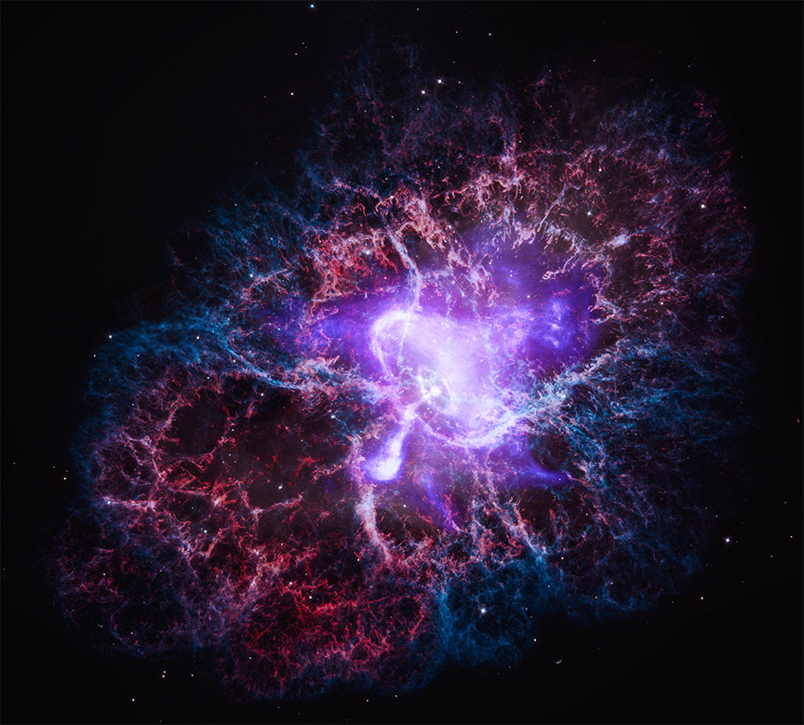
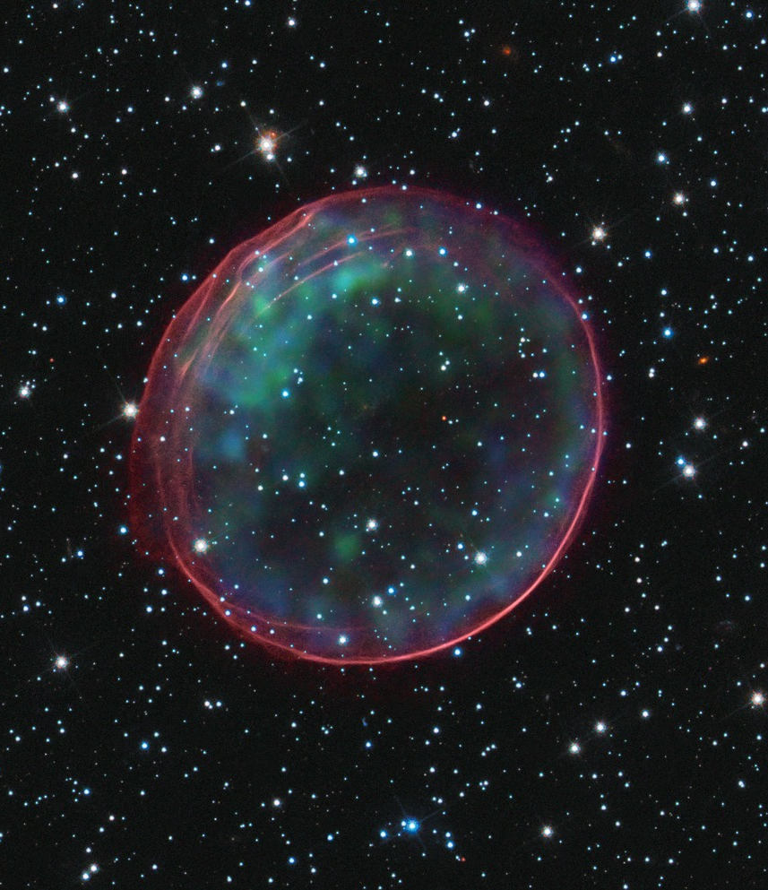
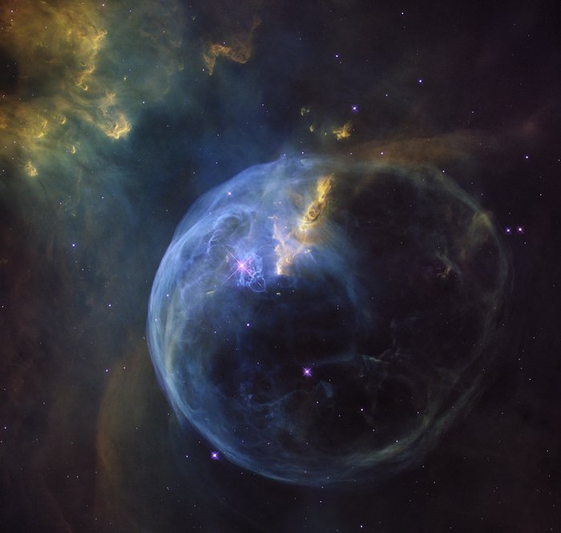
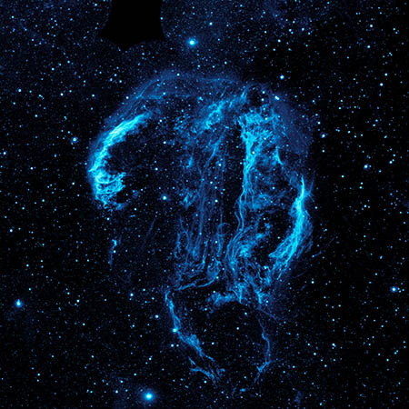
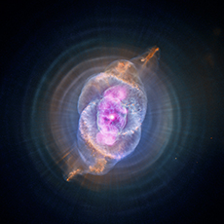
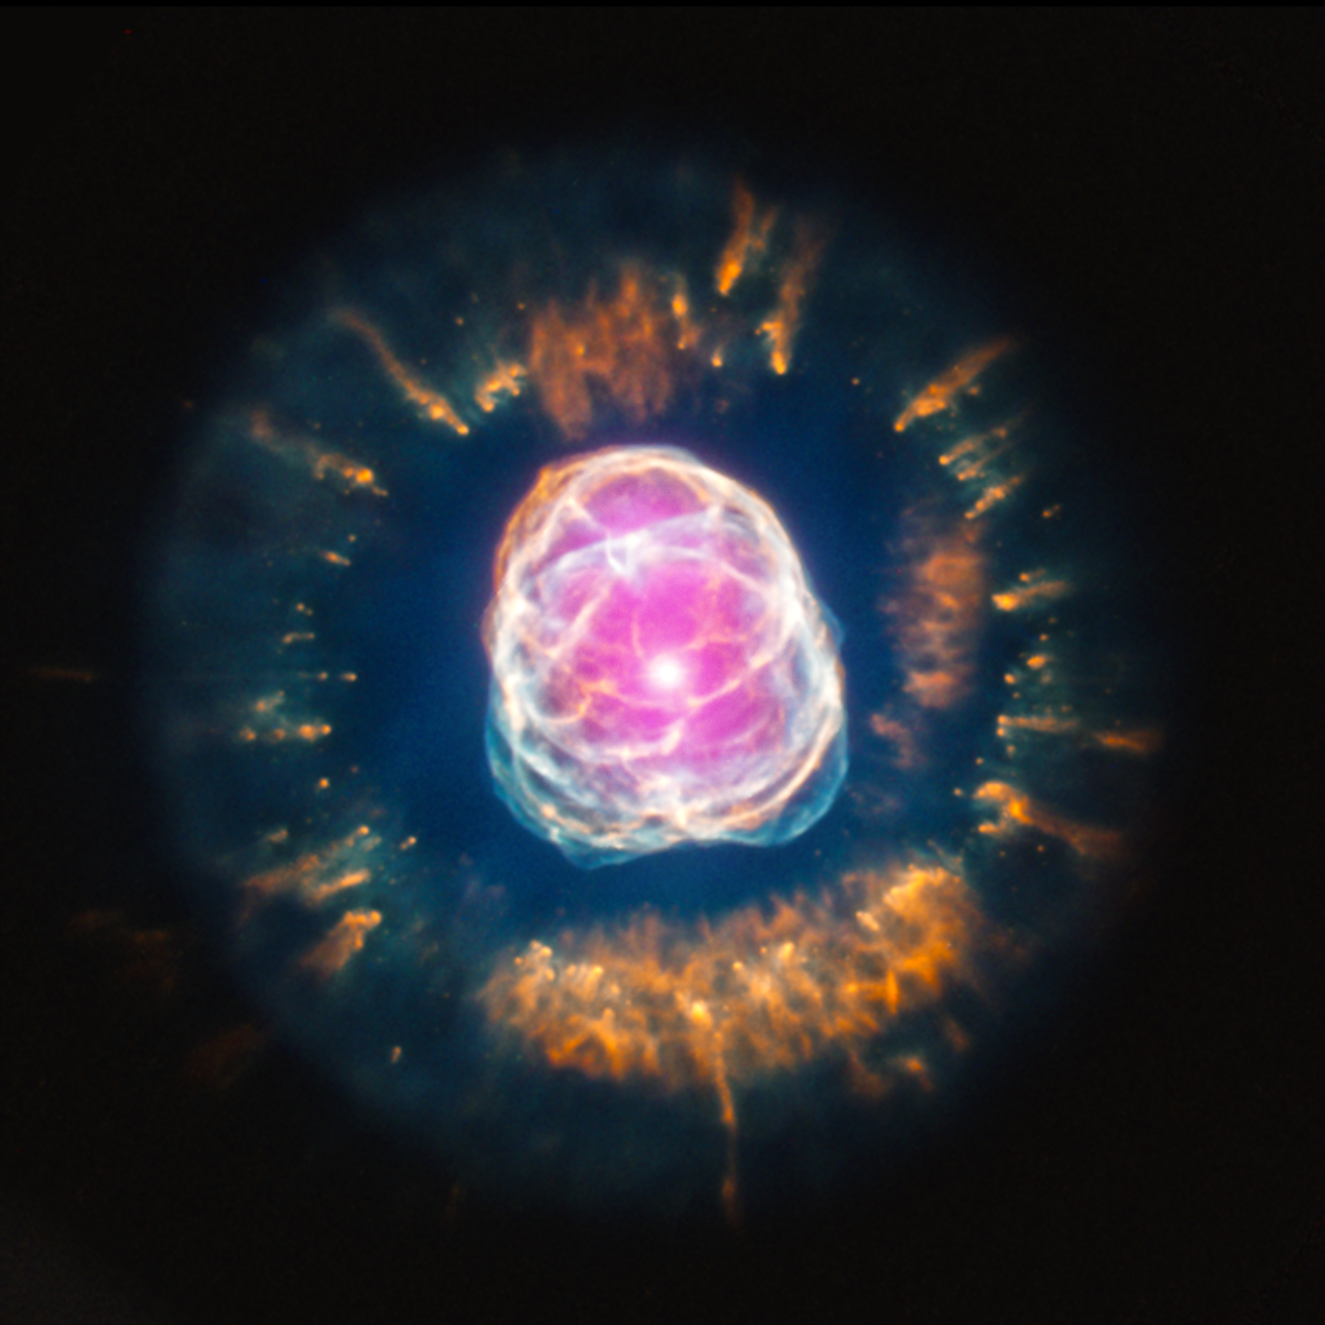
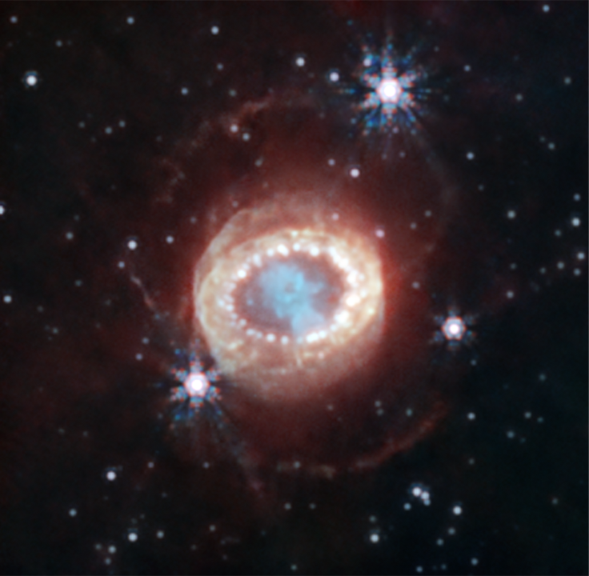
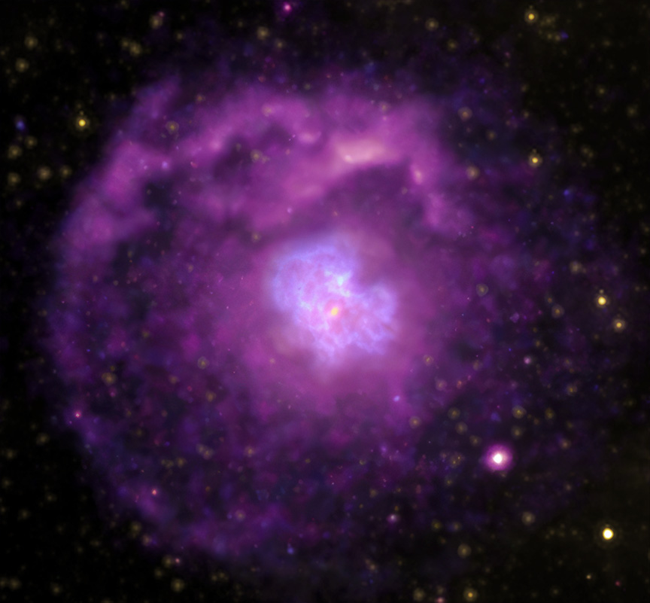
Planetary Nebula:
The Star’s Gradual Demise
Supernova:
The Star’s Fast Demise
Sun-like Stars
Massive Stars
Tens of thousands of years
Explosion: Seconds to minutes
Remnant: Up to hundreds of thousands of years
Notes:
14. The life stages of stars: Their final stages
Key points to address:
What happens in the star’s final stages depends on its mass:
Sun-like star:
The star will shed most of its mass, eventually forming a cloud of material called a planetary nebula.
The material shed by the star during its life and later stages will be recycled and enrich future star-forming clouds and become incorporated into the next generation of stars.
Massive star:
As the nuclear reactions stop, gravity makes the star’s iron core collapse, crushing the iron nuclei until forces between the nuclei abruptly halt the contraction.
This sudden change creates a powerful shock wave that travels through the star’s outer layers, heating them up and creating even more new elements!
The result is a huge explosion called a supernova.
The material cast into space during the star’s life and by the supernova will enrich future star-forming clouds and become incorporated into the next generation of stars.
Note: The images show the remnants of this explosion, called “supernova remnants.”
More background information:
Supernova Remnants – NASA Imagine the Universe!: https://imagine.gsfc.nasa.gov/science/objects/supernova_remnants.html
Image credits and sources:
Planetary Nebula (left to right and top to bottom):
Ring Nebula (ESA/Webb, NASA, CSA, M. Barlow, N. Cox, R. Wesson): https://www.esa.int/ESA_Multimedia/Images/2023/08/Webb_captures_detailed_beauty_of_Ring_Nebula_MIRI_image
Helix Nebula (NASA, NOAO, ESA, the Hubble Helix Nebula Team, M. Meixner [STScI], and T.A. Rector [NRAO]): https://noirlab.edu/public/images/noao0307a/
Southern Ring Nebula (NASA, ESA, CSA, STScI): https://science.nasa.gov/asset/webb/southern-ring-nebula-nircam-image/
Cat’s Nebula (X-ray: NASA/CXC/SAO; Optical: NASA/ESA/STScI; Image Processing: NASA/CXC/SAO/J. Major, L. Frattare, K. Arcand): https://chandra.harvard.edu/photo/2024/ar/
NGC 2392 (X-ray: NASA/CXC/IAA-CSIC/N.Ruiz et al, Optical: NASA/STScI): https://chandra.harvard.edu/photo/2013/ngc2392/
Bubble Nebula (NASA, ESA, Hubble Heritage Team): https://esahubble.org/images/heic1608a/
Supernovae Remnants (left to right and top to bottom):
Cas A (X-ray: NASA/CXC/SAO; Infrared: NASA/ESA/CSA/STScI/D. Milisavljevic [Purdue Univ.], I. De Looze [Ugent], T. Temim [Princeton Univ.]; Image Processing: NASA/CXC/SAO/J. Schmidt, K. Arcand, and J. Major): https://chandra.harvard.edu/photo/2024/25th/
Crab Nebula (X-ray: [Chandra] NASA/CXC/SAO, [IXPE] NASA/MSFC; Optical: NASA/ESA/STScI; Image Processing: NASA/CXC/SAO/J. Schmidt, K. Arcand, and L. Frattare): https://chandra.harvard.edu/photo/2024/25th/
Supernova Remnant 0509-67.5 (NASA, ESA, CXC, SAO, the Hubble Heritage Team [STScI/AURA], and J. Hughes [Rutgers University]): https://www.astropix.org/image/stsci/2010-27c
Supernova 1987 A (NASA, ESA, CSA, Mikako Matsuura [Cardiff University], Richard Arendt [NASA-GSFC, UMBC], Claes Fransson [Stockholm University], Josefin Larsson [KTH]): https://science.nasa.gov/missions/webb/webb-reveals-new-structures-within-iconic-supernova/
G21.5-0.9 (X-ray: NASA/CXC/SAO; Infrared: NASA/JPL/CalTech/Spitzer; Radio: NSF/NRAO/VLA; Image Processing: NASA/CXC/SAO/L. Frattare): https://chandra.harvard.edu/photo/2024/25th/
Cygnus Loop Nebula (NASA/JPL-Caltech): http://www.galex.caltech.edu/media/glx2012-01r_img01.html

Slide 15
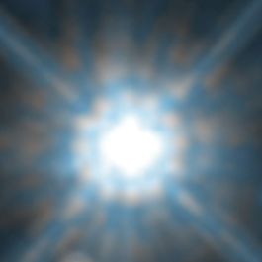
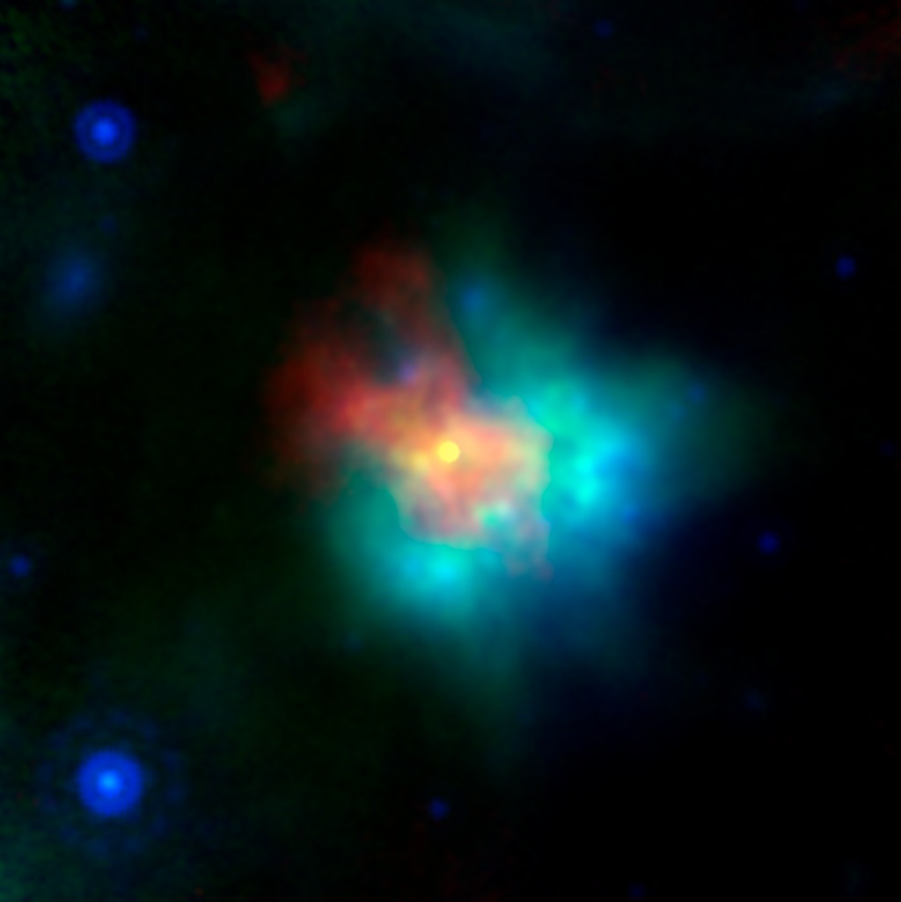
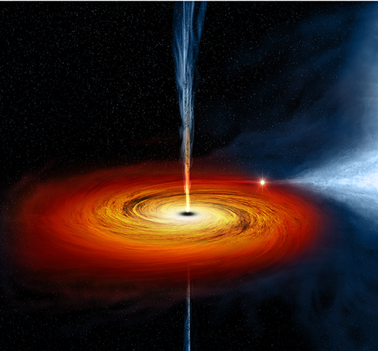
White Dwarf
Neutron Star or Stellar-mass Black Hole
Sun-like Stars
Massive Stars
Illustration
Images not to scale
Notes:
15. The life stages of stars: A star like our Sun will become a white dwarf. A massive star will become a neutron star or a stellar-mass black hole, depending on its initial mass
Key points to address:
What happens next depends on the mass of the star:
Sun-like star:
All that’s left of the star is its core, now called a white dwarf, a roughly Earth-sized object that slowly cools down.
Massive star:
Depending on the star’s initial mass, its surviving core will become either of the following dense remnants:
If the star was not that massive (less than 20 times the mass of our Sun), it will leave behind a a neutron star, a very dense object that packs more mass than the Sun into a sphere about as wide as New York City’s Manhattan Island.
If the star was very massive (larger than about 20 times the mass of the Sun), it will leave behind a stellar-mass black hole, an object so dense and with a very large gravity that not even light can escape it.
Fun fact: A tablespoon of neutron star material weighs about as much as Mount Everest!
Image credits and sources:
Stein 2051 B (left, NASA, ESA, and K. Sahu [STScI]): https://www.astropix.org/image/stsci/2017-25b
Supernova Remnant G54 (middle, NASA/JPL-Caltech/CXC/ESA/NRAO/J. Rho [SETI Institute]): https://www.spitzer.caltech.edu/image/ssc2018-16a-supernova-remnant-g54
Black hole illustration (right, NASA/CXC/M.Weiss): https://chandra.harvard.edu/photo/2011/cygx1/

Slide 16
Kahoot Quiz
www.kahoot.it
Replace the QR code accordingly and insert the code to join the Kahoot
Notes:
Kahoot Quiz
Replace the QR code with your own to host this Kahoot Quiz and/or insert the code to join.
Note that you will need to have a Kahoot account in order to host it.
This is the link for the host: https://create.kahoot.it/share/stars/05789594-b356-4509-b9bb-8812b928dbc4

