Slide 1
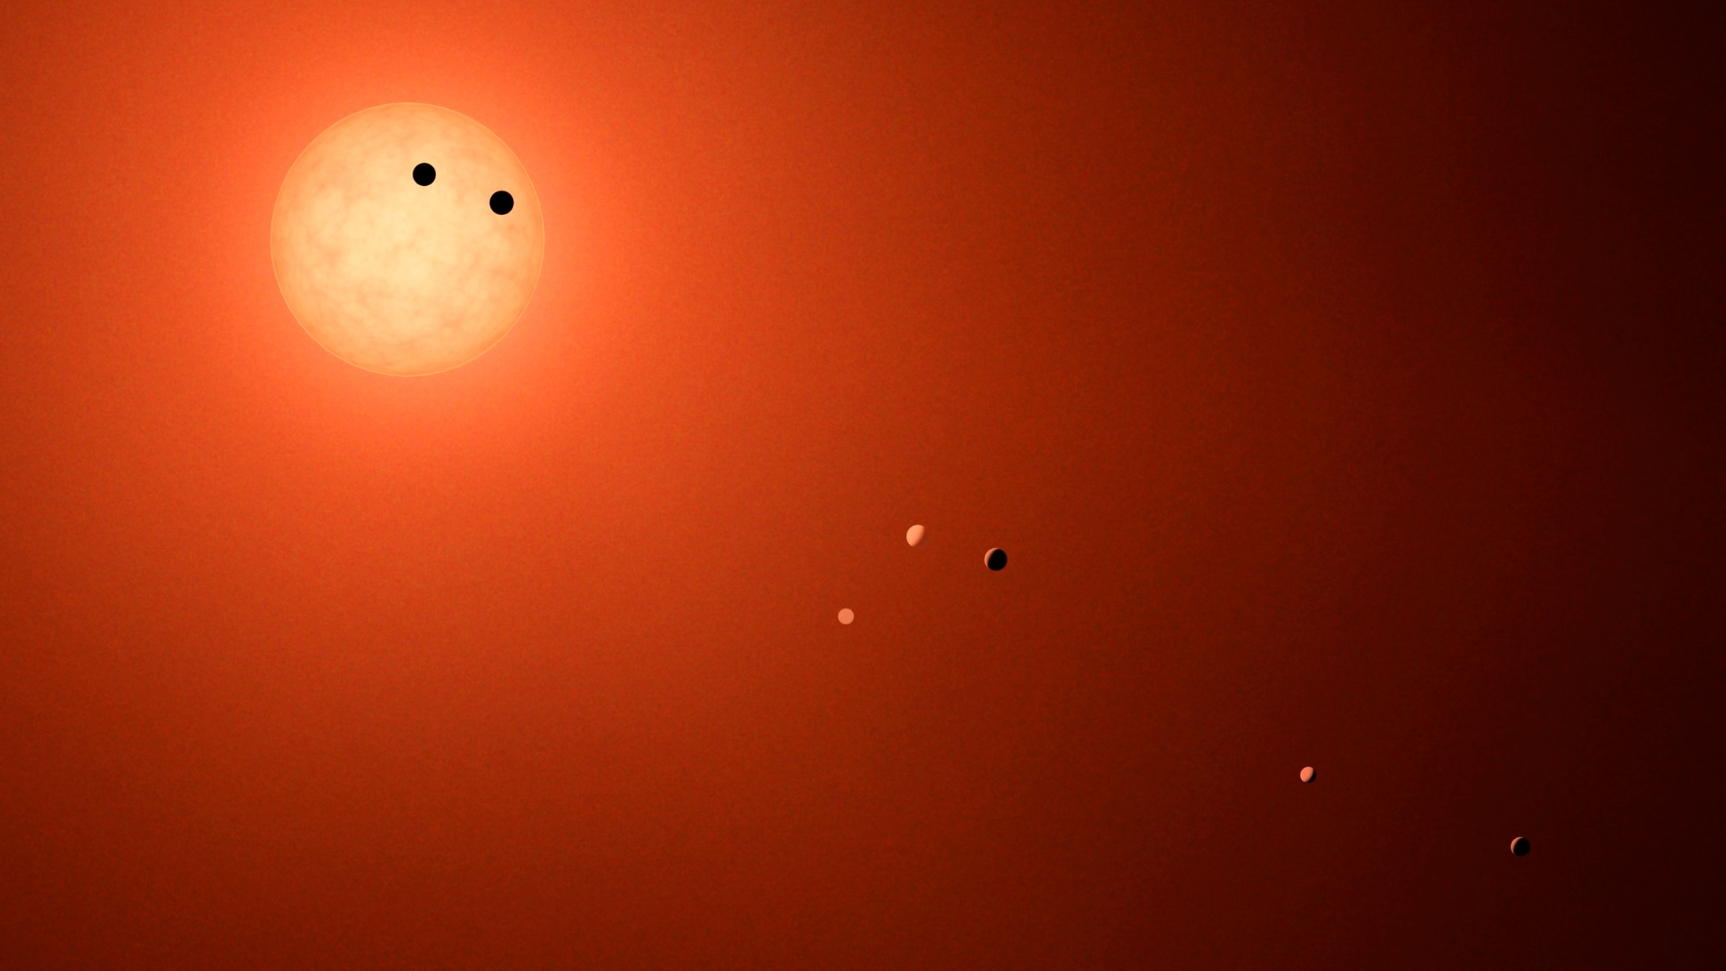
Finding Exoplanets
All images are credited to NASA, unless otherwise specified
Artist concept
Notes:
1. Onscreen slide before the presentation begins and during the introduction
These slides are available for you to customize for your presentation. Please feel free to add or remove slides as necessary to tailor the presentation for your event.
In this notes pane area, you will find key points for each slide, as well as links to additional background information.
Participant Takeaway Points:
Participants will learn during this presentation that:
Exoplanets are planets outside our solar system.
Most exoplanets are detected indirectly as they pass in front of (transit) their star, revealing some information about their properties.
For a handful of exoplanet systems, telescopes have been used to capture photographs of a star’s planetary companions by blocking out the bright starlight.
More Background Information:
Program Theme: Finding Exoplanets: https://universe-of-learning.org/contents/products/program-theme-5-finding-exoplanets
NASA: Exoplanets Home Page: https://science.nasa.gov/exoplanets/
NASA’s Exoplanet Missions: https://science.nasa.gov/exoplanets/missions/
NASA: 5 Ways to Find a Planet: https://exoplanets.nasa.gov/alien-worlds/ways-to-find-a-planet/?intent=021
Image credit & source:
NASA/JPL-Caltech/R. Hurt (IPAC); http://www.spitzer.caltech.edu/images/6278-ssc2017-01d-Transit-Illustration-of-TRAPPIST-1
Last Updated: August, 2025

Slide 2
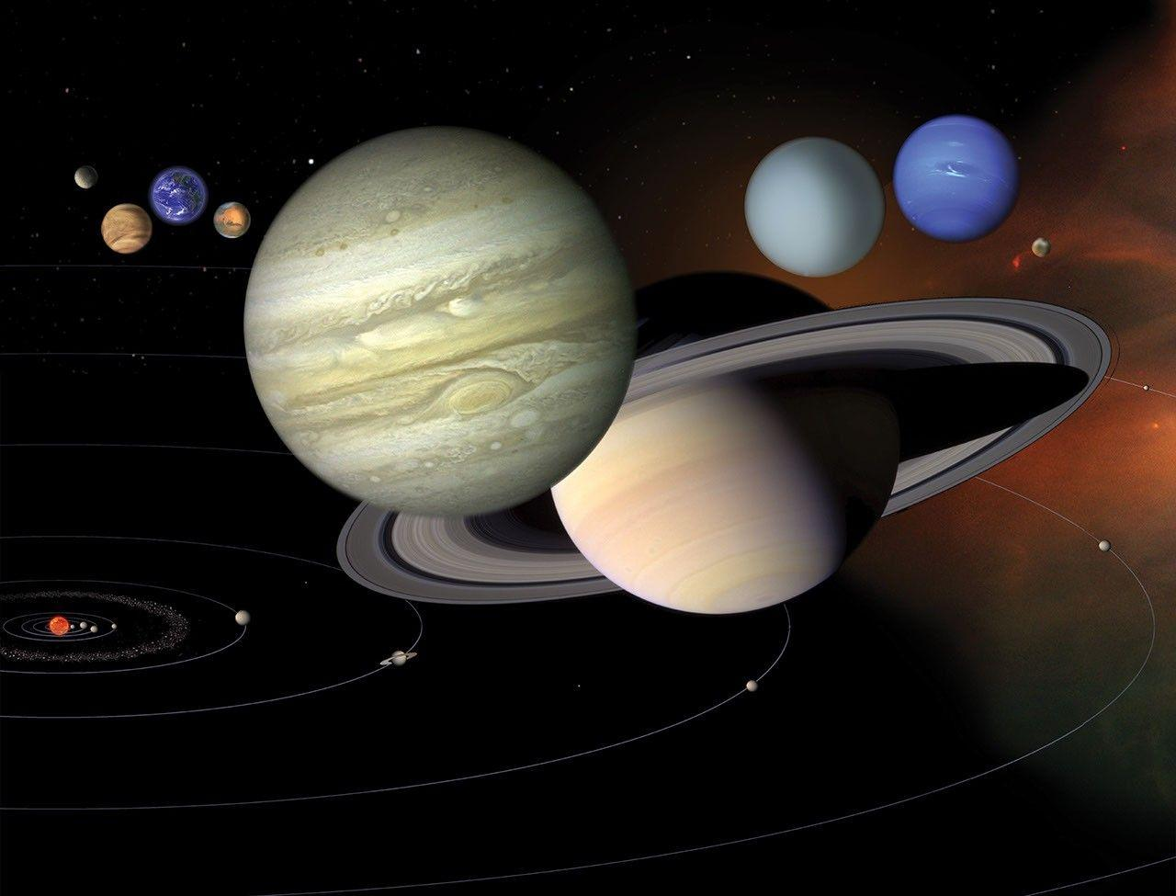
Planets in Our Solar System
What is a planet?
Planets typically orbit a star (for example, the Sun) and have gravity strong enough to clear other similar-sized objects from their path in space.
Notes:
2. Explain what a planet is
Key points to address:
A planet is a round object that typically orbits a star (for example, the Sun) and whose gravity is strong enough to clear other similar-sized objects from its path in space.
Examples of planets in our solar system are: Mercury, Venus, Earth, Mars, Jupiter, Saturn, Uranus, Neptune (Pluto, a dwarf planet, also orbits the Sun).
Image description: Our solar system features eight planets and the dwarf planet Pluto, seen in this artist’s diagram. The planets are depicted far closer together than they are in reality, and the bodies’ relative sizes are inaccurate. This is done to depict solar system bodies with some detail, otherwise the sun would be a mere speck, and the planets would be far too small to be seen.
Image credit & source: NASA/JPL; https://science.nasa.gov/resource/our-solar-system/

Slide 3
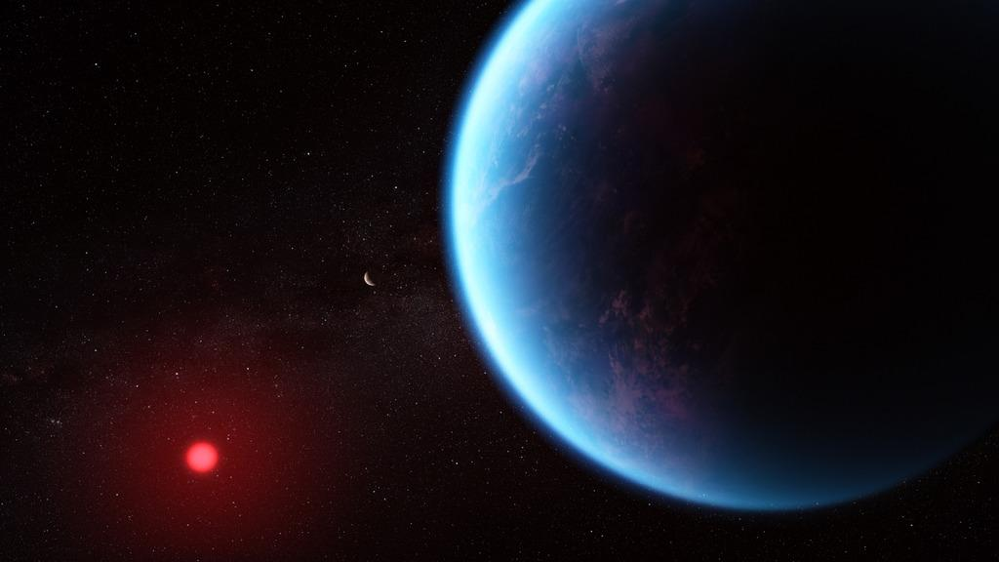
Exoplanets Are Planets Beyond Our Solar System
Artist Concept
Notes:
3. Explain what an exoplanet is
Key points to address:
An exoplanet is any planet beyond our solar system.
Most exoplanets discovered so far orbit other stars, called host stars.
Exoplanet systems are very far away from us.
Fun Fact: The closest exoplanet to Earth, Proxima Centauri b, is 4.2 light-years away—the equivalent of a grueling five-million-year trip by jet!
Image description: This illustration shows what exoplanet K2-18 b (large blue planet) could look like based on scientific data. K2-18 b is over 8 times as massive as Earth and orbits the cool dwarf star K2-18 (smaller red circle, lower left) in the habitable zone and lies 120 light years from Earth. In this illustration, the exoplanet K2-18 c (image center) is shown between K2-18 b and its star.
Image credit & source: NASA, ESA, CSA, Joseph Olmsted (STScI); https://www.astropix.org/image/stsci/2023-139a

Slide 4
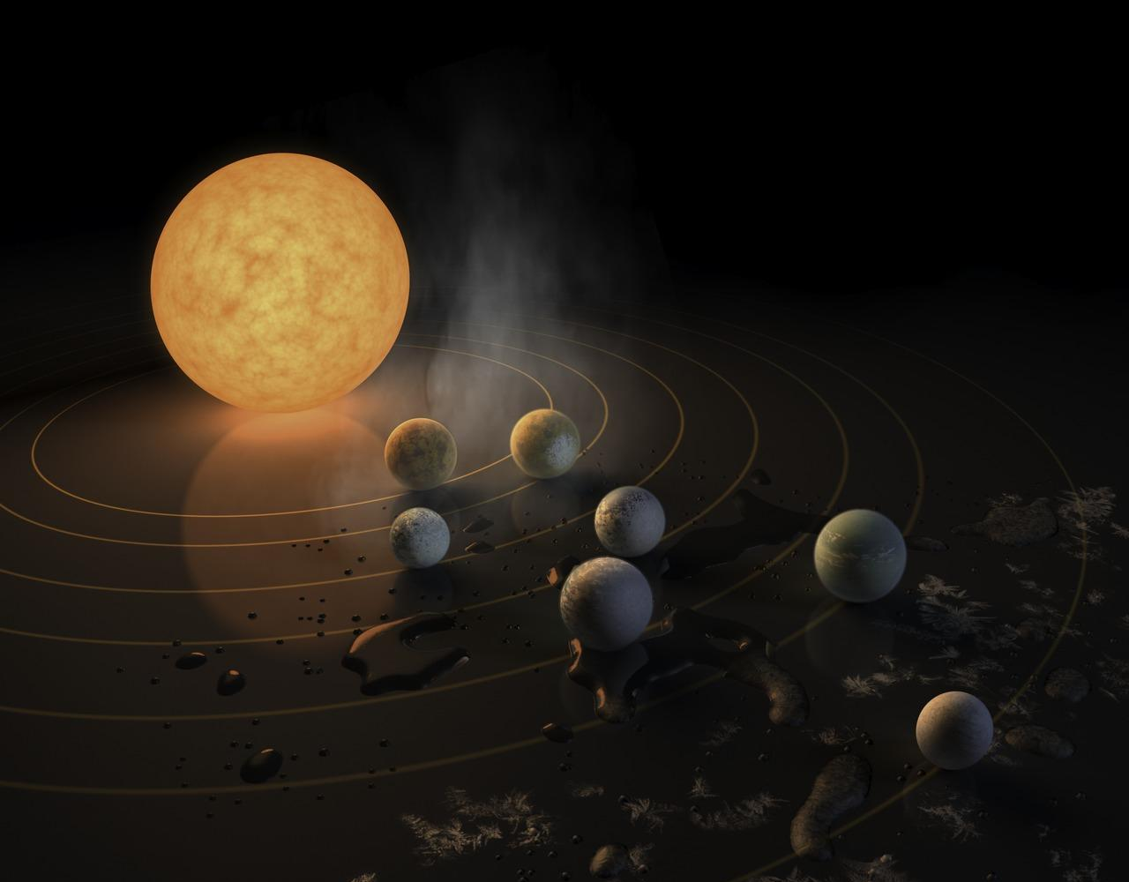
Key Vocabulary
Host Star
Any star with a confirmed planet orbiting around it.
Artist Concept
Notes:
5. Define Vocabulary
Use this slide to define vocabulary as needed.
A host star is any star with a confirmed planet orbiting around it. Our Sun is a host star.
Fun Fact: Some planets called “free-floating” or “rogue” planets do not orbit a star at all.
Image description: This artist’s concept depicts the TRAPPIST-1 exoplanet system, located about 40 light-years away from Earth. Several Earth-sized exoplanets orbit a red dwarf host star named TRAPPIST-1.
Image credit & source: NASA/JPL-Caltech/R. Hurt (IPAC) Science: NASA, ESA, and J. de Wit (MIT), H. Wakeford (University of Exeter/STScI), and N. Lewis (STScI); http://www.spitzer.caltech.edu/images/6270-ssc2017-01b-Abstract-Concept-of-TRAPPIST-1-System

Slide 5
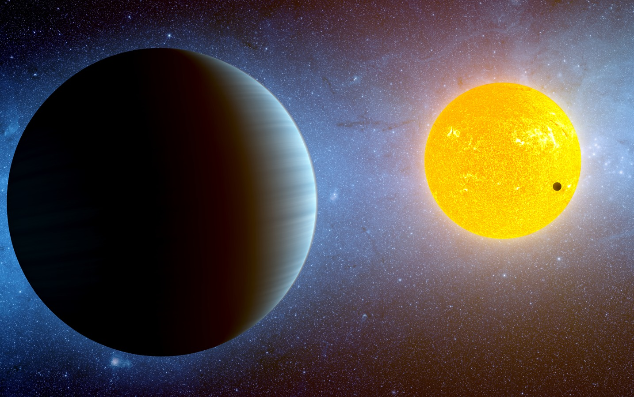
Why Study Exoplanets?
To better understand how planetary systems form and evolve.
To search for extraterrestrial life and habitable worlds.
Artist Concept
Notes:
6. Explain why astronomers study exoplanets
Key points to address:
Exoplanet systems help us better understand how planetary systems, including our own, form and evolve over time.
Scientists also study exoplanets because they could potentially support extraterrestrial life.
Image description: This artist's conception depicts the Kepler-10 star system, located about 560 light-years away near the Cygnus and Lyra constellations. NASA’s Kepler Space Telescope has discovered two planets around the host star: Kepler-10b, a small rocky exoplanet (depicted as a small dark spot against the yellow star) and Kepler-10c, a super-Earth (depicted as the larger foreground object). Both planets are blistering hot worlds.
Image credit & source: NASA/Ames/JPL-Caltech/T. Pyle; http://www.spitzer.caltech.edu/images/3593-sig11-004-Kepler-10-Stellar-Family-Portrait

Slide 6
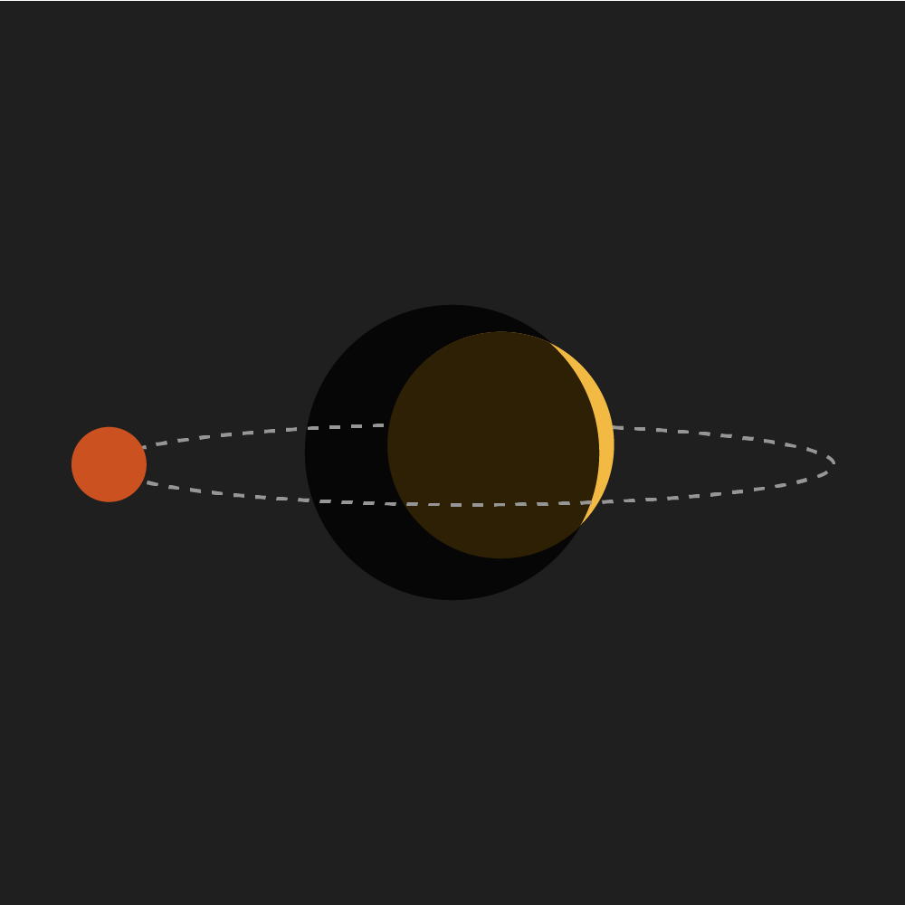

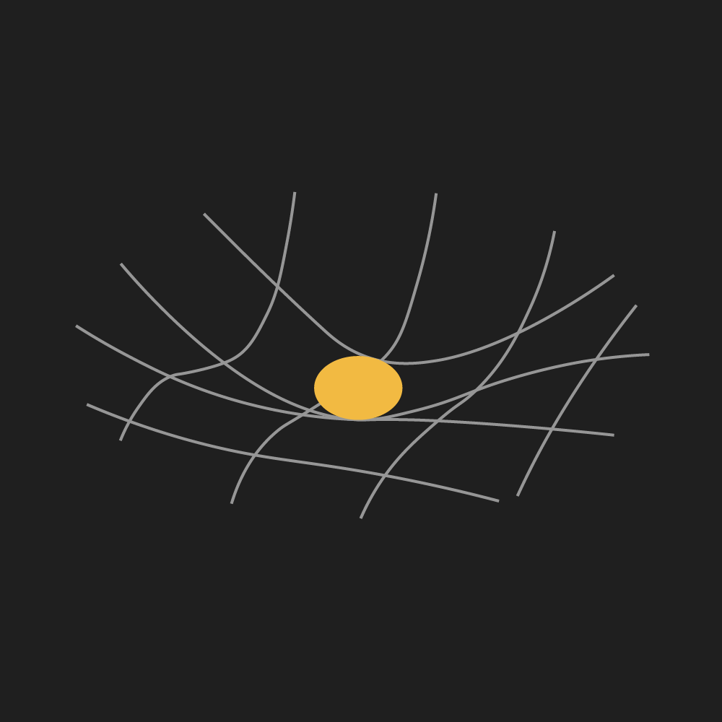
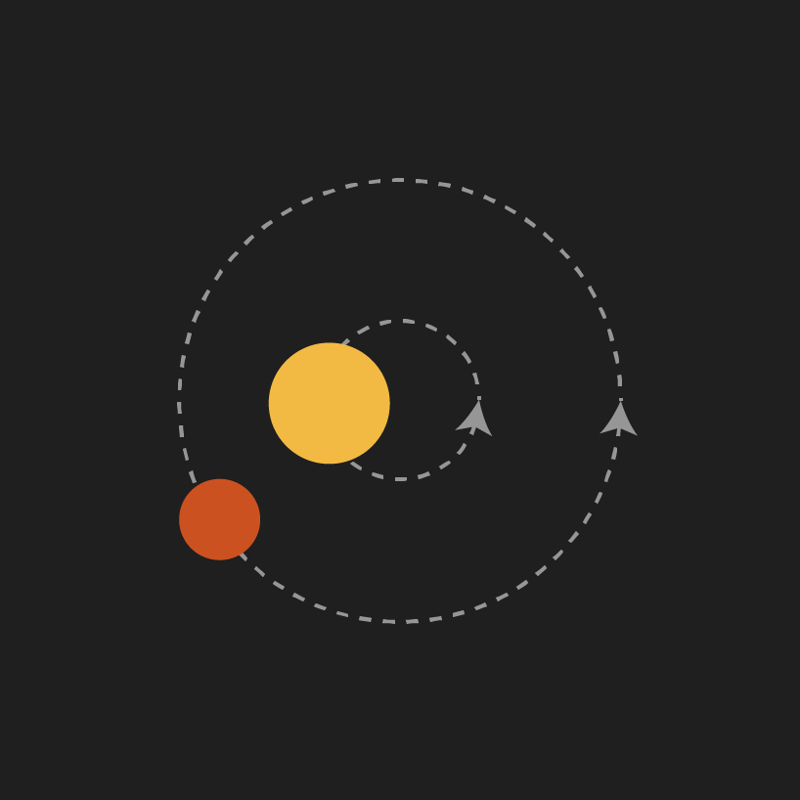
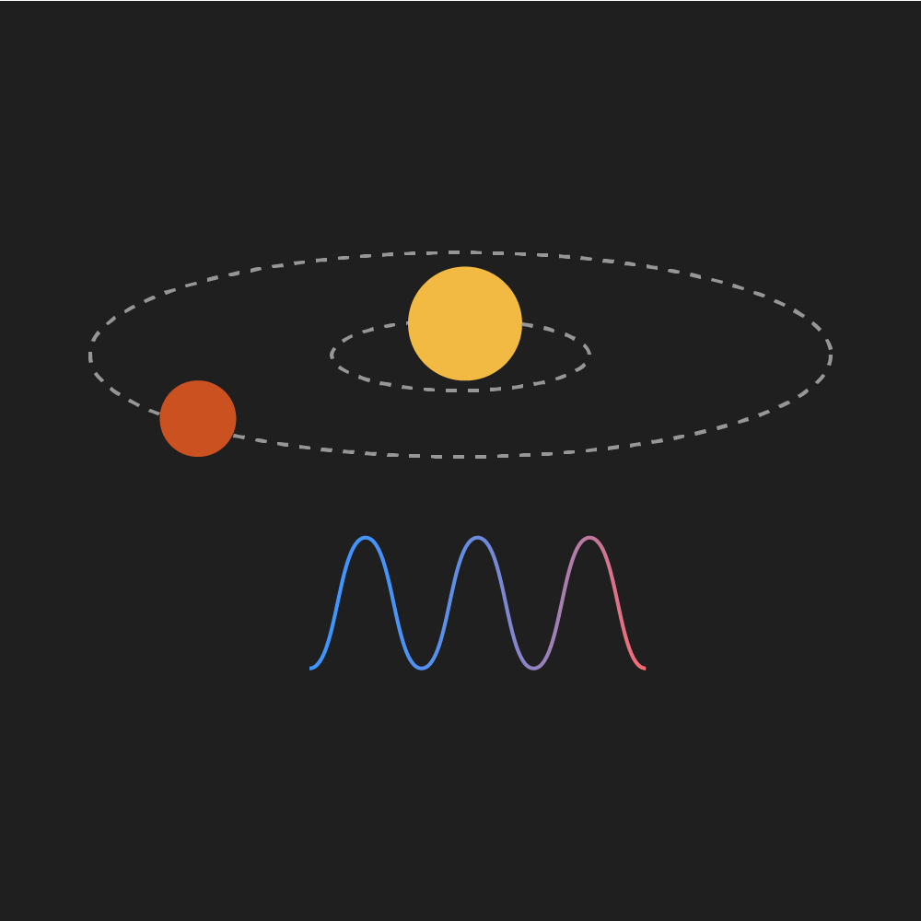
5 Ways to Find an Exoplanet
Direct
Imaging
Transit
Method
Gravitational Microlensing
Radial Velocity Method
Astrometry
Taking
pictures
Searching for shadows
Searching for magnification
Minuscule movements
Watching for wobble
Notes:
7. Explain that there are five main methods used to find exoplanets.
Key points to address:
Direct Imaging Method: Exoplanets are seen directly by using devices called coronagraphs to block out the host stars’ light.
Transit Method: When a planet passes directly between a star and its observer (for example, a telescope), it dims the star’s light by a measurable amount. Transits can help determine a variety of exoplanet characteristics, including the time it takes to complete one full revolution around its host star (the planet’s orbital period), the size of the planet, and information about its atmosphere.
Gravitational Microlensing: Light from a distant star is magnified by a planet passing between the distant star and our telescopes. The foreground planet’s gravity acts as a lens that bends and focuses light from stars behind it. Astronomers look for brief blips in the brightness of distant stars that appear when those stars are lensed.
Astrometry: As an exoplanet orbits its star, the gravitational tug between the star and the exoplanet causes the star to wobble. This method is used to measure subtle changes in the star’s position in the sky caused by the gravitationally induced wobble from an exoplanet.
Radial Velocity Method: Like astrometry, the radial velocity method is used to detect the stellar wobble induced by an orbiting exoplanet. This wobble is measured as a slight change in the host star’s color which appears bluer or redder as the planet tugs the star toward and away from us.
Note: NASA’s Universe of Learning Finding Exoplanets Program Guide covers only direct imaging and the transit method. More details for these methods are provided in the following two slides.
More background information:
Visit NASA’s “5 Ways to Find a Planet” webpage for animations depicting these 5 planet detection methods: https://exoplanets.nasa.gov/alien-worlds/ways-to-find-a-planet/?intent=021

Slide 7
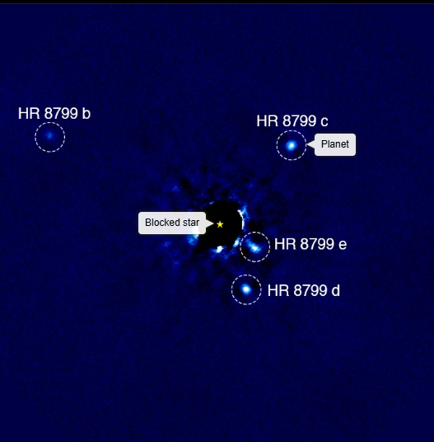
The Direct Imaging Method
Finding exoplanets by blocking out their host star’s bright light
W.M. Keck Observatory: Wang & Marois
Notes:
8. Explain how the direct imaging method works
Key points to address:
Powerful telescopes use devices called coronagraphs to block out the bright light of a star, making it possible to see the much fainter exoplanets hidden in the glare.
This method is the only one where we can “see” planets directly. These direct images can be used to infer a planet’s temperature and orbit.
Fun Fact: As of August 2025, there are only about 80 directly imaged exoplanets.
Tip: Leave this slide on screen while facilitating the Lights, Coronagraph, Action! Direct Imaging Demonstration: https://universe-of-learning.org/contents/products/light-coronagraph-action
Image description: This image shows the four exoplanets (HR 8799 b, c, d, and e) of the HR 8799 system that are revealed once the host star’s light is blocked using a coronagraph. This image was taken in August of 2009 by a ground-based observatory called the Keck Telescope.
Image credit & source: Infrared coronagraph images of HR 8799 from the Keck Telescope: Jason Wang (Caltech), Christian Marois (NRC Herzberg).
More background information:
Visit the following ViewSpace page to explore an interactive depicting the four HR 8799 system exoplanets: https://viewspace.org/interactives/unveiling_invisible_universe/detecting_other_worlds/direct_imaging

Slide 8
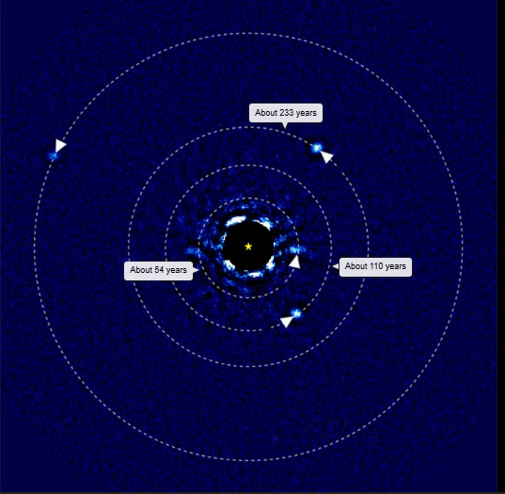
The Direct Imaging Method
Finding exoplanets by blocking out their host star’s bright light
W.M. Keck Observatory: Wang & Marois
Notes:
10. Explain what we learn about exoplanets using the direct imaging method
Key point to address:
Multiple direct imaging observations, taken at different times, help astronomers predict full orbits and determine if we are viewing the system from the side or from above/below..
Image Description: This image once again shows the four exoplanets of the HR 8799 system. This image was taken in October of 2013– about four years after the image in the previous slide. The labels in this image show the estimated orbital period for the inner three planets. Notice how the position of the planets has changed slightly.
Tip: Quickly switch back-and-forth between this slide and the previous slide to make the change more noticeable for the audience. Alternatively, you can also quickly scroll through the following interactive slider: https://viewspace.org/interactives/unveiling_invisible_universe/detecting_other_worlds/direct_imaging
Image Credit: Infrared coronagraph images of HR 8799 from the Keck Telescope: Jason Wang (Caltech), Christian Marois (NRC Herzberg).

Slide 9
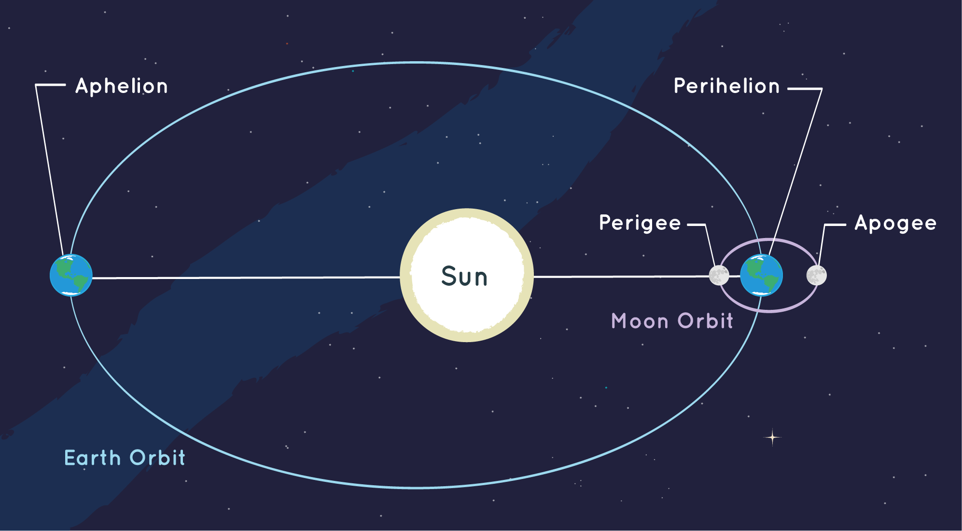
Key Vocabulary
Orbital Period
The time it takes an astronomical object to make one full orbit
around another object.
Notes:
9. Define Vocabulary
Use this slide to define vocabulary as needed.
A planet’s orbital period is the time it takes the planet to complete one full revolution around its host star.
Ask Participants: What is the orbital period of the Earth around the Sun? Answer: 365.25 days. The extra quarter day is the reason why we have leap years – to keep the calendar aligned with the Earth’s orbit!
Fun Fact: Exoplanet orbital periods can range from a couple hours to millions of years!
Image description: This diagram shows the Earth’s elliptical orbit around the Sun. The Earth’s orbital period is the time it takes Earth to travel the full ellipse. For planets, the point in their orbit closest to their star is called perihelion. The farthest point is called aphelion. For the moon and satellites, the closest point in their orbit is called perigee and the farthest, apogee.
Image credit & source: NOAA; https://spaceplace.nasa.gov/orbits/en/

Slide 10
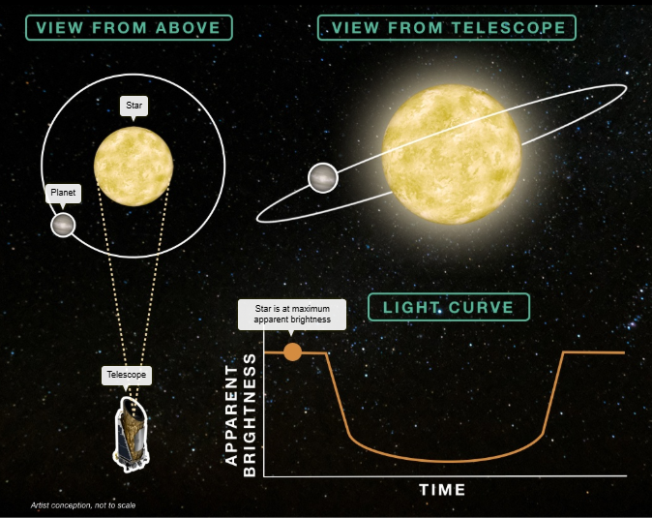
The Transit Method
Finding exoplanets by measuring changes in their host stars’ brightness.
Notes:
11. Explain the transit method
Key points to address:
The transit method for detecting exoplanets relies on measuring a star’s brightness over time and identifying periodic dips in brightness that occur when an exoplanet passes (transits) between the host star and the telescope.
The amount of dimming is directly related to the transiting exoplanet’s radius. By observing these recurring dips in a star’s brightness, astronomers are also able to measure the time between transits, or how long it takes the exoplanet to orbit around its host star (orbital period).
Fun Fact: About 75% of known exoplanets (approximately 4400 planets) have been discovered using the transit method. With new technologies, like the Roman Space Telescope, astronomers will be able to detect about 100,000 more exoplanets using the transit method.
Tip: Leave this slide on screen while facilitating the Exoplanet Detectives: Transit Activity: https://universe-of-learning.org/contents/products/exoplanet-detectives
Image description: This image from the ViewSpace interactive slider on exoplanet transits has three components: a “view from above” that shows the transiting exoplanet system and the telescope observing it; a “view from telescope” of the host star and transiting exoplanet; and a “light curve” graph that tracks the apparent brightness of the host star over time.
Image Credit:
Transit light curves from data collected by the Kepler Space Telescope, with plots and interpretations based on the work of Dr. Andrew Vanderburg. Produced by the Space Telescope Science Institute Office of Public Outreach.
More background information:
ViewSpace webpage to access the full interactive slider: https://viewspace.org/interactives/unveiling_invisible_universe/detecting_other_worlds/transiting_exoplanet

Slide 11
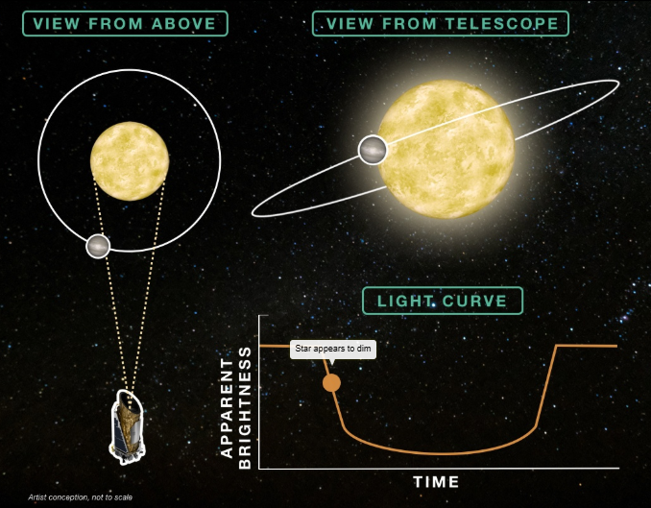
The Transit Method
As a transit begins, the brightness of the host star decreases slightly.
Notes:
12. Demonstrate the transit method (transit begins)
Image Description: This image shows that the host star appears to dim slightly when the transiting planet comes between the telescope and host star, blocking some starlight.
Image Credit:
Transit light curves from data collected by the Kepler Space Telescope, with plots and interpretations based on the work of Dr. Andrew Vanderburg. Produced by the Space Telescope Science Institute Office of Public Outreach.
More background information:
ViewSpace webpage to access the full interactive slider: https://viewspace.org/interactives/unveiling_invisible_universe/detecting_other_worlds/transiting_exoplanet

Slide 12
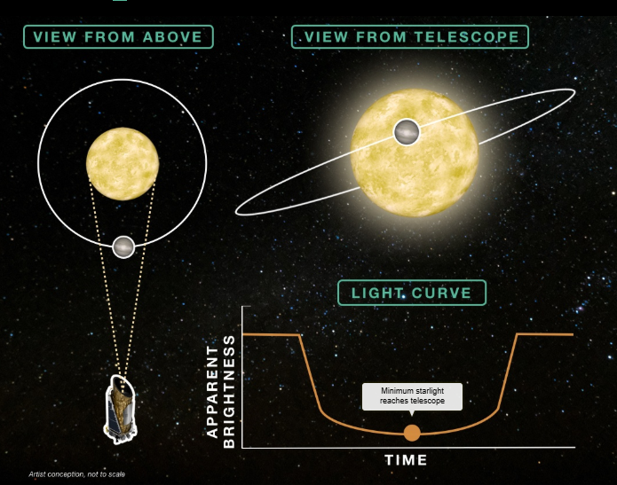
The Transit Method
The host star is dimmed most when the entire planet is between the star and telescope.
Notes:
13. Demonstrate the transit method (mid-transit)
Image description: The host star appears dimmest during the middle of a transit, when the entire planet is between the host star and the telescope.
Image Credit:
Transit light curves from data collected by the Kepler Space Telescope, with plots and interpretations based on the work of Dr. Andrew Vanderburg. Produced by the Space Telescope Science Institute Office of Public Outreach.
More background information:
ViewSpace webpage to access the full interactive slider: https://viewspace.org/interactives/unveiling_invisible_universe/detecting_other_worlds/transiting_exoplanet

Slide 13
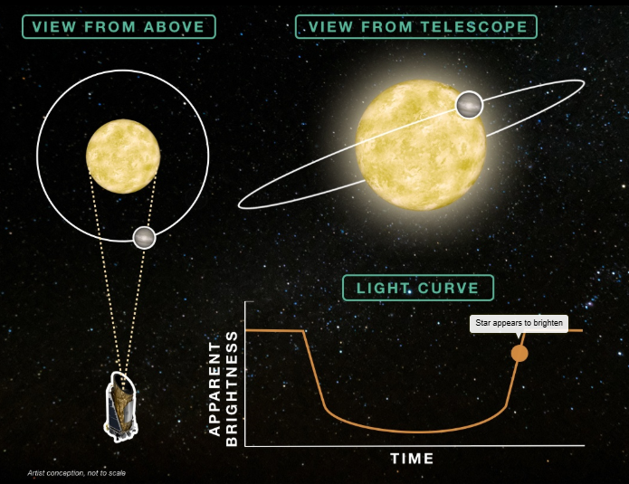
The Transit Method
As the planet completes its transit, the brightness of the host star appears to increase.
Notes:
14. Demonstrate the transit method (transit ending)
Image description: As the planet completes its transit and is no longer entirely between the host star and the telescope, the star appears to get brighter.
Image Credit:
Transit light curves from data collected by the Kepler Space Telescope, with plots and interpretations based on the work of Dr. Andrew Vanderburg. Produced by the Space Telescope Science Institute Office of Public Outreach.
More background information:
ViewSpace webpage to access the full interactive slider: https://viewspace.org/interactives/unveiling_invisible_universe/detecting_other_worlds/transiting_exoplanet

Slide 14
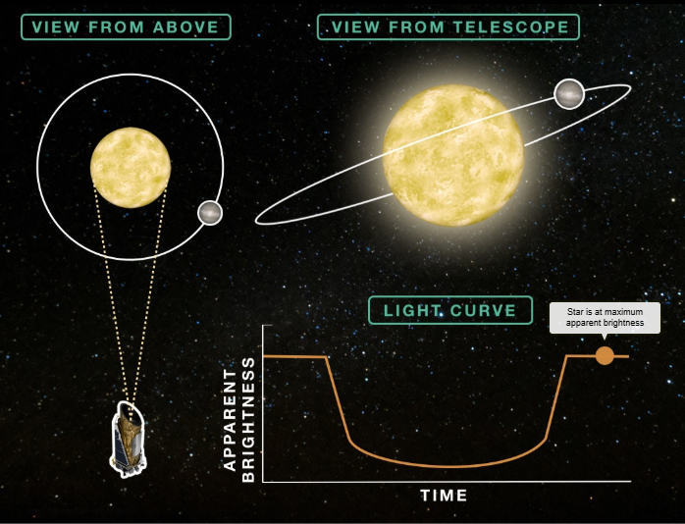
The Transit Method
Once the planet has completed its transit, the host star returns to its normal apparent brightness.
Notes:
15. Demonstrate the transit method (transit ends)
Tip: Instead of using the ViewSpace interactive slider, you may also transition between slides #11-15 for the same demonstration.
Image description: Once the planet has completed its transit, the planet is no longer blocking any starlight, so the host star returns to its normal brightness.
Image Credit:
Transit light curves from data collected by the Kepler Space Telescope, with plots and interpretations based on the work of Dr. Andrew Vanderbur.g. Produced by the Space Telescope Science Institute Office of Public Outreach.
More background information:
ViewSpace webpage to access the full interactive slider: https://viewspace.org/interactives/unveiling_invisible_universe/detecting_other_worlds/transiting_exoplanet

Slide 15
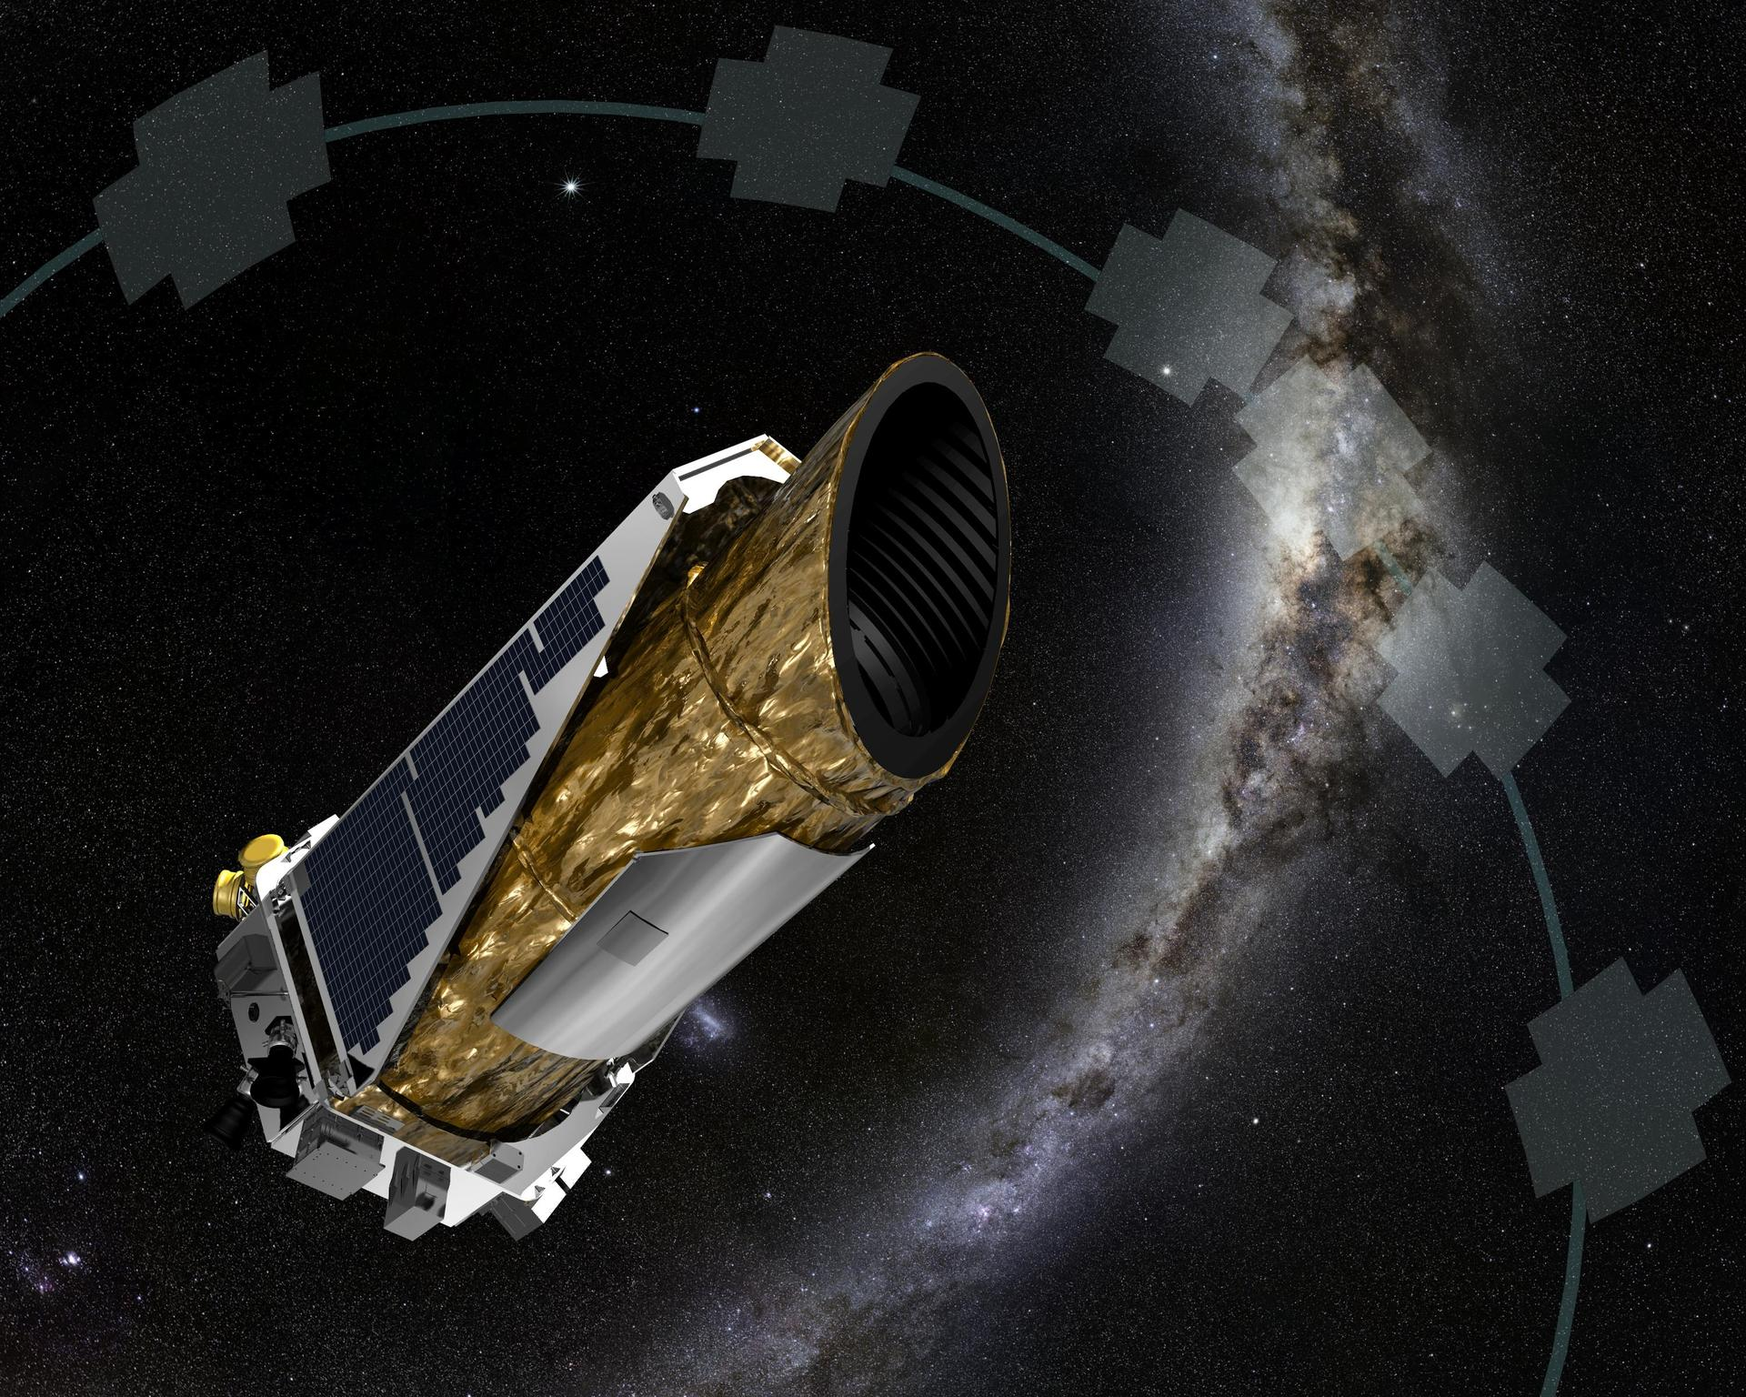
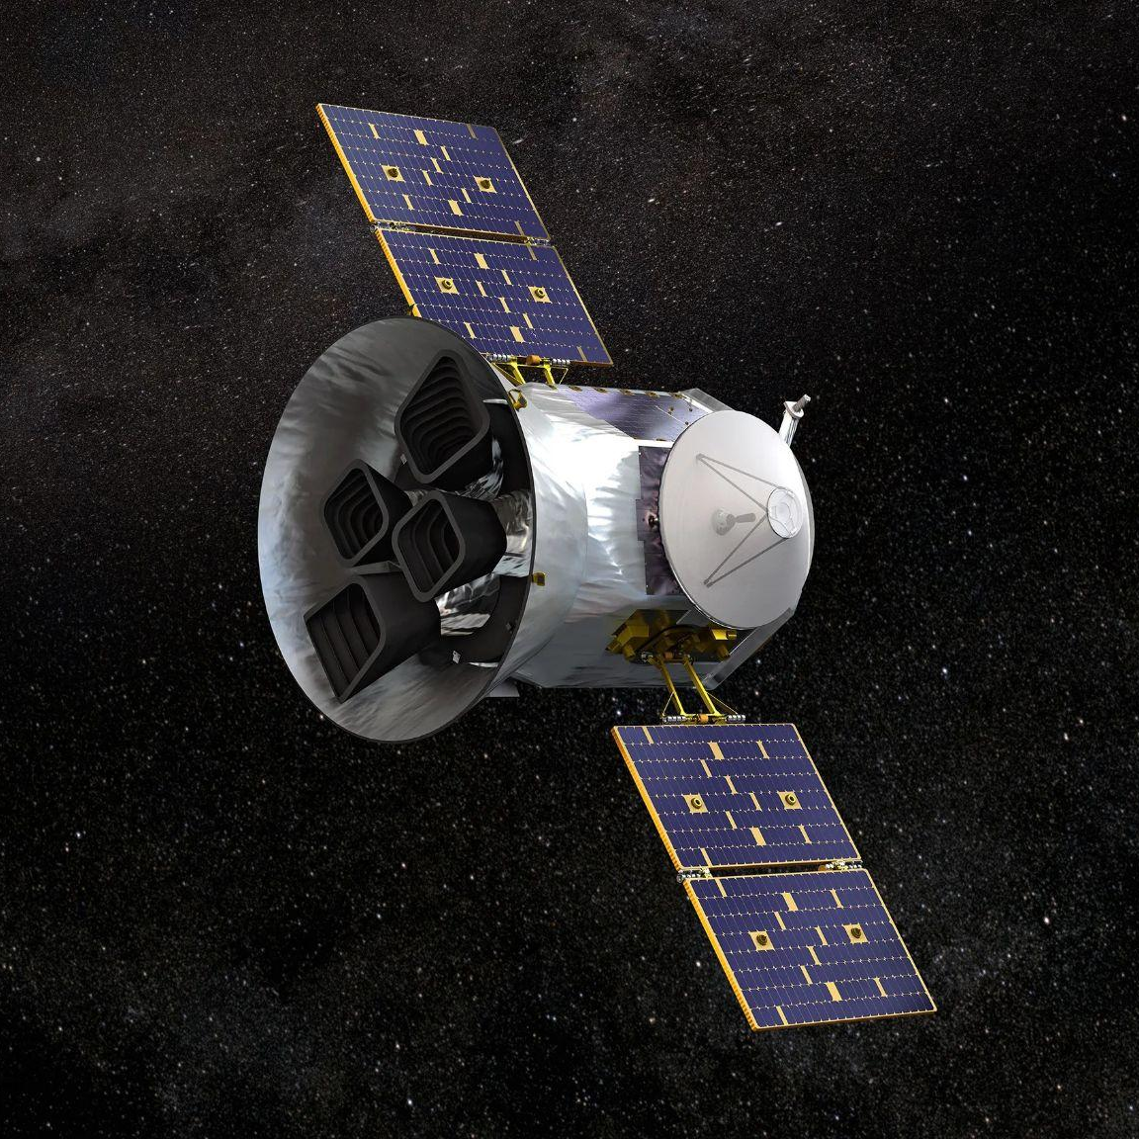
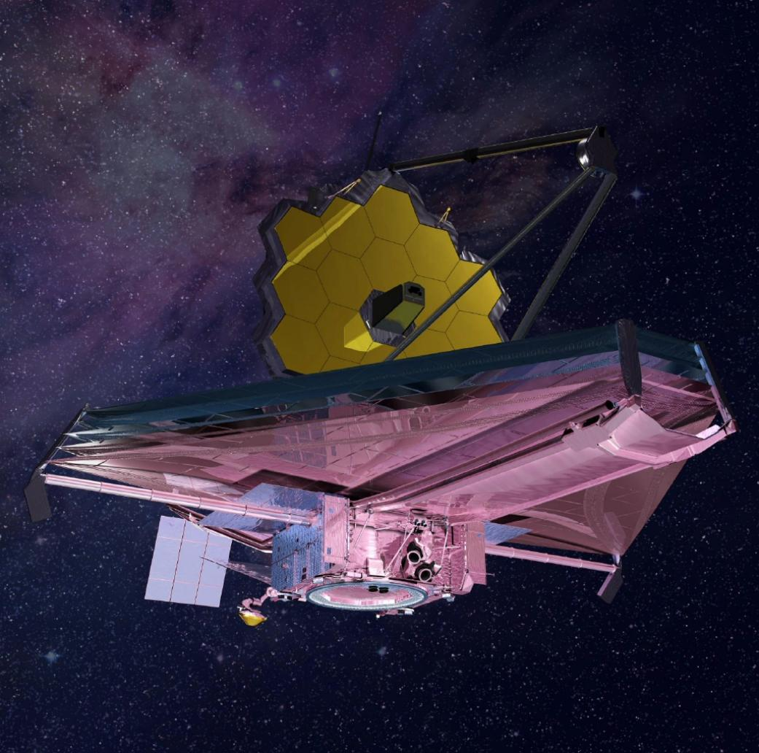
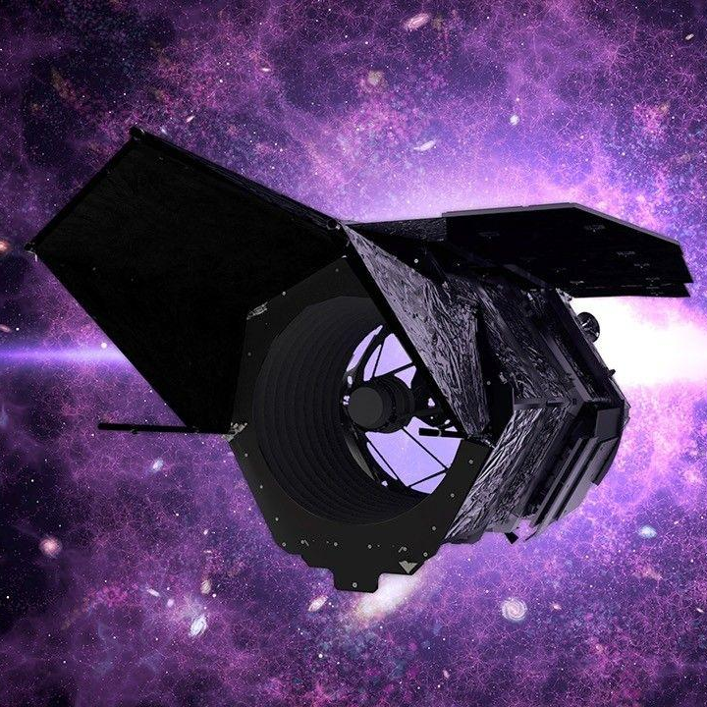
NASA’s Exoplanet Observatories
Kepler Space Telescope
Transiting Exoplanet Survey Satellite (TESS)
James Webb Space Telescope
Roman Space Telescope
NASA’s first planet-hunting mission
NASA’s premier exoplanet discoverer
NASA’s flagship observatory
NASA’s latest tool for exoplanet direct imaging
Notes:
16. Provide an overview of NASA’s exoplanet observatories
Key points to address:
NASA’s space telescopes offer several key advantages over ground-based observatories, primarily due to their location above Earth's atmosphere. These advantages include sharper images, the ability to observe a wider range of the electromagnetic spectrum (different types of light), and a less obstructed view of the cosmos.
Kepler: The Kepler Space Telescope discovered thousands of exoplanets (including many Earth-sized and potentially habitable worlds) using the transit method and revealed a vast variety of planetary systems.
TESS: The Transiting Exoplanet Survey Satellite (TESS) has discovered thousands of potential exoplanets, particularly those orbiting bright, nearby stars, making them ideal targets for follow-up study.
Webb: The James Webb Space Telescope is currently NASA’s best tool for exploring exoplanet atmospheres and directly imaging exoplanets.
Roman: The Nancy Grace Roman Space Telescope will search for thousands of new exoplanets using the transit method and gravitational microlensing. It will also test new coronagraph technology to take improved direct images of planets orbiting nearby stars.
Tip: Revisit Slide #7 for a refresher on these exoplanet detection methods.
Image Descriptions (Left to Right): Artists’ concepts of the Kepler Space Telescope, the Transiting Exoplanet Survey Satellite, the James Webb Space Telescope, and the Nancy Grace Roman Space Telescope.
Image Credit: NASA

Slide 16
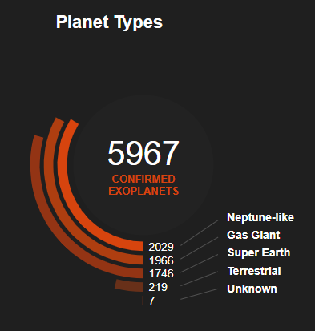
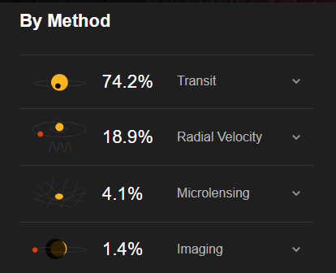
Exoplanet Discoveries Overview
Notes:
17. Provide an overview of exoplanet discoveries to date
Key Takeaways
The transit and radial velocity methods are responsible for the bulk of current exoplanet discoveries.
Neptune-like and gas giant planets are more likely to be detected primarily because of their large size and mass. The two most common detection methods, the transit method and the radial velocity method, are both more sensitive to larger and more massive planets.
Tip: Leave this slide on screen during your event wrap-up.
Image description: These diagrams, taken from the NASA Exoplanet Discoveries Dashboard, summarize the current population of known exoplanets using data from NASA’s Exoplanet Archive. The table on the left breaks down the total number of exoplanets by detection method: 74% of the nearly 6000 confirmed exoplanets were found using the transit method, 18.9% were found via the radial velocity method, etc. The chart on the right tracks the current number of known planet discoveries beyond our solar system, sorted by type:
Neptune-like: Similar in size to Uranus and Neptune, with hydrogen or helium-dominated atmospheres. So called sub-Neptunes, not found in our solar system, are smaller than Neptune but larger than Earth.
Gas Giants: The size of Saturn or Jupiter, or sometimes much larger.
Super Earths: Typically, rocky and more massive than Earth but lighter than Neptune. They may or may not have atmospheres.
Terrestrial: Earth-sized or smaller, mostly made of rock and metal. Some could possess oceans or atmospheres and perhaps other signs of habitability.
Unknown: So-called “unknown” plane types do not have good mass or radius constraints making it difficult to sort them into the categories above.
More background information:
Visit the NASA Exoplanet Discoveries Dashboard for the latest numbers: https://science.nasa.gov/exoplanets/discoveries-dashboard/

Slide 17

Kahoot Quiz
www.kahoot.it
Replace the QR code accordingly and insert the code to join the Kahoot
Notes:
17. Provide an overview of exoplanet discoveries to date
Key Takeaways
The transit and radial velocity methods are responsible for the bulk of current exoplanet discoveries.
Neptune-like and gas giant planets are more likely to be detected primarily because of their large size and mass. The two most common detection methods, the transit method and the radial velocity method, are both more sensitive to larger and more massive planets.
Tip: Leave this slide on screen during your event wrap-up.
Image description: These diagrams, taken from the NASA Exoplanet Discoveries Dashboard, summarize the current population of known exoplanets using data from NASA’s Exoplanet Archive. The table on the left breaks down the total number of exoplanets by detection method: 74% of the nearly 6000 confirmed exoplanets were found using the transit method, 18.9% were found via the radial velocity method, etc. The chart on the right tracks the current number of known planet discoveries beyond our solar system, sorted by type:
Neptune-like: Similar in size to Uranus and Neptune, with hydrogen or helium-dominated atmospheres. So called sub-Neptunes, not found in our solar system, are smaller than Neptune but larger than Earth.
Gas Giants: The size of Saturn or Jupiter, or sometimes much larger.
Super Earths: Typically, rocky and more massive than Earth but lighter than Neptune. They may or may not have atmospheres.
Terrestrial: Earth-sized or smaller, mostly made of rock and metal. Some could possess oceans or atmospheres and perhaps other signs of habitability.
Unknown: So-called “unknown” plane types do not have good mass or radius constraints making it difficult to sort them into the categories above.
More background information:
Visit the NASA Exoplanet Discoveries Dashboard for the latest numbers: https://science.nasa.gov/exoplanets/discoveries-dashboard/

Slide 18
Additional Slides
Notes:
These additional slides can be used to lead the discussion outlined in “Option 2: Explore Planet Detection Through the Ages“ (Page 20) of the 90-Minute Options section of the Finding Exoplanets Program Guide: https://universe-of-learning.org/contents/products/program-theme-5-finding-exoplanets

Slide 19
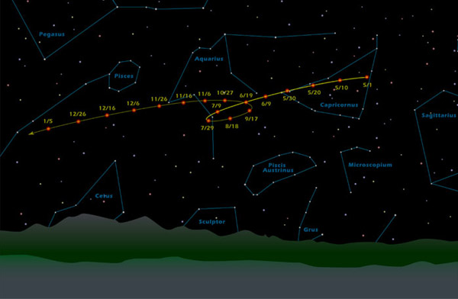
Planets Before the Telescope
The Wandering Stars
Planets appear to move differently from stars.
Notes:
19. Discuss what we knew about planets before telescopes were invented.
Key points to address:
For most of human history, we only knew of the existence of five other planets—Mercury, Venus, Mars, Jupiter, and Saturn—because they are visible with the naked eye.
Each night, stars and planets both appear to move westward in a fixed path across the sky due to Earth’s rotation. However, if you track the location of an inner planet night-to-night, the planet (Mars for example) slowly moves eastward relative to the background stars due to its orbital path around the Sun.
Occasionally, we see planets undergo apparent retrograde motion where that eastward motion seems to slow, stop, and reverse, causing them to appear to move westward for several weeks to a few months, then reverse again and continue moving eastward. In these cases, the planet’s motion does not actually reverse. It just appears to do so as the Earth laps a planet in its orbit.
Image Description: The diagram on this page shows Mars’ apparent retrograde motion.
Image credit: NASA/JPL-Caltech

Slide 20
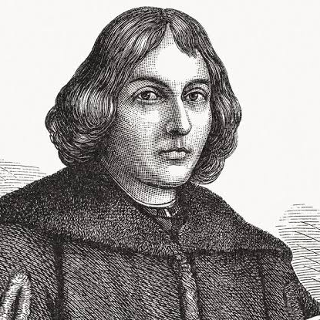
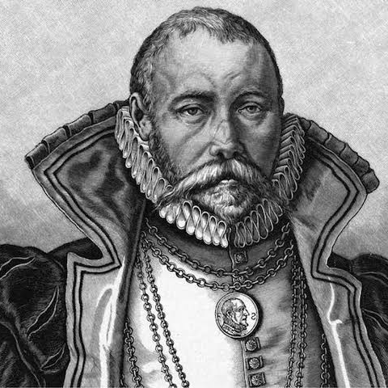
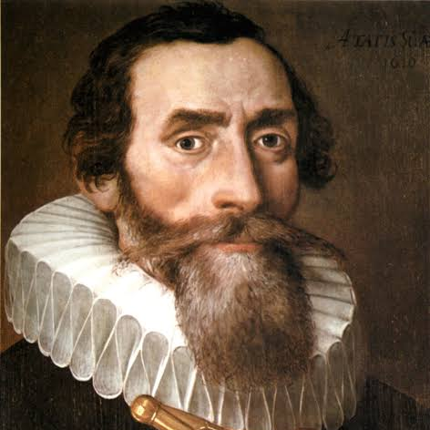
Early Planetary Scientists
Nicolaus Copernicus
1473 - 1543
Tycho Brahe
1546 - 1601
Johannes Kepler
1571 - 1630
Proposed a Sun-centered model of the solar system.
Made precise measurements of planetary orbits.
Developed mathematical laws of planetary motion.
Notes:
20. Provide an overview of the work of three early planetary scientists.
Key points to address:
By studying the movement of planets in the early 1500s, Nicolaus Copernicus led to the proposal for a Sun-centered (heliocentric) model of our solar system, challenging the long-held belief that Earth was at its center.
Tycho Brahe’s precise observations of planetary motion in the late 1500s provided the foundation for Johannes Kepler, who used the data in the early 1600s to show that planets orbit the Sun in ellipses and follow predictable mathematical laws of motion.
Image Descriptions: Paintings of Nicolaus Copernicus, Tycho Brahe, and Johannes Kepler.
Image Credits: Getty/ DigitalVision Vectors; BIT Teatergarasjen / Jacques de Gheyn II / Wikicommons; Artist unknown

Slide 21
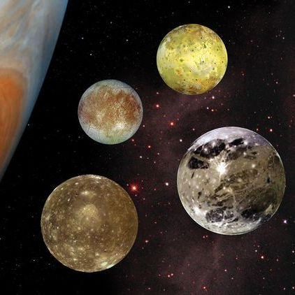
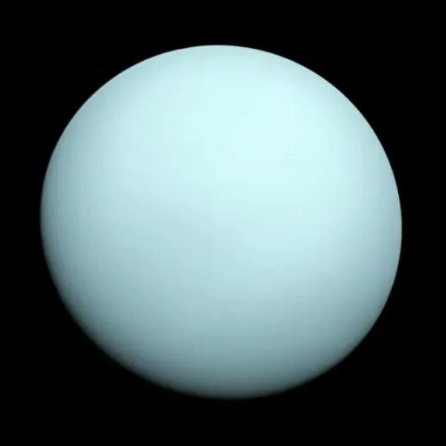
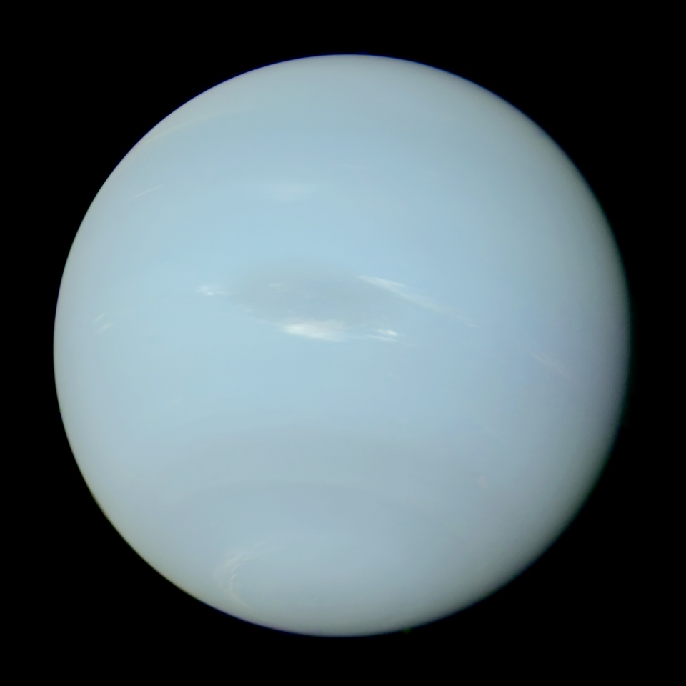
Planets After the Invention of the Telescope
1609: Jupiter's moons
1781: Uranus
1846: Neptune
One of the first major discoveries using telescopes.
Another solar system planet discovered!
The most distant solar system planet discovered.
Notes:
21. Discuss solar system planet discoveries after the invention of the telescope.
Key points to address:
When Galileo Galilei pointed one of the first telescopes at Jupiter in 1609, he observed four points of light circling Jupiter, just as the Moon circles the Earth. He concluded that Jupiter was not a star after all, but a planet with its own moons!
Galileo’s discovery of moons orbiting something other than Earth supported Copernicus’ earlier, controversial, heliocentric model.
In 1781, nearly two centuries after Galileo’s observations, William Herschel stumbled across what he thought was a new comet. Upon further inspection, the object’s orbit, which appeared less elongated than comet orbits, revealed that it was another planet within our solar system—Uranus!
By 1846, French and British astronomers had noticed tiny changes in Uranus’ orbit which suggested another large planet must be tugging at it from farther out. After lots of calculations and predictions as to where this new planet should be, Neptune was finally spotted!
Telescopes further changed our understanding of the solar system and our place within it by demonstrating the existence of objects in space that we cannot see with our unaided eyes.
Image descriptions (Left to RIght): Jupiter’s four largest moons: Ganymede, Callisto, Io, and Europa; Uranus imaged by NASA’s Voyager 2 spacecraft in 1986; Neptune imaged by Voyager 2 in 1989. These are all real images, but note that Jupiter’s moons are not shown at their actual positions in the sky.
Image Credits: NASA
Image Sources: https://science.nasa.gov/jupiter/jupiter-moons/; https://science.nasa.gov/uranus/; https://en.wikipedia.org/wiki/Neptune#/media/File:Neptune_Voyager2_color_calibrated.png

Slide 22
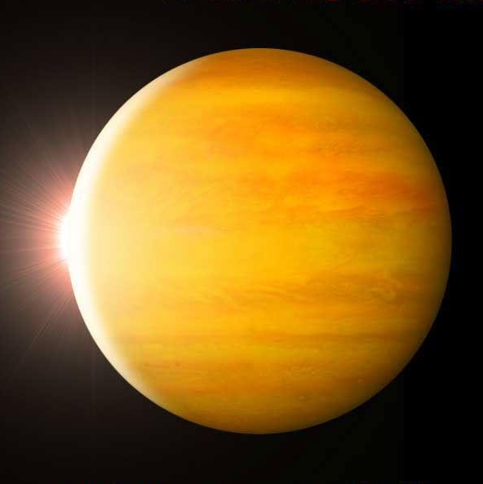
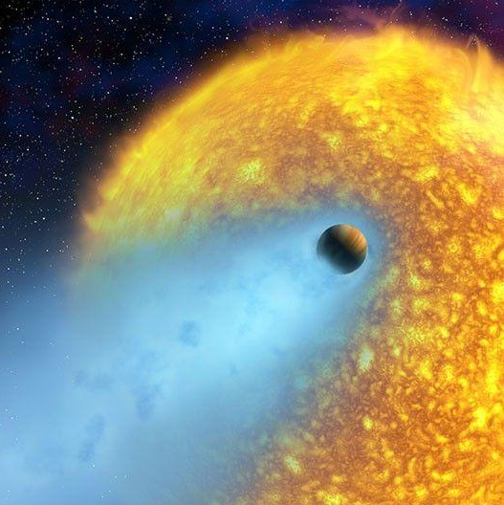


A Brief Timeline of Exoplanet Discoveries
1995
1999
2009
2017
2018
First exoplanet found around a sunlike star (Radial Velocity Method)
First transiting exoplanet observed (Transit Method)
Kepler planet-finding mission launches
TRAPPIST-1 and Kepler-90 multi-planet systems discovered
The Transiting Exoplanet Survey Satellite (TESS) launches
Notes:
22. Provide an overview of key exoplanet discoveries beyond our solar system.
Key points to address:
1995: Didier Queloz and Michel Mayor announce their discovery of the first exoplanet orbiting a main sequence star like our Sun, 51 Pegasi. The exoplanet is classified as a “hot Jupiter” – a Jupiter sized planet that orbits extremely close to its host star.
Fun Fact: This discovery shared the 2019 Nobel Prize in Physics.
1999: Research teams led by David Charbonneau and Greg Henry independently observe a planet passing across the front of the star HD 209458 in the constellation Pegasus.
Fun Fact: This planet is so close to its star that its atmosphere is being stripped off, forming a comet-like tail behind the planet.
2009: The Kepler Space Telescope, launched in 2009, is responsible for the discovery of thousands of exoplanets (including many Earth-sized and potentially habitable worlds).
2017: Seven Earth-sized planets are found orbiting the red dwarf star TRAPPIST-1. Also, an eighth planet is found orbiting the star Kepler-90. These systems are two of the very few exoplanet systems with six or more confirmed planets.
April 2018: The Transiting Exoplanet Survey Satellite (TESS), launched in 2018, has discovered thousands of exoplanet candidates, particularly those orbiting bright, nearby stars.
Image Descriptions (Left to Right): Artists’ concepts of exoplanet 51 Pegasi b; exoplanet HD 209458 b; the Kepler Space Telescope; the TRAPPIST-1 exoplanet system; and the Transiting Exoplanet Survey Satellite.
Image Credits: NASA
Image Sources: https://science.nasa.gov/universe/exoplanets/nobel-winners-changed-our-understanding-with-exoplanet-discovery/; https://science.nasa.gov/resource/hd-209458b/; https://science.nasa.gov/mission/kepler/; http://www.spitzer.caltech.edu/images/6270-ssc2017-01b-Abstract-Concept-of-TRAPPIST-1-System; https://science.nasa.gov/mission/tess/

